Slide 1

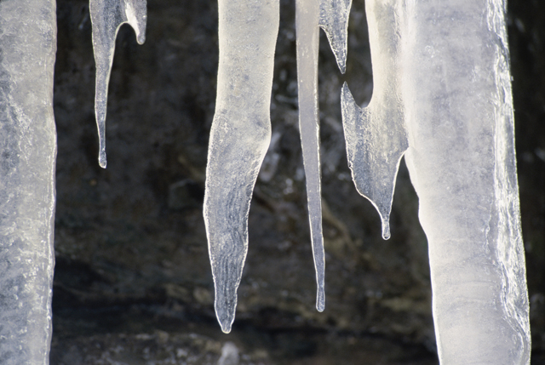
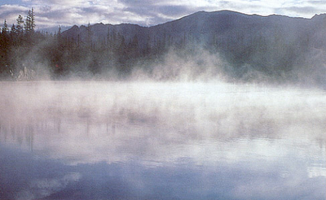


What are the Phase Changes of Matter?

Slide 2

MELTING
Solid Liquid
Heat is added
Molecules are speeding up
Melting point 32⁰ Fahrenheit
-Temperature at which something will melt

Slide 3
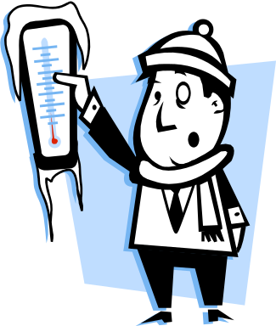
FREEZING
Liquid Solid
Heat is taken away
Molecules are slowing down
Freezing point 32⁰ F

Slide 4

CONDENSATION
Gas Liquid
Heat is taken away
Molecules are slowing down
You can see condensation

Slide 5
VAPORIZATION
Liquid Gas
Heat is added
Molecules speed up
Two types
boiling quickly
evaporation slowly
This process happens
layer by layer

Slide 6
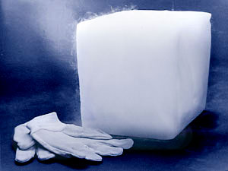
SUBLIMING
Solid Gas
Heat is added
Molecules speed up
http:/www.youtube.com/watch?v=76CNkxizQuc
/

