Slide 1
WELCOME
ADHD:
A STRENGTH BASED APPROACH in HOME AND SCHOOL.
ESSENTIAL STRATEGIES FOR SUCCESS
MELISSA SMITH, MS Ed
Founder of ADHD A NEW VISION

Slide 2

I AM PARENT
YOU ARE NOW:
ADVOCATE
COACH
TEACHER
COGNITIVE STICKY NOTE

Slide 3
ULTIMATE GOAL
TO EQUIP A CHILD WITH THE TOOLS NEEDED TO BE
RESILIENT, (Dr. Robert Brookes)
FEEL SUCCESSFUL,
AND CONNECTED

Slide 4
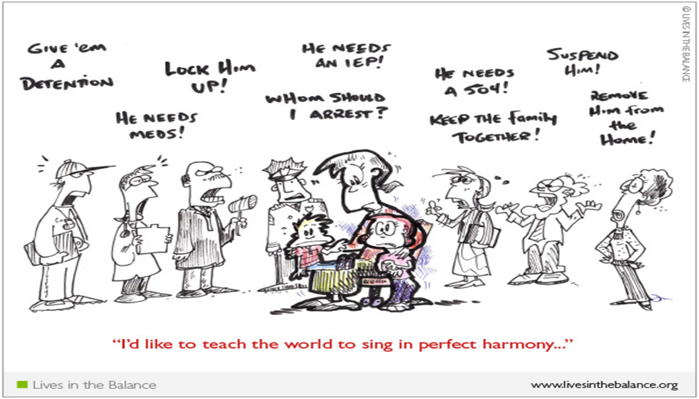

Slide 5
TEACHER
DO YOU UNDERSTAND WHAT ADHD IS ALL ABOUT?
HAVE YOU EXPLAINED ADHD TO YOUR CHILD?

Slide 6
WHAT ADHD IS
WHAT ADHD IS NOT

Slide 7

ADVOCATE
WHAT IS AN ADVOCATE?
RTI
504
CSE
TEACH CHILD

Slide 8
ACCOMODATIONS IN SCHOOL
DOUBLE SET OF TEXT BOOKS
COPY OF CLASS NOTES
GUM-WATER (sports bottle)
MOVEMENT
MUSIC
BREAKS
CHUNCK WORK-IMMEDIATE FEEDBACK
ORGANIZATIONAL SYSTEM
STANDING DESK
MOVEMENT

Slide 9
WHAT MAKES A GOOD COACH
COACH
INDEPTH UNDERSTANDING
Creates supportive environment
Helps Athlete believe in self
COACH
GOOD LISTENER
PRACTICE DRILLS
CLEAR INSTRUCTIONS
INSTILLS DISCIPLINE

Slide 10
MOTIVATION
THE ADHD BRAIN:
*NOVELTY
*COMPETITION
*URGENCY
*INTEREST
*HUMOR

Slide 11

COGNITIVE STICKY NOTE
WHAT IS EXECUTIVE FUNCTIONING?
Organizing
Prioritizing (procrastination)
Focus- Shifting
Sustaining Effort
Manage Frustration
Recall and Memory
Self-Regulating

Slide 12
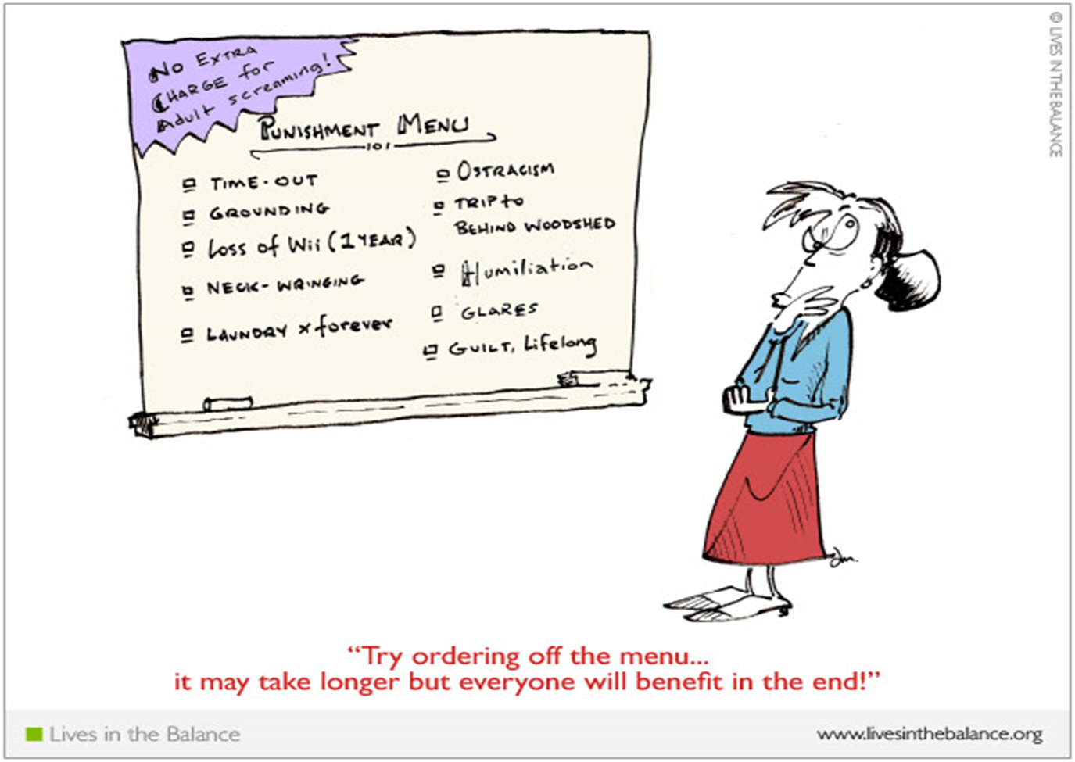

Slide 13
DISCIPLINE
PRE-PLAN MENU OF CONSEQUENCES
REMEMBER HOW THE BRAIN WORKS
DO NOT CREATE UNREALISTIC
PUNISHMENTS
PICK YOUR BATTLES
IMMEDIATE*CONSISTENT*FAIR
GOAL? MODIFY BEHAVIOR

Slide 14


Slide 15
STRATEGIES FOR SUCCESS
ROUTINE
BAG FOR EACH ACTIVITY
WEEKLY BACKPACK CLEANING
COLOR CODE
OPEN BINS
LESS IS BEST
CELL PHONE
INDIVIDUAL SPORTS
STOP THE NAGGING
ACCEPTANCE

Slide 16
RESOURCES
ADDITUDE MAGAZINE
CHADD- Local meeting at Four Winds Hospital
Dr. Edward Hallowell
Dr. Martin Kutscher
Dr. Patricia Quinn
Dr. Robert Brooks
Dr. Ross Greene

