Slide 1

The Other Essential Components – “the Glue”
Fidelity
Training & Professional Development
Family and Community Involvement

Slide 2
Fidelity
Essential Component

Slide 3

Fidelity
Also known as treatment fidelity:
  Fidelity of implementation is defined as the accurate and consistent application of an agreed upon procedure. Was “it” implemented as planned?
Why? Without fidelity information, we don’t know if:
  Good results are actually due to the procedure
  Poor results are actually due to the procedure, or to some modifications
  We must know if it was the procedure that failed, or if it was not followed/implemented properly
  Finally, we cannot assume the procedure will work with others if we are not sure it was “the” procedure that worked in the first place

Slide 4
Fidelity
Fidelity is often assumed, rather than assessed
Outcomes cannot be attributed to the curriculum, intervention, or other procedures unless one measures the extent to which the intervention plan was implemented
Outcomes cannot be attributed to the curriculum, intervention, or other procedures unless one measures the accuracy that a reliable and valid assessment was implemented.

Slide 5
WHY is this so Important with RTI?
A MAIN distinguishing factor of RTI is its presumed ability to rule out “instructional casualties”
  This can only be done if evidence-based curriculum, instruction, and interventions are done as intended
The same concept also applies to assessment
  Formative evaluation is a KEY component of RtI
    Is this evaluation being done as intended for all?

Slide 6
What is Assessed for Fidelity in RTI?
See Fidelity checklist handouts for:
Instruction of evidence-based core curriculum
Intervention instruction
Positive Behavior Supports – school-wide (SET)
Assessments – academic & behavioral
RTI framework procedural implementation
Why? –
Outcomes are reliable only if we know procedures were followed and outcomes were measured accurately.
See Handout “Fidelity” for additional information and ways to measure fidelity

Slide 7
Graph Progress with Integrity: Good Implementation

Slide 8
Graph Progress with Integrity:
Poor Implementation

Slide 9
How to Assess Fidelity
Direct observation – “walk throughs”
  Trained observers watch implementation (either live or taped)
  Drawbacks: Often limited resources
Examples
  Harcourt Reading (core program)
  PATR or Read Well (Intervention)
  DIBELS (assessment)

Slide 10

Read Well Plus Classroom ___________________
Observation Sheet Date ___________________
Each Read Well Plus lesson should be 40 - 60 minutes long.
 |  |  |  |  |  |  |  |  | Not
 |  |  |  |  |  |  |  | Evident | Evident
Rapport established at beginning of session/Use of decoding folders
Sound Review
> Review sound cards
> Review tricky word cards
> Whole group turns
> Individual turns
New Sound Introduction
> New sound modeled
> Student practices new sound
> Whole group/Individual turns

Slide 11
How to Assess Fidelity
Self-Reporting
  Person doing intervention (usually teacher) can rate the degree to each intervention component was implemented
  These are easy and may actually serve as a prompt
  Drawbacks: Not as objective; social desirability effect; more paperwork
Can use an weekly “Activity Log” (self report)
Example
See handouts

Slide 13
Developing a Fidelity Checklist
Steps:
  1. Develop a list of each procedure component
  2. . Record whether each component occurred
  3. . Compute level of integrity by session and component
  4. Can also calculate weekly (or monthly etc.) integrity checklists

Slide 14
Which Kind and How Often?
Try to use the most accurate, yet convenient
The more often, the better
  Some aspect of self-reporting should occur daily, or even with each intervention process
Direct observation by another individual:
  Twenty percent % of the time would be a great standard
  Is this possible?

Slide 15

Fidelity Checks—Some Examples
Notes:
Point out that there are 8 sample fidelity check forms as well as a brief narrative to provide additional information on fidelity of implementation in the handouts. Give participants about 3 minutes to look through these and discuss them with each other.

Slide 16

Time to Discuss & Decide
What programs do you already have checklists for?
What Fidelity checklists do you need to develop?
How will you keep track of your completion of these items?
Who will do it?

Slide 17

Montana Self-Assessment
Fidelity of Implementation

Slide 18
Training and Professional Development
Essential Component

Slide 19

Through experience and training, teachers will learn the skills to employ instructional techniques that have the greatest impact on learning.
Notes:
Be prepared to add a few comments or examples for each bulleted item on slides #11-14. Also reference these items in the RTI Framework under, ”Effective Instruction.” Tell the teachers you will be providing specific examples for Explicit and Systematic Lessons, and Differentiated Instruction/Flexible Groups.

Slide 20
High-Powered Professional Development
Tell
Show
Practice
Observe
Coach

Slide 21
Training on What??
RTI Philosophy & Process
Core Program(s)
Intervention Programs
Effective Instruction Practices
Assessment—Benchmark, Prog. Mon., Diag.
  Administration
  Recording & Scoring
  Interpreting

Slide 22
Who Gets Trained?
Based on Need to Know and Skill Level
A Few
Some
All Staff

Slide 23
DON’T FORGET…..
New Staff
District Adm. & Board of Trustees
Support Staff including Coop. Staff
Review, Review, Review

Slide 24
WHEN DOES TRAINING HAPPEN?
In Many Ways & in Little Chunks
  Inservice Days
  Summers & Saturdays
  Release Time/Roving Subs
  Before & After School
  At Staff Meetings
  Covering for Each Other
  IN THE CLASSROOM
Every Year, All Year

Slide 25

Instructional Coaching
Instructional Coaching:
  Developed at University of Kansas
  Primary purpose is to enable teachers to implement scientifically proven instructional practices aka “the big 4 ”
    Behavior
    Content knowledge
    Direct instruction
    Formative assessment
  Collaborative model of peer coaches
  Upcoming professional development –
  see Handout “Instructional Coaching” under “Teaming & Collaboration” tab

Slide 26
Who Does It?
Anyone who can!
Just don’t forget fidelity
Possibilities???
Notes:
Give participants 2-3 minutes to brainstorm with a partner. Check in with everyone for ideas.

Slide 27


THE BIG ROAD BLOCKS!
and
$$$$$$$$$$

Slide 28
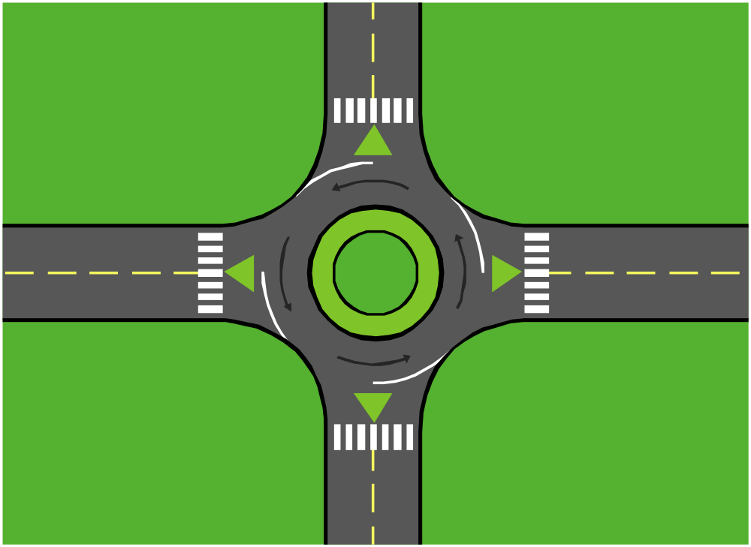
It’s time to build a roundabout!

Slide 29
Time to Discuss & Decide
What training needs do you have?
When could training be scheduled?
Could you establish a set time for regular training?
Who could provide the training?
What resources could you use?

Slide 30
Montana Self-Assessment
Training and Professional Development

Slide 31
Family and Community Involvement
Essential Component

Slide 32

Family Involvement
Involving families at all phases is
a key aspect of a successful RTI process.
Parent support of their child’s education increases the likelihood of success.
A summary of home-school collaboration research (Esler, Godber & Christenson, 2002) lists the demonstrated benefits of these partnerships for not only students, but for teachers and parents.

Slide 33

Research-Based Benefits
For Students…
Higher achievement
More positive attitudes toward school
Higher quality and more appropriate homework
Completion of more homework on weekends
Observing more similarities between family and schools
Source: Cherry Creek School District, CO (CCSD 9/05)
Notes:
33
Cathy – see their parents and school working together; power of a team; empower both parents and schools

Slide 34

Research-Based Benefits
For Families…
Receiving ideas from school on how to help their children
Learning more about educational programs and how the school works
Becoming more supportive of children
Becoming more confident about ways to help children learn
Gaining more positive views of teachers and the school
Source: Cherry Creek School District, CO (CCSD 9/05)
Notes:
34
Cathy

Slide 35

Research-Based Benefits
Source: Cherry Creek School District, CO (CCSD 9/05)
For Teachers and Administrators…
Improved teacher morale
Higher parent ratings of teachers by parents
Positive teacher’s rating of parents
Improved student achievement
Parents support schools and bond issues
Notes:
35
Cathy

Slide 36
Ways We May Already Encourage Parent Involvement…In Buildings
Volunteers
PTA and PTO’s
Accountability Committees
Safety Teams
Parent-Teacher Conferences
Back-to-School Nights
Family-School l Community Liaisons
Parent Universities/Parent Workshops
Staffing and IEP Meetings
Source: Cherry Creek School District, CO (CCSD 9/05)
Notes:
36
Julie

Slide 37
So What is Different About
Family-School Partnerships?
THEY ARE MORE…
Reciprocal
Inclusive
Systemic
Responsive
Source: Cherry Creek School District, CO (CCSD 9/05)
Notes:
37
Julie

Slide 38
WHY Family-School Partnerships?
Research – these partnerships work!
Laws - Parent-school partnerships are the law!
Recommendations- Parent-school partnerships are recommended!
Assets - Parent-school partnerships build assets!
Data - Parent-school partnerships provide data for decision making!
Source: Cherry Creek School District, CO (CCSD 9/05)
Notes:
38
Cathy

Slide 39
Legal Mandates
Source: Cherry Creek School District, CO (CCSD 9/05)
“No Child Left Behind (NCLB) requires that parents be involved in planning, implementation, evaluation, and accountability of their children’s education.” (Colorado Department of Education, 2004)
IDEA (2004) focuses on parent-school collaboration/agreement around such issues as paperwork, meeting attendance, and progress monitoring
Notes:
39
Cathy

Slide 40
Policy Group Recommendations
The President’s Commission on Excellence in Special Education (2002) recommends “that…IDEA should empower parents as key players and decision-makers in their children’s education… monitoring efforts should focus significantly results…”
The Learning Disabilities Roundtable (2004) states that there should be documentation of parent involvement throughout the LD identification process
Source: Cherry Creek School District, CO (CCSD 9/05)
Notes:
40
Cathy

Slide 41
Data for Decision-Making
Source: Cherry Creek School District, CO (CCSD 9/05)
Parents know their children at home and school personnel know their students at school.
Effective and prescriptive data-based decisions are made with the most complete data possible.
Parent and school data should be gathered collaboratively to help students succeed.

Slide 42
HOW?
Source: Cherry Creek School District, CO (CCSD 9/05)
Implement a Multi-Tiered Model
Problem-Solve With Parents
Address Barriers
Establish Communication
Notes:
42
Cathy

Slide 43
Informing Parents About RTI
Provide parents with written information about the RTI program and be prepared to answer questions about RTI processes.
Prepare parent handouts that explain:
  the process at their schools along with answers to commonly asked questions.
  how the system is different from a traditional education system and about the vital and collaborative role that parents play within a RTI process.
  the purpose of school -wide screening measures that are implemented three times per year to:
    match student skill to instruction.
    identify students at risk
See sample parent letter handouts

Slide 44
Parent Participation
Intensive
A Few Parents
Strategic
Some Parents
CORE
All Parents

Slide 45
Tier 1 - UNIVERSAL OPPORTUNITIES
Source: Cherry Creek School District, CO (CCSD 9/05)
Understanding that both parents and schools have important expertise/knowledge
Outreach to all parents including those with cultural, language, and learning differences
Purposeful, regular communication regarding student success
Parent knowledge of behavioral and academic expectations, including home support strategies
Notes:
45
Cathy

Slide 46
Tier 2 - TARGETED OPPORTUNITIES (Includes All Universal)
Ongoing parent partnership in problem-solving, intervention planning and progress monitoring of student success
Parent counseling related to student success
Focused, individualized parent partnership plan
Home visits
Personalized communication venues
Source: Cherry Creek School District, CO (CCSD 9/05)
Notes:
46
Cathy

Slide 47
Tier 3 - INTENSIVE OPPORTUNITIES (Includes all Universal and Targeted)
Source: Cherry Creek School District, CO (CCSD 9/05)
Wrap-around process with close home-school-community collaboration
Special education staffing and IEP process with ongoing parent partnership and problem-solving
Notes:
47
Cathy

Slide 48
Time to Discuss & Decide
See Handout “Parent Involvement” (Table on p.2) “Involving Parents in the RTI Process”
How would you involve parents?
Also discuss:
  Parent culture in school
  Barriers to participation (school & parents)
  Ways to eliminate potential barriers
Teams report out

Slide 49
Montana Self-Assessment
Community & Family Involvement

