Slide 1

Student Orientation
PHARR-SAN JUAN-ALAMO INDEPENDENT SCHOOL DISTRICT
Class of 2019 and Beyond

Slide 2
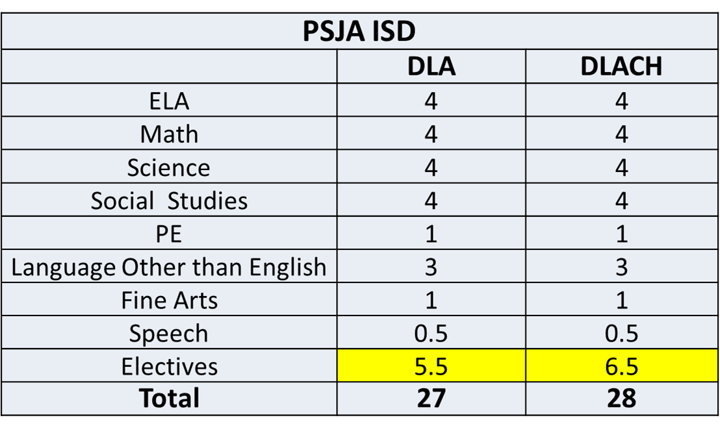
High School Course Requirements
Sample TEXT and Graph

Slide 3
Assessments
College Preparatory & State Exams
9th | 10th | 11th | 12th
TSI Algebra 1 EOC Biology EOC English 1 EOC AP Exams | TSI English 2 EOC AP Exams | TSI US History EOC PSAT/NMSQT (Fall) SAT (Spring) ACT (Spring) AP exams | TSI ACT SAT AP Exams
Performance Acknowledgments
AP exams College Board exams

Slide 4
High School Endorsement Selection
PHARR-SAN JUAN-ALAMO INDEPENDENT SCHOOL DISTRICT

Slide 5
What’s an Endorsement?
An endorsement is a program of study
An endorsement is earned when a student completes core curriculum requirements and a sequence of courses in a concentrated area of study.
Students must have their endorsement selection in writing prior “upon entering 9th grade.”

Slide 6

Endorsement Options

Slide 7
PSJA Endorsement Options: STEM
Programs of Study | Career Pathways | *Senior Level Academies -Senior Level Programs
Science, Technology, Engineering & Mathematics | Cybersecurity Engineering

Slide 8
PSJA Endorsement Options: Business & Industry
Programs of Study | Career Pathways | *Senior Level Academies -Senior Level Programs
Agriculture, Food, & Natural Resources | Animal Science Plant Science Agribusiness Applied Agri. Engineering Environmental And Natural Resources
Architecture & Construction | Electrical Trades Carpentry Architectural & Visual Technology HVAC
Arts, AV Technology & Communications | Digital Communications Design & Multimedia Arts
Business, Marketing & Finance | Accounting & Financial Services Business Management Entrepreneurship Marketing & Sales
Hospitality & Tourism | Culinary Arts
Information Technology | Information Technology Support & Services
Manufacturing | Welding Advanced Manufacturing & Machinery Mechanics | *Welding Technology Academy
Transportation, Distribution & Logistics | Automotive | *Automotive Maintenance & Light Repair Technology Academy

Slide 9
PSJA Endorsement Options: Public Service
Programs of Study | Career Pathways | *Senior Level Academies -Senior Level Programs
Education & Training | Teaching & Training
Health Science | Healthcare Diagnostics Nursing Science | *Emergency Medical Technology (EMT) Academy *Dental Assistant Academy Certified Nurses Aide/Assistant (CNA) Phlebotomy Technician Certified EKG Technician
Law, Public Safety, Corrections & Security | Law Enforcement Emergency Services | *Basic Firefighter Technology Academy
Human Services | Cosmetology

Slide 10
PSJA Endorsement Options: Arts & Humanities
Area of Focus | Courses related to this career pathway: | *Senior Level Academies -Senior Level Programs
Performing Arts of Music Theatre Visual Arts | Drama English Literature Band History Choir World Languages Political Science

Slide 11
psjaisd.us facebook.com/psjaisd twitter.com/psjaisd
PHARR-SAN JUAN-ALAMO INDEPENDENT SCHOOL DISTRICT
All materials, content and forms contained in this presentation are the intellectual property of PSJA ISD
and may not be copied, reproduced, distributed or displayed without PSJA ISD’s express written permission.
If written permission is granted, information may be used accompanied
by an acknowledgement that PSJA ISD is the source.

