Slide 1
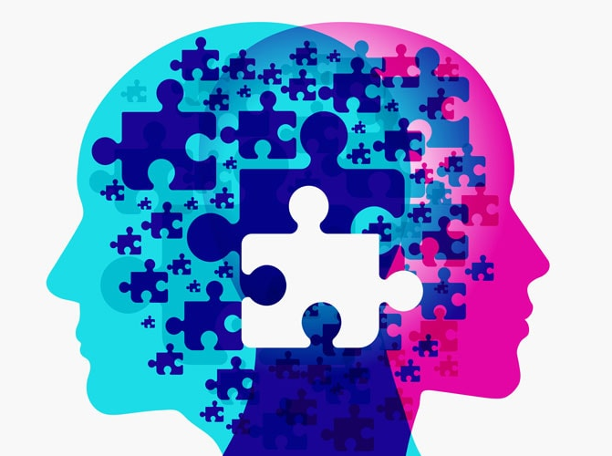

Mental Health
PHARR-SAN JUAN-ALAMO INDEPENDENT SCHOOL DISTRICT
A Guide for Parents

Slide 2
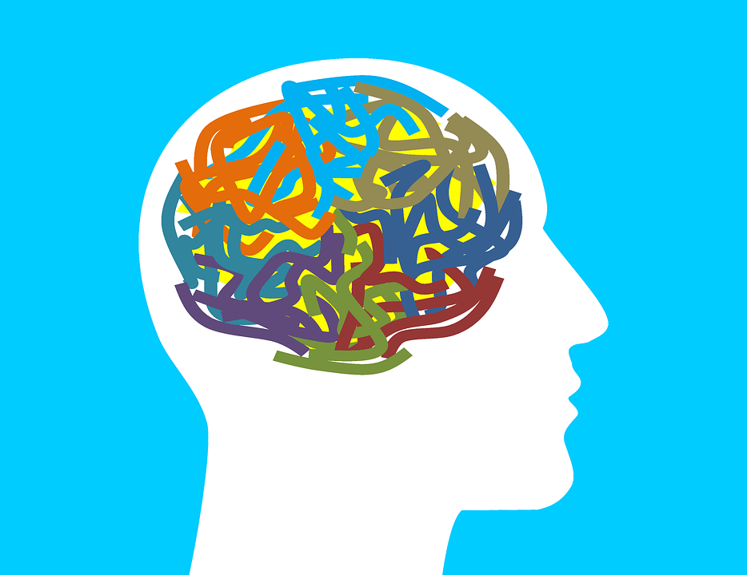
Agenda
Statistics 2020
What is Mental Health?
Early Warning Signs
Mental Health Difficulties
Mental Health Disorders
Anxiety Disorder
Common Effects
Did You Know?
Mental Health Resources

Slide 3

Mental health video
https://www.youtube.com/watch?v=y-ACcDIGi-c&list=TLPQMDEwNzIwMjFPLf3c6I-N9w&index=1
Notes:
If the video doesn’t play when you press arrow use the link below.

Slide 4

Statistics 2020
Mental Health Statistics 2020
In late June, 40% of U.S. adults reported struggling with mental health or substance use.
One in six U.S. youth aged 6-17 experience a mental health disorder each year.
Half of all lifetime mental illness begins by age 14, and 75% by age 24.
Suicide is the second-leading cause of death among people aged 10-34 in the U.S. and the 10th leading cause of death in the U.S.
More than 70% of youth in the juvenile justice system have a diagnosed mental illness.
The most common mental illnesses in the U.S. are anxiety disorders, which affect 40 million adults (18.1% of the population).
Mental health and substance use challenges affect everyone differently and recognizing when to get help yourself or offer support to someone else is an important step in changing these statistics for the better.
https://www.mentalhealthfirstaid.org/

Slide 5
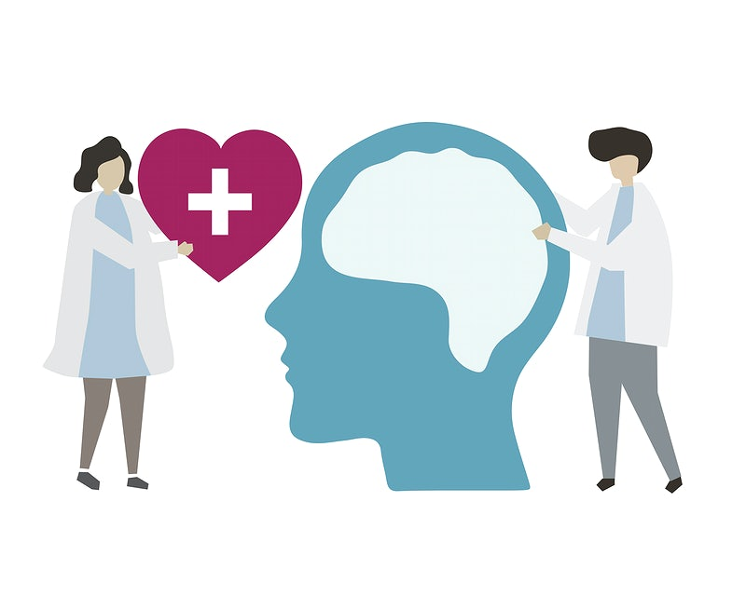
WHAT IS IT?
What is Mental Health?
What is Mental Illness?
Stress – Our response to: change, difficult situations, threatening situations.
Anxiety – A general term for several disorders that cause nervousness, fear, apprehension, and worrying. These disorders affect how we feel and behave and can cause physical symptoms. Mild anxiety is vague and unsettling, while severe anxiety can seriously affect day-to-day living.
Depression – A mood disorder characterized by low mood, a feeling of sadness, and a general loss of interest in things.
Mental health includes our emotional, psychological, and social well-being. It affects how we think, feel, and act. It also helps determine how we handle stress, relate to others, and make choices. Mental health is important at every stage of life, from childhood and adolescence through adulthood.
Over the course of your life, if you experience mental health problems, your thinking, mood, and behavior could be affected. Many factors contribute to mental health problems, including:
Biological factors, such as genes or brain chemistry
Life experiences, such as trauma or abuse
Family history of mental health problems
A broad term used to describe the range of mental health problems; from those with the most sever mental disorders.
https://www.mentalhealth.gov

Slide 6

Early warning signs
How do I know if someone s experiencing mental health issues? It is important to look for warning signs. Experiencing one or more of the following feelings or behaviors can be an early warning sign of a problem:
Eating or sleeping too much or too little
Pulling away from people and usual activities
Having low or no energy
Feeling numb or like nothing matters
Having unexplained aches and pains
Feeling helpless or hopeless
Smoking, drinking, or using drugs more than usual
Feeling unusually confused, forgetful, on edge, angry, upset, worried, or scared
Yelling or fighting with family and friends
Experiencing severe mood swings that cause problems in relationships
Having persistent thoughts and memories you can't get out of your head
Hearing voices or believing things that are not true
Thinking of harming yourself or others
Inability to perform daily tasks like taking care of your kids or getting to work or school

Slide 7
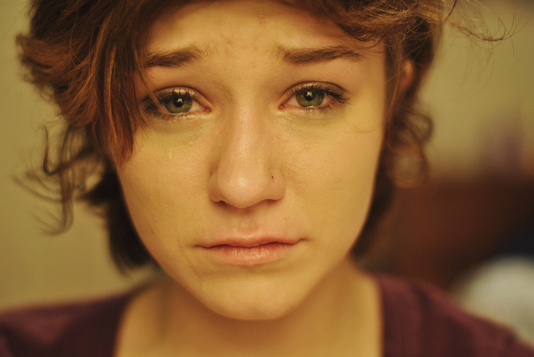
what can cause mental health difficulties
Possible Mental Health Triggers
There are numerous but not limited to these mental health triggers that can cause mental health difficulties.
Stress
Moving
Job Loss
Change of Environment
Deprivation

Slide 8
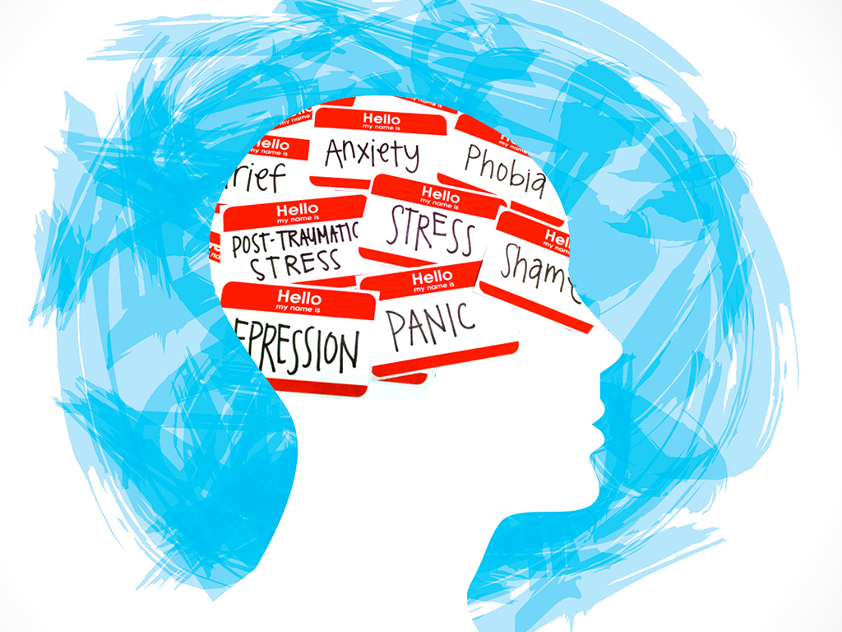
Mental health disorders
There are many different types of mental health disorders and they can affect your thinking, mood, and behaviors. Here are some examples:
Anorexia
Depression
Schizophrenia
Bi-Polar Disorder
Anxiety
Obsessive Compulsive Disorder
Paranoia
Phobia

Slide 9
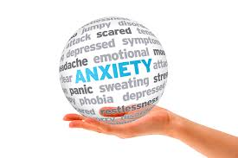
ANXIETY DISSORDER
People with anxiety disorders respond to certain objects or situations with fear and dread. They have physical reactions to those objects, such as a rapid heartbeat and sweating. An anxiety disorder is diagnosed if a person:
Has an inappropriate response to a
situation
Cannot control the response
Has an altered way of life due to the
Anxiety
Anxiety disorders include:
Panic Disorder
Phobias

Slide 10
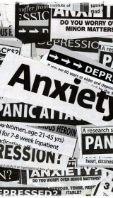
COMMON EFFECTS
Mental Health Common Effects
Isolation/Social Exclusion
Alcohol Abuse
Drug Abuse
Self Harm
Stress
Suicidal Thoughts

Slide 11
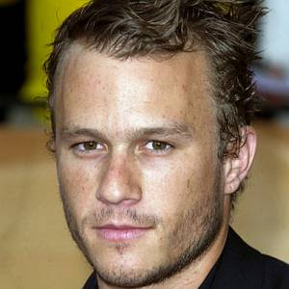

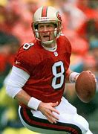


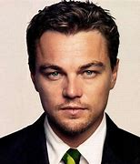


DID YOU KNOW?
Celebrities Who Have Suffered from Mental Health
Heath Ledger
Depression
Demi Lovato-Bipolar Disorder
Steve Young- Social Anxiety Disorder
Michael Phelps-ADHD
Dan Reynolds-Clinical Depression
Leonardo DiCaprio-
Obsessive Compulsive Disorder
Lady Gaga-
PTSD
Adele-
Postpartum Depression
11
10 Celebrities Who Struggle With Mental Health | University of Utah Health

Slide 12



LOCAL Mental health resources
Hidalgo County Resources
Need Immediate Help in an Emergency or Crisis 911
Rio Grande Valley Crisis Hotline 866-423-9304
National Crisis Hotline 800-273-TALK (8255)
United Way of South Texas 956-686-6331
Information & Referral Community Council of the RGV 211
Alcoholics Anonymous 956-544-8530
Abuse Hotline 1-800-252-5400
National Suicide Prevention Lifeline 1-800-273-TALK (8255)
American Foundation for Suicide Prevention Crisis Text Line Text TALK to 741741
Jason Foundation
Palmer Drug Abuse Program 956-544-3333
South Texas Behavioral Center 888-977-1400
Tropical Texas Behavioral Health 956-289-7000
UTRGV Counseling Services https://www.utrgv.edu/counseling/services/suicide-prevention/index.htm
Hospitals:
McAllen Medical Center-Emergency Room 956-632-4100
Rio Grande Regional Hospital- Emergency room 956-632-6443
Doctor’s Hospital at Renaissance- Emergency Room 956-362-5101
Edinburg Regional Medical Center-Emergency Room 956-388-6500

Slide 13
resources
https://www.mentalhealthfirstaid.org/
https://www.mentalhealth.gov
10 Celebrities Who Struggle With Mental Health | University of Utah Health
www.rethink.org
www.mentalhealth.org.uk
www.nami.org
www.mentalhealth.gov

Slide 14
psjaisd.us facebook.com/psjaisd twitter.com/psjaisd
PHARR-SAN JUAN-ALAMO INDEPENDENT SCHOOL DISTRICT
All materials, content and forms contained in this presentation are the intellectual property of PSJA ISD
and may not be copied, reproduced, distributed or displayed without PSJA ISD’s express written permission.
If written permission is granted, information may be used accompanied
by an acknowledgement that PSJA ISD is the source.

