Slide 1
Excellence Begins With Me… MPSD Culture

Slide 2
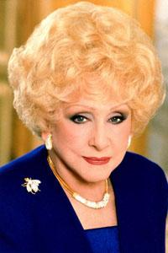
Who is this leader? What is the
culture of her company?
Pink Cadillacs
Recognizes accomplishments of others
God first, family second, career third
Beliefs: Integrity, honesty and the Golden Rule

Slide 3
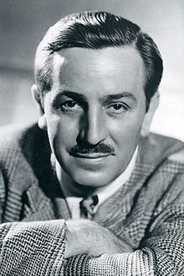
Who is this leader? What is the culture of this company?
Everyone smiles
People want to be there
A commitment to excellence, creativity and innovation
Four Keys: safety, courtesy, show and efficiency

Slide 4
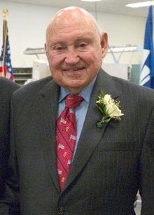
Who is this leader? What is the
culture of this company?
Official Statement of purpose says that the business exists “To glorify God by being a faithful steward of all that is entrusted to us.”
“My pleasure”
Core values: Customers first, Personal Excellence, Continuous Improvement, Working Together and Stewardship

Slide 5
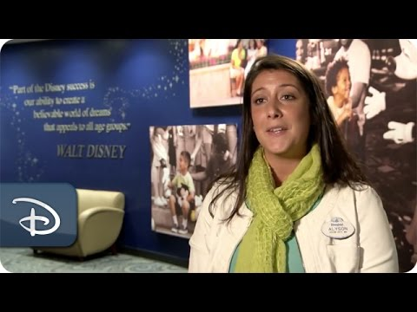

Slide 6
For these companies, there is a specific way of doing things…
Train on behaviors desired
Same message for all employees
They have shared values and beliefs
THIS IS CULTURE!

Slide 7
Time to Brainstorm…
On sticky notes…
write down all of the programs, resources, foci we have in the district
Write down what is the MPSD way of doing things...when you think of MPSD what do you think (good or bad)
Notes:
Divide room into two sides (left and right, building admin and other) have charts on either side of room for these two categories … one side do programs and the other do ideas of MPSD

Slide 8
Discussion
What do all these sticky notes say about what it’s like to teach in MPSD?
What do these sticky notes say about how things are done in MPSD?
What is the culture of MPSD about? How do people describe MPSD? Is there ONE core belief that we all have?

Slide 9
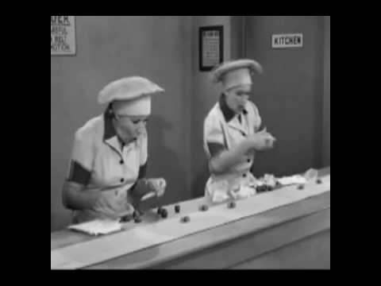
Notes:
Does this describe what it’s like to teach/work in Meridian...we move people from department to department, just when they think they have things figured out, we speed things up...add a few more tasks

Slide 10
CULTURE doesn’t happen by chance…
We have the charge …
To CHANGE
the way we do things across MPSD
How people feel about MPSD
EXCELLENCE BEGINS WITH ME!”

Slide 11
Seven Components to Shaping Culture
Assemble a Team & Make a plan: This is your school/team think tank
Start with the Heart (Vision and Mission): visible, connect, exemplify
Build Trust: with team, those you serve
Enlist Others: Who and Why?
Own Difficult Responsibilities: Data, staffing, conversations
Constantly Look for Signs of Success: Behaviors change first, then mindset
Set the Stage for Sustainable Change: delegate, hire based on schools values, build capacity
Notes:
Have 7 posters around room….divide people into groups...what will this look like on campus and for district

Slide 12
EXCELLENCE BEGINS WITH ME..
Excellence looks like this
Students are :
Actively Engaged learners
Self-motivated, problem solvers, collaborators
Leaders within the school community

Slide 13
STAFF Culture:
The Culture of MPSD is one of excellence as demonstrated by:
Accepting Personal accountability for the success of ALL learners
Building Positive Relationships (Golden Rule)
Creating Nurturing learning environments

Slide 14
Evidence of Excellence will be when we are in buildings and classrooms we will see:
a. Students reading, speaking, writing, and thinking
b. Application of skills
c. Students and teachers supporting each other in
learning
The ultimate outcome will be……...Learners becoming Leaders of Excellence

Slide 15
STAR ACTIVITY
Get in pairs
Partner One will need a pen and their phone or a mirror
Partner Two will need a binder/notebook….something to use a shield
Partner One will trace between the two stars
Partner Two may encourage but nothing more….simply hold the shield so Partner One cannot see anything except their phone
Begin when told to start
Notes:
Why is this so difficult….you know what you need to do….I gave you the tools, you had a partner to encourage you….so why was it hard...this is our job in creating a culture of Excellence. We know what we need to do, we have to provide the tools, we have to train in the desired behaviors….but when things don’t go as planned, we can’t give up on each other.

Slide 16
