Slide 1
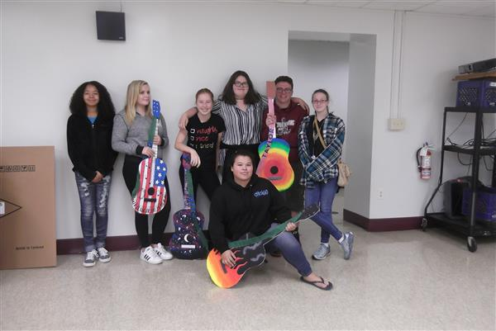


Fairport Harbor Exempted Village Schools
Community Meeting
October 9, 2018

Slide 2
Background
FHEVSD working with Ohio Facilities Construction Commission (OFCC) – 92% contribution
TDA was hired in February 2018 to provide Pre-Bond Services
OFCC & TDA completed thorough assessments of existing buildings

Slide 3
Background
School | 2018 Assessment | Renovation / Rebuild Percentage
McKinley ES | $8,647,779.71 | 79%
Fairport Harding Jr/Sr HS | $19,615,106.08 | 80%
Total Renovation Cost | $28,262,885.79
Notes:
What was the project?

Slide 4
Master Planning
District /TDA/OFCC exploring new building master plan options
Challenges
Options: OFCC new unwritten policy on funding for small districts
Timeline: District funding now has more demand than resources – impacts FHEVSD
Land: District-Owned site options limited

Slide 5
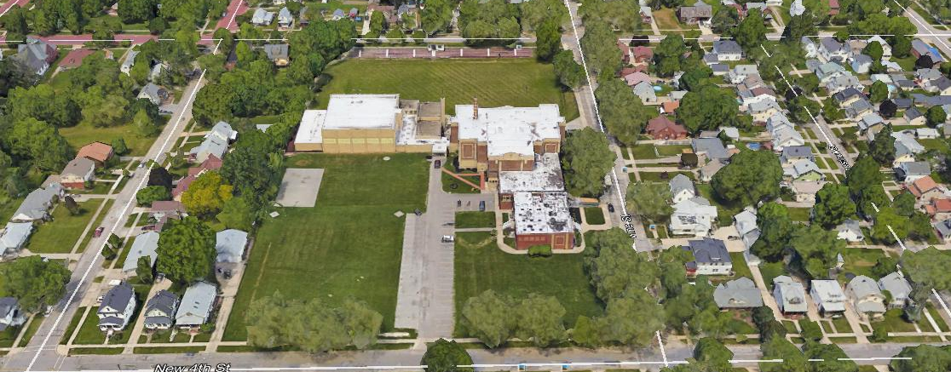
Master Plan Option 1
Notes:
What was the project?

Slide 6
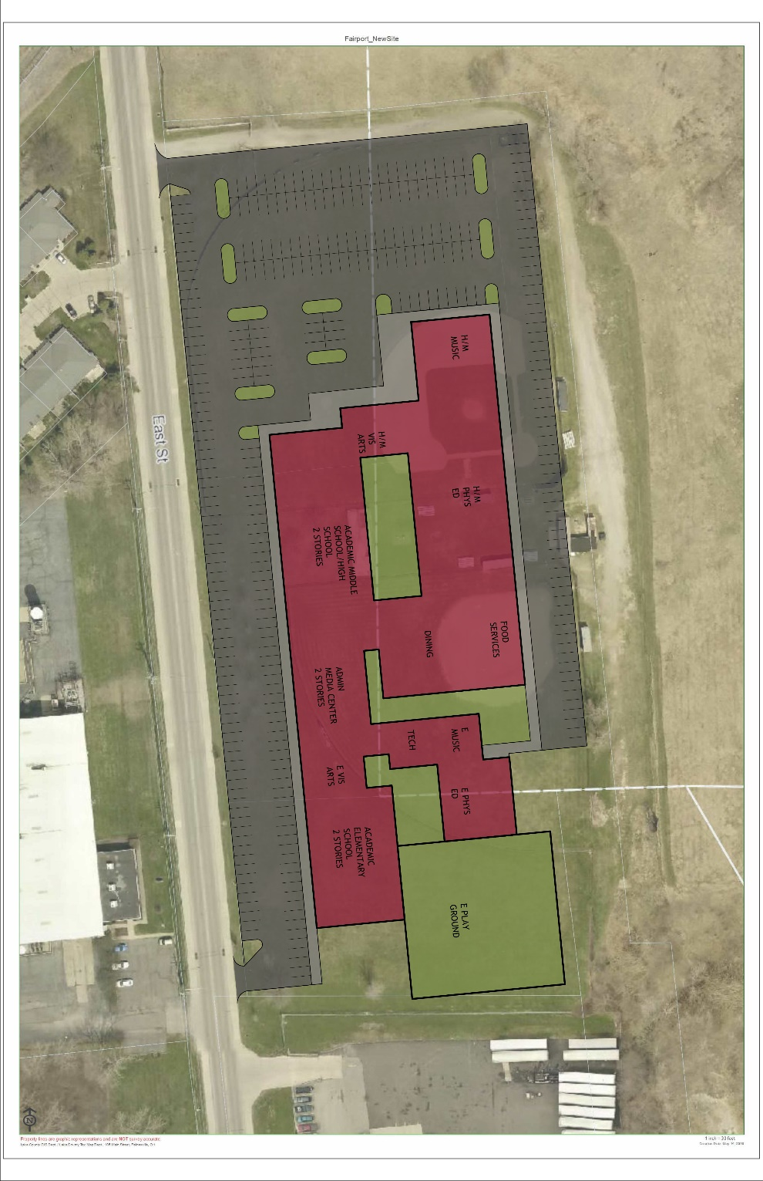
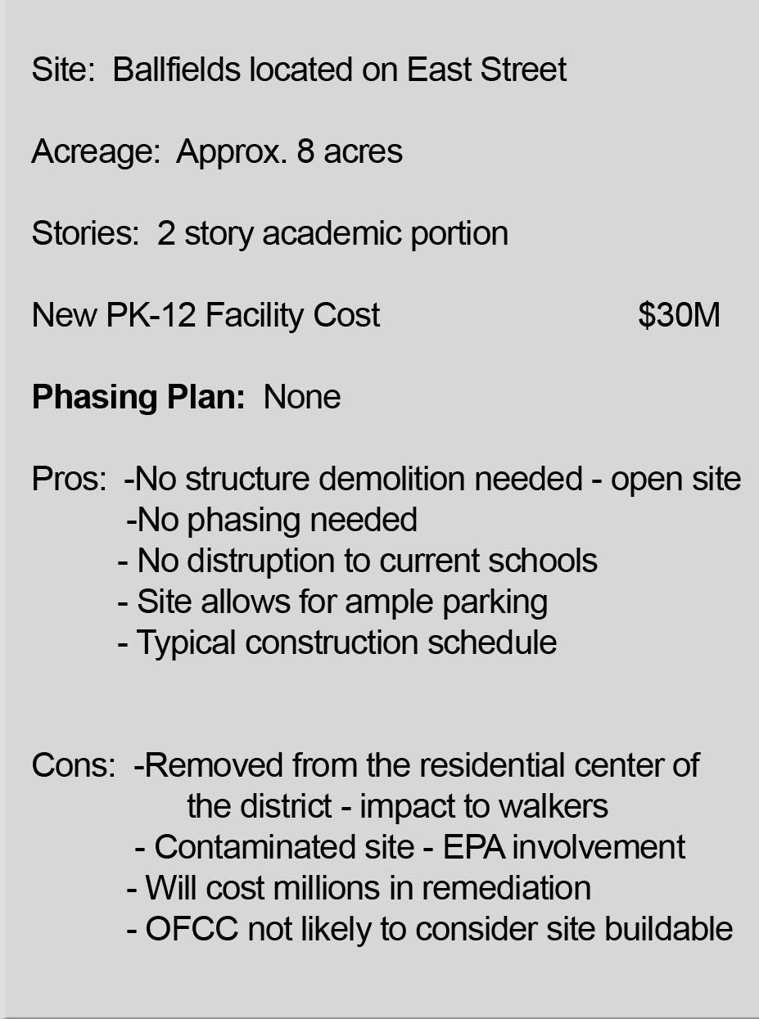
Master Plan Option 1
APPROX. COST: $30M
Notes:
What was the project?

Slide 7
Master Plan Option 2

Slide 8
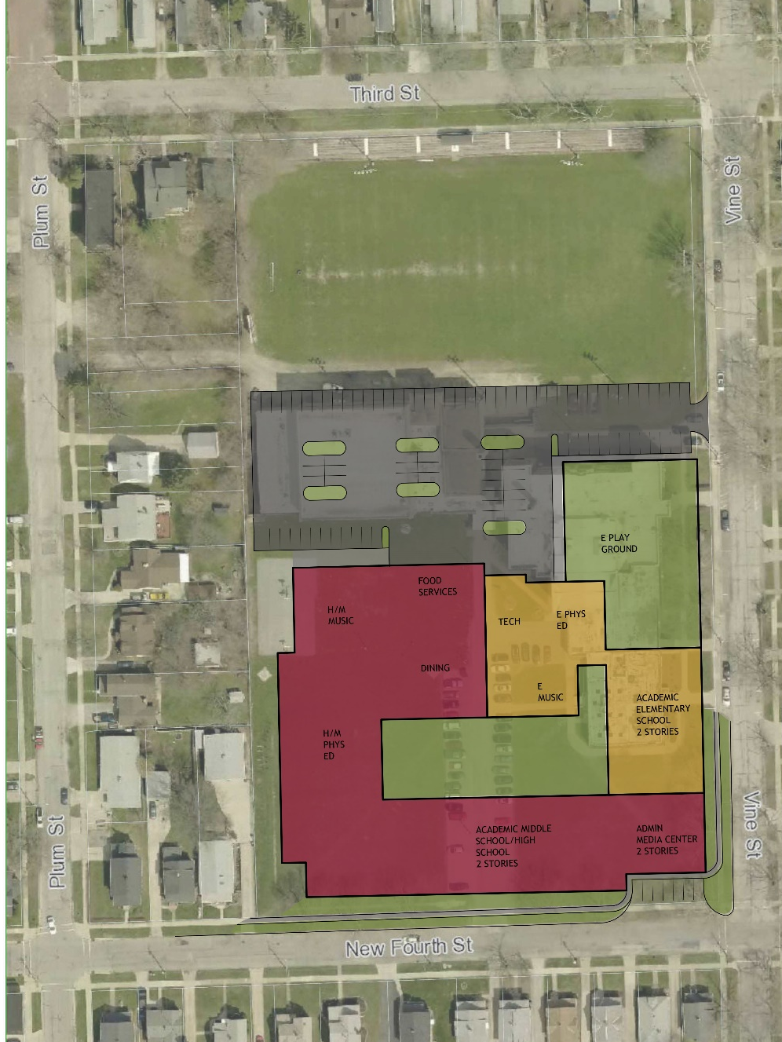

Master Plan Option 2
APPROX. COST: $32.7M

Slide 9
Master Plan Option 3

Slide 10
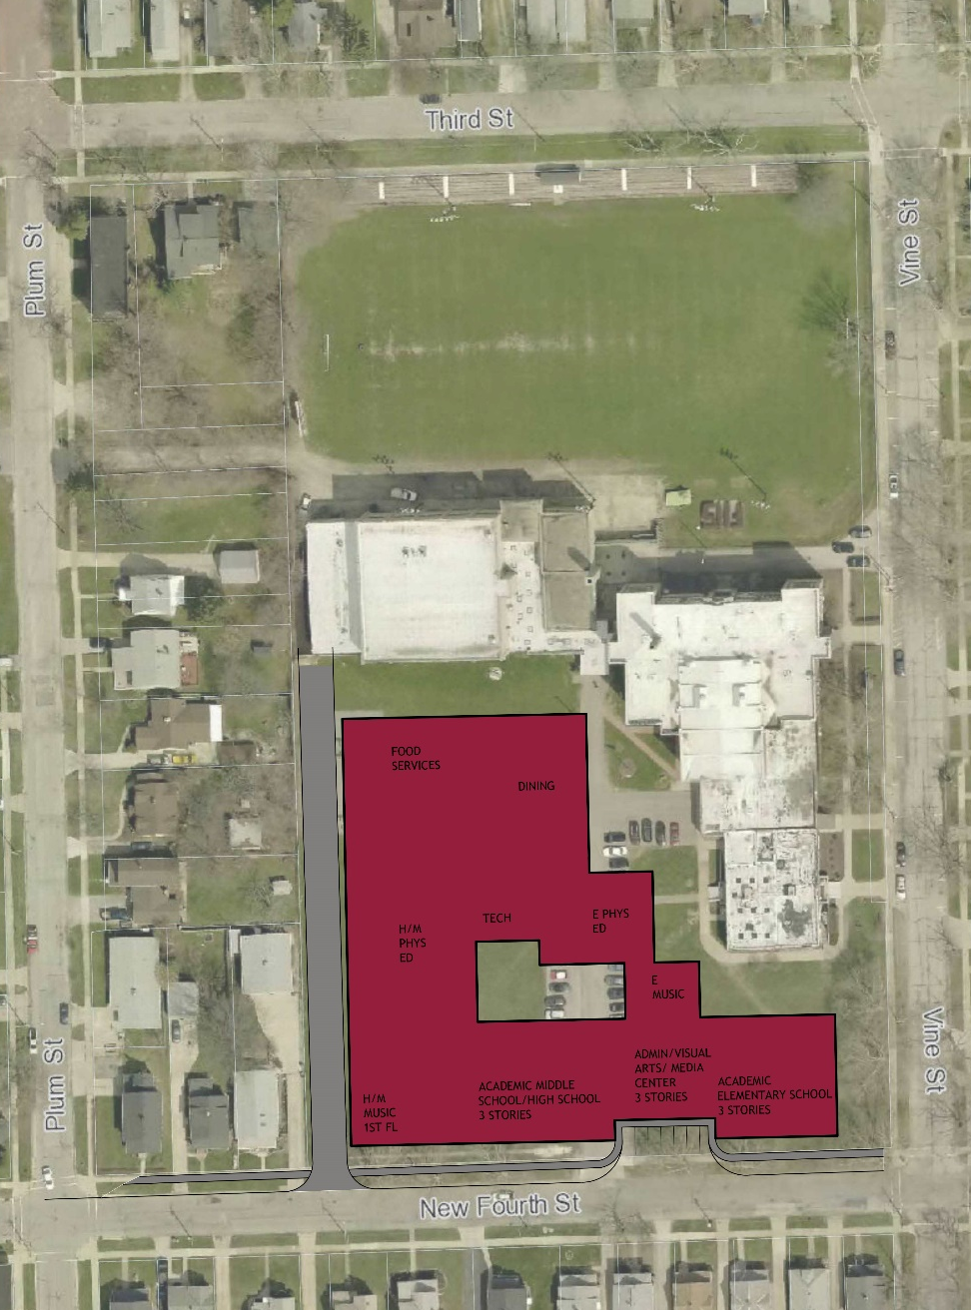

Master Plan Option 3
APPROX. COST: $30M

Slide 11
Exploring LFI’s

Slide 12
Exploring LFI’s
Board of Education LFI
SPACE NEEDS:
Reception / Secretary
Superintendent Office w/meeting space
IEP meeting Space
District Technology Personnel office/work space
Total New SF = 1,620 SF
Existing SF @ Harding = 1,597 SF
APPROX. COST: $405K

Slide 13

Next Steps
Explore New Land Purchase Opportunities
Continue meeting with OFCC on progress / status towards funding date
Engage the community in progress and planning process

Slide 14

Q & A
Thank You!
Notes:
chris

