Slide 1

Elementary
World Language Program
Fox Chapel Area
School District

Slide 2

Welcome and Introductions
Elementary World Language Team
Miss Jessica Taylor
Mrs. Claire McCourt
Executive Director of Elementary Education
Dr. Ashley Constantine
Notes:
Ashley, Jess, and Claire

Slide 3

Agenda
Stakeholder Engagement and Implementation Timeline
Why World Language
Standards and Research
National and Local Program Models
Fox Chapel Area Program Goals & Design
Curriculum and Instruction
A Look at a Lesson

Slide 4
Stakeholder Engagement and Implementation Timeline
Advertise for Elementary World Language Specialist (Jan. 31-Feb. 17)
General Staff Email (February 1)
Launch District World Language Survey (February 6)
**EAT Discussion (February 11)
**District Office Administration (February 20)
**K-12 World Language Chairs (February 22)
**Grade Level Chairs and FCEA (March 1)
**PTO Officers (March 14)
**Elementary Site Based Teams (March 15)
Analyze Feedback from Stakeholder Groups (April)
Teacher Selection (May)
Curriculum Development with University of Pittsburgh (June 26)
Detailed Programming Planning and Development (May, June, and July)
Program Roll-Out to Staff and Stakeholders (August)
2019-2020 Implementation

Slide 5
Why World Language?
Extensive cognitive benefits that enhance overall academic performance:
  - Supports problem-solving skills across content areas
  - Supports reading and writing in native language
  - Improves memory, increases attention span, and strengthens ability to switch between two tasks
Early start is beneficial for future proficiency
Younger learners better able to integrate a new linguistic system
Increased job opportunities (international business, medical field, government, education)
Deeper intercultural awareness and sensitivity to diversity
Development of global citizenship
Enrichment of international travel experiences

Slide 6

Program Goals and Outcomes
Introduce students to language learning
Enhance cross-curricular connections in classrooms
Build awareness and understanding of other cultures
Develop an appreciation for the value of learning another language
Increase motivation for future language study

Slide 7

Standards
World Readiness Standards for Learning Languages
  Communication, Cultures, Connections, Comparisons, and Communities
*American Council on the Teaching of Foreign Languages (ACTFL)

Slide 8





Research
American Council on the Teaching of Foreign Languages (ACTFL)
Center for Applied Linguistics (CAL)
Center for Advanced Research on Language Acquisition (CARLA)
Languages and Learners Making the Match
University of Pittsburgh Department of Instruction and Learning in Foreign Language Education

Slide 9
Key Findings from Our Research
Earlier starts with language instruction ensure greater success for more students.
Foreign language programs can be found in only about 20-25% of all public and private elementary schools in this country.
Programs should (1) reflect the national standards, (2) provide exposure to different languages, (3) help children learn about different cultures, and (4) motivate them to continue foreign language study.
Program models can be adapted, modified, and combined to suit the needs of schools and school districts.

Slide 10
National Program Models
Exploratory
Multiple introductory foreign languages
Supports and reinforces cross-curricular connections in classrooms
Introduces students to other cultures and languages as a general concept
Limited fluency; emphasis isn’t on learning the language itself
Immersion
Total immersion (all day) programs; all subjects (math, social studies, science, etc.) taught in the second language
Partial immersion; some subjects taught in the second language
The language is the medium for content instruction rather than the subject
Higher level of competence than those participating in other language programs

Slide 11

Local Program Models
Over 30 districts surveyed/contacted
Only 3 districts offer World Language studies in elementary school
Spanish only language offered
Programs are exploratory in nature
***Conclusion: The expansion of the Elementary World Language program at Fox Chapel Area will give our children a leg up academically and create a very unique learning opportunity for our kids!

Slide 12
Fox Chapel Area Elementary Exploratory Model
The most common program option in public elementary schools.
Time spent learning one or more languages.
Fluency in a language is not expected, nor is it the goal.
Enhances cross-curricular connections through STEAM, Mathematics, and ELA
Provides general exposure to language and culture with the goal of developing an interest in foreign language for future study.

Slide 13

Language Phase-In
Grade K | Spanish
Grade 1 | Spanish
Grade 2 | Spanish
Grade 3 | French/German
Grade 4 | French/German
Grade 5 | Spanish/French/German/Latin World Language Symposium

Slide 14

Schedule
Trimester 1
HW ½ (Grades 3-5) - Mrs. McCourt
FV (Grades 3-5) - Mrs. McCourt
OH (Grades K-2) - Miss Taylor
Trimester 2
OH (Grades 3-5) - Mrs. McCourt
HW ½ (Grades K-2) - Miss Taylor
KR (Grades K-2) - Miss Taylor
Trimester 3
KR (Grades 3-5) - Mrs. McCourt
HW ½ (Grades 3-5) - Mrs. McCourt
HW ½ (Grades K-2) - Miss Taylor
FV (K-2) - Miss Taylor

Slide 15

Content-related Instruction
Integration of language teaching objectives with curricular content (e.g., math, science, language arts)
Contextualized and goal-directed language use - meaningful repetition and recycling of vocabulary with a task-related purpose
Appropriate for language learners in the elementary grades: hands-on, visual, experiential, engaging
Important to counterbalance cognitive demands of language learning and content knowledge
Foreign Language
Curricular Content

Slide 16
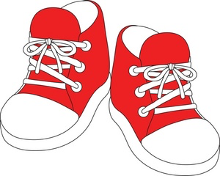
World Language in Action
“Put Yourself in the Shoes of the Learner”
Notes:
Alexis

Slide 17
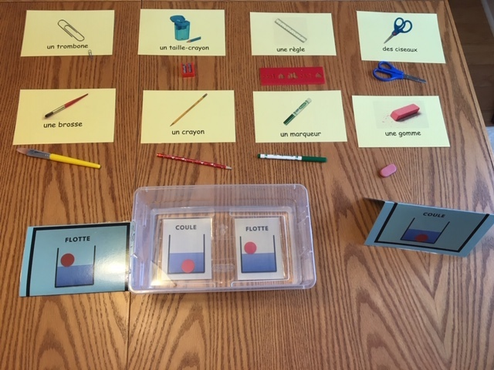
Sample Lesson - Sink or Float?
Notes:
Evaluating

Slide 18
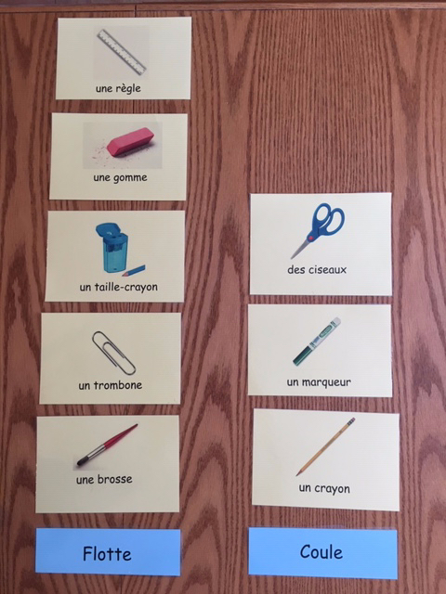
Predict - Sink or Float?

Slide 19
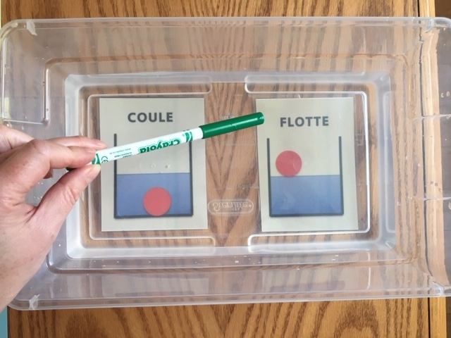
Test - Sink or Float?

Slide 20
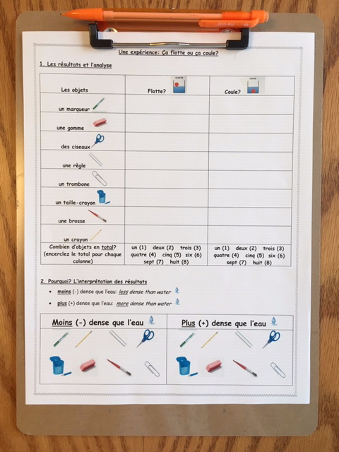
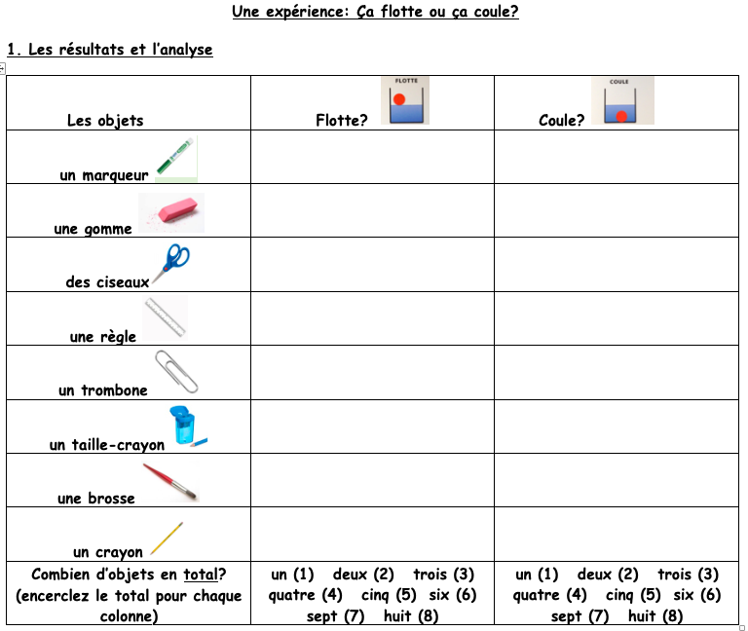
Results - Sink or Float?

Slide 21
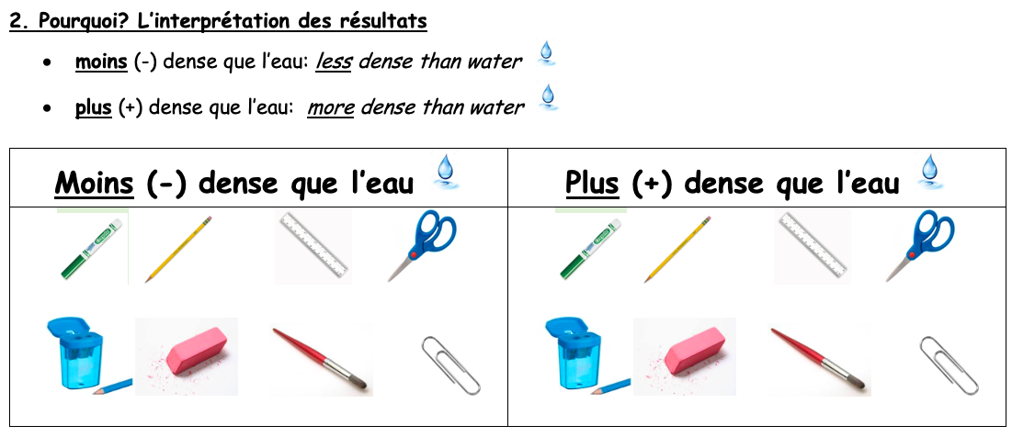
Interpretation of Results - Sink or Float?

Slide 22
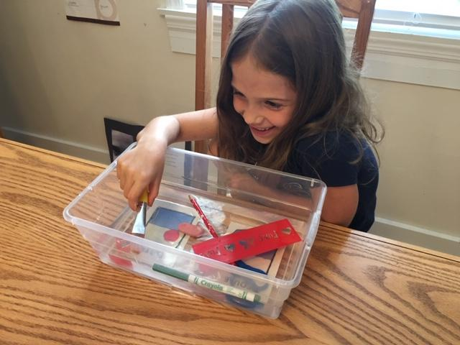
Concluding Game

Slide 23
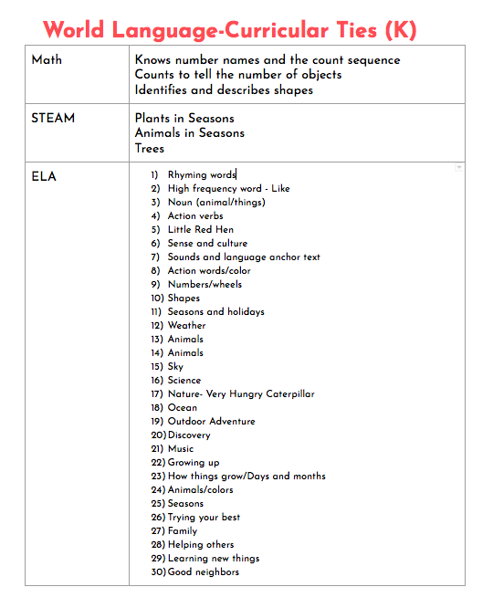

Curriculum Development
Content: English Language Arts, Mathematics, and STEAM
Culture: Art, Music, Traditions, Holidays, Food, Games, etc.

Slide 24

Fox Chapel Area Elementary World Language Curriculum
Kindergarten Spanish:
Math: Identify Shapes, Counting
STEAM: Life Cycle of a Butterfly, Seasons
ELA: Animals, Shapes, Colors, Action Verbs
Grade 1 Spanish:
Math: Compare Numbers, Shapes, Extend the Counting Sequence
STEAM: Living vs. Non-Living, Habitats
ELA: Oceans, Friends, Animal Classification
Grade 2 Spanish:
Math: Odd vs. Even Numbers, Measure in Standard Units
STEAM: Solids, Liquids, & Gases, Classifying Matter
ELA: Helping others, Heroes, Traditional Stories, Animals/Pets

Slide 25

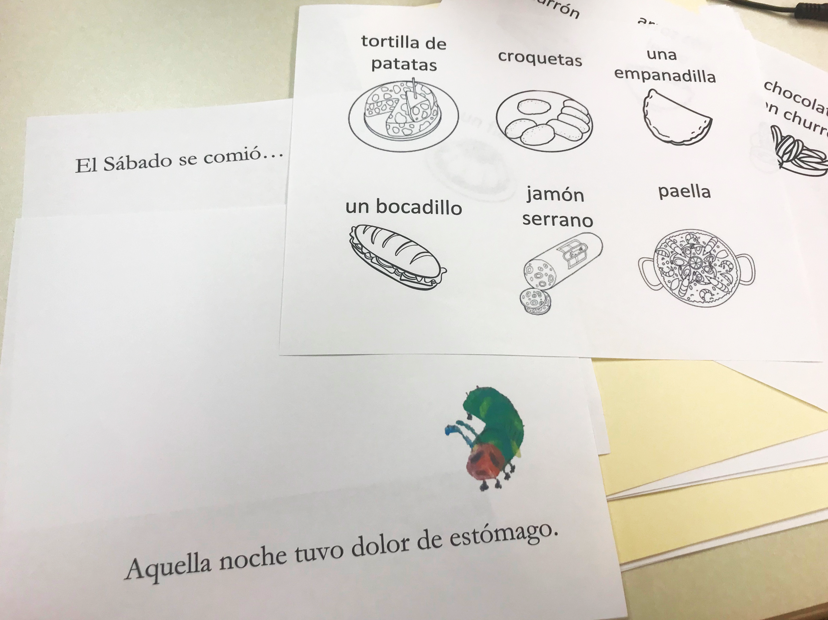
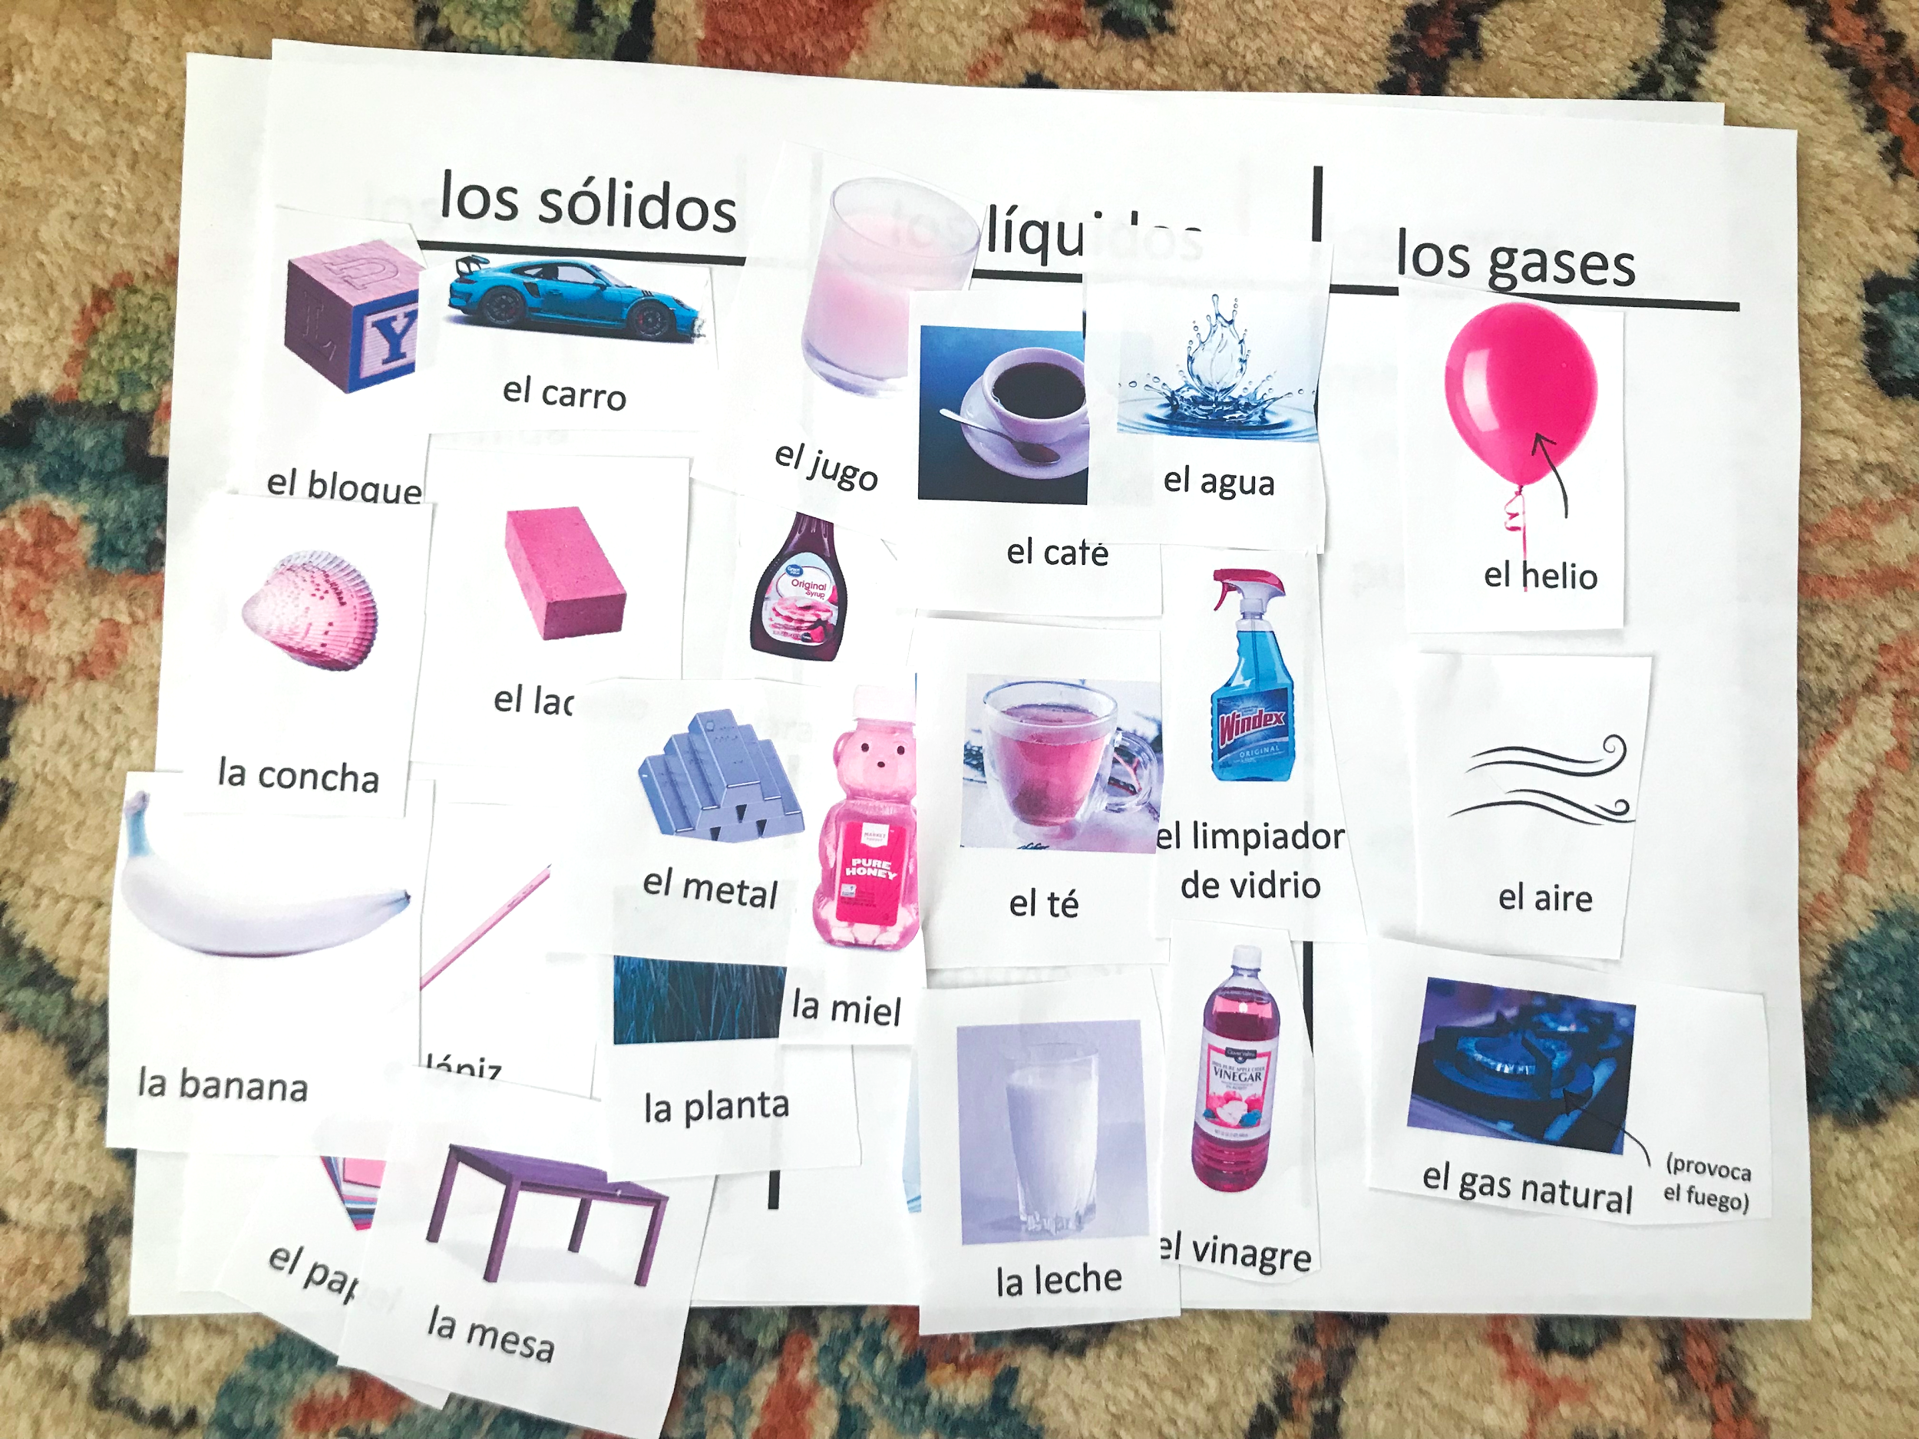
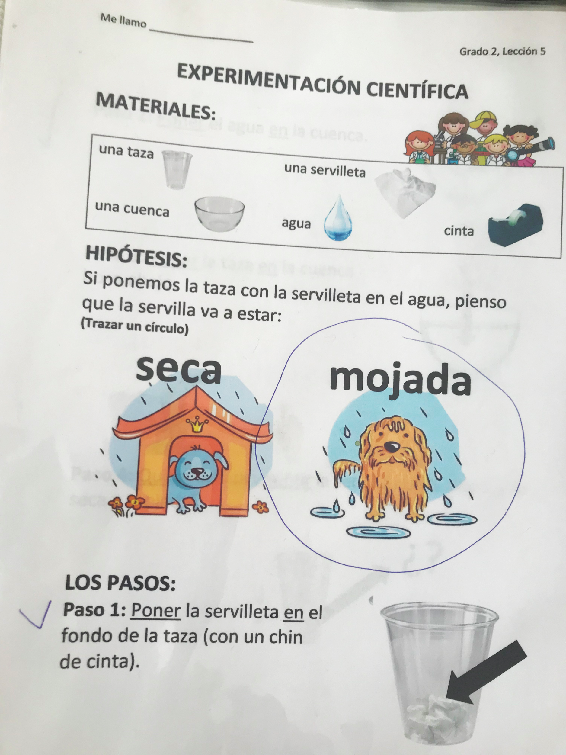
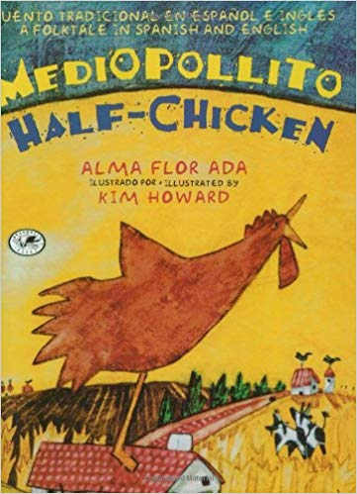

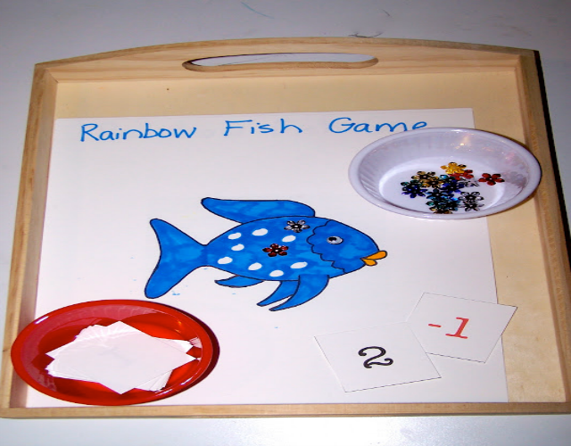
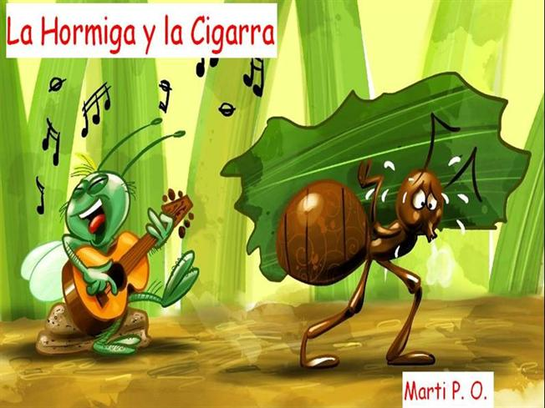
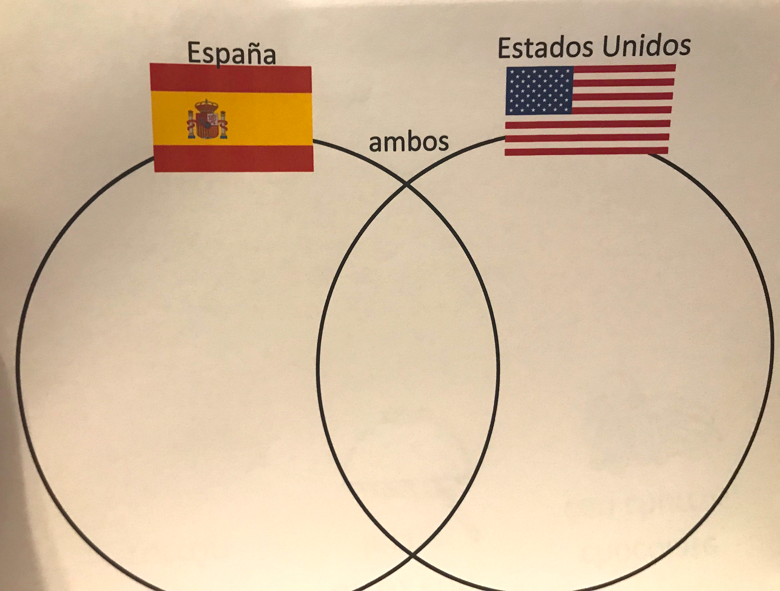
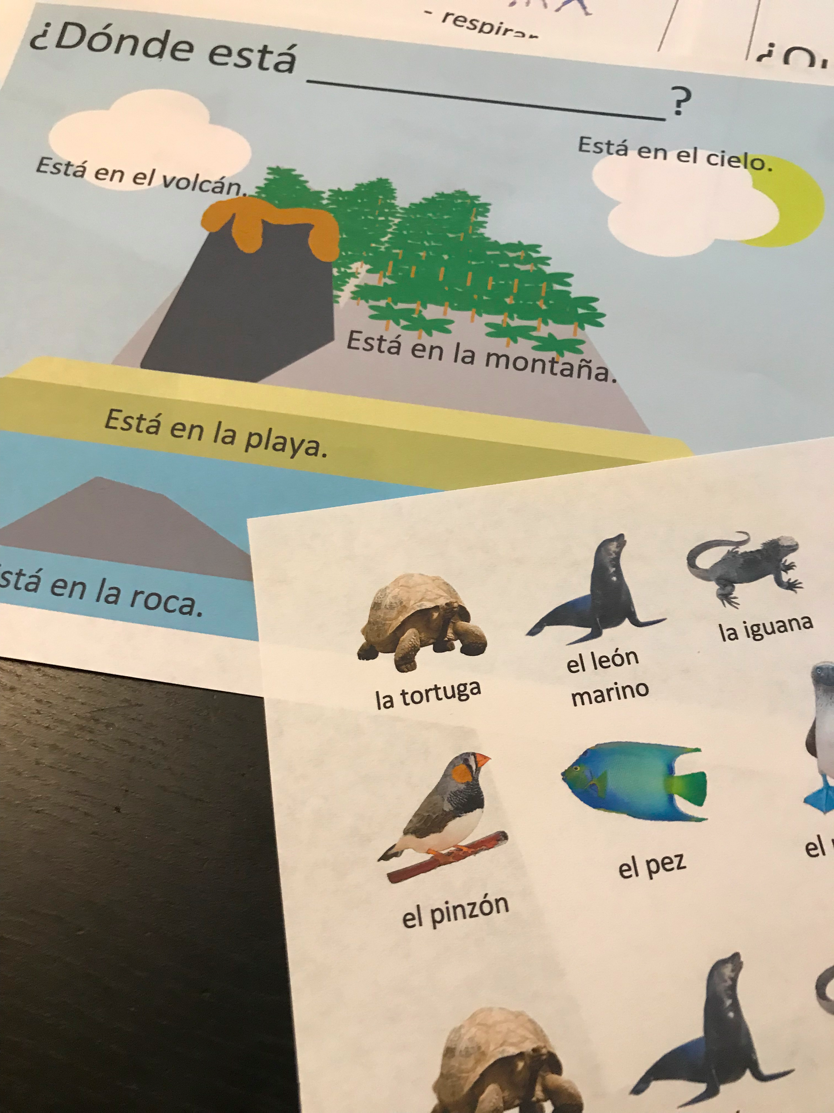


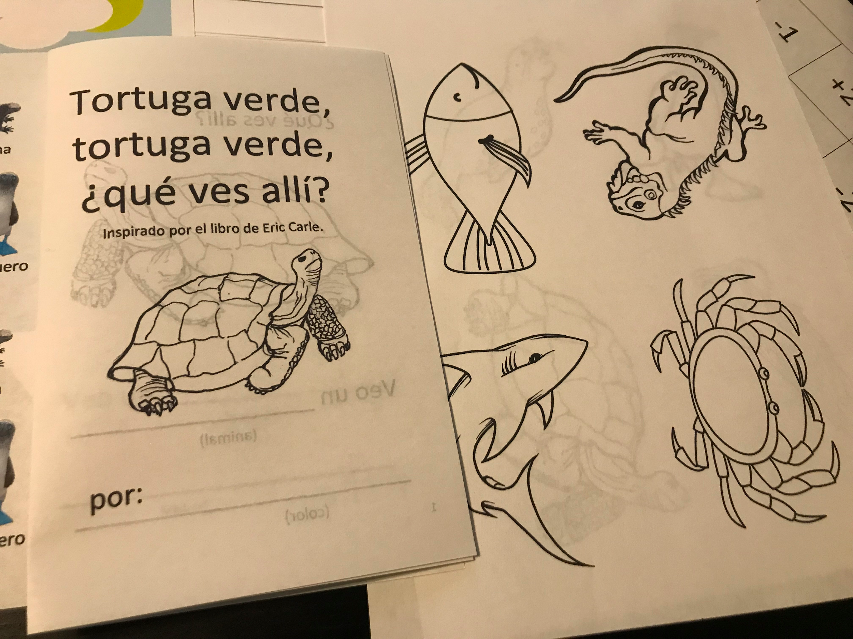
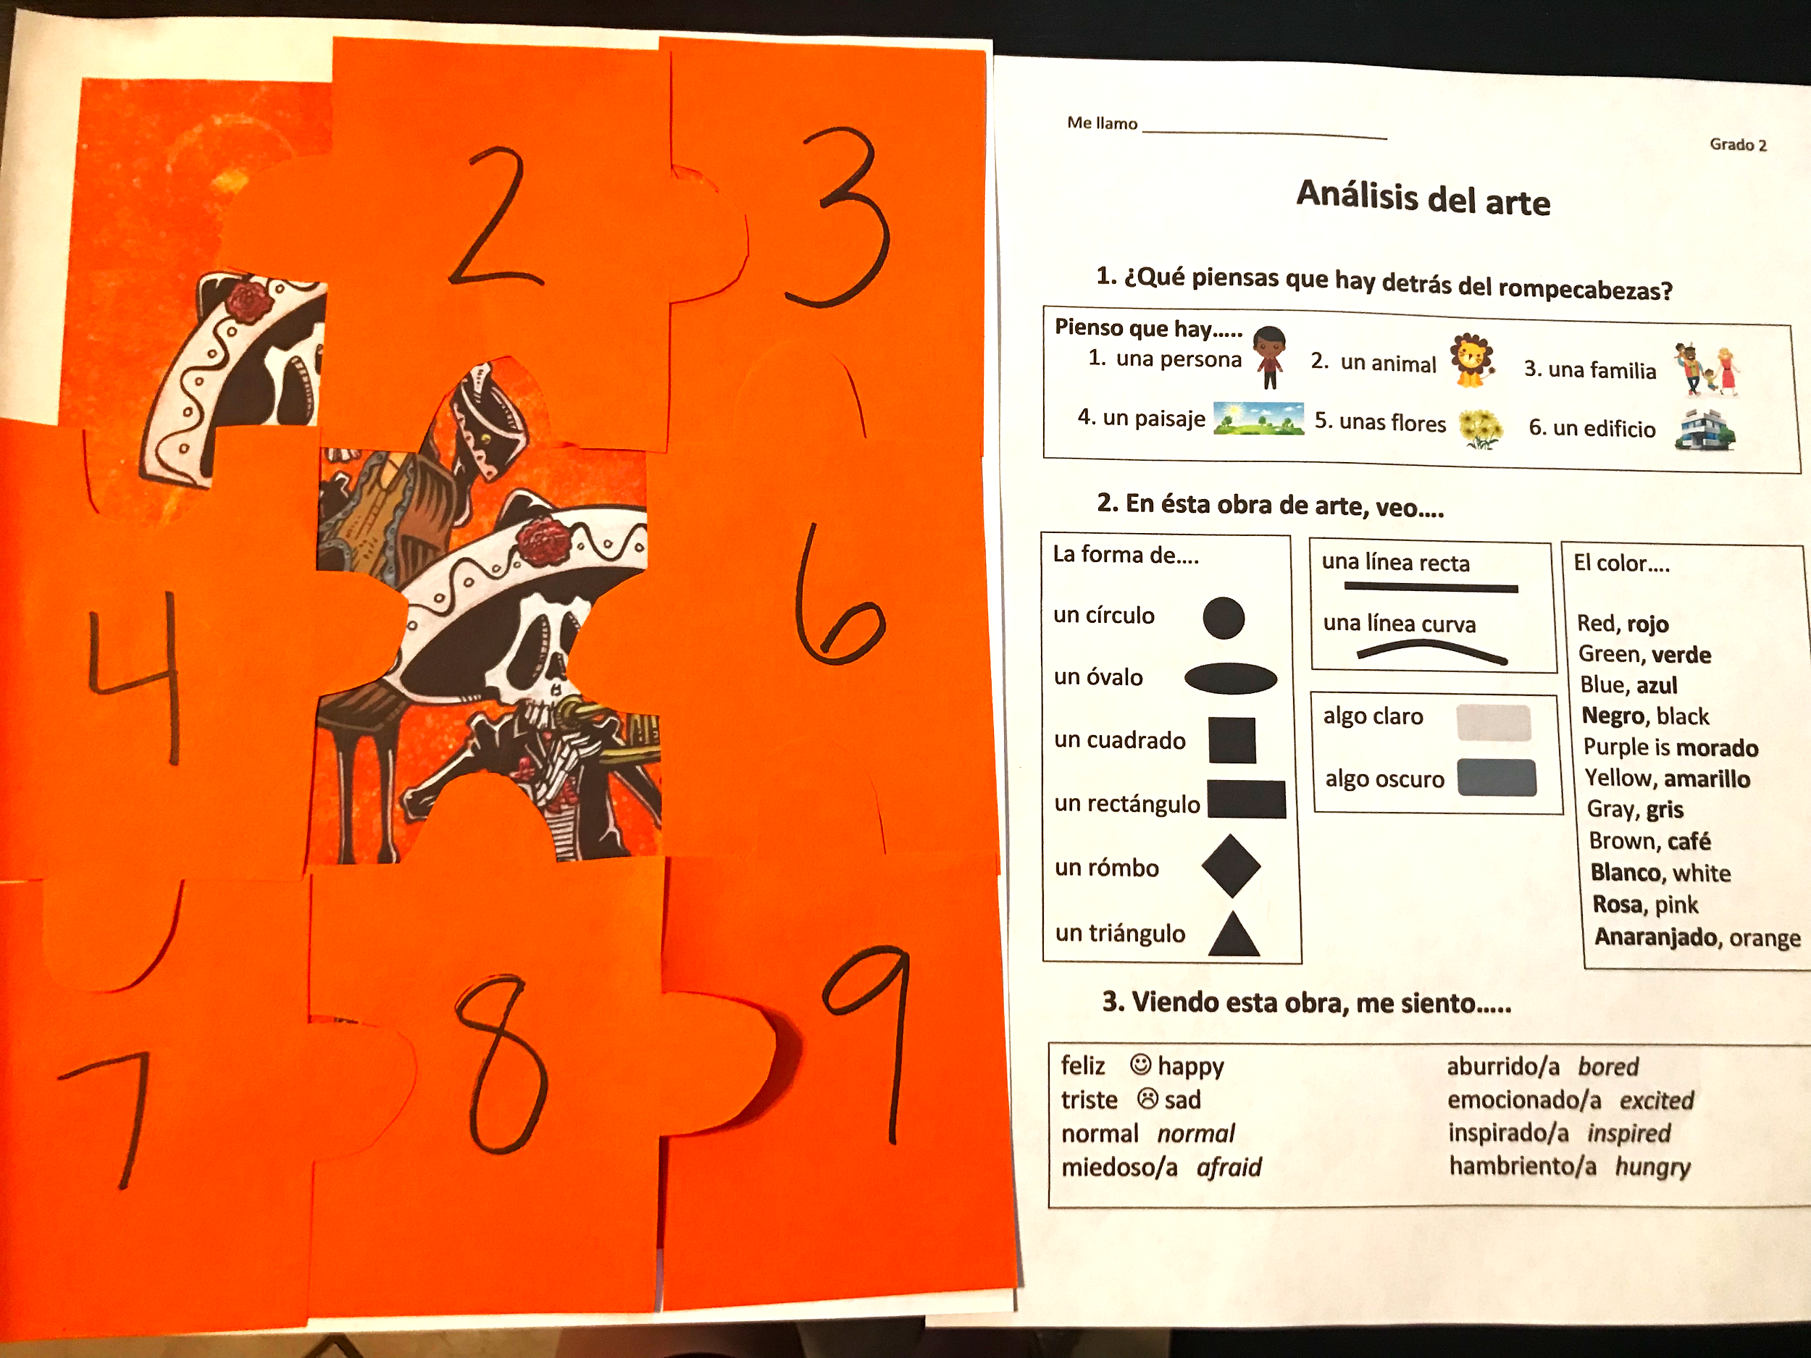
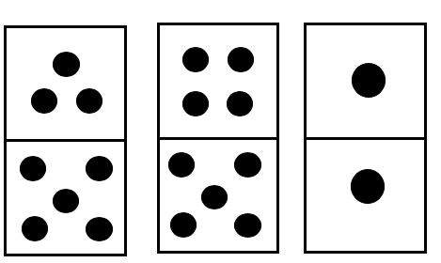
Sample Materials

Slide 26
Fox Chapel Elementary World Language Curriculum
Grades 3 and 4: French
Math: Represent and Interpret Data, Generate and Analyze Patterns, Reason with Shapes and Their Attributes
STEAM: Food Chains, Animal Classification, Grouping Animals, Properties of Matter
ELA: People and Animals, Agriculture/Food/Crops, Visual Art, Different Cultures
Grades 3 and 4: German
Math: Solve Problems Involving Measurement, Represent and Interpret Data, Reason with Shapes and Their Attributes
STEAM: Moon Phases, Comparing the Earth, Moon, and Sun
ELA: Helping Others, Research, Environment, Visual Art, Different Cultures, Traditions
Grade 5: French, German, Spanish, and Latin
Math: Roman Numerals, Analog Time, Solve Problems Using Conversions, Solve Word Problems, Generate and Analyze Patterns, Use the Four Operations with Whole Numbers to Solve Problems
STEAM: Weather, Natural Hazards, Hurricanes, Bridges Around the World, The Planets
ELA: Roman Mythology, Nature, World Travel, Protecting the Environment, Experiments, Solving Problems

Slide 27


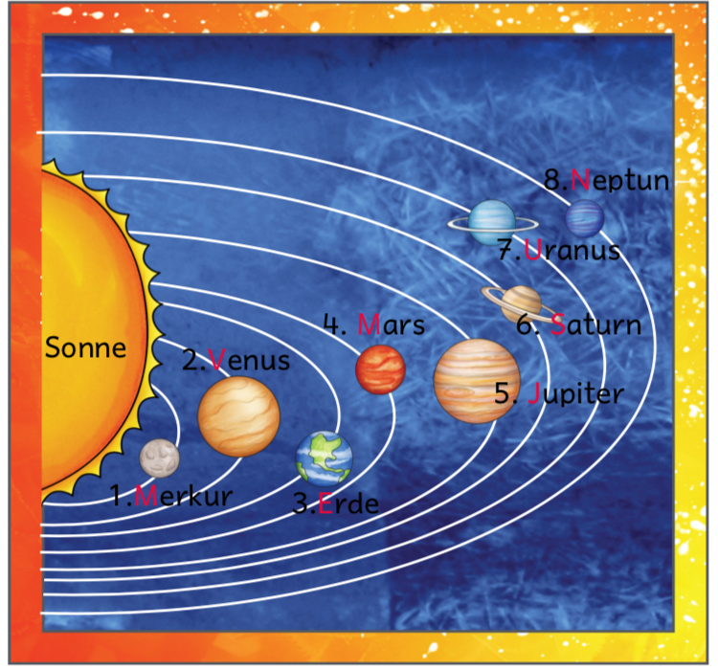






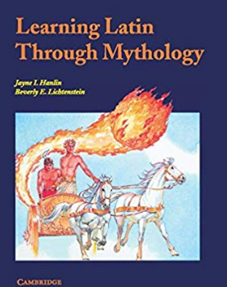


Sample Materials

Slide 28


Thank You!

