Slide 1


FY 2022-2023
BUDGET PRESENTATION

Slide 2
MISD Long Term Financial Plan
Goal: Use MISD General Fund over the next 3 fiscal years to supplement losses as we move towards a balanced budget.
Goal for 2022-2023: $10M deficit

Slide 3
Projected 2022-2023 Revenue

Slide 4
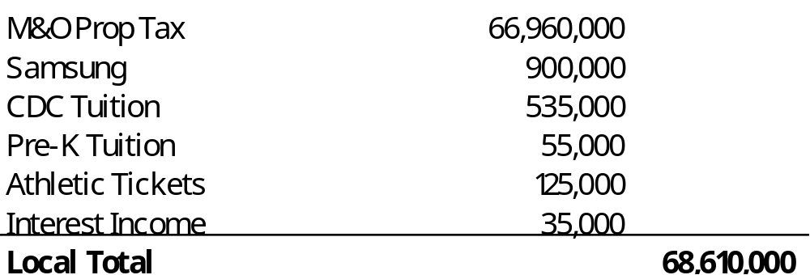
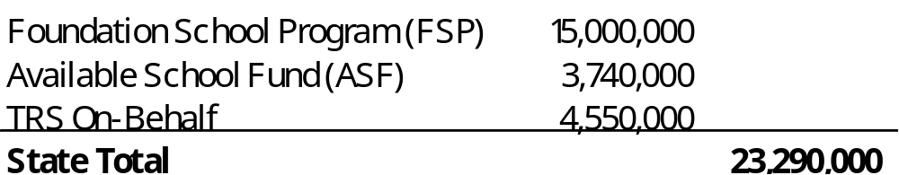
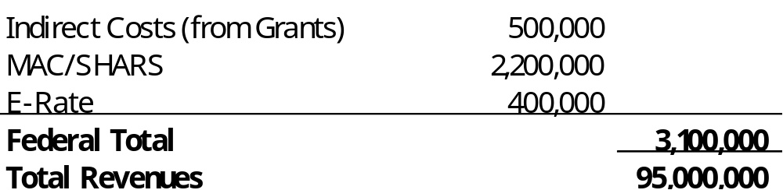
Projected 2022-2023 Revenue

Slide 5
Expenditure Assumptions
All changes to our Compensation plan are included in the presentation
    Stipends are included
    Extra duty pay is included
    Taxes and benefits are included
Bus Drivers to 8 hours per day
Additional CDC Classrooms
Five (5) options will be presented

Slide 6
Expenditure Scenarios
7% raise for teaching staff and hourly employees and a 2% raise for all others (“7%/2%”)
6% raise for teaching staff and hourly employees with a 2% raise for all others (“6%/2%”)
5% raise for teaching staff and hourly employees with a 2% raise for all others (“5%/2%”)
4% raise for teaching staff and hourly employees with a 2% raise for all others (“4%/2%”)
4% raise for everyone (“4% all”)
(“teaching staff” includes teachers, registered nurses, librarians, elementary instructional coaches, literacy coaches and secondary department heads)

Slide 7
77% Payroll
23% Non-Payroll

Slide 8
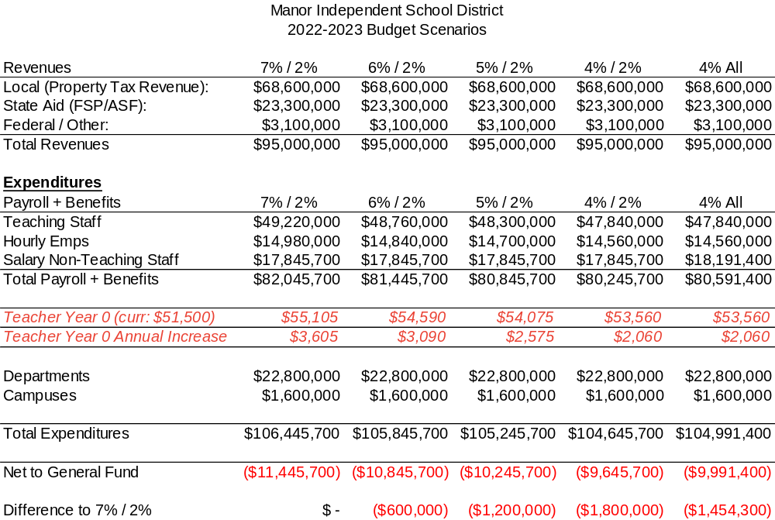
Scenario Comparison

Slide 9
Manor ISD Compensation Comparables for Novice Teachers
District | 21-22 ‘0’ Teacher Pay | 22-23 ‘0’ Teacher pay | 4% Increase | 7% Increase
Manor ISD (3rd highest in 21-22) | $51,500 | ?? | $53,560 | $55,105
Del Valle ISD | $50,970 | $54,000
Bastrop ISD | $50,000 | $53,000 | $52,000 | $53,000
Pflugerville ISD | $51,900(1) | $53,400 | $54,076 | $55,533
Elgin ISD | $51,700(2) | $52,855
Austin ISD | $51,150 | $52,151 | $53,196 | $54,731
Hays CISD | $50,000 | N/A | $52,000 | $53,500
Georgetown ISD | $50,300 | N/A | $52,312 | $53,821
Round Rock ISD | $50,250 | $53,000
Hutto ISD | $51,350 | $53,300

Slide 10
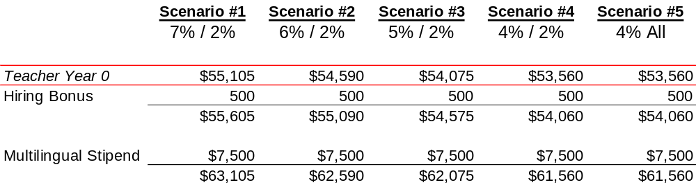
Compensation Comparison

Slide 11
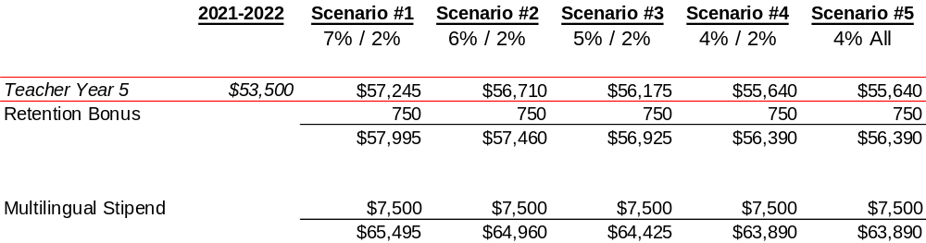
Compensation Comparison

Slide 12
QUESTIONS?

