Slide 1

Welcome to Stuco!!!
2018-2019 Information Meeting
Please Sign In & Leave your Flight Teacher Name/Class Period

Slide 2
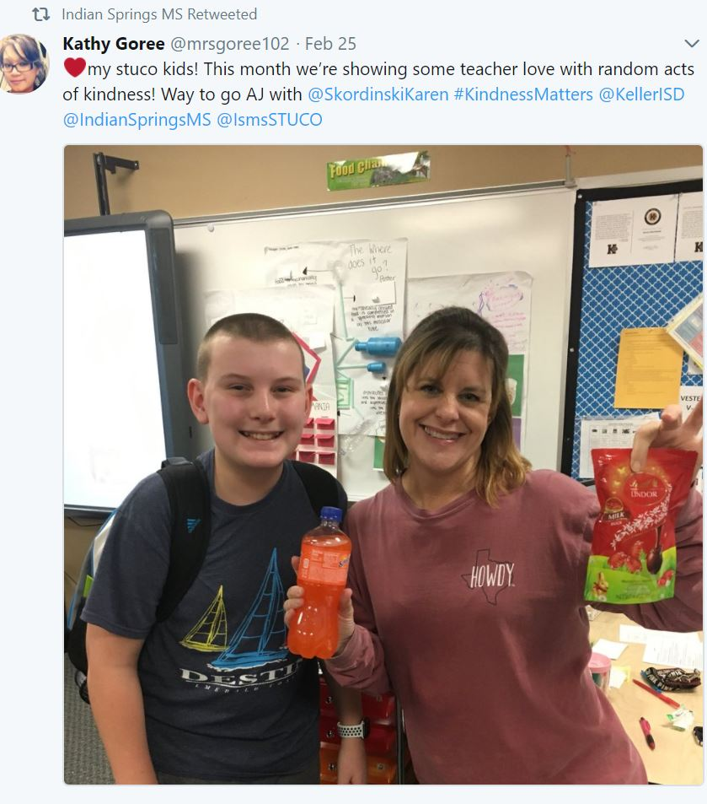
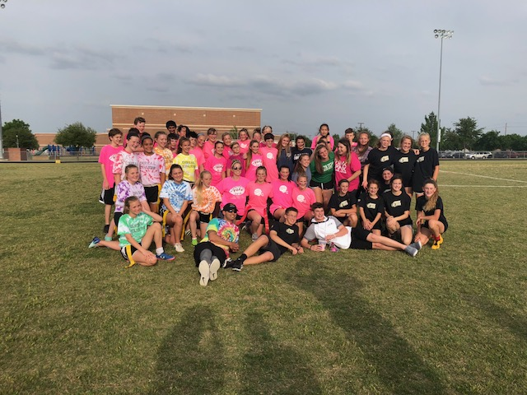
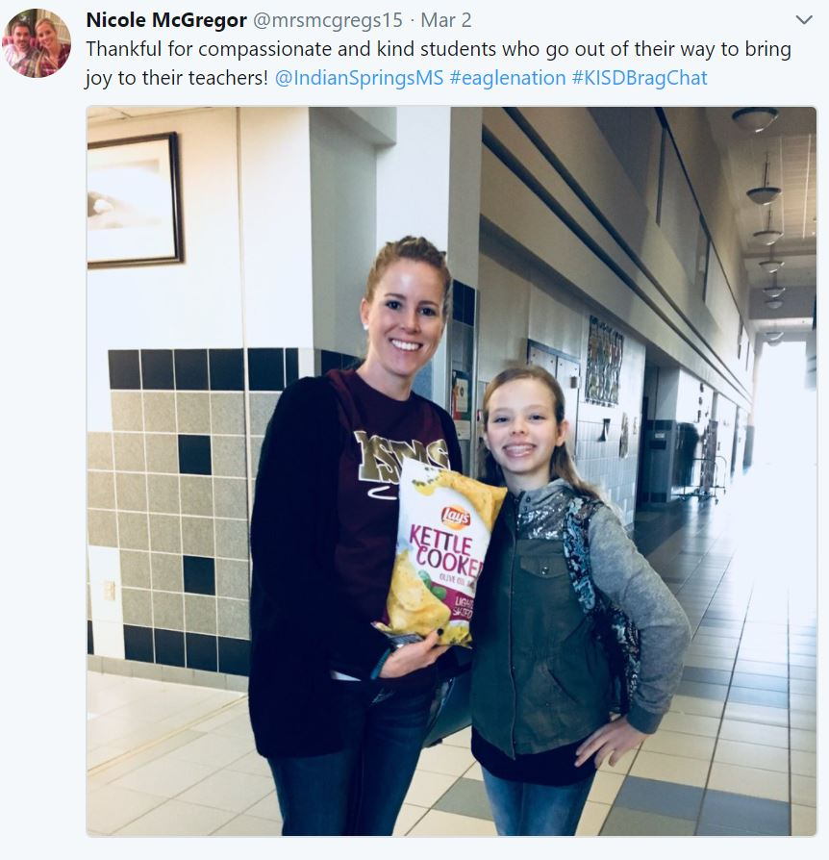
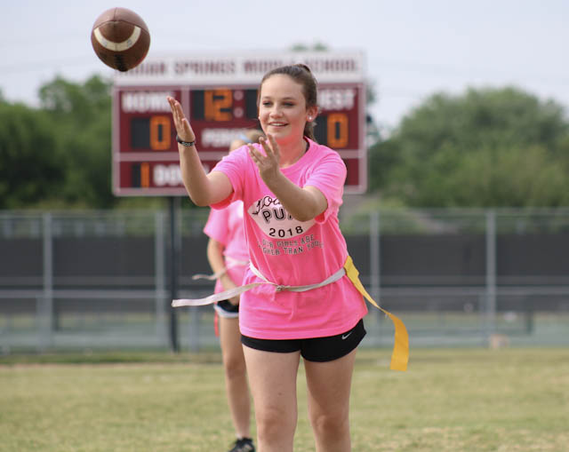

Think you have what it takes to
Join 7th & 8th Grade STUCO?
Come Check Us Out & Have some POPSICLES with us!
7/8 StuCo Information Meeting
Tuesday, May 15th | 4:00-4:30 pm
Mrs. Goree’s Room #102
All incoming 7th & 8th graders welcome!!!
*We will hand out early STUCO applications this Friday, May 11th in Flight classes. Or you can pick up in Front Office!

Slide 3
What is StuCo?
StuCo is a student-based civic organization designed to help promote school spirit and leadership among students.
Our main goal is to foster positive student/faculty relationships and improve school morale.

Slide 4
So What does StuCo Do?
Pep Rallies- plan agenda & pep rally games
Fundraisers- partner with other clubs for the winter holidays & partner with the Keller Community Storehouse
Trunk-or-Treat- plan & organize our annual Trunk-or-Treat for our younger ISMS students
Teacher Appreciation- promote positive student-teacher relationships through small acts of kindness throughout the year, Secret StuCo dedicated to each teacher

Slide 5
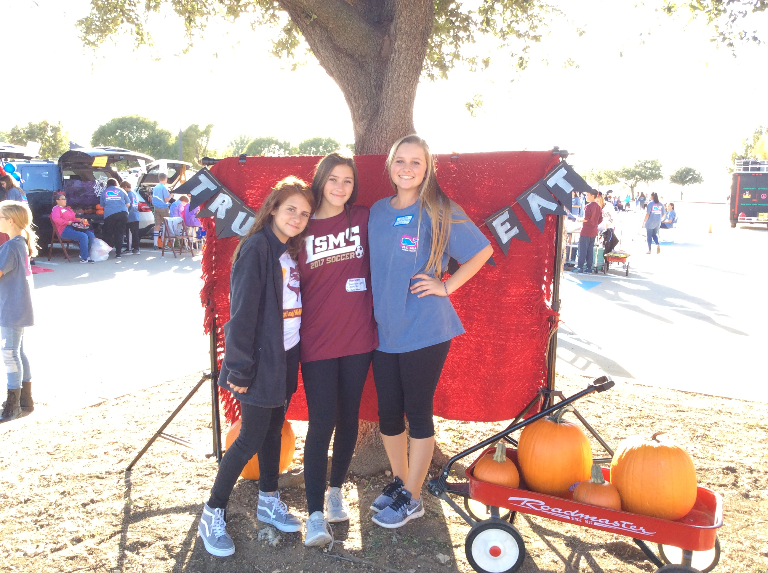
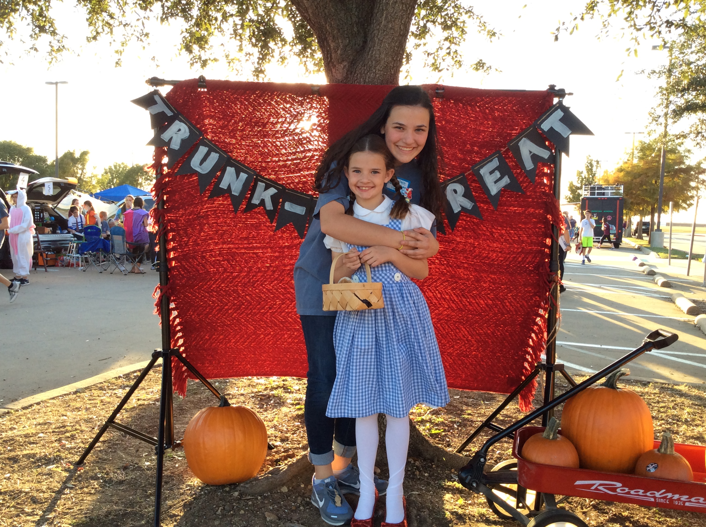
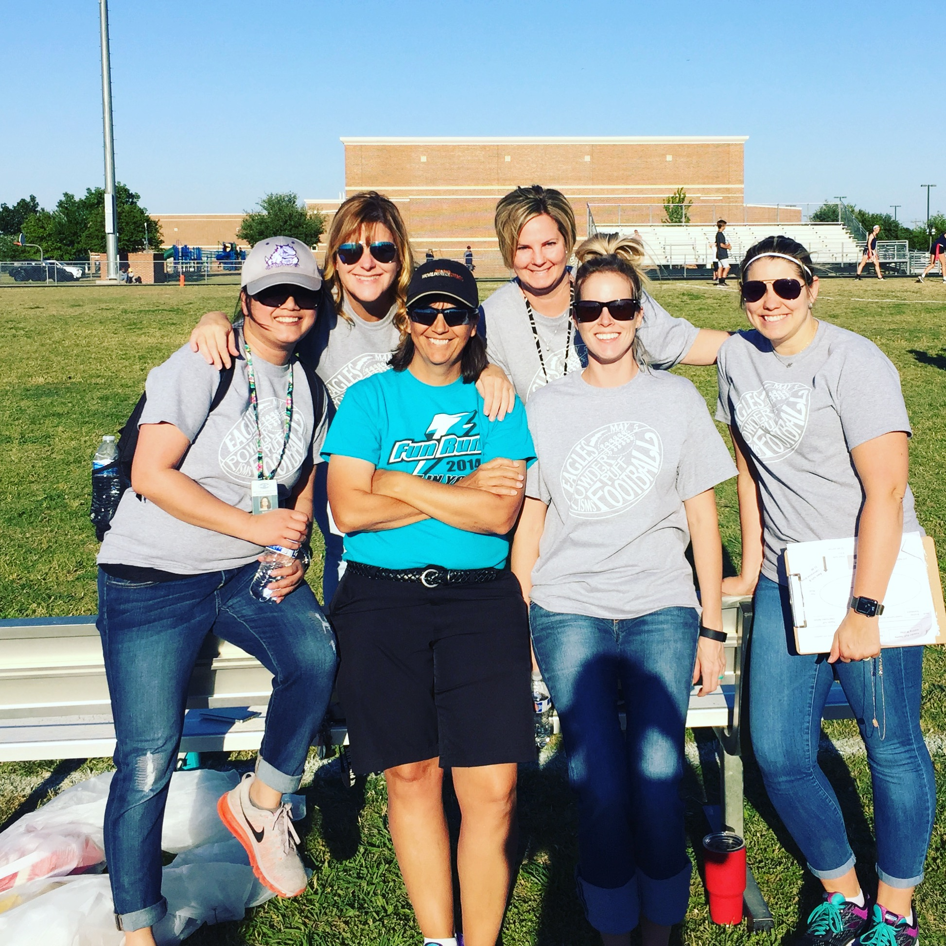
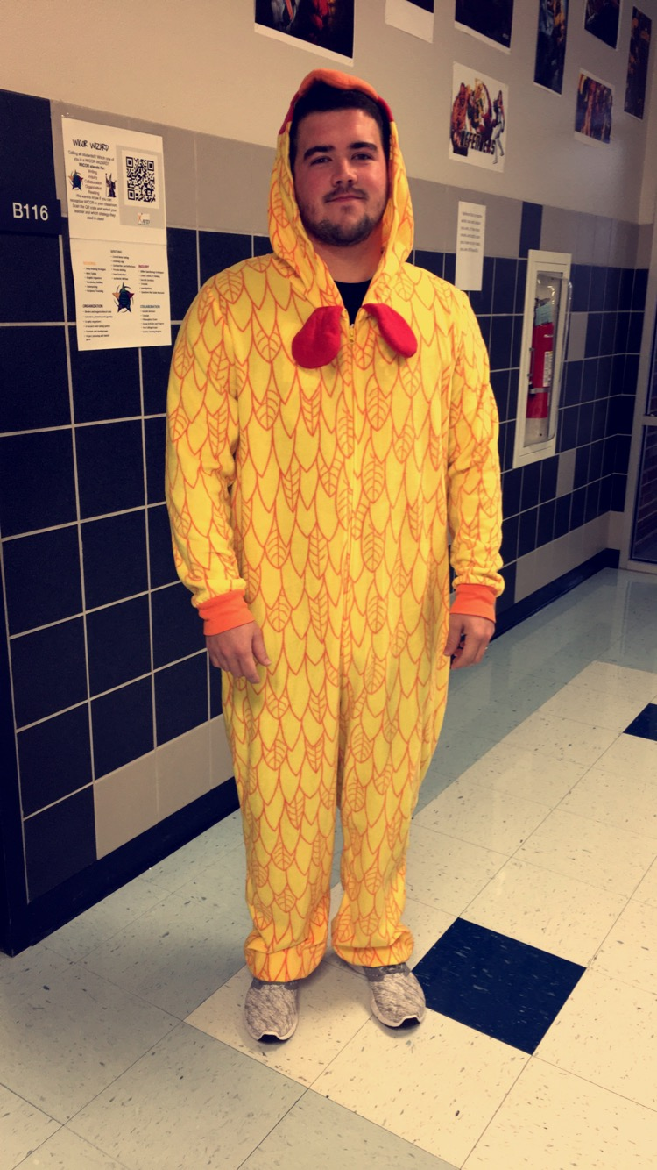
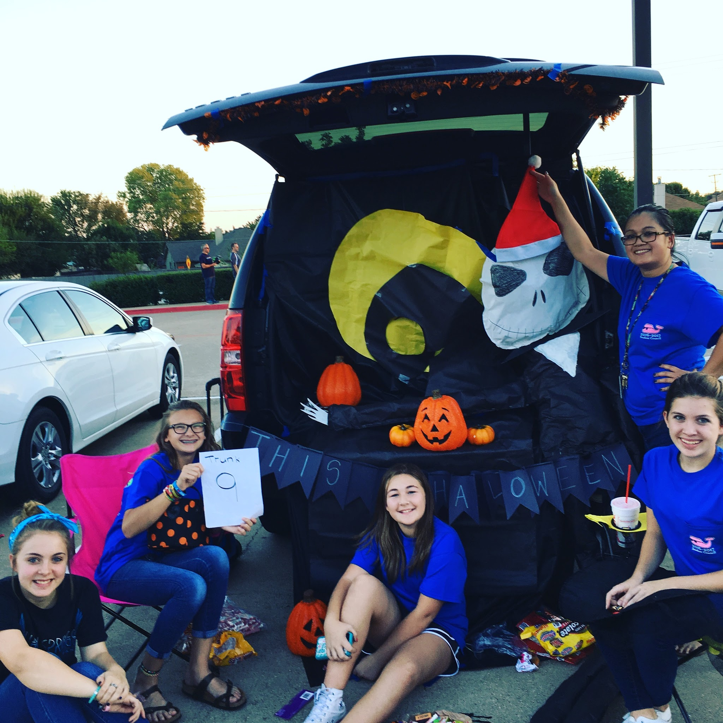
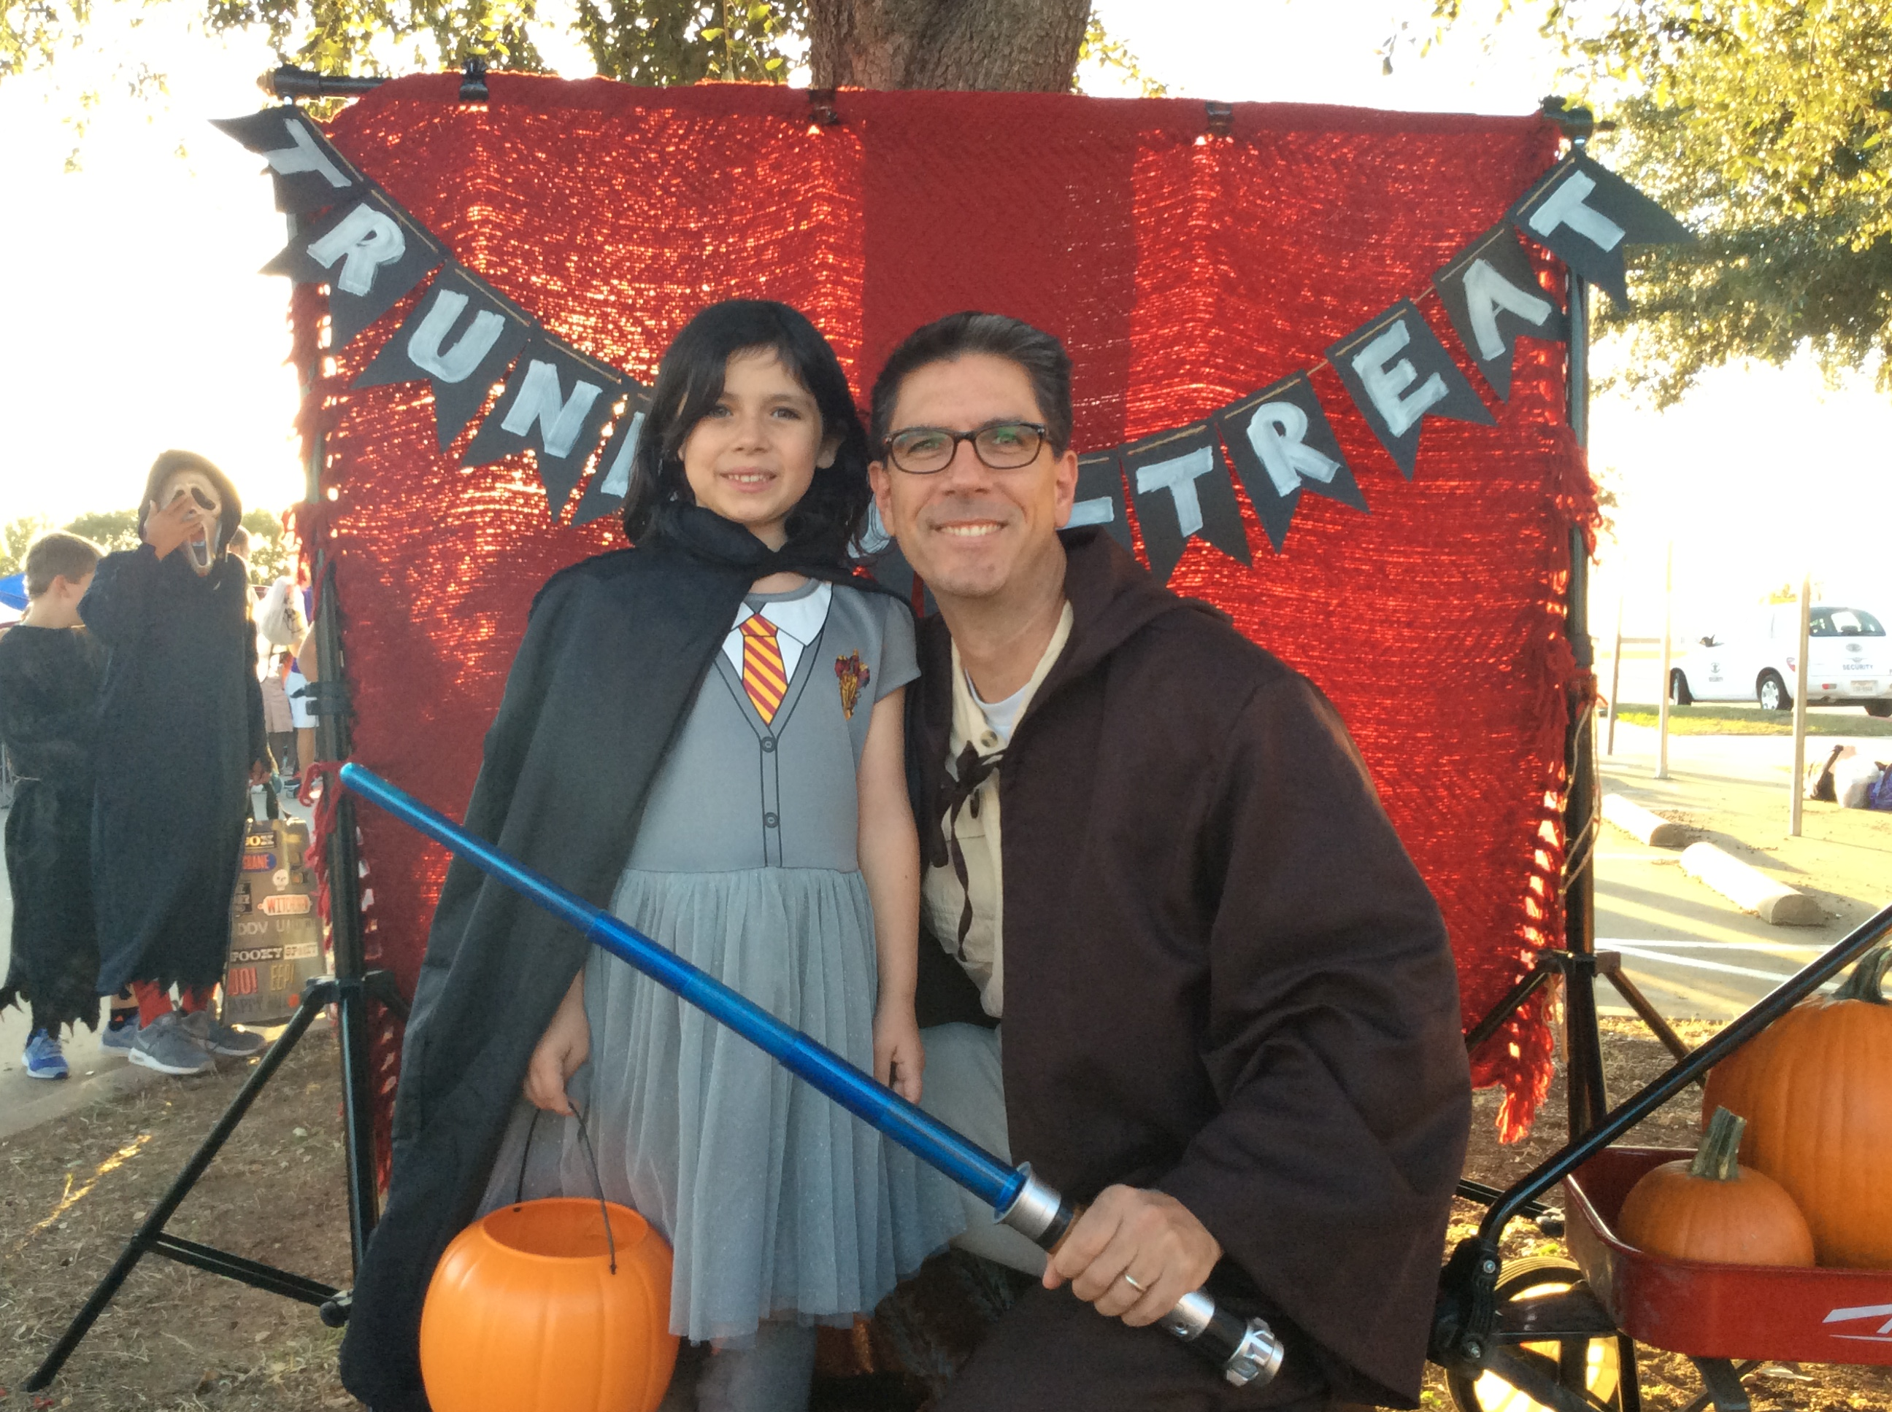
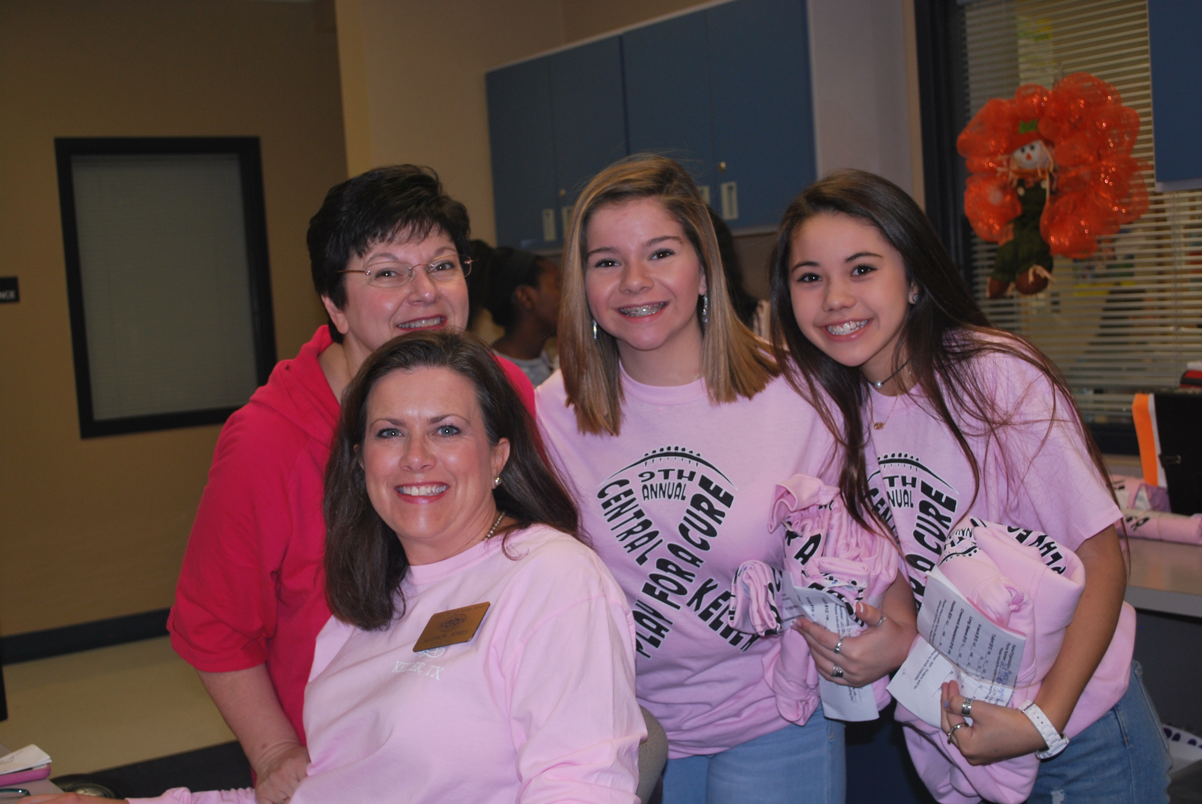
So What does StuCo Do?

Slide 6
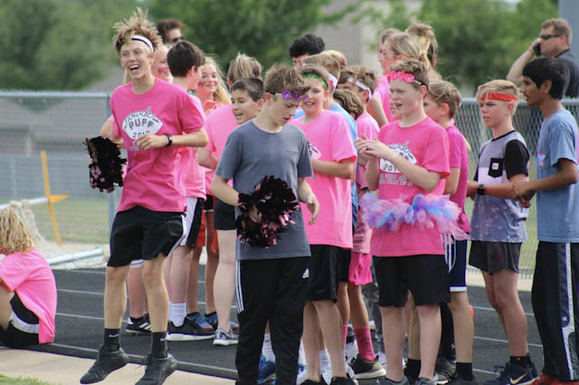
So What does StuCo Do?
Community Service Hours- 20 service hours per year
Powder Puff Football Game- plan & organize our annual Powder Puff Fundraiser, proceeds supports the entire school

Slide 7
Early Application
Allows you to get your application in before the start of 2018 hectic school year!
No worries next year that your forgot to turn in your application!
You can get teacher recommendations from teachers who know you well!
Applications will be processed & FINISHED at the beginning of next school year
  Membership Fees ($30 approximately) have to be paid in full for membership to be offered to prospective student
  Membership Fee includes mandatory StuCo T-shirt & covers activity costs

