Slide 1

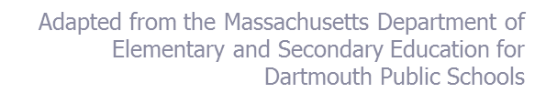
Overview:
The Massachusetts Framework for Educator Evaluation
DARTMOUTH PUBLIC SCHOOLS
September Early Release Day
Notes:
Massachusetts Department of Elementary and Secondary Education
1

Slide 2
DARTMOUTH PUBLIC SCHOOLS
The purpose of the new educator evaluation tool is to increase student achievement, to do this the process needs to be meaningful, streamlined, transparent, and manageable for the educator and evaluator.

Slide 3
Intended Outcomes
Participants will have a clear understanding of the educator evaluation framework, including:
  Performance Standards & Indicators
  5-Step Cycle of Evaluation
  Self Assessment Process
  Development of S.M.A.R.T. goals
    Professional Practice Goal
    Student Learning Goal
3
Adapted from the Massachusetts Department of Elementary and Secondary Education for
Dartmouth Public Schools
Notes:
Massachusetts Department of Elementary and Secondary Education
3

Slide 4
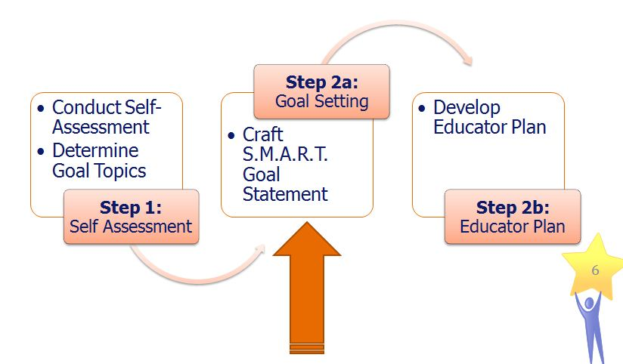
Today’s focus is…
4

Slide 5
Everyone earns an overall rating.
Summative
Performance Rating
Exemplary
Proficient
Needs Improvement
Unsatisfactory
What is new?
Student learning has been embedded into standard 2
as a new indicator:
Student Learning
Demonstrates expected impact on student learning
based on multiple measures of student learning, growth,
and achievement. (For teachers who are responsible for
direct instruction, these measures must include student progress on common assessments and, where available, statewide student growth measures.)
A Student Impact rating is no longer a component of the overall rating
Notes:
Let’s begin with the end. As a result of this new evaluation framework, everyone will earn an overall rating: a Summative Performance Rating of either Exemplary, Proficient, Needs Improvement or Unsatisfactory.
One critical change this year is the removal of student impact ratings an overlay to the Summative Performance rating. This year DESE has removed this requirement and replaced it with a Student Learning Indicator within Standard 2.

Slide 6
Performance Standards and Indicators
I. Curriculum, Planning, & Assessment | II. Teaching All Students | III. Family & Community Engagement | IV. Professional Culture
Curriculum and Planning Subject Matter Knowledge Child and Adolescent Development Rigorous Standards-Based Unit Design Well-Structured Lessons B. Assessment Variety of Assessment Methods Adjustments to Practice C. Analysis Analysis and Conclusions Sharing Conclusions with Colleagues Sharing Conclusions with Students | Instruction Quality and Effort of Work Student Engagement Meeting Diverse Needs B. Learning Environment Safe Learning Environment Collaborative Learning Environment Student Motivation C. Student Learning D. Cultural Proficiency Respects Differences Maintains Respectful Environment E. Expectations Clear Expectations High Expectations Access to Knowledge | A. Engagement Parent/Family Engagement B. Collaboration Learning Expectations Curriculum Support C. Communication Two-Way Communication Culturally Proficient Communication | Reflection Reflective Practice Goal Setting B. Professional Growth Professional Learning and Growth C. Collaboration Professional Collaboration D. Decision-making Decision-Making E. Shared Responsibility Shared Responsibility F. Professional Responsibilities Judgment Reliability and Responsibility
Notes:
As part of the Model System, DESE developed performance rubrics that incorporate the four Standards of practice and each corresponding Indicator. In order to further define what effective practice associated with each Indicator looks like, the Model System Teacher Rubric, which you see here, breaks the Indicators down further into specific, concrete elements of practice. Again of note this year is the inclusion of the student learning indicator within Standard 2.
6

Slide 7
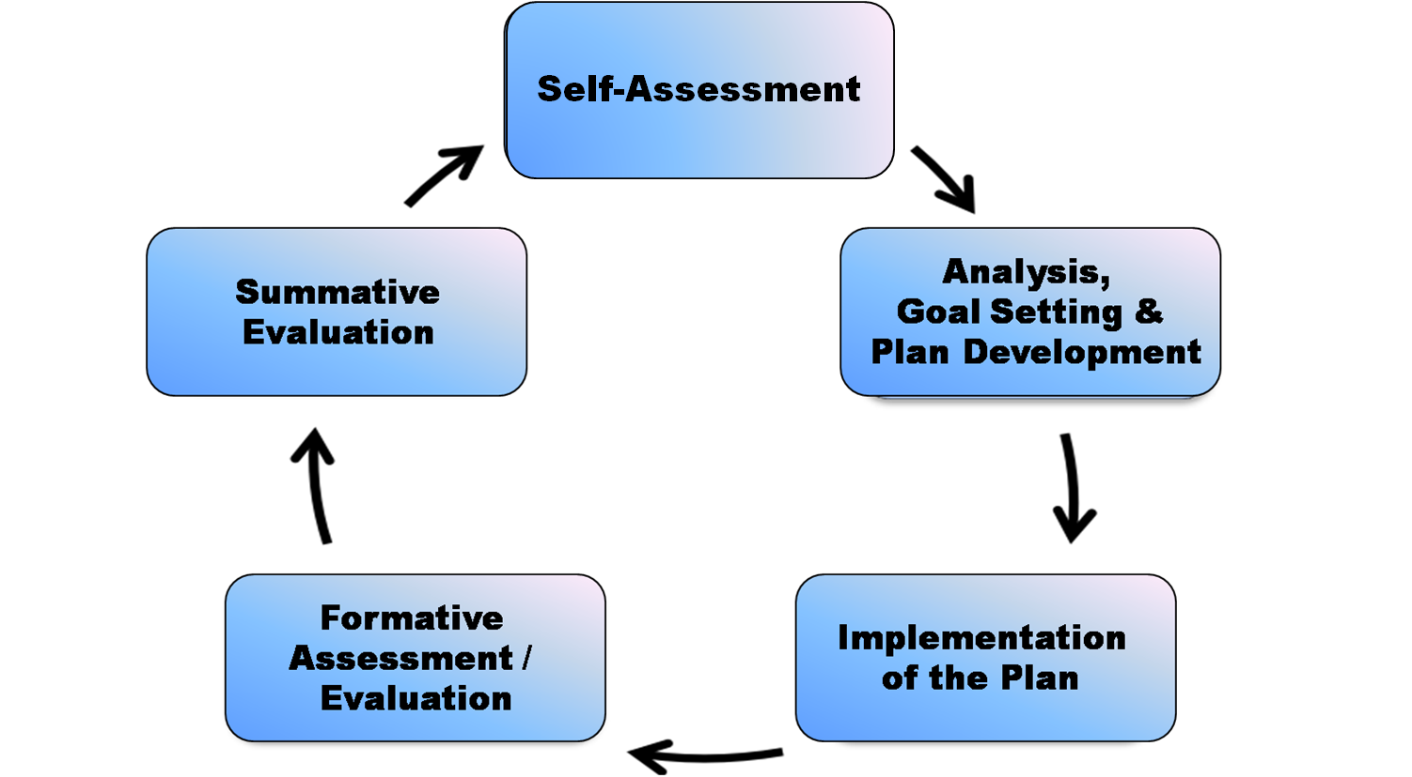
5 Step Evaluation Cycle
Continuous
Learning
Educators on a Developing Educator Plan or those in Year 1 of a 2-year plan must submit their self-assessment and proposed goals to evaluators by October 1st.
Educators in Year 2 of a 2-year plan who wish to modify goals
should submit these adjustments to evaluators by October 1st.
Massachusetts Department of Elementary and Secondary Education
Notes:
The 5-Step Cycle is designed to ensure that the educator is an active participant throughout his or her evaluation and is driving the very process forward. Each step is designed to capitalize on collaboration and promote continuous learning.
7

Slide 8
Educator Evaluation: Developing Educator Plan
Self Assessment
Educator Plan Development & Goal Setting
Implementation of Plan & Collection of Evidence
Formative Evaluation
Summative Evaluation
September
Sept - Oct
Oct - May
Jan - Feb
May - June
Teacher self-assesses and proposes goals
Educator Plan is determined that includes Goals and Actions
Educators implement the Plan; both Educator and Evaluator gather evidence
Evaluator assess/evaluates Educator progress; mid-cycle or on-going
Evaluator determines rating on each Standard and Overall Rating
Educator Evaluation: 2-Year plan
Self Assessment
Educator Plan Development & Goal Setting
Implementation of Plan & Collection of Evidence
Formative Evaluation
Summative Evaluation
Sept. Yr. 1
Sept – Oct. Yr. 1
Oct. Yr. 1 – May Yr. 2
May-June Yr. 1
May – June Yr. 2
Teacher self-assesses and proposes goals
Educator Plan is determined that includes Goals and Actions
Educators implement the Plan; both Educator and Evaluator gather evidence
Evaluator evaluates performance and progress at end of Year 1
Evaluator determines rating on each Standard and Overall Rating

Slide 9
Self-Assessment Components
Self-assessment must include:
“an analysis of evidence of student learning, growth, and achievement for students under the educator's responsibility;
an assessment of practice against Performance Standards; and
proposed goals to pursue to improve practice and student learning, growth, and achievement”
    Student learning goal; and
    Professional practice goal
Notes:
Explain:
“Educators can start their self-assessment at the end of the previous school year and/or at the very beginning of the new school year, keeping in mind that some data won’t be available until the beginning of the new school year.
“One component of a comprehensive self-assessment calls for educators to conduct an analysis of student learning, growth and achievement. During this part of the self-assessment, educators collect and analyze a wide range of evidence of student learning (e.g. readiness, academic achievement, social-emotional learning) related to both their incoming students and students they have taught in the past.
“A second component of the self-assessment involves educators assessing their own professional practice against the Standards and Indicators of Effective Teaching Practice and/or Administrative Leadership, as outlined in the rubrics. Educators identify performance standards, indicators and even behaviors from the rubric where they excel, as well as areas where they need to improve their practice in order to facilitate student learning.
“Finally, based on this analysis of student learning and assessment of practice against Performance Standards, each educator proposes goals.”

Slide 10
Sources of Data
Consider the following questions:
  What improvement objectives are identified in our SIP?
  What types of data are available for your students?
  Based on this analysis, what types of “student learning needs” might you focus on in the coming year?
Massachusetts Department of Elementary and Secondary Education

Slide 11
Let’s begin…
In teacher teams, identify the following:
  Data and other evidence of student learning, growth, and achievement
  Evidence of professional practice
Discuss ways in which individual teachers and teacher teams can access, analyze and, interpret this data.
Brainstorm goals with your team.
Massachusetts Department of Elementary and Secondary Education

Slide 12

Materials
Goal Statement Templates (provided at training)
  Professional Practice Goal
  Student Learning Goal
Evaluation Rubrics (please bring your rubric)
  Classroom Teacher
  (Librarians, ELA/Math Specialists, ELL Tchrs.)
  SISP
  (Nurses, OT/PT/SLP, SW/Psych., Coaches – ELA/Math/IT)
Massachusetts Department of Elementary and Secondary Education
Notes:
Massachusetts Department of Elementary and Secondary Education
12

Slide 13
The Power of Concentrated Action
District Goals
School Goals
Team Goals
Teacher Goals

Slide 14
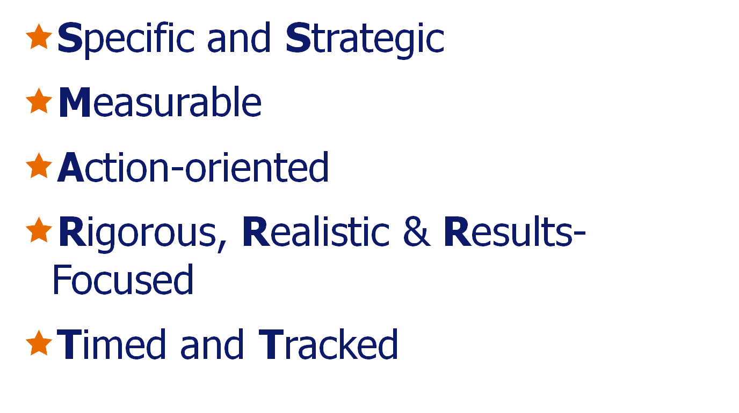
What makes a goal S.M.A.R.T.?
*Does not need to be in this order.
Notes:
Try to start with the end in mind when developing your goals. Fast forward to your end of year meeting when you will submit evidence towards progress on y our goals and consider what evidence you would utilize. This will help a great deal in developing goals which are measurable, realistic and results-focused.

Slide 15
Breaking down S.M.A.R.T…
Why is this topic/focus important? STRATEGIC
What/who will benefit and how? SPECIFIC, RIGOROUS, RESULTS-FOCUSED
When will I achieve this goal? REALISTIC, TIMED
How will I demonstrate progress toward this goal? ACTION-ORIENTED, TRACKED
How will I know the goal has been achieved? MEASURABLE

Slide 16
Two Types of Goals
Professional Practice Goal
  Focus on your professional growth opportunity – what do you, as an educator, want to get better at or learn more about?
    If I achieve this goal, how will it improve my professional practice and knowledge?
    No requirement to connect to student learning goal
Student Learning Goal
  Focus on the needs of the students – what’s the greatest area of need for support?
    All students? Subset of students?
    What’s my history of supporting students in this area?

Slide 17
Professional Practice Goals

Slide 18
Identify/Clarify a focus or goal topic
Draw upon specific Indicators or elements from your performance rubric. INDIVIDUAL or TEAM Goal?
Why is this topic/focus important?
Strategic
Draft Initial Goal Objective [bullets or phrases]
What skills, knowledge, or practice will I/we acquire or develop through achieving this goal?
Specific, Rigorous, Results-Focused
When will I/we achieve this goal? Agree on 1 or 2 year time period. Consider how this will affect the scope of your goal.
Realistic, Timed
How will I/we demonstrate progress toward this goal?
Action oriented, Tracked
How will I/we know the goal has been achieved?
Measurable
Draft Final Goal Statement
[Draw from responses to Prompts #1-5]

Slide 19
Student Learning Goals

Slide 20
Identify/Clarify a focus or goal topic
Area of student learning, performance, behavior, etc.
INDIVIDUAL or TEAM Goal?
Why is this topic/focus important?
Strategic
Draft Initial Goal Objective [bullets or phrases]
What students (subgroup, class, grade span, etc) are the focus of this goal?
Specific, Rigorous, Results-Focused
When will I/we achieve this goal? Agree on 1 or 2 year time period. Consider how this will affect the scope of your goal.
Realistic, Timed
How will I/we demonstrate progress toward this goal?
Action oriented, Tracked
How will I/we know the goal has been achieved?
Measurable
Draft Final Goal Statement
[Draw from responses to Prompts #1-5]

Slide 21
Educators on a Developing Educator Plan or
those in Year 1 of a 2-year plan must submit
their self-assessment and proposed goals
to evaluators by October 1st.
Educators in Year 2 of a 2-year plan who wish
to modify goals should submit these adjustments to evaluators by October 1st.
Thank you!

