Slide 1


How to change your panthernet id
Craven Community College
Rocky Patacsil

Slide 2



Slide 3
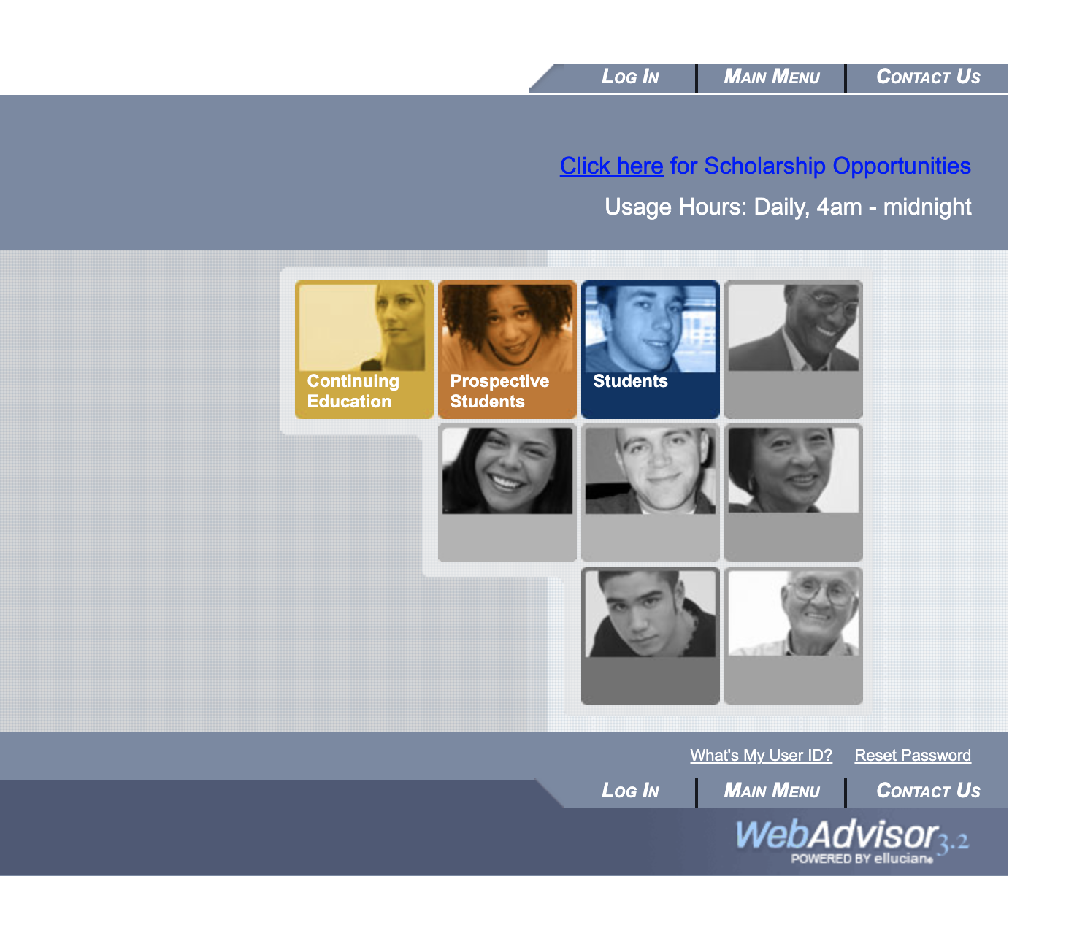


Slide 4
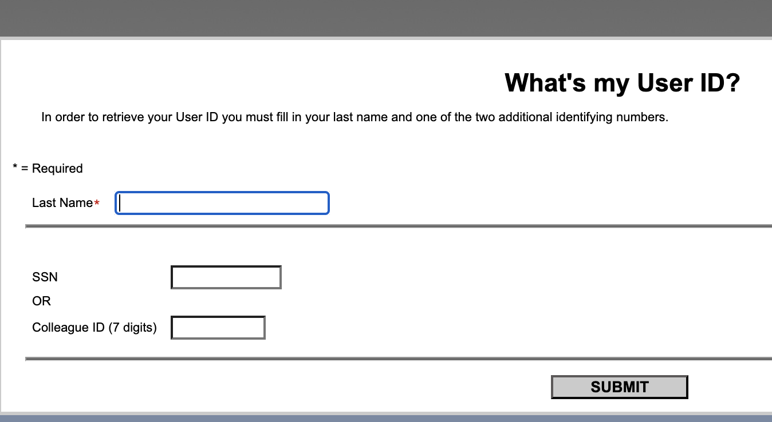

Slide 5
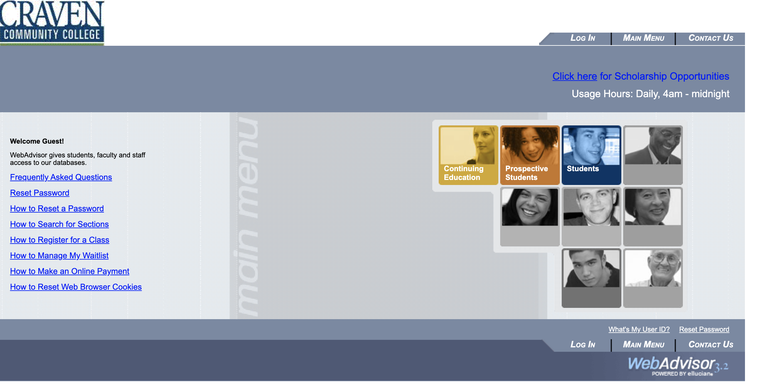


Slide 6
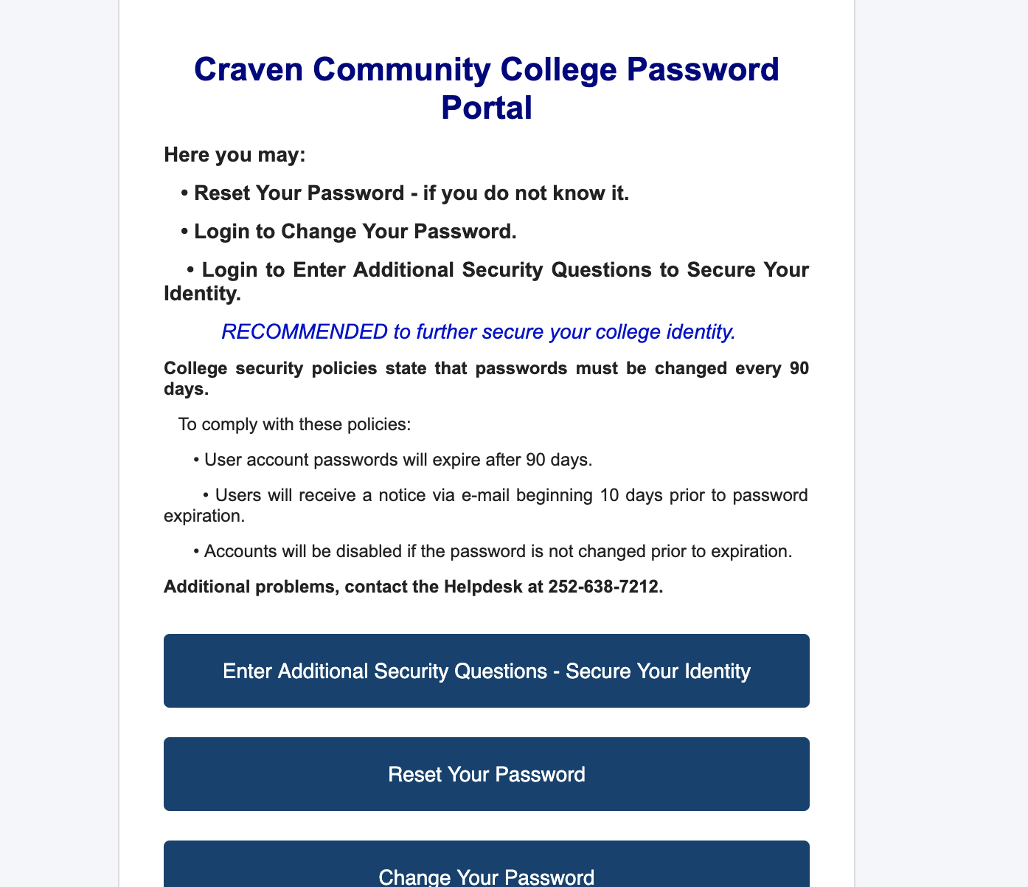


Slide 7
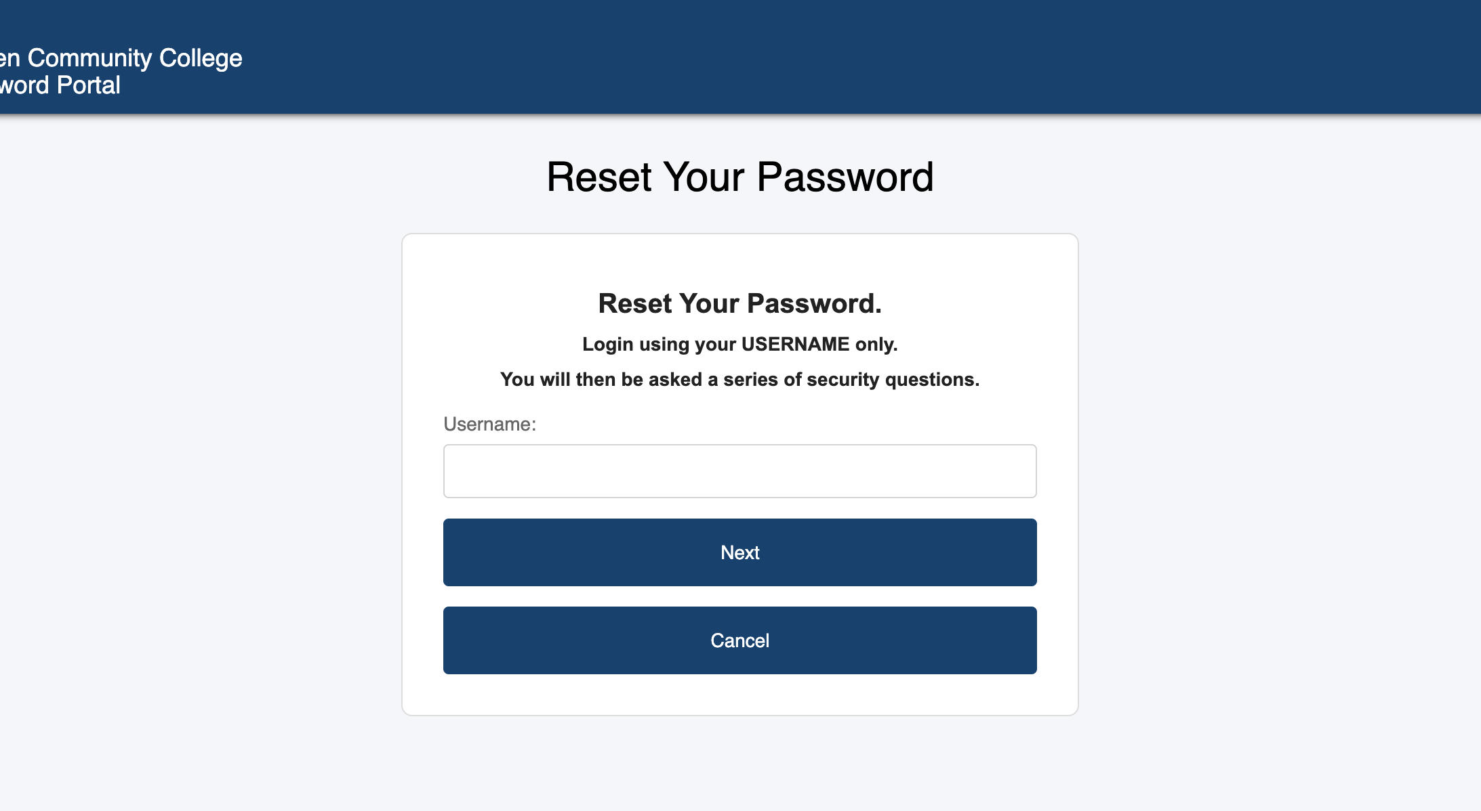

Slide 8
