Slide 1
Griffith Public Schools Promise
Griffith Public Schools Financial Update and Strategic Plan
April 2020
Presented by Michele Riise, Superintendent
Meghan Damron, Director of business services
Matthew Ruess, Vice President, Raymond James & Assoc., inc

Slide 2
Agenda
Financial History 2015-2019
Steps Taken to Date
Current Situation – 2020 Budget
Solutions
GPS Promise – Strategic Plan

Slide 3
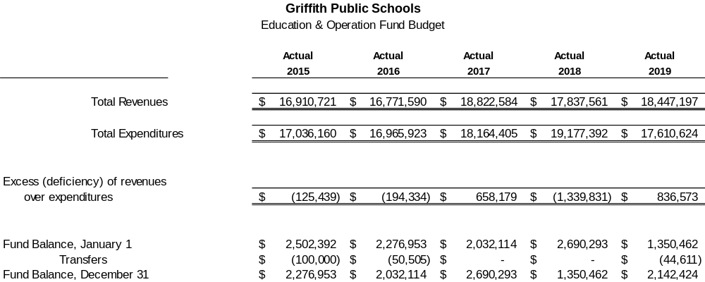
Financial History 2015-2019

Slide 4
Financial History 2015-2019

Slide 5
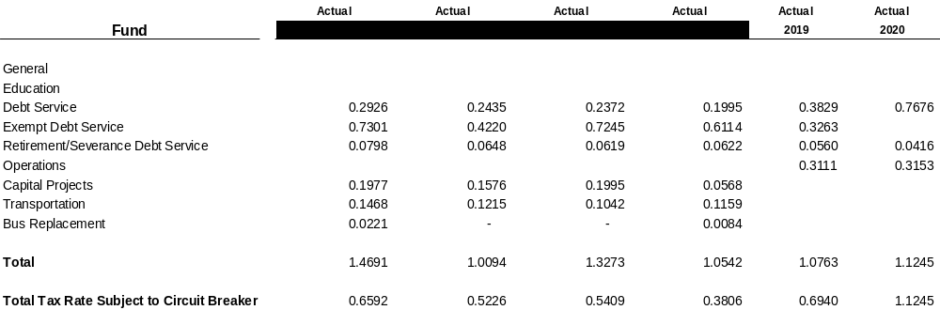
Financial History 2015-2019

Slide 6
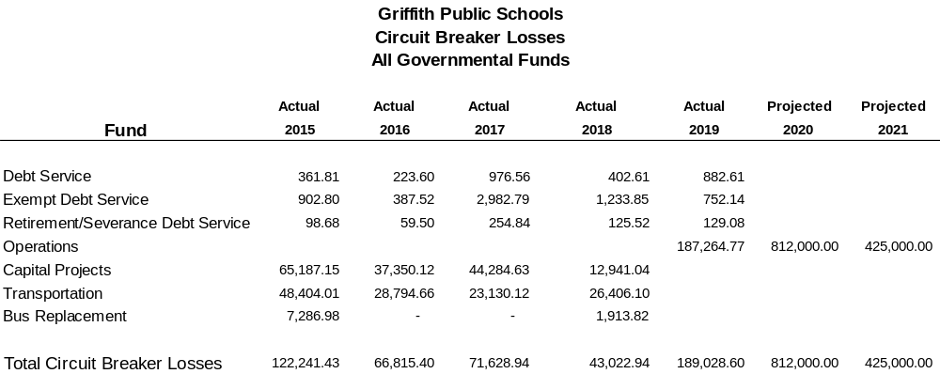
Financial History 2015-2019

Slide 7
Current Situation/2020 and Future Budget
One time transfer from Rainy Day $395,703
One time transfer from Old Health Insurance Fund $449,899
Budget Reduction from Operations Fund of $971,602
                Total $1,817,204

Slide 8
Griffith Public Schools Promise
Griffith Public Schools Graduate Portraiture
Upon graduation, Griffith Graduates will be/will be able to:
  Problem Solve
  Manage time well
  Adapt to any situation
  Exhibit organizational skills
  Utilize proper grammar when communicating
  Self-regulate
  Form relationships both personal and professional, as well as with the community

Slide 9
Griffith Public Schools
  Collaborate with others
  Innovate and are visionary
  Critically think
  Creative
  Utilize technology in order to learn, understand, and apply the skills of informational, media, and technology literacy
  Persevere with determination, intrinsic motivation, tenacity, and socially/emotionally
  Communicate with various avenues, such as written, digitally, non-verbal, and verbal
  Lead and exhibits responsibility, accountability, professionalism, and with integrity
  A Gateway in the areas of ELA/Math, Career Exploration, Pathway Components, and Foundational Skills via Student Agency

Slide 10
Griffith Public Schools Promise
4 Focus Areas
  Students
  Teachers/Counselors
  Parents
  Central and Building Administration/Directors

Slide 11
Griffith Public Schools Promise
Focus Area: Students
  Goal: Project Based Learning
      Classroom Environments with flexible seating choices for collaboration and working alone
      STEAM Integration
      Makerspace Areas within all buildings
  Goal: Self-advocacy and Student Ownership
      Collaboration
      Feedback

Slide 12
Griffith Public Schools Promise
    Social/Emotional Development
    Student Agency
    Goal Setting and Tracking Progress and Mastery
Goal: Community Based – Student Led Service Projects
    Career Pathway Development, Exploration and Experiences
    Partnerships with businesses to create places where work based learning, internships, and observations can occur for students
Goal: Mastery of Grade Level Touchstones

Slide 13
Griffith Public Schools Promise
Focus Area: Teachers/Counselors
  Goal: Clear, effective, and consistent Communication
    Schoology – Common Learning Management System
    Collaboration
    Annual Meetings with parents regarding Graduate Touchstones for grade level
  Goal: Opportunity for Grade Level/Counselor Collaboration that fosters district continuity and consistency
    Ongoing Professional Development
    Graduate Touchstones defined by grade level
    SEL Development of K-12 Curriculum

Slide 14
Griffith Public Schools Promise
    Project Based Learning
    Instruction is Differentiated and Personalized for all students
    Master of Content Assessment
    Diversity Training
  Goal: Teacher Ownership in Meeting the Needs of All Learners
    Collaboration
    Co-Teaching
    Social/Emotional Development and Learning

Slide 15
Griffith Public Schools Promise
Focus Area: Parents
  Goal: Positive, Team Building Approach with District Staff
    Relationship Healing
    Community Stakeholder Meetings
    Communication
    Customer Service Training
  Goal: Parent-Child Ownership
    Attendance

Slide 16
Griffith Public Schools Promise
    Work Completion
    Behavior
    Graduate Portrait/Portraiture
    Grade Level Touchstones
  Goal: Student and Parent Involvement
    Parent Technology Support
    Schoology – Common Learning Management System
    Social/Emotional Development and its impact on student learning

Slide 17
Griffith Public Schools Promise
Focus Area: Central and Building Administration/Directors
  Goal: Staff Evaluations
    Grade Level Touchstones
    Focus on Teaching and Learning
    Goals outlined in Strategic Plan
    Classroom Environments
      Differentiated
      Personalized
      Flexible Seating Options
      Surprise and Delight Opportunities for Students
      Project Based
      Blended Learning
    Active Learner in Professional Development

Slide 18
Griffith Public Schools Promise
  Goal: Communication
    Surveys
    Schoology
    Social Media
    Message Alert System
  Goal: Relationship Building with all stakeholders
    Customer Service and Diversity Training
    YMCA partnership
    Virtual Board of School Trustees Meetings
    Parent Communication
    Building and Corporation Level Stakeholder Groups

Slide 19
Griffith Public Schools Promise
  Goal: STEAM Integration
  Goal: Career Development and Exploration
  Goal: Creation of K-2 Building and 3-5 Building
    Consistency
    Financial Benefits
    Staffing
    Transportation

Slide 20
Griffith Public Schools
Griffith Public Schools’ Board of School Trustees and I believe strongly that success does not happen by accident. Change does have to occur. The connection of all of our focus areas within this Promise are vital components to who we are, what we stand for, what we strive to become, and how we will get there.
This is an exciting time for Griffith Public Schools. We are proud to extend Griffith Public Schools’ tradition of excellence to meet today’s challenges through academic and personal achievements in partnership with our students, families, our community’s future, and our world’s future.
We want to make an impactful difference in our children’s todays and tomorrows!

Slide 21
Steps Taken to Date
District Wide Staffing Reductions
Contract Reviews in District
Leaving NISEC (Done for the betterment of our students, but still helped with some savings)
Moving towards more electronic district (Paper usage cuts)
Grant Money
LED Lighting
Cell Tower Revenue
Textbook Fees

Slide 22
Solutions
Transportation and School Start Time Changes
  Route Pick up and Drop Off Times will be the same for all students. Centralized location will be utilized for elementary students who ride buses to “catch” the bus to his/her school.
  All buses will arrive to MS/HS at 7:30am. MS/HS students will enter MS/HS at 7:30am. Elementary students will be let off at 7:35am to catch the bus to his/her school.
  MS/HS will start at 7:45am.
  Elementary will start at 8:05am.
  Elementary will be dismissed at 2:25pm.
  MS/HS will be dismissed at 2:45pm.

Slide 23
Solutions
Benefits of Transportation and Schedule Change
  Less of a childcare need for families
  Same pick up and drop off times for families
  After-school activities and programs, as well as athletics
Cost to District
  Additional Bus for Transportation at approximately $75,000

Slide 24

Solutions
Eldon Ready School will be the home to Crossroads YMCA.
  Much like Griffith Public Schools, Crossroads YMCA operates on important core values and mission with a focus on strengthening the community.
  Crossroads YMCA is working to change Lake County through leadership in programs that nurture lifelong development of individuals and families.
  YMCA within the current Ready Elementary School will be a community safe place and keep families connected, and help our seniors stay active.
  The YMCA is excited for this partnership with Griffith Public Schools for streamlined opportunities.

Slide 25

Solutions
These opportunities include:
  Additional kindergarten readiness through the Y’s Early Learning Center
  New School Age Programs to support kids and families Before & After School
  Expanded youth sports
  New gymnastics/dance/cheer programs
  Updated Group Exercise Studio/Kids Studios
  Kids cooking classes
  STEAM classes (coincides with STEM initiative from IDOE)
  Leadership Development Center

Slide 26
Solutions
YMCA’s staff strives to be positive role models to our youth. As role models, they can help build character through our programs and combat the growing epidemics of youth obesity, social isolation, anxiety, and depression.
YMCA is a leading nonprofit committed to nurturing the potential of every child and teen, supporting their social-emotional, cognitive and physical development from birth to career.
Financial assistance is available to those in need to ensure that every child and teen has the opportunity to learn and grow at the YMCA.
“Crossroads YMCA is very grateful to Griffith Public Schools, Michele Riise, and the Board of School Trustees for working with the YMCA in this partnership. We look forward to working together and nurturing the lifelong development of individuals and families in the Griffith community.”
-Jay Buckmaster, CEO of Crossroads YMCA

Slide 27
Solutions
Board of School Trustees and I believe that our partnership with Crossroads YMCA will be stronger working together.
  Expansion of programs and activities for not only our students, but their families, and the Griffith community.
  Better utilization of resources while both entities continue to educate and support the whole child.
  Increased accessibility for Griffith residents with this location.
  Provide employee wellness opportunities.
  Total Cost Savings to District: $670,629.66

Slide 28
Solutions
Reconfigure Elementary Buildings
  Movement of 6th grade into GMS
    Increase MS/HS to approximately 1259 students
  K-2 Building – Wadsworth Elementary School
    Approximate enrollment of 457
  3-5 Building – Beiriger Elementary School
    Approximate enrollment of 487 + Additional students in our Exceptional Programs

Slide 29
Solutions
4 Distinct Areas of Benefit with this Change
  Educational Impact
  Consolidation of Resources and Staffing
  Professional Development and Collaboration
  Cost Savings

Slide 30
Solutions
Educational Impact
  There can be a more specific focus on the developmental needs of the children at each of the age levels.
  School routines, assemblies, and activities can be more grade and age focused.
  With multiple classes at a single grade level, there can be more opportunity to distribute students more evenly among classes by academic levels, specific needs, and/or social/behavioral issues.
  It addresses the racial and socio-economic imbalance that currently exists among the schools within the district.
  Parent involvement opportunities can focus more specifically on the developmental stages of the students in each building.
  Enrichment and remediation programming, along with our exceptional programs, will be focused on the developmental and educational needs of 3 grade levels rather than spread among the 7 grade levels.

Slide 31
Solutions
Consolidation of Resources and Staffing
  School staff is able to focus on one specific developmental stage of children’s educational growth.
  In each building, there would be more staff with specialized knowledge and expertise in a specific developmental stage of educational growth.
  Teachers are able to integrate curriculum areas and provide appropriate services for the smaller range of grade levels, such as Special Education and Title services.
  There will be a better balance of class sizes due to a greater concentration of classrooms at each grade level in a school.
  The opportunity exists to maximize building usage which will result in fewer empty classrooms, as these schools have today due to loss of enrollment.

Slide 32
Solutions
Professional Development and Collaboration
  Multiple staff at a single grade level allows for increased collaboration and consistency among staff at the same grade level. This was an area of concern addressed during our community forums this year.
  There is an increased potential for common planning times among same grade level teachers.
  Professional development can be more focused on the educational needs of a special developmental stage.

Slide 33
Solutions
Cost Savings
  A more equalized distribution of students among classes at a single grade level will result in a consolidation of grade level and special area staff.
  The potential exists for fewer teachers who are scheduled to travel among buildings which will result in a saving of time and cost to the district.
  There will be a cost savings on instructional supplies, texts, and library/media materials due to the less need for duplication among the current 3 elementary buildings.

Slide 34
Solutions
Bond Issue
  Operational Expenses in the future are still a concern.
  Facility needs due to Beiriger and Wadsworth Elementary Schools
  Needs addressed within Strategic Plan: Griffith Public Schools Promise

Slide 35
Solutions
Operation Fund Additional Appropriation
  Source of Funds is due to the savings from 2019.
    Facility needs, such as flooring and painting at Beiriger and Wadsworth Elementary Schools
    1 Additional Bus for transportation change
    Flexible Seating Options (Griffith Public Schools Promise)

Slide 36
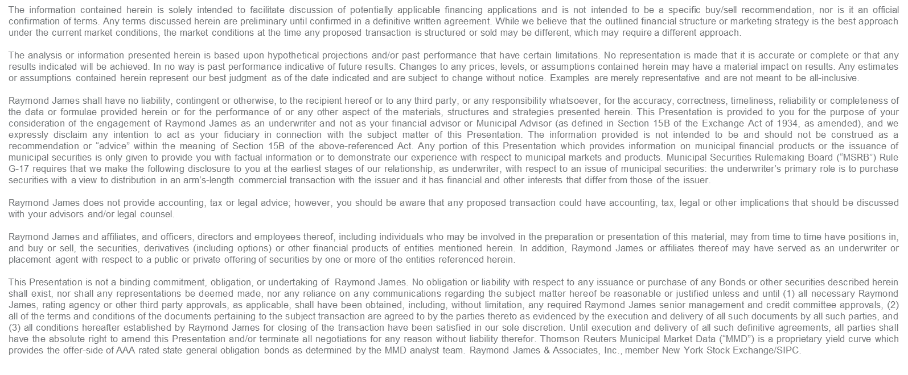
Disclaimer

