Slide 1
Chapter Two
The Constitution

Slide 2
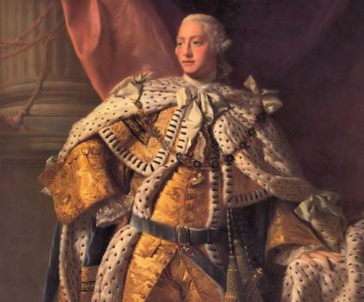
The Problem with Liberty?
The British “Constitution” did not adequately protect the liberties of colonists against abuses of the king

Slide 3
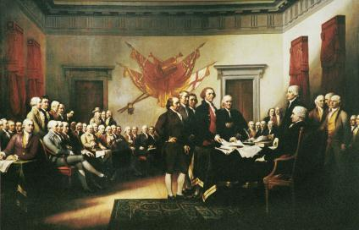
The Problem with Liberty?
The colonial mind
  Belief that corrupt British politicians = inadequate English constitution.
  Natural rights
    Unalienable Rights…
  A war of ideology, not economics…
  Specific complaints against King George III…Declaration of Independence.

Slide 4
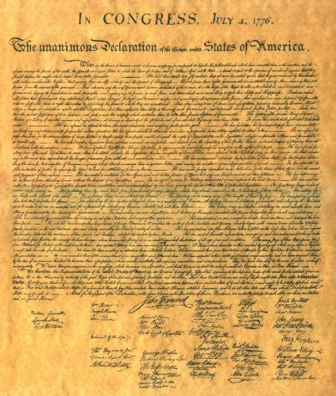
The Problem with Liberty?
The “real” revolution
  Radical change in belief about what made authority legitimate and liberties secure.
  Govt by consent not prerogative
  Direct grant of power to the people…
  Liberty before government…
  Checks and balances

Slide 5
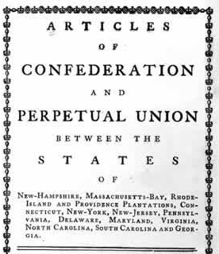
The Problem with Liberty?
Weaknesses of the Articles of Confederation
  Could not levy taxes or regulate commerce
  Individual state sovereignty
  One vote per state in Congress
  9/13 votes to pass any measure
  Delegates picked & paid for by state legislatures

Slide 6
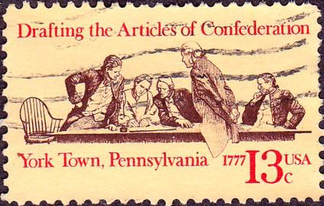
The Problem with Liberty?
Weaknesses of the Articles of Confederation
  No money coined by federal govt
  Army small
  Could not solve territorial disputes between states.
  No federal judicial system
  13/13 states consent required for amendments

Slide 7
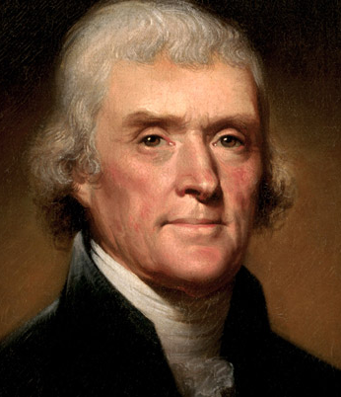
The Constitutional Convention (May 1787)
Lessons of Experience –
  No blueprint in history for the type of govt this new nation was trying to form
  “There is no model, history consist only of beacons of light which give warning of the course to be shunned, without pointing out that which ought to be pursued” ~ Thomas Jefferson

Slide 8


The Constitutional Convention (May 1787)
State Constitutions
  Pennsylvania – too strong, too democratic
    Also rejected by the general assembly in Philadelphia due to disagreement with the Quakers…
  Massachusetts – too weak, less democratic

Slide 9
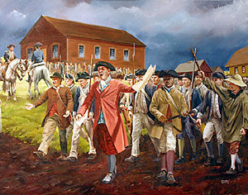
The Constitutional Convention (May 1787)
Shay’s Rebellion – led to the fear that the states were about to collapse. This fear saw to it that the May convention was well attended by delegates from all states (minus RI)

Slide 10
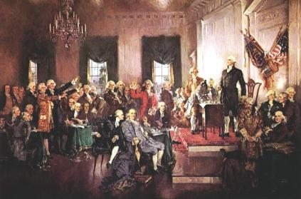
The Constitutional Convention (May 1787)
The Framers
  Who Came?
  Who didn’t attend?
  Intent
  Lockean influence
  Doubts
  Results: “Delicate Problem”

Slide 11
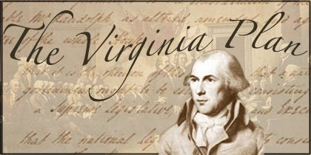
The Challenge
Virginia Plan
  Design for a true national government
  Two house legislature
  Executive chosen by legislature
  Council of revision with veto power
  Two key features
    National legislature with supreme powers
    One house elected directly by the people

Slide 12

The Challenge
New Jersey Plan
  Sought to amend rather than replace the A.o.C.
  Proposed one vote per state in Congress
  Protected small states’ interests
    If presented before the Virginia Plan, the NJ plan may have taken a more prominent place in the convention.

Slide 13
The Challenge
The Great Compromise
  House of Representatives based on population
  Senate of two members per state
  Reconciled interests of big and small states
  Committee of Detail – July 26, 1787 – James Madison and Governeur Morris are charged with drafting the final document including the themes hammered out by the delegates during the convention.
  September 17, 1787 – Constitution is approved by each of the 12 states in attendance in Philadelphia.

Slide 14
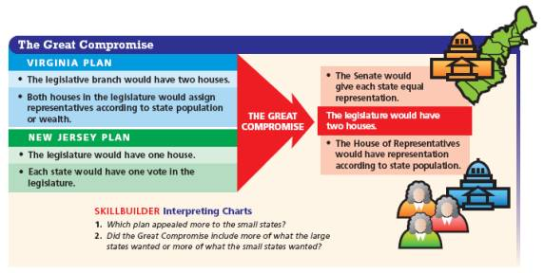

Slide 15
The Constitution and Democracy
Founders did not intend to create pure democracy
  Physical impossibility in a vast country
  Mistrust of popular passions…
  Intent instead to create a republic with a system of representation
Popular rule only one element of the new government
  State legislatures to elect senators
  Electors to choose president
  Two kinds of majorities: voters and states
  Judicial review another limitation…
  Amendment process – relatively difficult process…

Slide 16
Formal Amendment Process
Types of Proposals
Types of Ratification
Proposed by Congress by a 2/3 vote in both Houses
Ratified by State legislatures of ¾ of states
Proposed by a national convention when requested by 2/3 of state legislatures
Ratified by conventions held in ¾ of the States

Slide 17
The Constitution and Democracy:
Key Principles
Separation of Powers – Executive, legislative, and judicial branches each have checks and balances on each other.
Federalism – power is to be shared between the state and national governments. 10th Amendment…
  Enumerated Powers
  Reserved Powers
  Concurrent Powers

Slide 18
The Constitution and Democracy
Government and human nature
  Aristotelian view – govt should improve human nature by cultivating virtue. Before a good government can exist…good people must exist.
  Madisonian view – cultivation of virtue would require a government too strong, too dangerous, self-interest should be freely pursued within reasonable limits.
  Federalism – enables one level of govt to act as a check on the other. All factions can gain some but not total control of government.

Slide 19
The Constitution and Democracy
Antifederalist View
  Liberty could only be strong in small republics
    Big = government too removed from masses
    Strong govt would use its powers to crush states rights
  There should be more restrictions on central government
Madison’s Rebuttle
  Personal liberties safest in large republics
    Coalitions likely to be more moderate
    Government should be somewhat distant from the popular passions of the masses

Slide 20
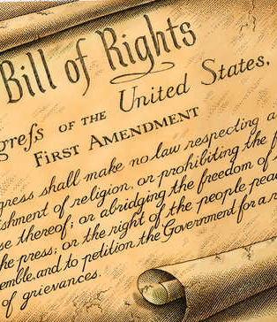
The Constitution and Democracy
Why no Bill of Rights in Original document?
  Habeas Corpus
  No bills of attainder
  No ex post facto laws
  Trial by jury
  Privileges and immunities
  No religious tests
  Obligations of contracts
Most states had a bill of rights
U.S.C intended on limiting the Federal Government…

Slide 21
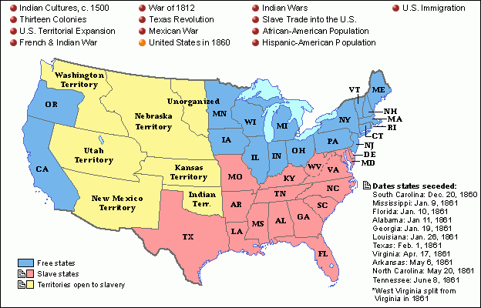
The Constitution and Slavery
Slavery virtually unmentioned
Apparent hypocrisy of declaration signers (All men created equal)
Necessity of compromise…
If the U.S.C took a stance against slavery it would have never passed.
Legacy?

Slide 22
The Motives of the Framers
Economic interests varied widely during drafting
  Beard (1913): those who owned govt debt supported the constitution
  No clear division along class lines found
  Recent research: state considerations outweighed personal considerations: exception – slaveholders
Economic interests and ratification
  Played a larger role
  In favor – merchants, urbanites, owners of western lands, holders of government debt, non-slave owners
  Opposed – farmers, people who held no govt debt, slave-owners
Most definitive factor in whether one voted for or against ratification…
  Federalist or antifederalist

Slide 23
The Motives of the Framers
Constitution and Equality
  Critics: Government today is too weak
    Bows to special intersts
    Fosters economic inequality
    Liberty and equality are therefore in conflict
  Framers more concerned with political inequality; weak government reduces political privilege.

Slide 24
Constitutional Reform – Modern Views
Reduce the separation of powers and enhance national leadership
  Urgent problems remain unresolved…due to gridlock
  President should be more powerful, accountable, to produce better policies
  Government agencies exposed to undue interference from Congress and special interests
  Proposals
    Choose cabinet members from Congress
    Allow President to dissolve Congress
    Empower Congress to require special presidential election
    Require presidential/congressional terms (teaming to ensure like parties)
    Establish a 6 year term for President (single term)
    Lengthen terms in the house to four years
  Counter argument – results uncertain, could make things worse

Slide 25
Constitutional Reform – Modern Views
Less Government
  Government does too much not too little
  Attention to individual wants over general preferences
  Proposals
    Limit amount of taxes collectible
    Require a balanced budget
    Grant president true line-item veto
    Narrow authority of federal courts
  Counter argument – unworkable, or open to evasion

