Slide 1
Chapter Three
Federalism

Slide 2
Governmental Structure

Slide 3
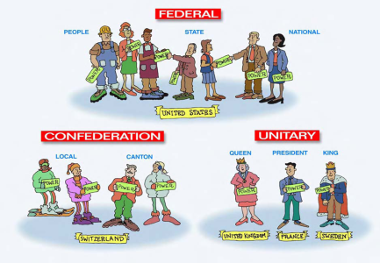
Federalism: Good or Bad?
Definition – Government where power is shared by a central govt and several local govts.
Examples of Federal Govts …
Unitary Government – Power is centralized within the central government and distributed down the chain to citizens.
Examples of Unitary Governments…

Slide 4
How & Why Federalism Works
Special protection of subnational governments (state and local govt)
  Constitution
  Habits and tradition
  Distribution of political power
How – National government sets the standard and relies in large part on the state and local governments to fund and execute the standard.
Negative Views of federalism:
  Blocks progress
  Protects local interests not national interests
Positive Views of federalism:
  Provides strength, flexibility, and liberty.
In general…federalism makes good and bad effects possible in the US.
  Different political groups come to power at different times.

Slide 5
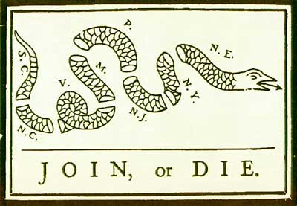
Federalism and Political Activity
Most obvious impact of federalism is that it facilitates mobilization of political activity.
Federalism lowers the cost of political organization at the local level.

Slide 6
The Founding

Slide 7
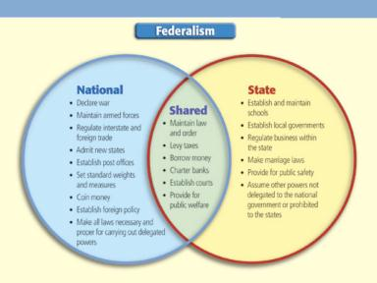
A bold, New Plan
Important note – there is no blueprint for what the framers develop!
Framers believed that neither national nor state government would have authority over the other because power comes from the people who shift their support.
10th Amendment – genius or afterthought

Slide 8
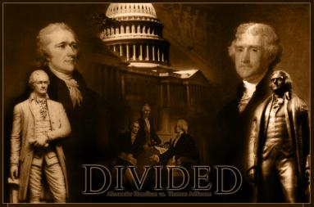
Elastic Language in Article I:
Necessary and Proper Clause
Necessary and Proper Clause says – Congress can make laws it finds “necessary and proper for carrying into execution the foregoing powers”
  Result of the impossibility of precisely defining powers without burning political bridges.
Hamilton – viewed this as a national supremecy due to the Constitution being the law of the land.
Jefferson – states rights ruled the day because people ultimately hold sovereignty.

Slide 9
Debate over the Meaning of federalism

Slide 10
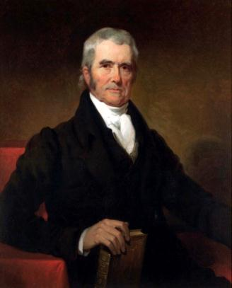
The Supreme Court Speaks
Chief Justice John Marshall – a supporter of Hamilton’s (Federalist) views controls the USSC in the early 1800’s.
McCulloch v. Maryland –
  Could Congress start a bank – yes because of N & P clause of USC Article I.
  Could states tax such a bank? – No because national powers are supreme.

Slide 11
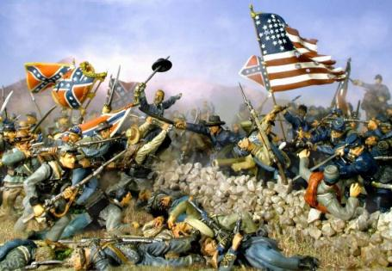
Nullification
Definition – the doctrine that a state can declare null and void a federal law that, in the states opinion, violates the Constitution.
Main question determined by the Civil War. Can a state nullify federal law?
  Answer?

Slide 12
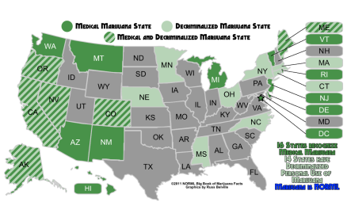
Dual Federalism
Both national and state governments supreme in their own spheres.
  Commerce Clause at the center of this debate post 1864. (Interstate vs Intrastate commerce)
    Early Product-based distinction difficult
    “Original Package” also unsatisfactory.
  Debate rages on today – Medical Marijuana

Slide 13
State Sovereignty
Mistake to think that dual federalism is today entirely dead.
Supreme Court limited the congressional use of the commerce clause, thus protecting state sovereignty under the 10th Amendment.
Supreme Court in Alden v. Maine (1999) upheld the 11th Amendment which, protects states from being sued by citizens from other states or foreign countries
Not all USSC decisions reflect state sovereignty
  Upholding of Obamacare as a tax.
Police Power – state power to enact laws promoting health, safety, and morals.

Slide 14
Federal-state relations
Grants-in-Aid – money given to states by the national government.
Show how political realities modify legal authority.
Began before the Constitution… “land grant colleges” & cash grants
Dramatically increased in the 20th Century
Were attractive for many reasons
  Federal budget surplus (late 19th century)
  Federal income tax arrived in 1920 and brought in more money
  Feds could print money at will (no thought toward inflation yet)
  “Free” money for state officials
Required broad congressional coalitions

Slide 15

Federal-state relations
Meeting national needs: 1960’s saw a shift in grants-in-aid.
  Pre 1960 – what states want/demand
  Post 1960 – What the federal agencies perceived as in the best interest of the nation.
Where do you think most federal grant monies go?

Slide 16
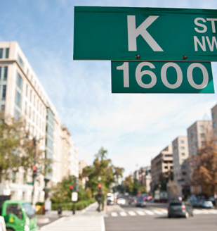
Federal-state relations
Intergovernmental Lobby – consists of governors, mayors, superintendents of schools, state public health directors etc…
Hundreds of state and local officials have offices in DC with the purpose of lobbying.
  Goal – get more money with fewer strings attached.

Slide 17
Federal-state relations
Categorical grants versus revenue sharing
  Categorical Grant – federal grants for specific purposes, such as building an airport. Usually require a state to match the funds put up by the federal government.
  Block grant (revenue sharing) – money devoted to general purposes with few restrictions.
  Revenue sharing requires no matching funds and provides freedom in how to spend.
    Distributed by statistical formula
    Ended in 1986

Slide 18
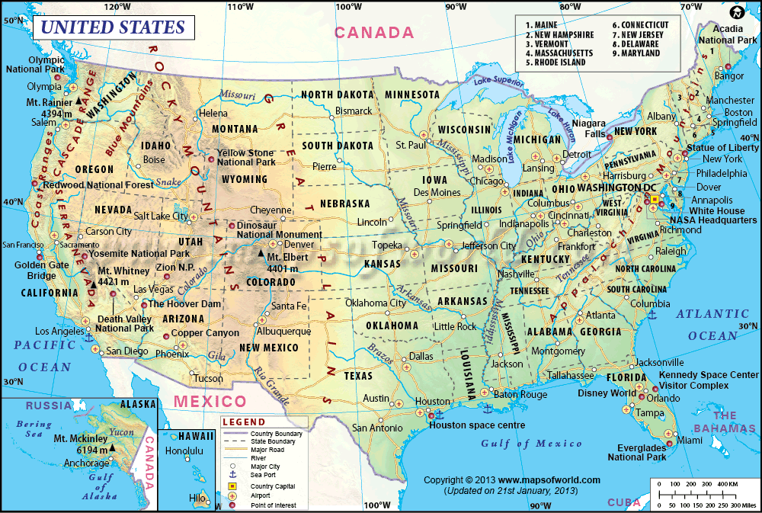
Federal-state relations
State Rivalry
  Increased competition as a result of increased dependency
  Snowbelt versus sunbelt states
  It is hard to tell where the money actually goes.
  It is difficult to tell if federal funds affect growth rates in states.
  Argument centers around the formula used to distribute money
Best data collecting device – US Census

Slide 19
Federal aid and federal control
All Federal money comes with strings.
  Fear – Govt requirements to receive aid would make the 10th Amendment null and void.
  Block grants/ revenue sharing was an attempt to reverse the trend of federal money with strings attached….failed miserably.
Conditions of Aid – terms set by the federal government that states must meet if they are to receive certain federal funds (NCLB).
Mandates – terms set by the national government that states must meet in order to recieve federal grants.

Slide 20
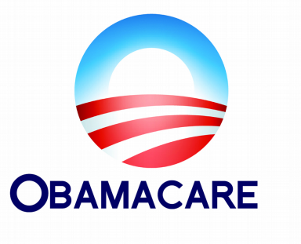
Mandates
Most concern civil rights and environmental issues
Often create admin and financial hardships.
Mandate growth explodes 81-91
Features
Additional Costs
Federal Court Rullings

Slide 21
Conditions of Aid
Received by states voluntarily, in theory
  Financial dependence blurs the theory
  Civil rights generally focus of most important conditions in the 1960s, environmental in the 80s and 90s
  Conditions will range from specific to general
Divergent views of states and federal government on costs, benefits
1980’s – President Reagan challenged Congress to consolidate categorical grants into 6 block grants.

Slide 22
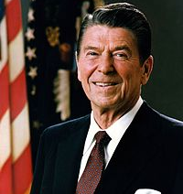
Devolution Revolution
Shift of important functions to states by Republican-controlled Congress in 1994
  Key Issue – Welfare
  1996 Clinton gives control of Welfare to the states.
Devolution – efforts by Congress and President to roll back government control of state issues.

Slide 23
Devolution Revolution
Block Grants for Entitlements
  Most block grants are for operating and capital purposes
  AFDC and Medicaid were made into block grants in the 90s (Republican idea)
  Partial success and possible effects
    AFDC was turned into the Block Grant TANF
    Possible triggering of second-order devolution
    Possible triggering of third-order devolution
    Dramatic decrease in welfare rolls increase in unspent dollars

