Slide 1
Chapter 5
Civil Liberties

Slide 2
Bill of Rights
1st Freedom of Speech, Press, Assembly, & Petition. | 2nd Right to Bear Arms | 3rd Quartering of troops | 4th Searches and Seizures | 5th Criminal proceedings, Due Process, Eminent Domain
6th Criminal Proceedings (speedy trial by jury) | 7th Civil Trials | 8th Prevents cruel and unusual punishment | 9th Enumerated rights | 10th Powers reserved to the states.

Slide 3
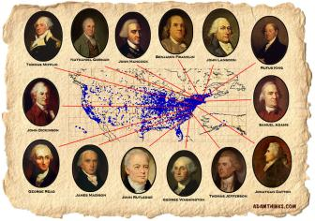
The Politics of Civil Liberties
The objectives of the Framers
  Limited federal powers
  Constitution: List of do’s and do not’s
  Bill of Rights – specific do not’s

Slide 4
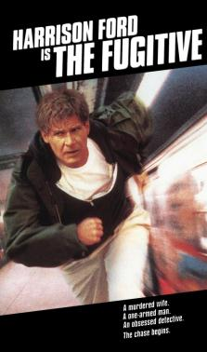
Politics, culture, and civil liberties
Liberties become a major Issue for 3 reasons
#1 – Rights in Conflict
  Sheppard Case
  New York Times & Pentagon Papers
  Kunz anti-Jewish Speeches

Slide 5
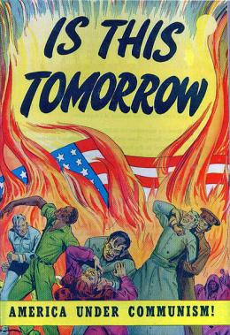
Politics, culture, and civil liberties
#2 Crisis (Never let a good crisis go to waste!)
  Sedition Act 1789
  Espionage and Sedition acts 1917
  Smith Act – WWII
  Internal Security Act of 1950 – Korean War.
  Communist Control Act 1954 - McCarthyism

Slide 6
Constitutional or No?
The Franklin County Court House places a crèche depicting the birth of Jesus from Black Friday through Christmas Day.
Jim Bob frequently posts status updates on Facebook referencing or picturing he and his partner Jason. Jim Bob is subsequently asked by the local Boy Scouts troop, which he is a den leader, to refrain from attending future meetings (in essence he is fired).
Juan’s family moves to East Ja-bip from Venezuela and promptly enrolls him in the local High School. Juan is one of three students who does not have a command of the English language. The school offers no accommodations (ESL services) for these students…(i.e. they are in regular ed classes)

Slide 7
Politics, culture, and civil liberties
#3 Cultural Conflicts
  Original settlement by white European Protestants produced Americanism.
  Waves of immigration brought new cultures & conflicts.
    Non-Christians offended by govt sponsored creches at Christmas
    English speakers prefer monolingual schools
    Boy Scouts of America prohibit openly homosexual men from being Den leaders
  Differences even within cultural traditions
    Exhibit A – Buffet Catholics

Slide 8
Interpreting and applying the First Amendment

Slide 9
First Amendment
Congress shall make no law respecting an establishment of religion, or prohibiting the free exercise thereof, or abridging the freedom of speech, or of the press; or the right of the people peaceably to assemble, and to petition the Government for a redress of grievances.

Slide 10
Speech and national security
Blackstone View – press should be free from prior restraint.
Sedition Act of 1789 – kept in line with Blackstone View
Freedoms are relative not absolute – 1917-1919 defined limits
  Treason, insurrection, forcible resistance
  Schenck v. US – “clear and present danger”

Slide 11
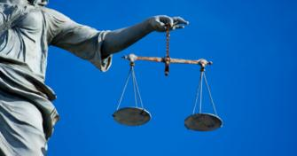
Speech and national security
14th Amendment – provides due process to individuals applicable to state govt’s
  Gitlow v. New York – found guilty…however the 14th amendment is forever linked to due process at the state level.

Slide 12
Speech and national security
USSC moves toward more free expression – post WWII (relative not absolute)
  Communists are prosecuted for advocating the overthrow of the country (Smith Act 1940).
  1957 “Calculated to incite” test applied by the courts
  1969 – likely to incite “imminent” unlawful action.
  1977 – Nazi’s are allowed to assemble and march in a largely Jewish populated city.
    “Hate speech” is legal but “hate crimes” are not.

Slide 13
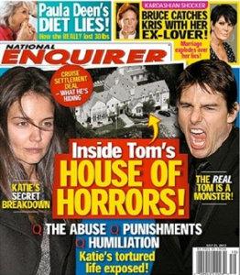
What is speech?
Unprotected speech
Libel - defaming and false speech (written)
  Slander – oral false speech.
  “Actual malice” needed for public figures to prove libel and slander.

Slide 14
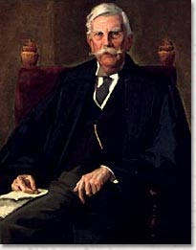
What is speech?
Obscenity
  “I know it when I see it” – Justice Stewart
  No clear definition of obscenity and thus no clear cut cases.
  Local govt’s largely responsible for defining what is and what is not obscene

Slide 15
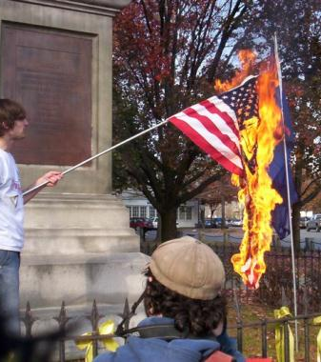
What is speech?
Symbolic speech – protected and not protected
  Burning a draft card, murder, rape…not protected
  Burning the US flag, wearing black in protest of war…protected

Slide 16
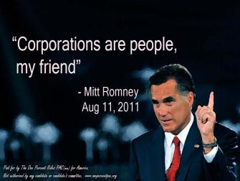
Who is a Person?
Corporations, etc…usually have the same rights as individuals.
Exceptions and such
  First Ntl Bank of Boston
  Antiabortion group
  CA Public Utility Commission

Slide 17
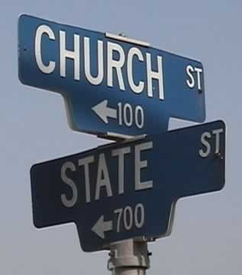
Church and state
Free Exercise Clause – Congress shall make no law prohibiting the “free exercise” of religion
  Law may impose no burden on a religion
  NO religious exemption to laws binding all.

Slide 18
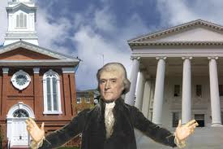
Church and State
Free Exercise continued…
Perfectly murky
  Conscientious objectors & military service.
  Amish refuse to send kids to school past 8th grade despite compulsory school legislation

Slide 19
Church and State
Establishment Clause – Congress shall make no law “respecting an establishment of religion”
Jefferson’s view – wall of separation
Congress – 18th Century took this to mean no national religion

Slide 20
Establishment Clause In the USSC
1947 New Jersey (school bussing reimbursements – parochial schools)
  1st Amendment applies to states
  State must me neutral toward religion
USSC Decisions upholding the wall of separation (ie these are unconstitutional)
  School prayers
  Teaching creationism
  Bible club during school hours

Slide 21
Establishment Clause In the USSC
Public aid to parochial schools
  Allowed – aid for construction of buildings, textbook loans, tax-exempt status, state deductions for tuition, computers, and sign language interpreters.
  Disallowed – teacher salary supplements, tuition, reimbursements, various school services, money to purchase instructional materials, special districts
  USSC can and does change its mind on all of this from time to time.

Slide 22
Establishment Clause In the USSC
Lemon Test – Lemon v. Kurtzman 1968
Schools must pass a 3 part test to get tax money (funding)
  It has a strictly secular purpose (the use of money that is)
  It neither advances nor inhibits religion
  It involves no excessive government entanglement with religion.

Slide 23
Crime and Due Process
Exclusionary Rule – improperly collected evidence cannot be used against you.
  Court originally declined this rule
  1961 Mapp v. Ohio – USSC adopts use of Exclusionary Rule
Search and seizure – 4th amendment – when can “reasonable” searches be made?
  Search warrant
  Incident to an arrest

Slide 24
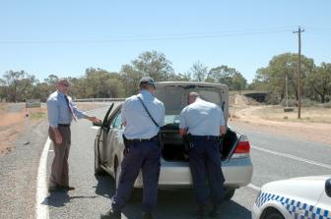
Crime and Due Process
Searchable incident to arrest
  Person being arrested
  Things in plain view
  Things under immediate control of the individual
What about when I’m driving?

Slide 25

Crime and Due Process
Testing for Drugs and AIDS
  No mandatory AIDS testing yet
Permissible testing
  Law enforcement and public transit workers
  Random sobriety checks on drivers
  Key- concern for public safety and NTL security
  High school athletes

Slide 26
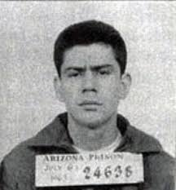
Crime and Due Process
Fifth Amendment protections against self confessions
  Originally intended to protect against torture.
  Escobedo v Illinois
  Miranda v. Arizona

Slide 27
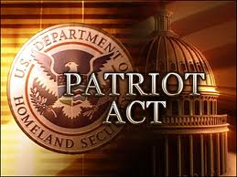
Terrorism and Civil Liberties
USA Patriot Act
  Telephone and internet taps, voice mail seizure all legal.
  Grand Jury info exchange
  Detainment and deportation
  Money laundering
  Crime and punishments – no statute of limitations for terrorism

Slide 28
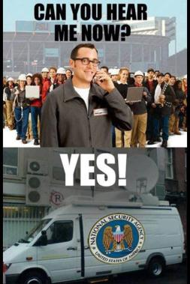
Terrorism and Civil Liberties
Military Tribunals
  Trial before a commission of military officers, may be secret
  2/3’s vote for conviction. Appeals directly to Sec of Def and President
NSA spying on the homeland.

