Slide 1
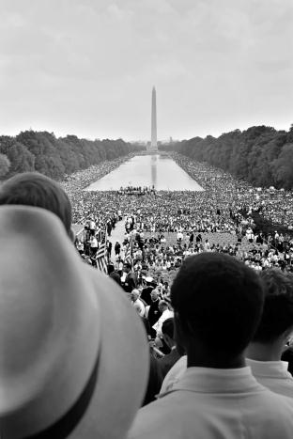
Civil Rights

Slide 2
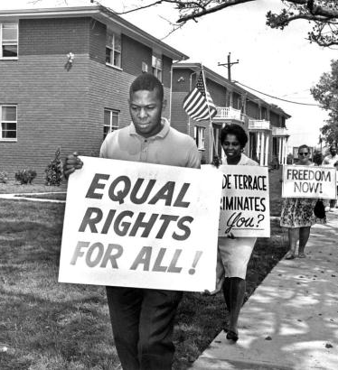
Civil Rights
Def – a civil right is an enforceable right or privilege, which if interfered with by another gives rise to an action for injury ~ Cornell Law School
Examples – right to vote, freedom from involuntary servitude, right to equality in public places.

Slide 3
Civil Rights Issues
A group is denied access to facilities, opportunities, or services available to other groups, usually along ethnic or racial lines.
Issue is whether differences in treatment are “reasonable”
  Some differences are “reasonable” – progressive taxes have been held to this standard.
  Some are not – classification by race whatsoever is subject to “strict scrutiny”. Example having a quota of black masters candidates.

Slide 4
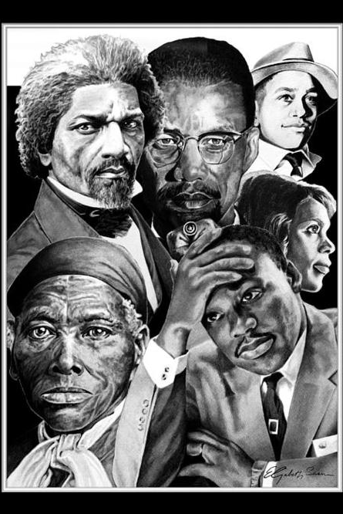
The Black Predicament

Slide 5
Perceived costs of granting blacks rights
African Americans make up 13.6% of the population (2010 census).
  Fear in the South that these small communities would gain power at the cost of white elites.
  In the North where there were some political gains…it was perceived to be at the cost of lower class whites
=‘s fear and resentment.

Slide 6
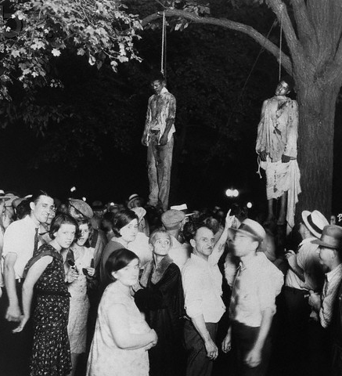
Majoritarian Politics Work Against Blacks
Lynching – beating, torturing, and hanging by a “mob”. Locally illegal, nationally ignored.
General public opinion that the races should not co-mingle.
Those whites that did support Civil Rights tepidly, resented the means (marches, protests, etc)

Slide 7
Progress and Affect
Progress depended on…
  Finding white allies
  Shifting policy making arenas
Affect – Civil Rights movement both
  broadened the base of supporters by publicizing grievances.
  Moved the legal struggle from Congress to the courts.

Slide 8
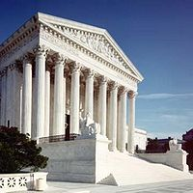
The Campaign in the Courts

Slide 9
14th Amendment
“No state shall make or enforce any law which shall abridge the privileges or immunities of citizens of the US; nor shall any state deprive any person of life, liberty, or property, without due process of law, nor deny any person within its jurisdiction the equal protection of the laws”
Pre- Brown v. Bd. Of Ed 1954
Broad Interpretation – the Constitution is color blind.
Narrow Interpretation – blacks and whites have equal legal rights but not social rights.

Slide 10
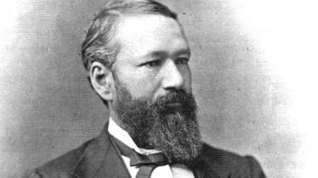
Supreme Court View of 14th Amendment
Plessy v. Fergussen
  Background – Louisiana passed a law that said blacks and whites could not travel in the same train car.
  Plessy – 1/8th black tested the law by riding in a whites only train car. Subsequently arrested and take appeal to Supreme Court.
  Court Decision – in a 7-1 decision the court upheld the Louisiana statute and “separate but equal” becomes the law of the land.

Slide 11
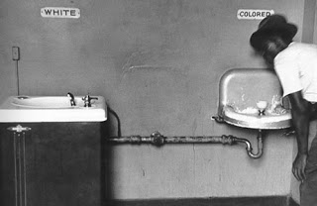
Separate but Equal
Cumming v. Richmond County Bd of Ed – applies separate but equal to schools.
NAACP leads a campaign in courts against separate but equal through the courts.
  Obviously unequal schools
  Not so obviously unequal schools
  Separate schools inherently unequal.

Slide 12
Can separate schools be equal?
Step 1: obvious inequalities
  Lloyd Gaines – 1938
  Ada Lois Sipuel – 1948
Step 2: less obvious inequalities
  Heman Sweat – 1950
  George McLaurin – 1950
Step 3: Making separation inherently unequal
  Climax to the fight to integrate schools. Begins with Linda Brown and her decision to enroll in the all white high school in Topeka, KS.
    High risk strategy…

Slide 13
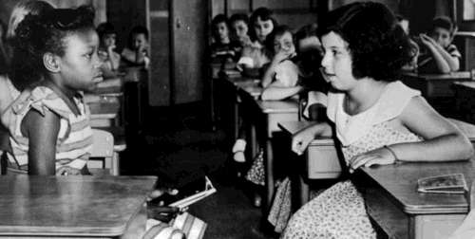
Brown v. Bd. Of Ed
May 17, 1954 – USSC rules 9-0 that separate schools were inherently unequal.
Three Issues created by this decision
  How to Implement
  Selling the Rationale
  Desegregation versus integration

Slide 14
Brown v. Bd. Of Ed
Implementation
  Class-action law suit – this means that the suit and decision applied to all black children not just Brown.
  What does that mean?
  “All Deliberate Speed” – USSC ruled that schools should integrate with all deliberate speed. However, this was left up to the districts in charge…in the South this was done at a snails pace!
    Southern Manifesto – 100 Southern Congressmen signed this pledge to overturn the Brown decision.
    National Gaurdsmen were required to escort black students to formerly all white schools…Little Rock
    Result – 1970 14% of southern black children still attended all black schools.

Slide 15
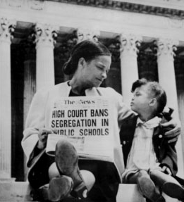
Brown v. Bd. Of Ed
Rationale
  Segregated schools were a detriment to black students creating a sense of inferiority.
  Relied on social science rather than law for the decision because the intent of the 14th amendment was unclear and the court needed a unanimous decision.

Slide 16
Brown v. Bd. Of Ed
Desegregation versus integration
  The decision of Brown was ambiguous at best…did separate being inherently unequal mean unrestricted choice (desegregation) or forced integration was necessary?
  De Jure and de facto segregation…
  Freedom of Choice Plan -1968 Court rejects the idea that students could “choose” a school…thus falling on the side of forced integration.
  Swann v. Charlotte-Mecklenburg Board of Education …see 12th edition pages 132-133.

Slide 17
Check Point
1. In the past, de jure segregation usually resulted from…
  A) Housing patterns
  B) court decisions
  C) state and local laws or actions and regulations
  D) National laws and regulations
  E) actions by civil rights interest groups
2. The decision issued by the Supreme Court in Brown v Board of Education of Topeka in 1954 led mostly to
  A) the establishment of “separate but equal” doctrine
  B) a great decline in the de facto school segregation
  C) equal opportunities for blacks in employment
  D) a great decline in de jure school segregation
  E) greater access to school vouchers in poor urban communities

Slide 18
Check Point
Which of the follow was a successful method used by the NAACP in order to gain civil rights?
  A) litigating cases in federal court
  Lobbying state legislatures
  Pressuring for executive orders
  Litigating cases in state courts
  Pressuring foreign governments
This 1978 case set precedents for later rulings on reverse discrimination.
  A) Lawrence v Texas
  B)Bakke v California Board of Regents
  C) Hardwick v Georgia
  Rostker v Goldberg
  Brown v Topeka

Slide 19
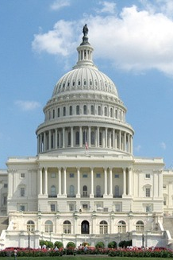
The Campaign in Congress

Slide 20
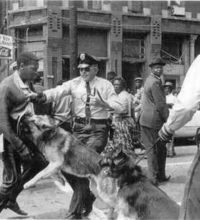
Civil Disobedience
Knowingly breaking what you view as an unjust law and accepting the punishment (arrest).
Mobilize through dramatic events
  Sit-ins and freedom rides
  MLK Jr.
  Montgomery, AL
  Birmingham, AL
Mixed results
  Agenda setting success
  Coalition building setbacks

Slide 21
Legislative Politics
Opponents Defensive Positions
  Senate Judiciary Committee controlled by southern Democrats
  House Rules Committee controlled by Howard Smith (staunch opponent of Civil Rights)
  Senate Filibuster threat
  President Kennedy Reluctant to propose strong Civil Rights Bills

Slide 22
Legislative Politics
Four developments break the legislative deadlock
  Changing public opinion – white parents were more inclined to be ok with integration.
  Violent reaction to civil rights demonstrators saturated the news
  Kennedy Assassination – coupled with LBJ’s reelection buoyed major Civil Rights legislation.
  1964 Democratic landslide – brought more northern Democrats into office that countered southern Democrats

Slide 23
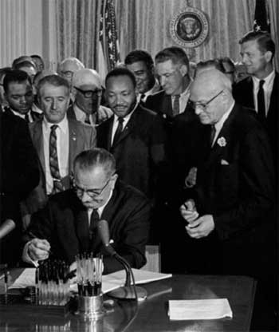
Positive Legislation Passed
1957, 1960, 1965 – voting rights laws
1968 – Housing discrimination law
1964 – Civil Rights Act – most far reaching
  Broad in scope, strong enforcements
  Memorial to JFK
  Broke a Senate filibuster to pass…had not been previously achieved on a C.R.’s bill
  Post 1964 Results…

Slide 24
Racial Profiling
Def – police stopping, questioning, etc one ethnicity based on the belief that they commit more crime
  Getting stopped for “driving while black”.
Condemned by Clinton, Bush, and Congress
Complex issue…what if one group does commit more crime than another?
Cost/Benefit
  Does it increase legit arrests?
  When is it justified?
  What’s the impact on innocent Americans

Slide 25
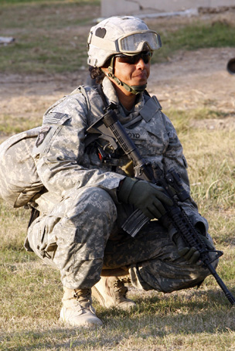
Women and Equal Rights

Slide 26
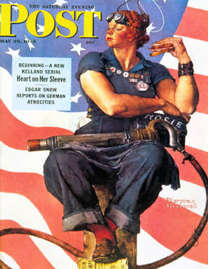
Supreme Court’s Position’s
Pre 1970’s – the court took a paternalistic approach. i.e. discrimination under the guise of protection.
Shift – the Shift occurs during and after WWII when women take on a giant roll in the war effort.
Post 1970’s – laws must pass the intermediate scrutiny test.

Slide 27
Gender-based differences
Prohibited
  Age of adulthood
  Drinking age
  Arbitrary employee height-weight requirements
  Mandatory pregnancy leaves
  Little league exclusions
  Jaycees exclusion
  Unequal retirement benefits
Allowed
  All-boys/ all-girls schools
  Widows’ property tax exemption
  Delayed promotions in Navy
  Statutory rape.

Slide 28
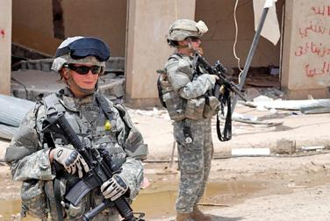
Women in the Military
Women must be admitted to all-male, state-supported military colleges.
Rostker v. Goldberg (1981) – Congress may draft only men.
1993 – Women allowed in air and sea combat.
2013 – ban on women in combat roles is lifted.

Slide 29
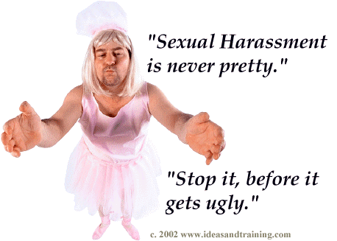
Sexual Harassment
Type 1 – Requesting sexual favors as condition of employment
  Quid pro quo rule
  Employer strictly liable
Type 2 – Hostile work environment
  Employer not strictly liable
  Employer can be found negligent.
Almost no federal laws regarding S.H.

Slide 30
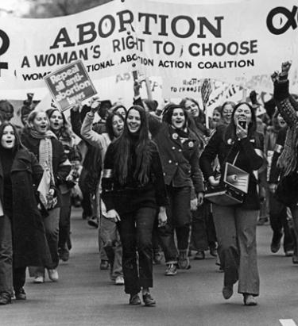
Abortion
Until 1973 individual states determined their position on abortion.
1973 – Roe v. Wade – USSC decided
  1st Trimester – a woman has unfettered access to abortion
  2nd Trimester – no ban but can be regulated
  3rd Trimester – states may ban

Slide 31
Abortion
Critics claim life begins as conception
  Unborn child entitled to equal protections
Supporters claim no one can say when life begins
Pro-life versus pro-choice
Hyde Amendment – 1976 – federal dollars can not be used for abortions (until the Affordable Health Care Act…now is federally funded)
1973-1989 – Supreme Court upholds the Roe on several occasions.

Slide 32
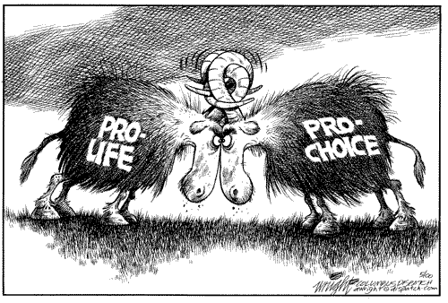
Casey v. Planned Parenthood of SE PA
Court allows Roe to stand, however, allows states to restrict abortions as long as it does not place “undue burden” on the women.
  24 hour wait
  Parental consent if under 18
  Counseling pamphlets (alternatives to abortion)

Slide 33
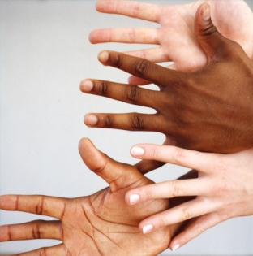
Affirmative Action

Slide 34
Affirmative Action
Definition – preferential hiring practices must be used to find and hire women, blacks, and other minorities.
Equality of results (camp #1)
  Racism and sexism overcome only by taking them into account designing remedies
  Equal rights not enough; people need benefits
  Affirmative action should be used in hiring.
Equality of opportunity (camp #2)
  Reverse discrimination to use race or sex as preferential treatment
  Laws should be color-blind and sex neutral
  Government should only eliminate barriers.

Slide 35
Targets or Quotas?
Issue fought out in courts
  No clear definition in Supreme court decisions
  Court is deeply divided; affected by conservative Reagan appointees
  Law complex and confusing
    Bakke v. California 1978 – USSC says that colleges can not explicitly use a numerical quota on admissions but can take race into account.
    Subsequent court decisions were less strict on quotas however.

Slide 36
Emerging Standards for Quotas
Must be “compelling justification
Must correct a pattern of discrimination
Must involve practices that discriminate
Federal quotas are to be given deference
Voluntary preference systems are easier to justify
Not likely to apply to who gets laid off

Slide 37
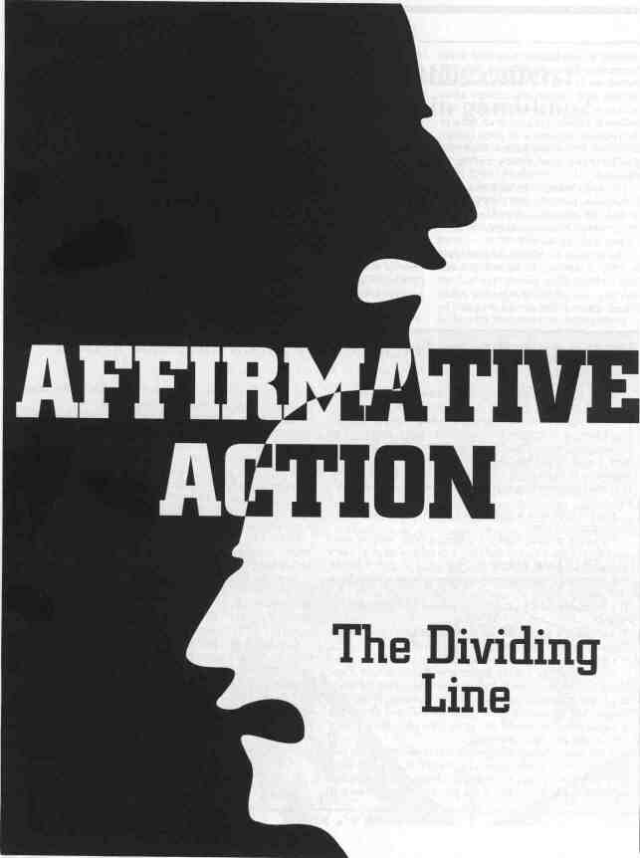
Compensatory Action vs. preferential treatment
Compensatory Action – helping minorities catch up
Preferential treatment – giving minorities preference
  Public supports Compensatory Action not preferential treatment
Courts are divided on Affirmative action
  Circuit courts in large part in favor of quotas
  USSC applies strict scrutiny test on case-by-case basis.

Slide 38
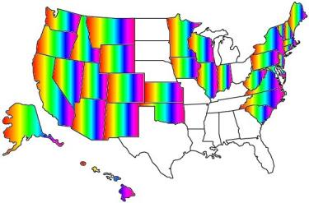
Gays and the Supreme Court
Bowers v. Hardwick – 1986 – USSC upheld a Georgia statute that banned sodomy.
1996 – USSC strikes down a Colorado law that banned protections based on sexual orientation.
Lawrence v. Texas -2003 – USSC used “right to privacy” to overturn a Texas statute that banned same sex sex.
2013 – USSC in a 5-4 decision struck down the 1996 DOMA law which prevented same sex couples from receiving federal benefits.
2013 – Same sex couples can file joint federal tax return.

