Slide 1
Chapter 13 Congress

Slide 2
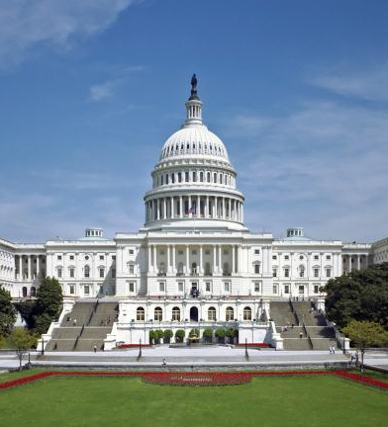
Congress: the “first branch”
Congress has considerable power. Importance revealed in the Constitution.
Many consider this branch to be in the most need of repair/reform.
  Congressional Approval as of 10/31/12 is at 11% - Gallup
In fact the US Congress if studied it most in tune with public sentiment. The puzzles, processes and actions of this branch say a great deal about America’s representative body (unique to the US)

Slide 3
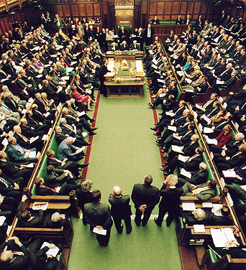
Congress vs Parliament
Parliamentary candidates are selected by party.
  Members of Parliament select prime minister and other leaders
  Party members vote together on most issues
  Renomination depends on loyalty to the party
  Principal work is debating national issues
  Very little power, very little pay

Slide 4
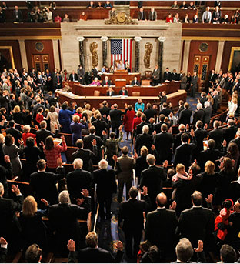
Congress vs parliament
Congressional candidates run in a primary election, with little party control
  Vote is for the man or woman not the party
  Result is a body of independent representatives
  Members do not choose the president
  Principal work is representation and action
  Great deal of power, high pay, parties cannot discipline members

Slide 5

Congress vs parliament
Congress is a decentralized institution
  Reps are more interested in the views/opinions of their constituents than the party and president.
  Congress in general can be very unpopular due to having to serve multiple masters.
    Constituents
    Self
    Interest Groups
    Party

Slide 6
The Evolution of Congress

Slide 7
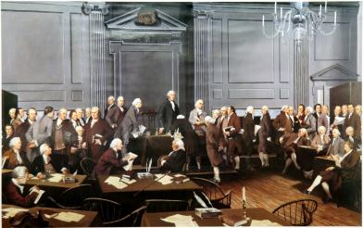
Evolution of Congress
Intent of Framers
  To oppose concentration of power in a single institution
  To balance large and small states through bicameralism. (Great Compromise).
Common Criticisms – Too slow
  Centralization – pros & cons
  Decentralization – pros & cons

Slide 8
Evolution of Congress
Development of the House
  Always powerful but varied in organization and leadership. At various times throughout history power has originated in various places including
    Powerful Speakers
    Powerful committee chairmen
    Powerful individual members (see page 318-319 12th ed)
  Ongoing dilemmas
    Increases in size (435 members) have led to more centralization (condensed leadership) and less individual power.
    Desire for individual power can only be satisfied by decentralization which in turn slows down the process and turns off the public at large.

Slide 9
Evolution of Congress
Development of the Senate
  Structural advantages over the House
    Small enough (100) to be run without losing individualism
    It is evenly balanced with 2 Senators from each state (regional politics usually level out in the Senate)
    No time limits or restrictions on speech and debate (effect – if a bill doesn’t cut the mustard it dies in the Senate).
    Originally chosen by state legislatures (reflected the positions of the state majority party)
  Major changes
    Direct election of Senators – 17th Amendment (1913)
    Cloture – 2/3rds of the Senate, today 60 votes, can stop a filibuster and require a vote (1919)

Slide 10
Who is in Congress?

Slide 11
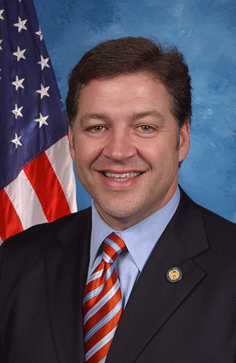
Who’s in Congress
Congress today has unparralled racial, ethnic and gender diversity…however, the average representative/senator is still
  Middle aged
  White
  Protestant
  Male
  Lawyer
  See chart pg 321

Slide 12
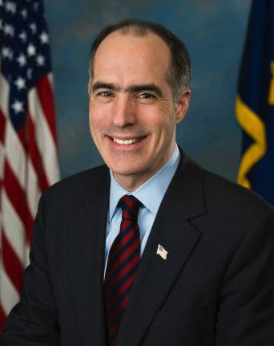
Who’s in Congress
Incumbancy
  Low turnover rates and safe districts common in Congress
  Incumbents increasingly viewed as professional politicians and out of touch with the people by the 1980s
  Call for term limits a result

Slide 13
Who’s in Congress
Democrats dominate Congress from 1938 – 1994
Historically Republicans get more votes than they did seats. Why
  Gerrymandering – redrawing congressional district lines to the benefit of the state majority party.
  Republicans do better in the burbs and Democrats in urban areas (more seats available)
  Possibly – democrats run more politically attractive candidates.
By 1994 Republicans win back both houses of Congress
South becomes solidly Republican during the 1990’s
Party unity and subsequently party politics on the rise ever since.

Slide 14
Do Members Represent their Voters?

Slide 15
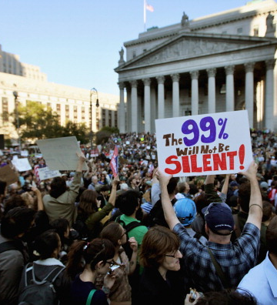
Do Members Represent their Voters?
Representational View
  Assumes that members vote to please their constituents
  Constituents must be informed and have clear views on an issue.
  Can lead to big conflicts between rep and voters (gun control)
  There remains many independent thinking representatives (mavericks)
  Major problem with this view is…American public doesn’t have a clear opinion on most issues.

Slide 16
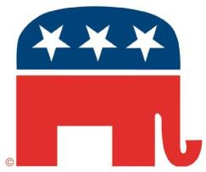
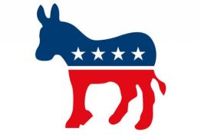
Do Members Represent their Voters?
Organizational view
  Assumes that reps vote to please their colleagues.
  Organization cues include
    Party
    Ideology
  Problem is that parties do not have a clear view on all issues.
  Particularly influenced by members of same party on a sponsoring committee.

Slide 17
Do Members Represent their Voters?
Attitudinal View
  Assumes that ideology affects legislators vote.
  House members tend more than senators to have opinions similar to those of the public.
  Prior to 1990’s Southern Democrats aligned themselves with Republicans to form the “conservative coalition”

Slide 18
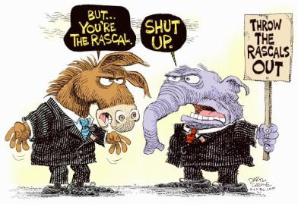
Do Members Represent their Voters?
Ideology and Civility in Congress
  Members of Congress more sharply divided ideologically today than ever.
  New members are even more ideological
  Members of Congress are more polarized than voters
  Compromise amongst representatives is DEAD in the House.

Slide 19
The organization of Congress:
Parties and caucuses

Slide 20
Party Organization of the Senate
President pro tempore presides – member of majority party with the most senority.
Leaders are the majority leader and minority leader, elected by their respective party members.
Party Whips keep leaders informed, round up votes, count no’s and yes’s.
Policy committee schedules Senate business
Committee Assignments
  Democratic Steering Committee
  Republican Committee on Committees
  Emphasize ideological and regional balance
  Other factors: popularity, effectiveness on television, favors owed.

Slide 21
Party organization of the house
Speaker of the House as leader of majority party; presides over House.
  Decides whom to recognize to speak on the floor
  Rules of germaneness of motions
  Decides to which committee bills go
  Appoints members of special and select committees
  Has some patronage power
Majority leader and minority leader (“Coaches of each caucus)
Party Whips – count votes
Democratic Steering and Policy Committee
  Makes committee assignments
  Schedules legislation
Republican Committee on Committees – makes committee assignments
Republican policy Committee – discusses policy

Slide 22
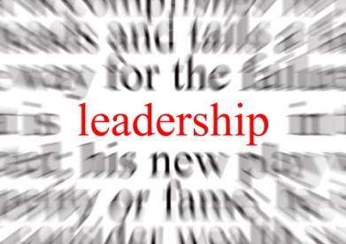
Strength of party structure
Most important measure of leadership strength is getting reps to vote with you.
  Applies mostly to House
Senate is the most stable of the two houses…only 33 members up for elections every two years. Allows for tremendous fluidity.

Slide 23
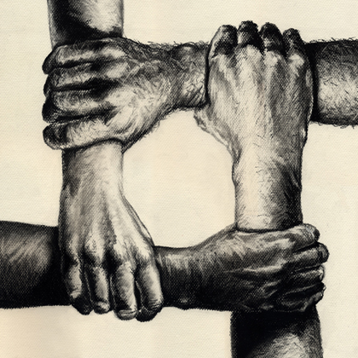
Party Unity
What extent do party members vote together?
  1953 – 1963 – party votes
  1966-1982 – more bipartisan
  1983- present increasingly partisan ( extremely evident in the House)
No specific correlation to the mindset of the populous
  Examples – Clinton impeachment and abortion

Slide 24
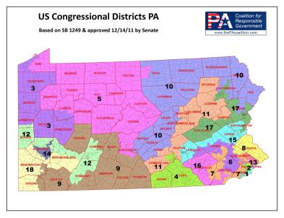
How is this possible in a Democratic nation?
Gerrymandering – drawing of Congressional district lines in the favor of majority party in individual states.
  Result – few districts are truly competitive.
  Voters are becoming more partisan based on cues from Congress
  Committee chairs are based on seniority…most senior reps are from “safe” districts.

Slide 25
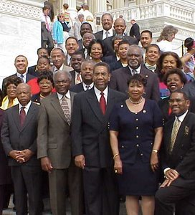
Caucuses
An association of members of Congress created to advocate a political ideology or a regional or economic interest.
  1959 – only 4
  2013 - +300
Serve members as a source of leadership and showing that they care about a particular issue.
Congressional Black Caucus – CBC – one of the most influential.

Slide 26
Committees
The Organization of Congress

Slide 27
Committees
Work horse of Congress – This is where all heavy lifting is done and among the chairs is where real “power” resides.
Legislative Committees – most important organizational feature of Congress
  Consider Bills or legislative proposals
  Maintain oversight over executive agencies
  Conduct investigations
  Primary killing field of “unfit” legislation.

Slide 28
Types of committees
Select committees – groups appointed for a limited purpose and limited duration
Joint committees – those on which both representatives and senators serve
Conference committee – a joint committee appointed to resolve differences in the Senate and House versions of the same piece of legislation before final passage.
Standing committees – most important type of committee
  Majority party has majority of seats on the committees
  Each member usually serves on two standing committees
  Chairs are elected, but usually the most senior member of the committee is elected by the majority party.

Slide 29
Staff and Specialized Offices
The Organization of Congress

Slide 30
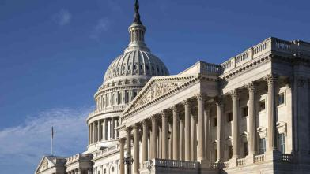
Tasks of staff members
Constituency Service is major task of staff
Legislative functions – monitor hearings, devise proposals, draft reports, meet with lobbyists
Staff members are above all advocates for their boss.

Slide 31
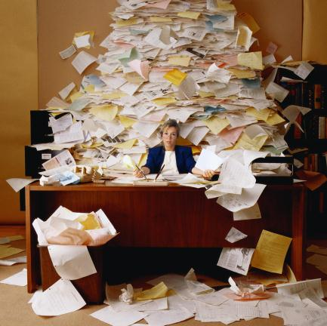
Growth and Influence of Staff
Rapid growth of staff is a result and byproduct
Larger staff generates more legislative work
Reps cant keep up with demands and rely heavily on staff.
Creates a more individualistic Congress

Slide 32
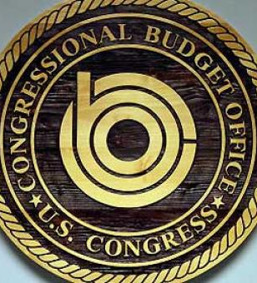
Specialized information
Congressional Research Service (CRS)
General Accounting Office (GAO)
Office of Technology Assessment (OTA)
Congressional Budget Office (CBO)

Slide 33
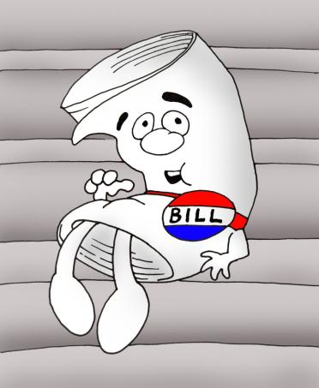
I’m A Bill on Capital Hill
How a Bill Becomes a Law

Slide 34
How a bill becomes a law
Bills travel through Congress with different speeds depending on substance.
Introducing a bill
  Can only be introduced by a member of Congress
  Most legislation initiated by Congress (some outside influence – heavily influenced by the Executive Branch)
Resolutions
  Simple – passed by one house affecting that house
  Concurrent – passed by both affecting both
  Joint – passed by both houses, signed by president

Slide 35
How a bill becomes a law
Study by committees
  Bill is referred to committee by Speaker or presiding officer
  Revenue bills must originate in House
  Most bills die in committee
  Hearings are often conducted by several subcommittees on relevance of bill
Committees can
  Report favorably
  Amend (earmarks or pork)
  Report unfavorably (kill)
  Draft own legislation
  Do nothing
If nothing is done the bill can be drawn out with a discharge petition.

Slide 36
How a bill becomes a law
House Rules committee sets rules for consideration
  Closed rule – sets time limit on debate and restricts amendments
  Open rule – permits amendments from the floor
  Restrictive rule – permits only some amendments
  Rules can be bypassed by the house
    Rules can be suspended – requires 2/3rds vote
    Discharge petition

Slide 37
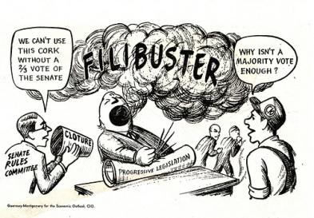
How a bill becomes a law
Floor debate House
  Committee of Whole – procedural device for expediting House consideration of bills but cannot pass bills.
  Committee sponsor of bill organizes the discussion
Floor debate Senate
  No rule limiting debate or germaness.
  Filibuster
  Cloture

Slide 38
How a bill becomes a law
Procedures in voting
  Voice vote
  Division vote
  Teller vote (doesn’t exist in Senate)
  Roll call vote
Differences in bill
  If minor last house to act merely sends the bill to other house for acceptance
  If major a conference committee hammers out differences
President can
  Sign into law
  Veto
    Can be overridden by a 2/3rds vote in both houses

Slide 39
Reducing Powers and Perks

Slide 40

Common perceptions
Self indulgent and over staffed
Quick to regulate others but not self
Quick to pass pork laden legislation but slow to address controversial issues
Misuse of franking privilege
  Ability to send parcels free of charge.
  Accused of using for campaign purposes.

Slide 41
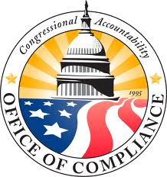
Congressional Accountability Act of 1995
Made Congress follow the laws it passed (previously avoided)
Addressed enforcement issues (Executive branch responsible traditionally)
Meat of the law
  Obliged Congress to obey major laws
  Created the Office of Compliance
  Established an employee grievance procedure

Slide 42
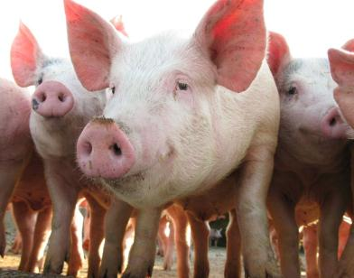
Trimming the pork
Recently calls for reforming a representatives ability to “bring home the bacon”.
In fact entitlement programs (Medicare, medicaid, welfare) more responsible for increasing national debt.
Price of citizen-oriented Congress is Pork.

