Slide 1
Chapter 14
The Presidency

Slide 2
Presidents and Prime Ministers

Slide 3
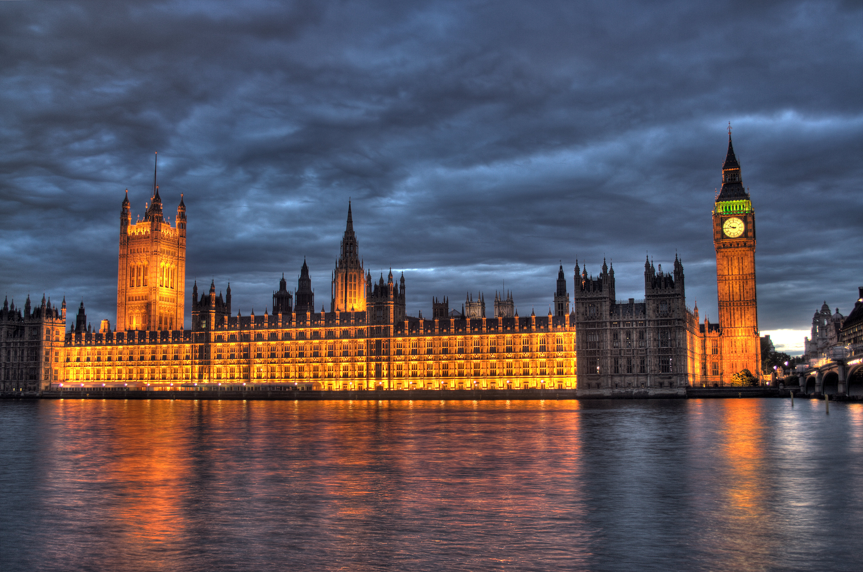
Characteristics of Parliaments
Parliamentary system twice as common
Chief executive chosen by legislature
Cabinet ministers chosen from among members of parliament
Prime minister remains in power as long as his or her party or coalition maintains a majority in the legislature

Slide 4
Differences
President
Prime Minister
Presidents are often outsiders
Presidents choose their cabinet from outside Congress
Presidents have no guaranteed majority in the legislature
Presidents and Congress often at odds…even when he does have a majority in Congress
Prime ministers are always insiders
Prime ministers choose members of parliament for their cabinet.
Prime ministers are guaranteed a majority in the legislature

Slide 5
Divided Government

Slide 6
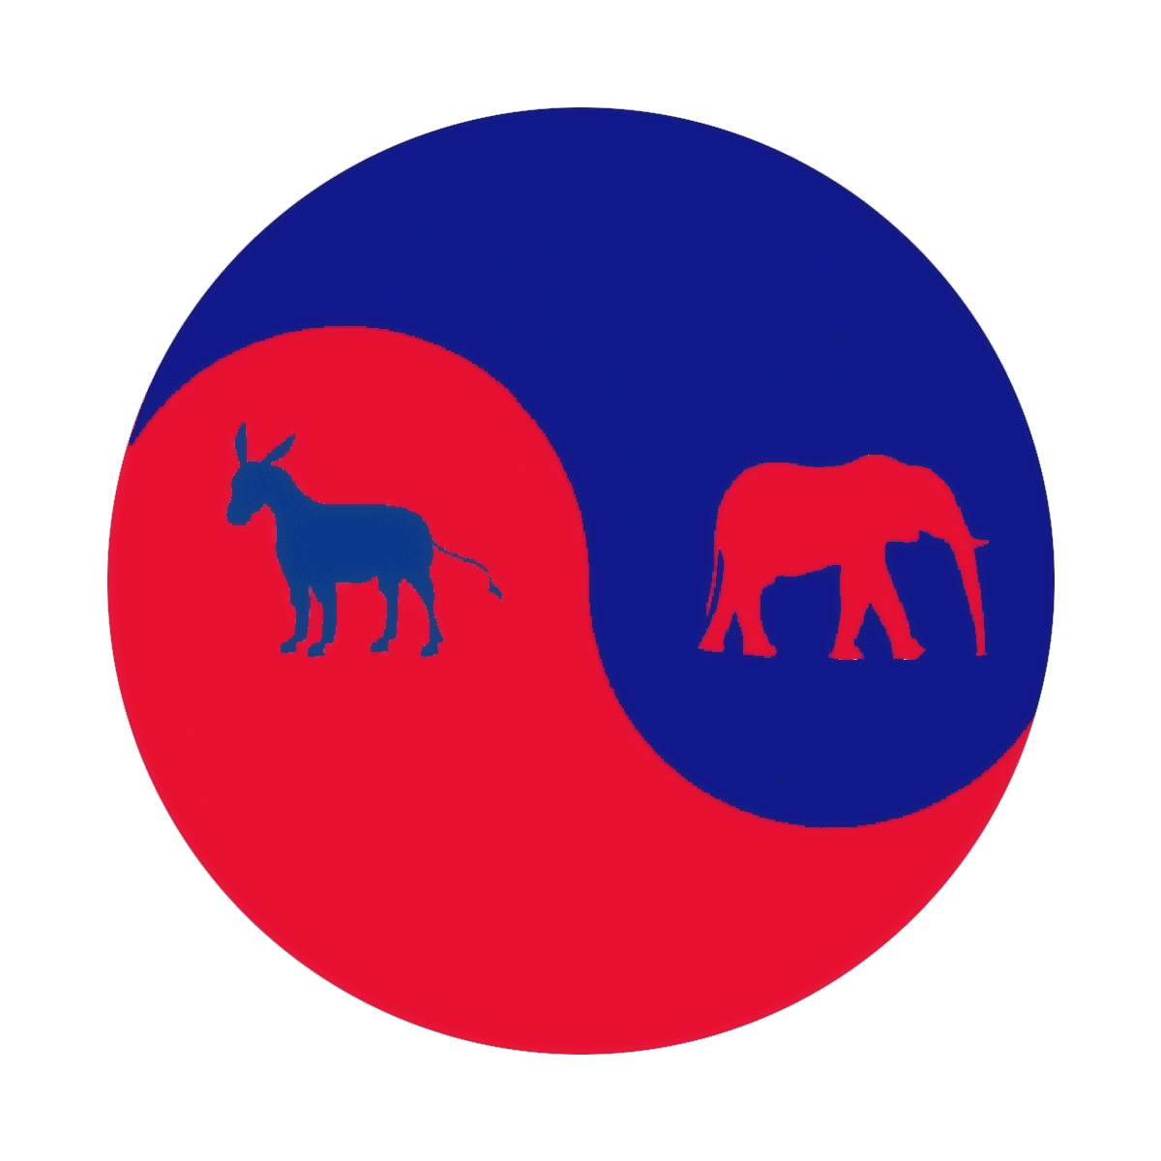
Divided vs. Unified Government
  Fifteen of twenty-two congressional/presidential elections since 1952 produced divided government
  Americans dislike divided government because it can lead to gridlock.

Slide 7
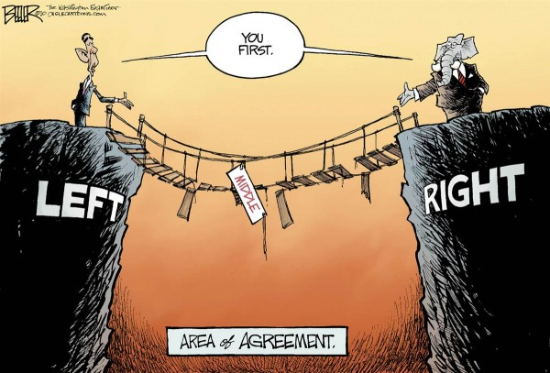
Does Gridlock Matter?
  But divided government enacts as many important laws as a unified government
  Reason: Unified government is something of a myth in U.S.
  Is policy gridlock bad?
    Unclear whether gridlock is always bad; it is a necessary consequence of representative democracy
    Representative democracy opposite direct democracy

Slide 8
The Evolution of the Presidency

Slide 9
The Evolution of the Presidency
Delegates feared both anarchy and monarchy
    Idea of a plural executive
    Idea of an executive checked by a council
Concerns of the Founders
    Fear of military power of president who could overpower states
    Fear of presidential corruption of Senate
    Fear of presidential bribery to ensure reelection

Slide 10
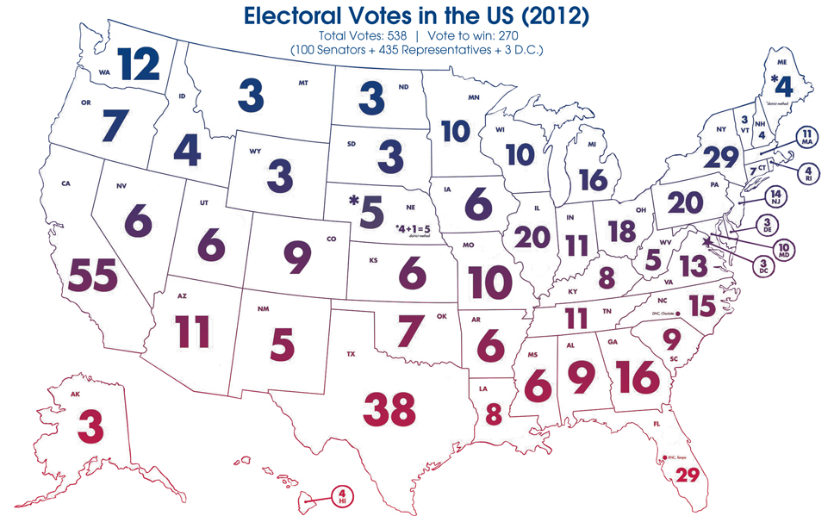
The Evolution of the President
The electoral college
  Each state to choose own method for selecting electors
  Electors to meet in own capital to vote for president and vice president
  If no majority, House would decide

Slide 11
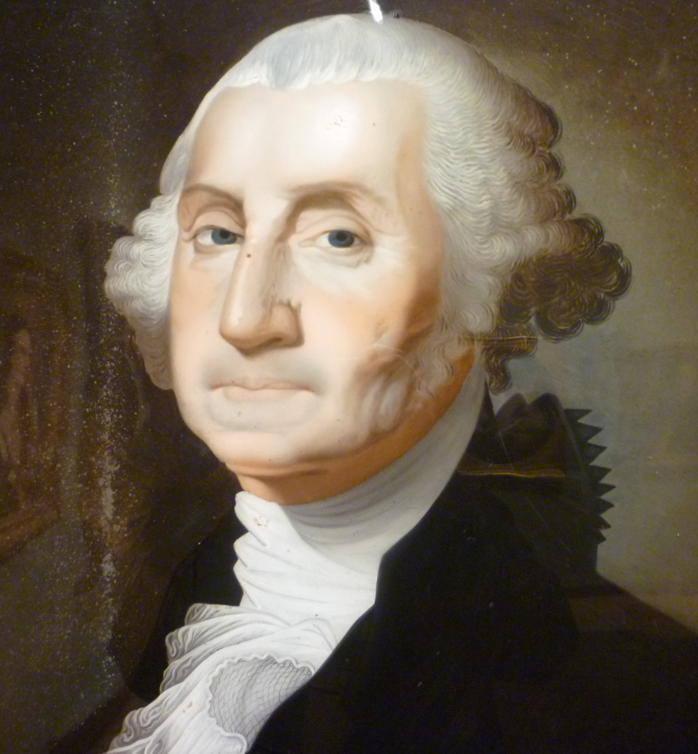
The Evolution of the President
The president's term of office
  Precedent of George Washington and two terms
  Twenty-second Amendment in 1951 limits to two terms
  Problem of establishing the legitimacy of the office
  Provision for orderly transfer of power

Slide 12
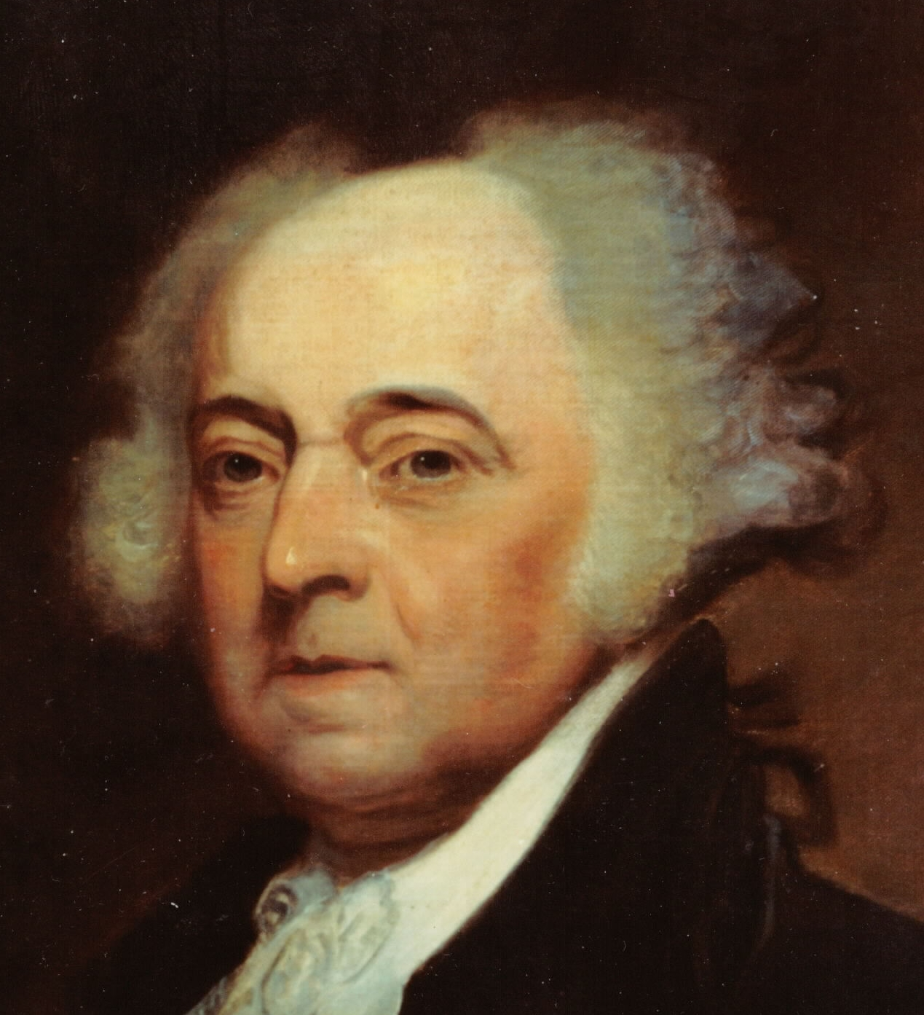
The Evolution of the President
The first presidents
  Prominent men helped provide legitimacy
  Minimal activism of early government contributed to lessening fear of the presidency
  Appointed people of stature in the community (rule of fitness)
  Relations with Congress were reserved; few vetoes, no advice

Slide 13
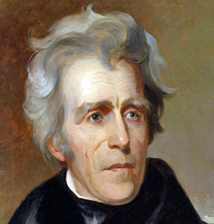
The Evolution of the President
The Jacksonians
  Jackson sought to maximize powers of presidency
  Vigorous use of veto for policy reasons
  Challenged Congress

Slide 14
The Evolution of President
The reemergence of Congress
  With brief exceptions the next hundred years was a period of congressional ascendancy
  Intensely divided public opinion
  Only Lincoln expanded presidential power
    Asserted "implied powers" and power of commander in chief
    Justified by emergency conditions
  President mostly a negative force to Congress until the New Deal
  Since the 1930s power has been institutionalized in the presidency
  Popular conception of the president as the center of government contradicts reality; Congress often policy leader

Slide 15
The Powers of the President

Slide 16
The Powers of the President
Formal powers found in Article II
    Not a large number of explicit powers
    Potential for power found in ambiguous clauses of the Constitution, such as power as commander in chief and duty to "take care that laws be faithfully executed"
Greatest source of power lies in politics and public opinion
    Increase in broad statutory authority
    Expectation of presidential leadership from the public

Slide 17
The Office of the President

Slide 18
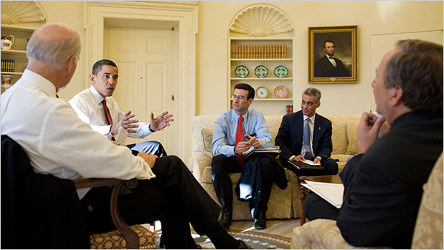
Office of the President
  The White House Office
    Contains the president's closest assistants
    Three types of organization
      Circular
      Pyramid
      Ad hoc
    Staff typically worked on the campaign: a few are experts
    Relative influence of staff depends on how close one's office is to the president's

Slide 19

Office of the President
The Executive Office of the President
  Composed of agencies that report directly to the president
  Appointments must receive Senate confirmation
  Office of Management and Budget most important
      Assembles the budget
      Develops reorganization plans
      Reviews legislative proposals of agencies

Slide 20
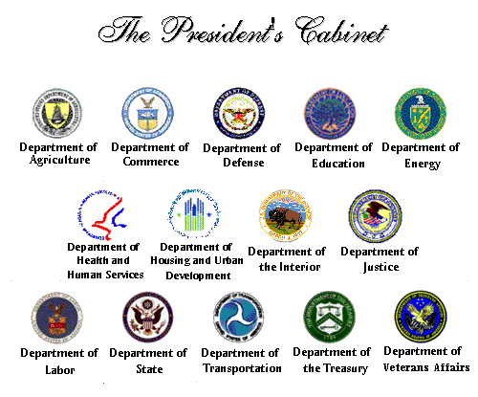
Office of the President
The cabinet
    Largely a fiction, not mentioned in Constitution
    President appoints or controls more members of cabinet than does prime minister
    Secretaries become preoccupied and defensive about their own departments

Slide 21

Office of the President
Independent agencies, commissions, and judgeships
    President appoints members of agencies that have a quasi-independent status
    Agency heads serve a fixed term and can be removed only "for cause"
    Judges can be removed only by impeachment

Slide 22
Who Gets Appointed?
Who gets appointed
  President knows few appointees personally
  Most appointees have had federal experience
    "In-and-outers"; alternate federal and private sector jobs
    No longer have political followings but picked for expertise
  Need to consider important interest groups when making appointments
  Rivalry between department heads and White House staff

Slide 23
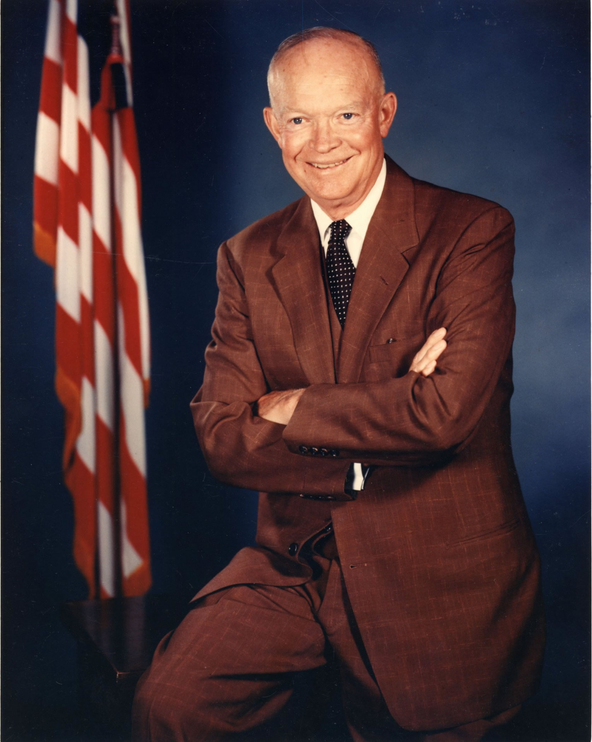
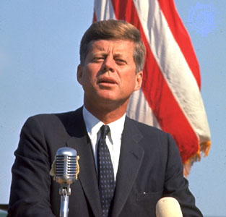
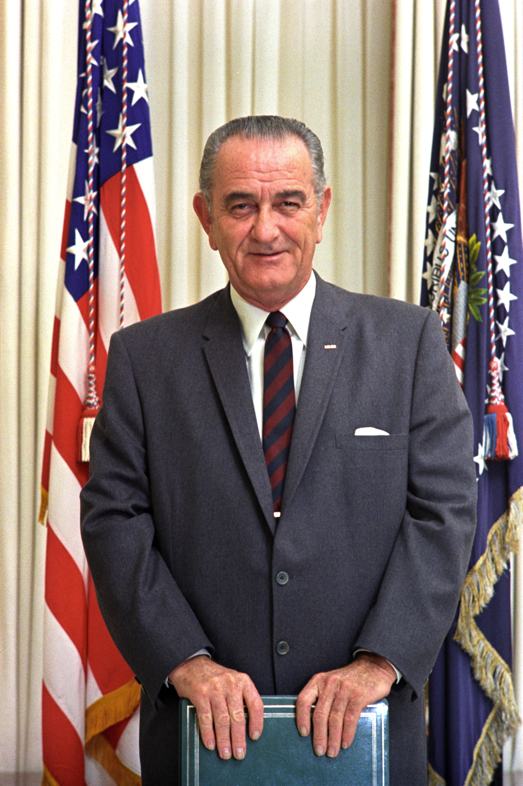
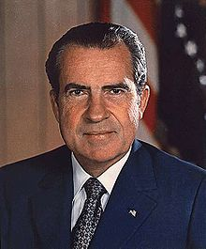
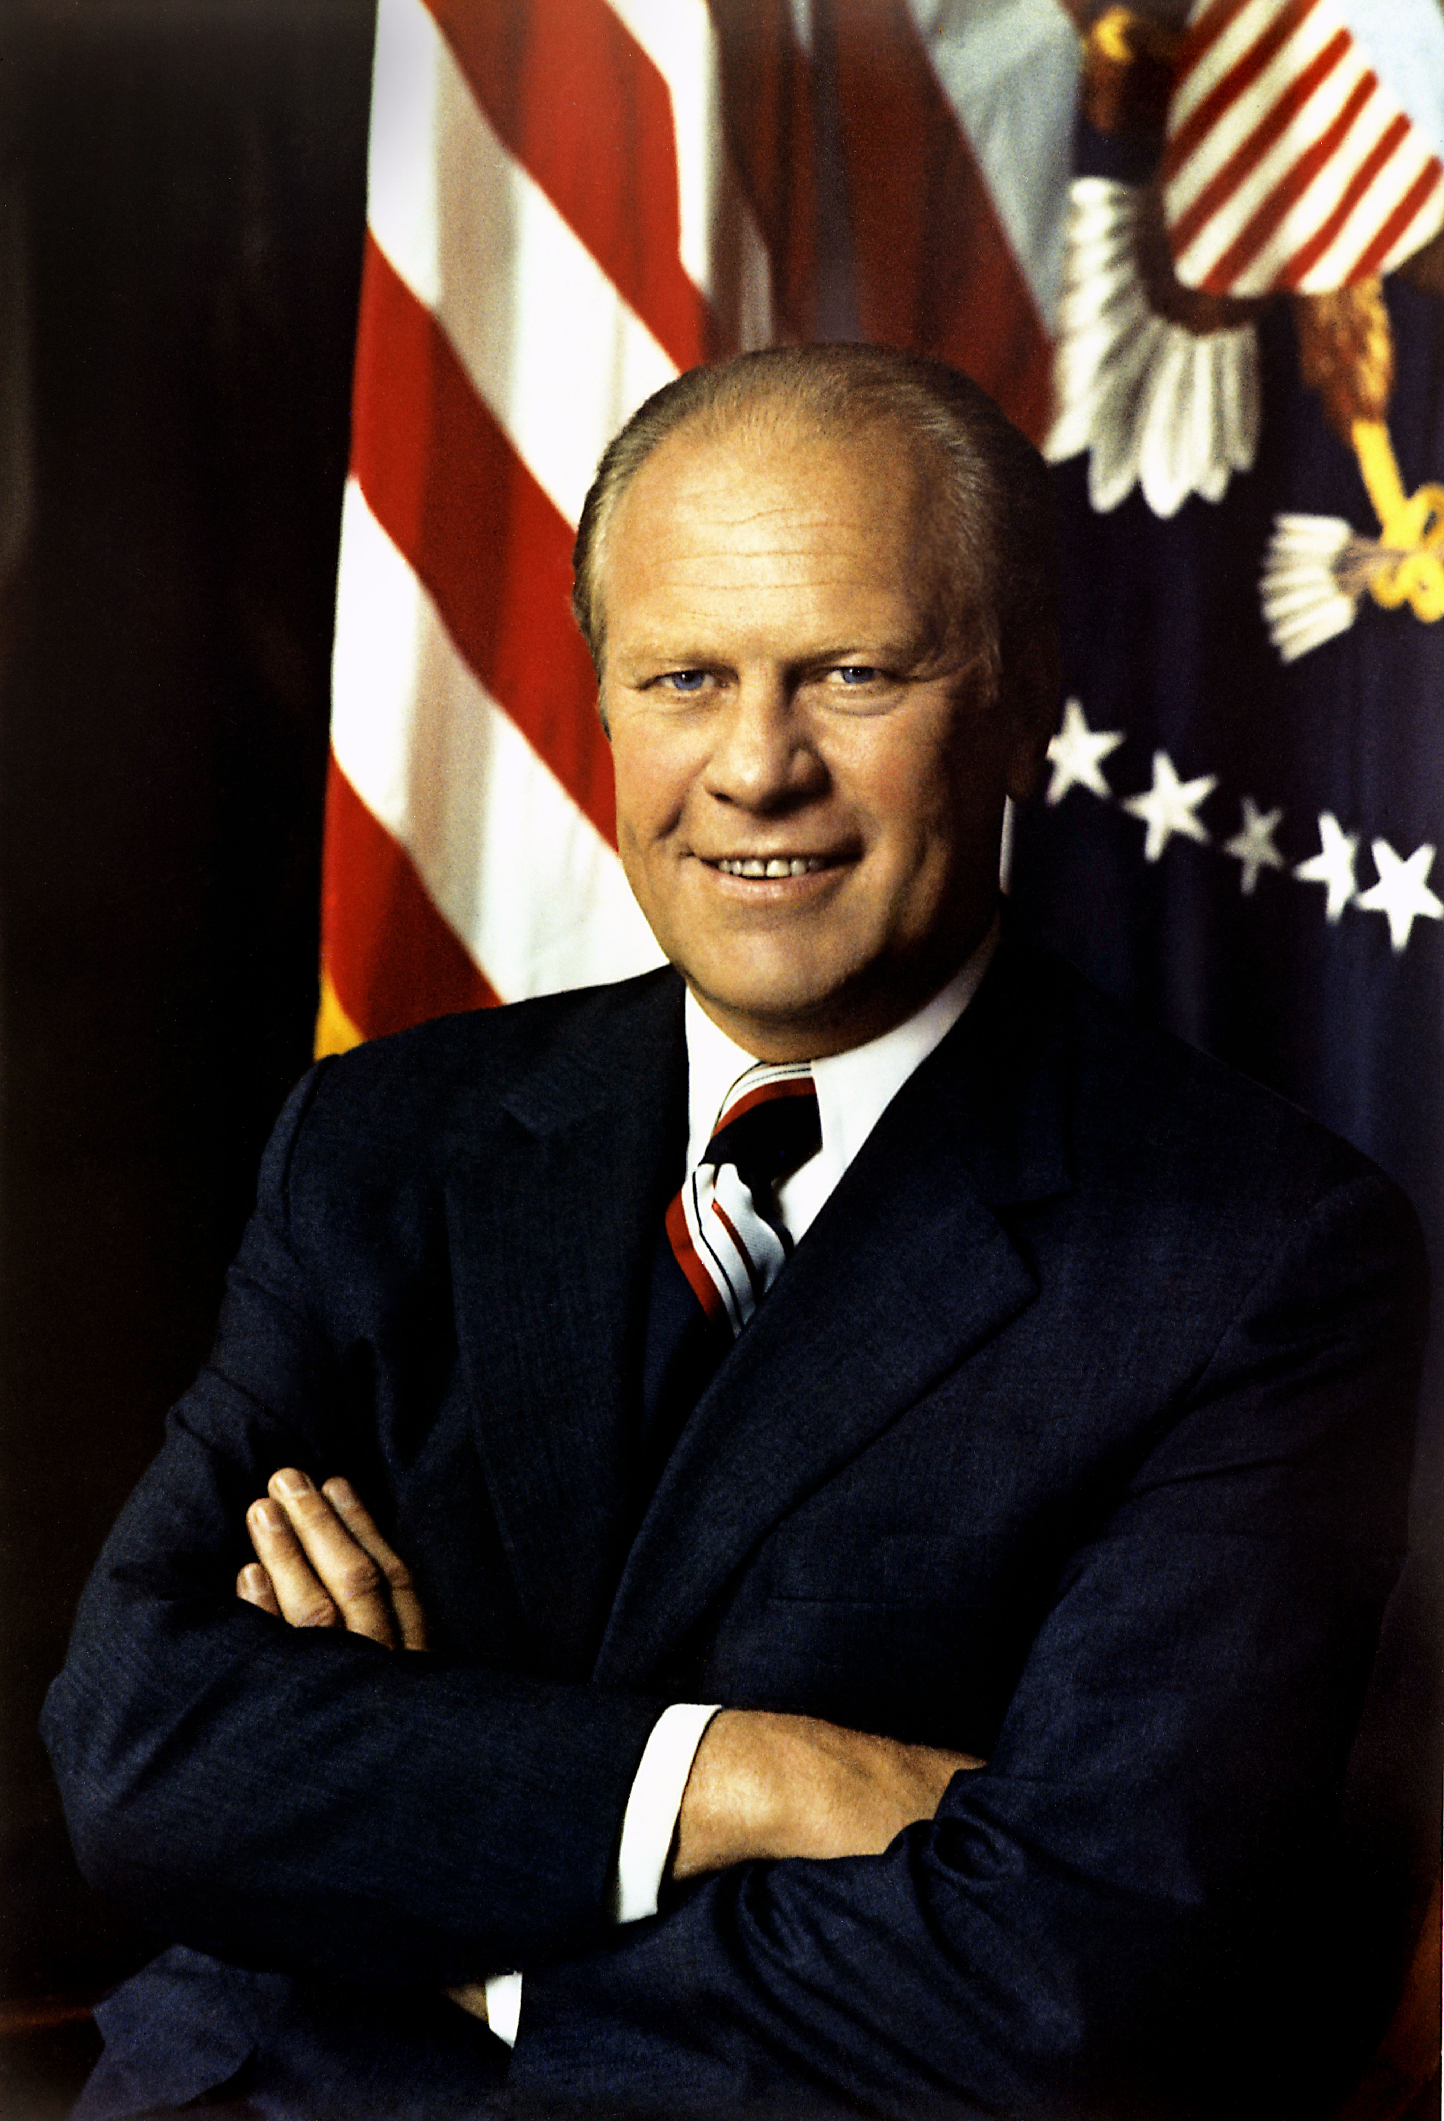
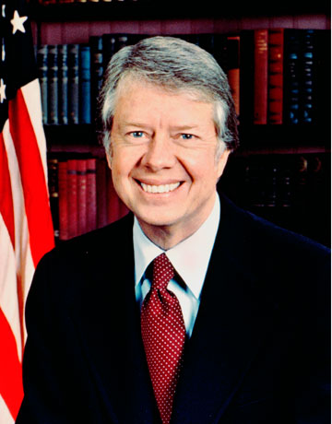
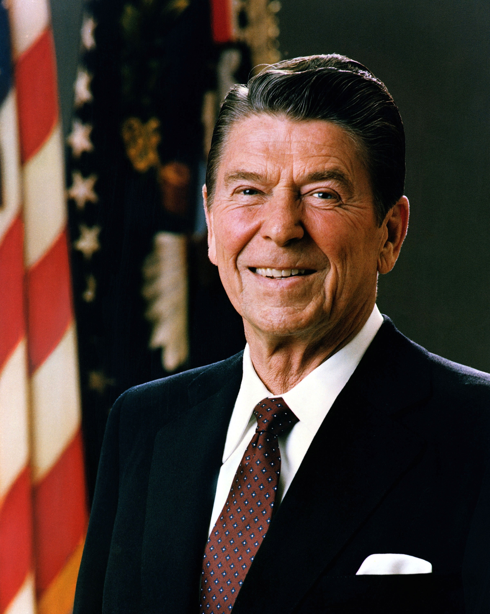
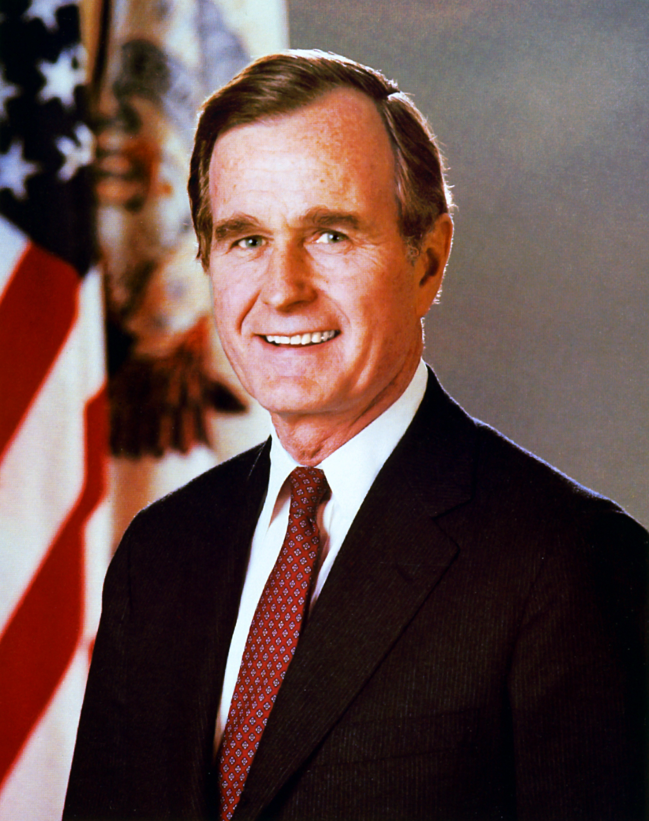
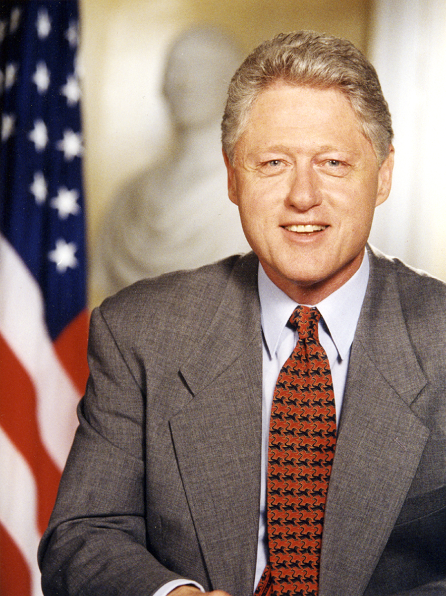
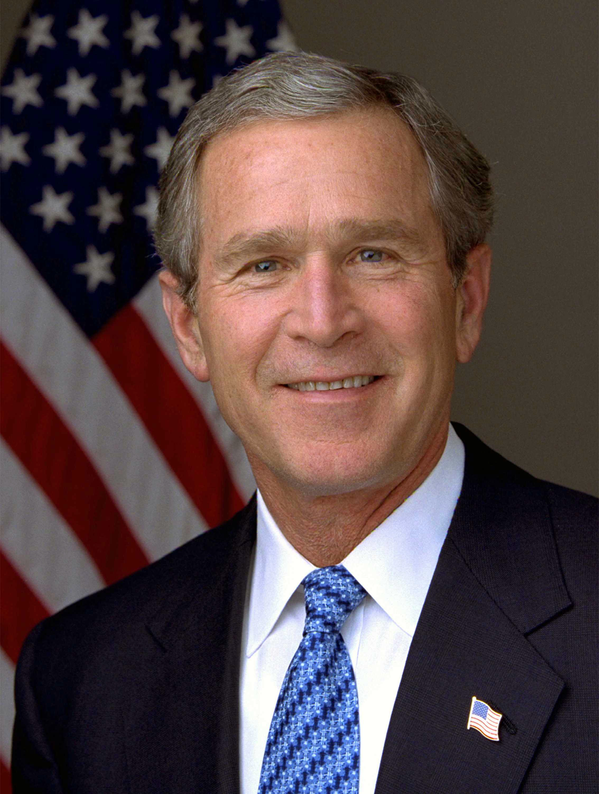
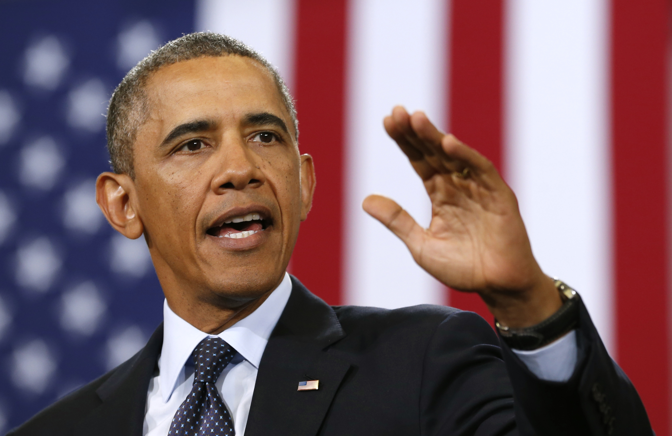
Presidential Character

Slide 24
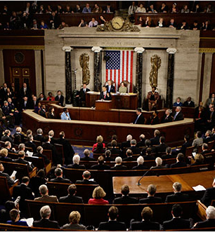
The Power to Persuade
  Formal opportunities for persuasion
The three audiences
  Other politicians and leaders in Washington, D.C.; reputation very important
  Party activists and officials inside Washington
  The various publics

Slide 25
The Power to Persuade
  Popularity and influence
    Presidents try to transform popularity into support in Congress
    Little effect of presidential coattails
    Members of Congress believe it is politically risky to challenge a popular president
    Popularity is unpredictable and influenced by factors beyond the president's control.
  Decline in Popularity
    Highest immediately after an election victory
    Declines by midterm after the honeymoon period.

Slide 26
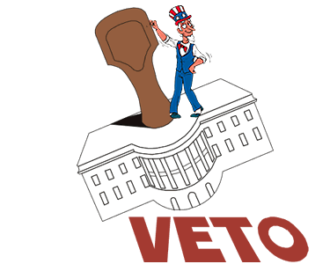
The Power to Say No
Veto
  Veto message
  Pocket veto (only before end of Congress)
  Congress rarely overrides vetoes in 1996

Slide 27
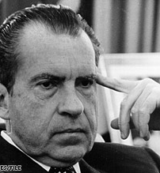
The Power to Say No
Executive privilege
  Confidential communications between president and advisers
  Justification
    Separation of powers
    Need for candid advice
  U.S. v.Nixon (1973) rejects claim of absolute executive privilege

Slide 28
The Power to Say No
  Impoundment of funds
    Defined: presidential refusal to spend funds appropriated by Congress
    Countered by Budget Reform Act of 1974
      Requires president to notify Congress of funds he does not intend to spend
      Congress must agree in forty-five days

Slide 29
Presidential Program

Slide 30
Putting together a program
  Putting together a program
    President can try to have a policy on everything (Carter)
    President can concentrate on a small number of initiatives (Reagan)
    Constraints
      Public reaction may be adverse
      Limited time and attention span
      Unexpected crises
      Programs can be changed only marginally
    Need for president to be selective about what he wants
    Heavy reliance on opinion polls
    Impact of dramatic events and prolonged crises

Slide 31
Attempts to reorganize the executive branch
  Bush and the Department of Homeland Defense
    White House Office of Homeland Security created in aftermath of terrorist attack of September 11
        Small staff
        Little budgetary authority
        No ability to enforce decisions
      Bush's call for a reorganization
        Creation of third largest cabinet department encompassing twenty-two federal agencies
        170,000 employees and an annual budget of almost $40 million
      Fate of proposal is pending, but it is neither the first of its kind nor the largest

Slide 32

Attempts to reorganize the executive branch
Reasons for reorganizing
    Large number of agencies
    Easier to change policy through reorganization
    Reorganization outside the White House staff must be by law

Slide 33
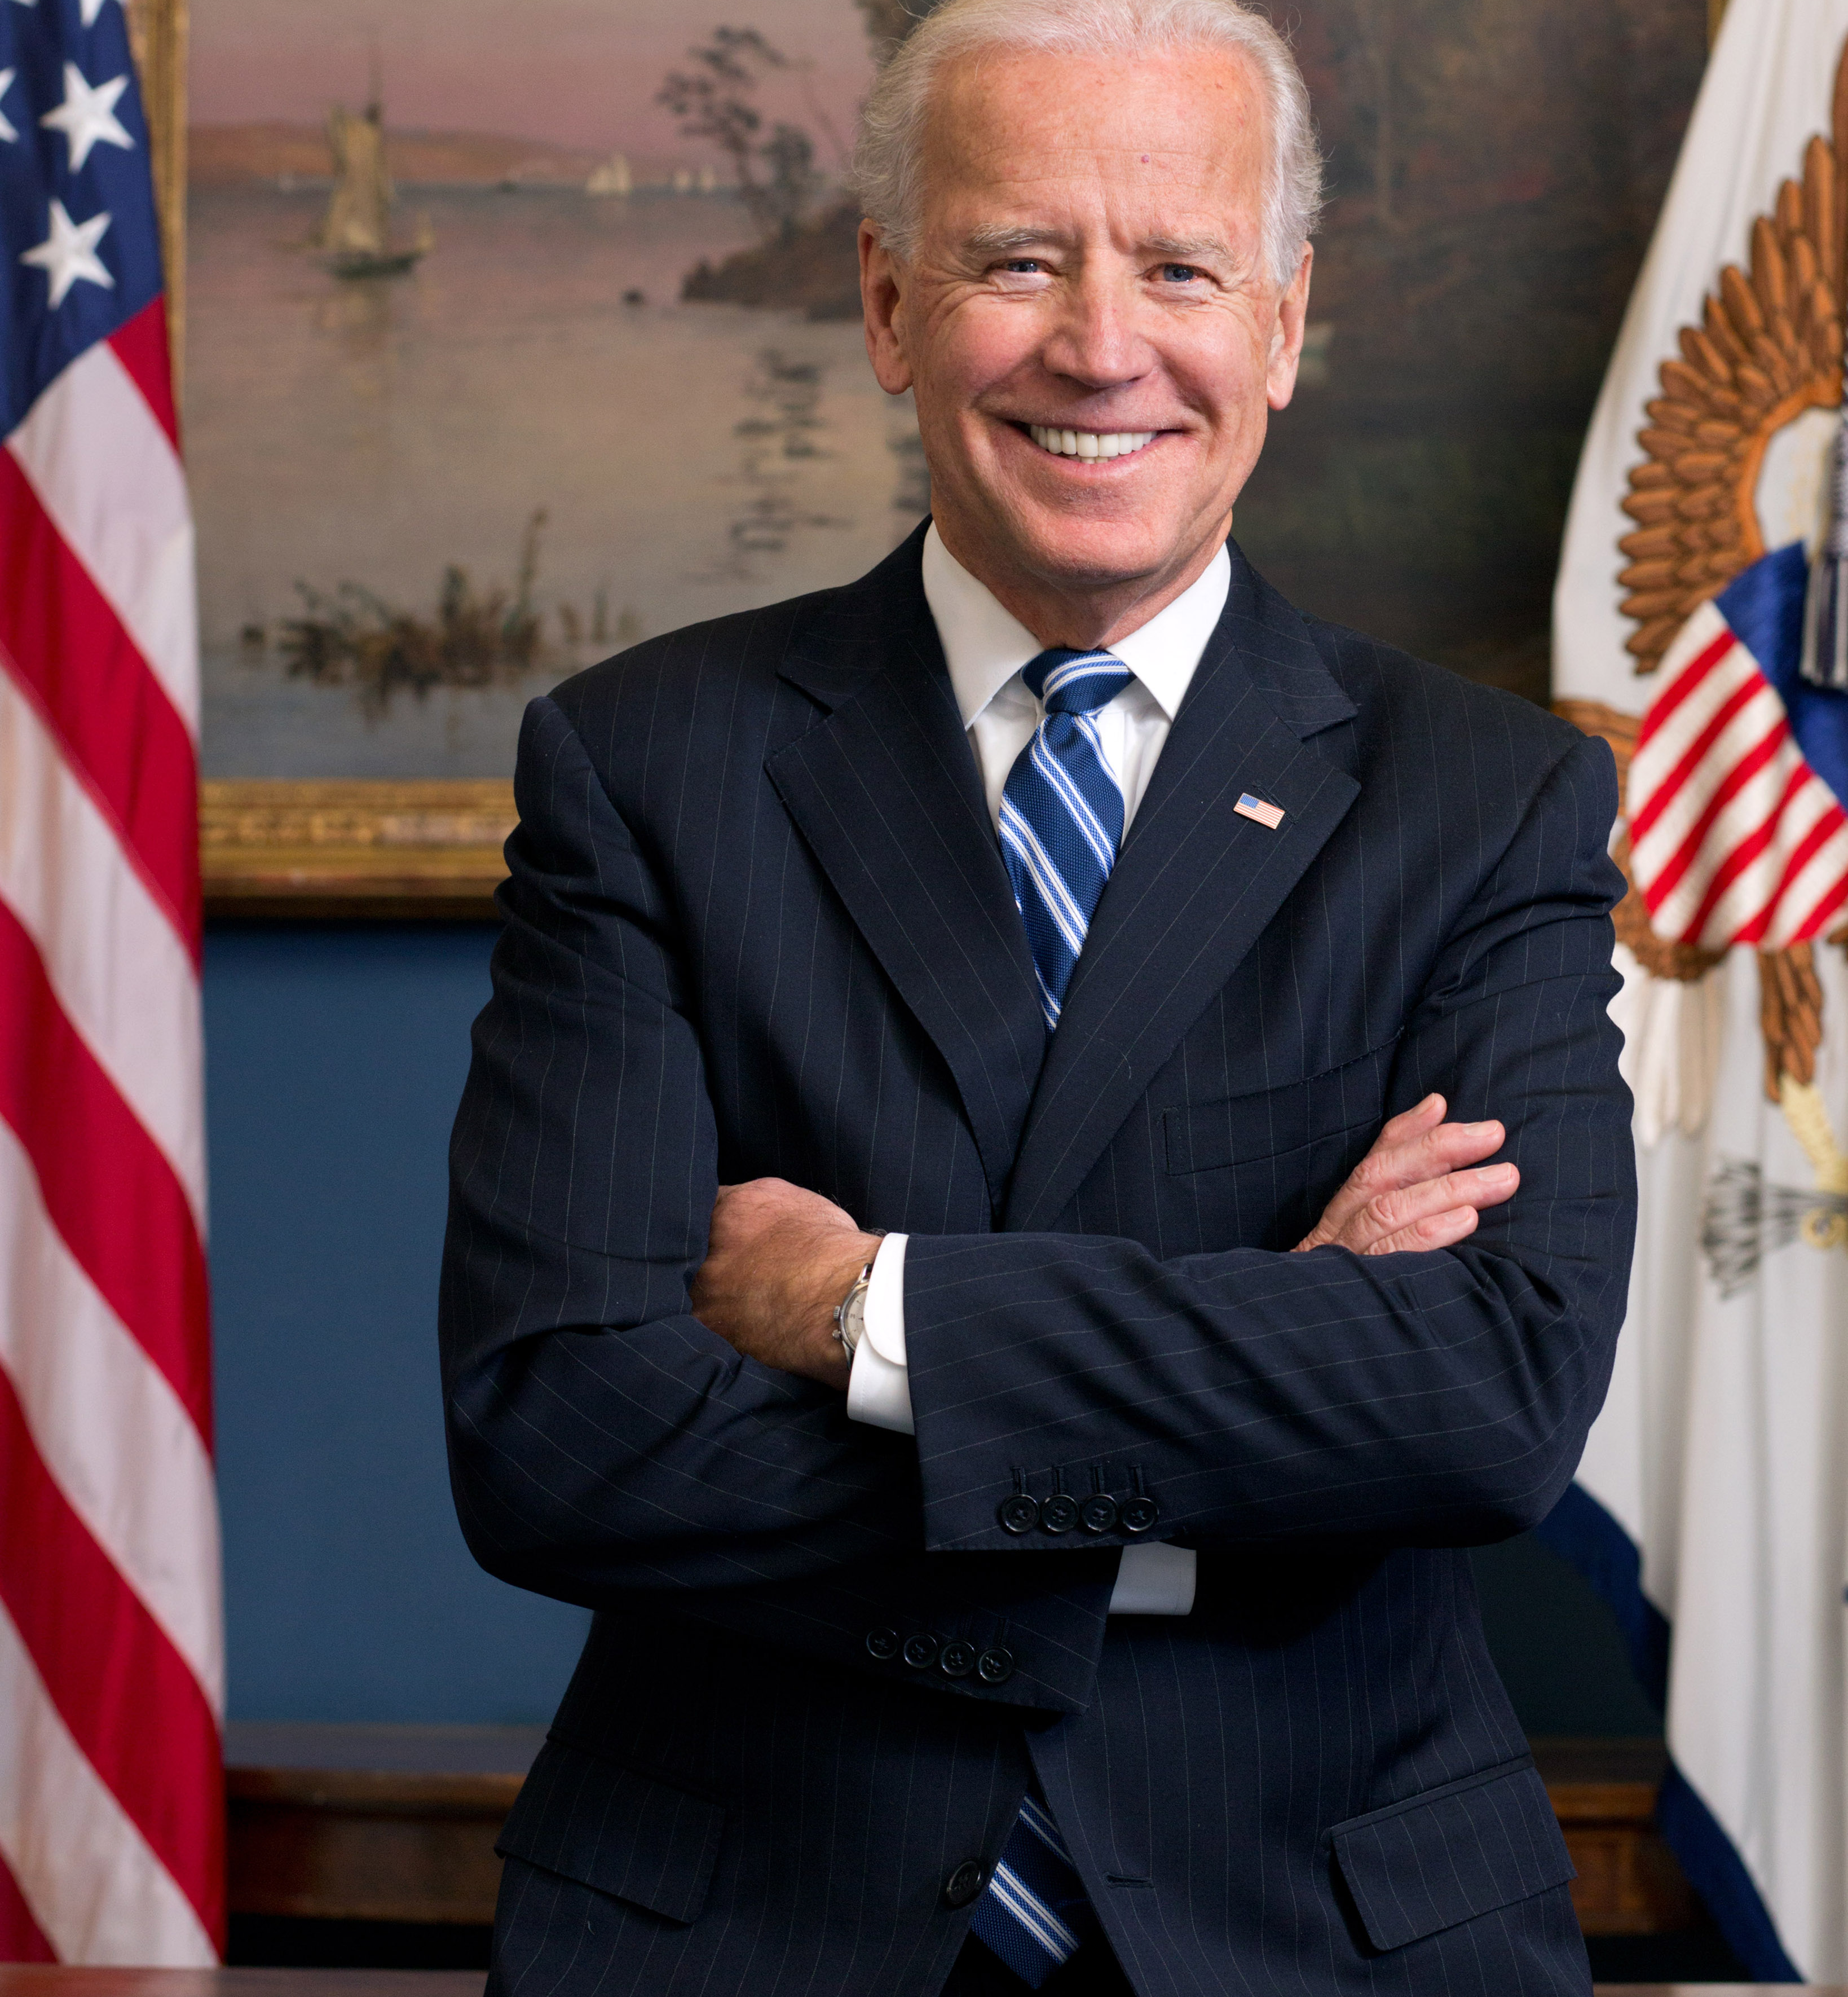
Presidential Transition
The vice president
  May succeed on death of president
    Has happened eight times
    John Tyler defined status of ascending vice president: president in title and in powers
  Rarely are vice presidents elected president
    Unless they first took over for a president who died
    Only five instances otherwise: Adams, Jefferson, Van Buren, Nixon, and Bush
  "A rather empty job"
    Candidates still pursue it
    Preside over Senate and vote in case of a tie
    Leadership powers in Senate are weak

Slide 34
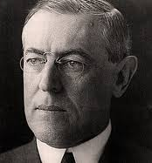
Problems with Succession
    What if the president falls ill?
    Examples: Garfield, Wilson
If vice president steps up, who becomes vice president?
  Succession Act (1886): designated secretary of state as next in line
  Amended in 1947 to designate Speaker of the House

Slide 35
Problems with Succession
Twenty-fifth Amendment resolved both issues
  Allows vice president to serve as "acting president" if president is disabled; decided by president, by vice president and cabinet, or by two-thirds vote of Congress
  Requires vice president who ascends to office on death or resignation of the president to name a vice president
    Must be confirmed by both houses
    Examples: Agnew and Nixon resignations

Slide 36
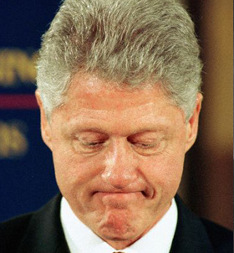
Impeachment
Judges most frequent targets of impeachment
Indictment by the House, conviction by the Senate.
  Presidents Impeached?

