Slide 1
Chapter 15
The Bureaucracy

Slide 2
Distinctiveness of the American Bureaucracy
Constitutional system and traditions
  Supervision shared
  A federalist structure shares functions
  Adversary culture leads to defense of rights and lawsuits
Scope of bureaucracy
  Little public ownership of industry in the United States
  High degree of regulation in the United States of private industries

Slide 3
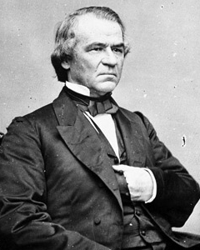
Growth of Bureaucracy
The early controversies
  Senate consent to removal of officials is challenged by supporters of a strong president
  President is given sole removal power but Congress funds and investigates

Slide 4
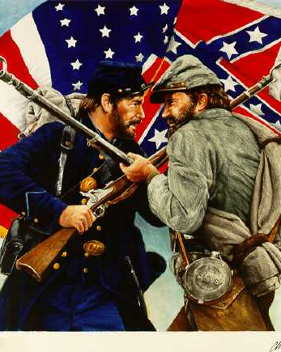
Growth of Bureaucracy
The appointment of officials
  Officials affect how laws are interpreted, the tone of their administration, and their effectiveness
  Use of patronage in the nineteenth and early twentieth centuries to reward supporters
  Civil War a watershed in bureaucratic growth; showed the weakness of federal government

Slide 5
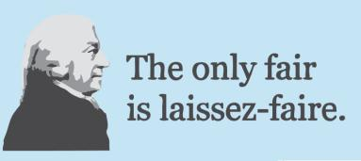
Growth of Bureaucracy
A service role
  1861-1901: shift in role from regulation to service
  Reflects desire for limited government, laissez-faire beliefs, and the Constitution's silence
A change in role
  Depression and World War II lead to a role of government activism
  Introduction of heavy income taxes supports a large bureaucracy

Slide 6
Federal Bureaucracy Today
Direct and indirect growth
  Modest increase in the number of government employees
  Indirect increase through the use of private contractors much greater
Growth in discretionary authority
  Delegation of undefined authority by Congress
  Primary areas of delegation
    Subsidies to groups
    Grant-in-aid programs
    Enforcement of regulations

Slide 7
Federal Bureaucracy Today
Factors explaining behavior of officials
  Recruitment and retention
    The competitive service: most bureaucrats compete for jobs through OPM
      Appointment by merit based on a written exam
      Decreased to less than 54 percent of federal government work force
    The excepted service: most are appointed by other agencies on the basis of qualifications approved by OPM
      Fastest growing sector of federal government employment
      Examples: Postal Service employees and FBI agents
      But president can also appoint employees: presidential appointments, Schedule C jobs, and NEA jobs
      Pendleton Act (1883): transferred basis of government jobs from patronage to merit
      Merit system protects president from pressure and protects patronage appointees from new presidents ("blanketing in")

Slide 8
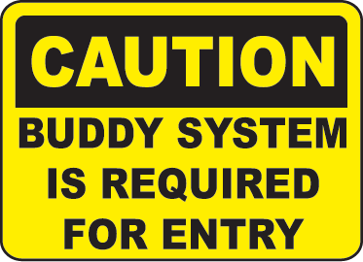
Federal Bureaucracy Today
The buddy system
  Name-request job: filled by a person whom an agency has already identified for middle- and upper-level jobs
  Job description may be tailored for person
  Circumvents usual search process
  But also encourages "issue networks" based on shared policy views

Slide 9
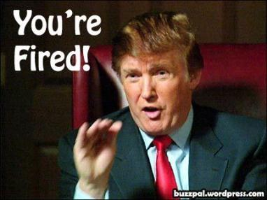
Federal Bureaucracy Today
Firing a bureaucrat
  Most bureaucrats cannot be fired
  Exception: Senior Executive Service (SES)
  SES managers receive cash bonuses for good performance
  But very few SES members have been fired or even transferred

Slide 10
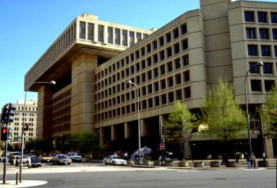
Federal Bureaucracy Today
The agencies' point of view
  Agencies are dominated by lifetime bureaucrats who have worked for no other agency
  System assures continuity and expertise
  But also gives subordinates power over new bosses: can work behind boss's back through sabotage, delaying, and so on

Slide 11
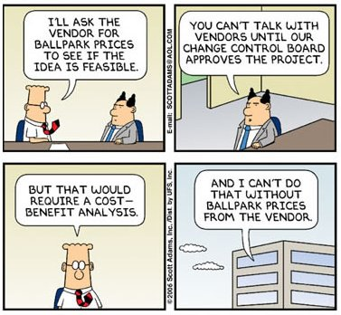
Federal Bureaucracy Today
Personal attributes
  Allegations of critics
    Higher civil servants are elitists
    Political appointees and career bureaucrats think about government and politics differently than public at large
  Correlation between type of agency and attitudes of employees: activist versus traditional
  Professional values of officials

Slide 12
Federal Bureaucracy Today
Do bureaucrats sabotage their political bosses?
  If so, such sabotage hurts conservatives more than liberals; bureaucrats tend to be liberal
  But loyalty to bosses runs strong--despite the power of bureaucrats to obstruct or complain
    Whistleblower Protection Act (1989) created Office of Special Counsel
    "Cooperation is the nature of a bureaucrat's job"
  Most civil servants: highly structured roles make them relatively immune to personal attitudes
  Professionals such as lawyers and economists in the FTC: loosely structured roles may be much influenced by personal attitudes, professional values help explain how power is used

Slide 13
Federal Bureaucracy Today
Culture and careers
    Each agency has its own culture
    Jobs with an agency can be career enhancing or not
    Strong agency culture motivates employees but makes agencies resistant to change
Constraints
    Biggest difference between a government agency and a business: hiring, firing, pay, procedures, and so forth
    General constraints
      Administrative Procedure Act (1946)
      Freedom of Information Act (1966)
      National Environmental Policy Act (1969)
      Privacy Act (1974)
      Open Meeting Law (1976)
      Assignment of single jobs to several agencies

Slide 14
Federal Bureaucracy Today
Agency allies
  Agencies often seek alliances with congressional committees or interest groups: "iron triangle"
  Far less common today; politics has become too complicated
      More interest groups, more congressional subcommittees, and easier access for individuals
      Far more competing forces than ever given access by courts
  "Issue networks": groups that regularly debate government policy on certain issues
      Contentious and partisan
      New president often recruits from networks

Slide 15
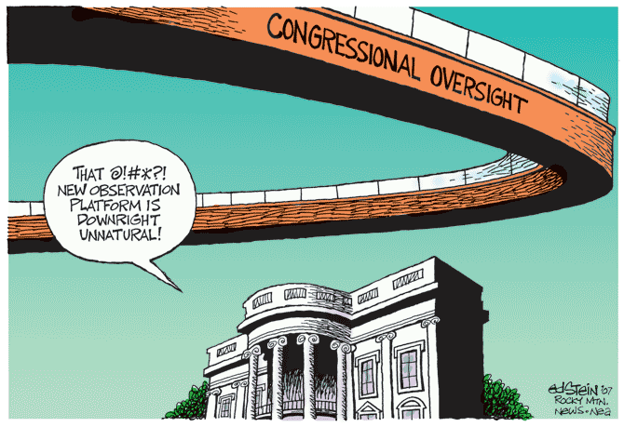
Congressional Oversight
Forms of congressional supervision
  Approval necessary for creation
  Statutes influence agency behavior (sometimes precisely)
  Authorization of money, either permanent or fixed number of years
  Appropriation of money allows spending

Slide 16
Congressional Oversight
Congressional oversight and "homeland security"
  Lieberman's call for Department of Homeland Defense after September 11 attack
  President Bush's creation of Office of Homeland Security
    Appointment of Governor Ridge and the blueprint for homeland security
    Congressional calls for testimony about strategies
    Need to coordinate personnel and budgets
  Proposal of a Department of Homeland Security
    Consolidation, reorganization and transformation
    Need for Congress to reorganize itself to make the bureaucracy work
      Immediate protests about committee and subcommittee jurisdiction
      Congress' historical tendency to resist streamlining

Slide 17
Congressional Oversight
The Appropriations Committee and legislative committees
  Appropriations Committee most powerful
    Most expenditure recommendations are approved by House
    Has power to lower agency's expenditure request
    Has power to influence an agency's policies by marking up an agency's budget
    But becoming less powerful because of
      Trust funds: Social Security
      Annual authorizations
      Meeting target spending limits

Slide 18
Congressional Oversight
Legislative committees are important when
  A law is first passed
  An agency is first created
  An agency is subject to annual authorization
Informal congressional controls over agencies
  Individual members of Congress can seek privileges for constituents
  Congressional committees may seek committee clearance: right to pass on certain agency decisions
  Committee heads may ask to be consulted

Slide 19
Congressional Oversight
The legislative veto
  Declared unconstitutional by Supreme Court in Chadha (1983)
  Weakens traditional legislative oversight but Congress continues creating such vetoes
Congressional investigations
  Power inferred from power to legislate
  Means for checking agency discretion
  Means for limiting presidential control

Slide 20

Bureaucratic Pathologies
  Red tape--complex and sometimes conflicting rules among agencies
  Conflict--agencies work at cross-purposes
  Duplication--two or more agencies seem to do the same thing
  Imperialism--tendency of agencies to grow, irrespective of benefits and costs of programs
  Waste--spending more than is necessary to buy some product or service

Slide 21
Reforming the Bureaucracy
Numerous attempts to make bureaucracy work better for less money
  Eleven attempts to reform in this century alone
  National Performance Review (NPR) in 1993 designed to reinvent government
    Differs from previous reforms that sought to increase presidential control
    Emphasizes customer satisfaction by bringing citizens in contact with agencies
  NPR calls for innovation and quality consciousness by
    Less-centralized management
    More employee initiatives
    Customer satisfaction

Slide 22
Reforming the Bureaucracy
Bureaucratic reform always difficult to accomplish
  Most rules and red tape result from the struggle between the president and Congress.
  This struggle makes bureaucrats nervous about irritating either
  Periods of divided government exacerbate matters, especially in implementing policy.
    Republican presidents seek to increase political control (executive micromanagement)
    Democratic Congresses respond by increasing investigations and rules (legislative micromanagement)

