Slide 1
Chapter 16: The Judiciary
Mr. Sherman
By PresenterMedia.com

Slide 2
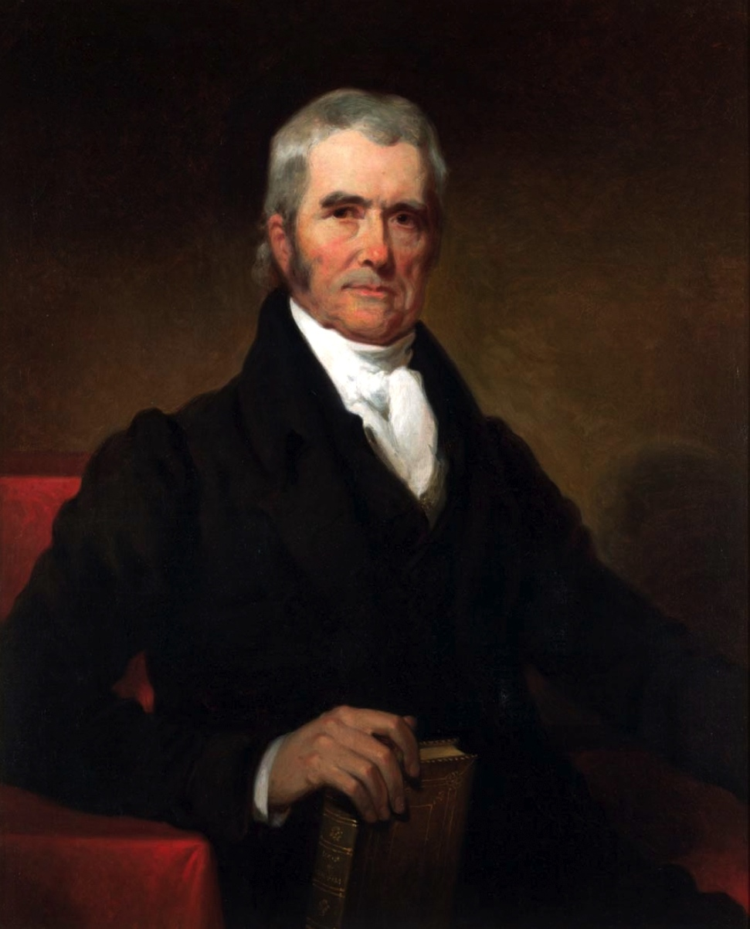
Introduction
Only in the United States do judges play so large a role in policy-making.
  Judicial review: right to rule on laws and executive acts on basis of constitutionality; chief judicial weapon in system of checks and balances
  In Great Britain, Parliament is supreme
  In other countries, judicial review means little
  Exceptions: Australia, Canada, Germany, India, and a few others

Slide 3
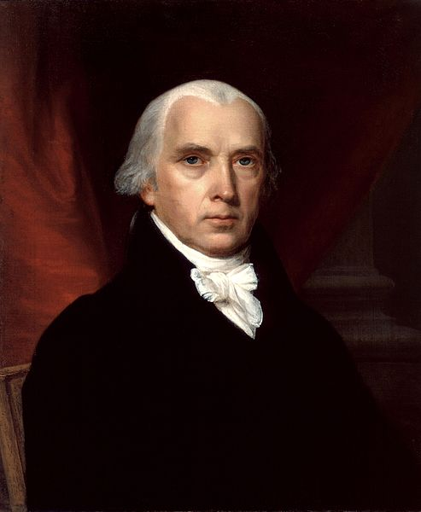
Introduction
Debate is over how the Constitution should be interpreted
  Strict constructionist (interpretivist) approach: judges are bound by the wording of the Constitution
  Activist (legislative) approach: judges should look to the underlying principles of the Constitution
  Not a matter of liberal versus conservative
    A judge can be both conservative and activist, or vice versa
    Today most activists tend to be liberal, most strict constructionists conservative

Slide 4
Development of the Federal Courts
Founders' view
  Most Founders probably expected judicial review but not its large role in policy making
  Traditional view: judges find and apply existing law
  Activist judges would later respond that judges make law
  Traditional view made it easy for Founders to justify judicial review
  Hamilton: courts least dangerous branch
  But federal judiciary evolved toward judicial activism

Slide 5
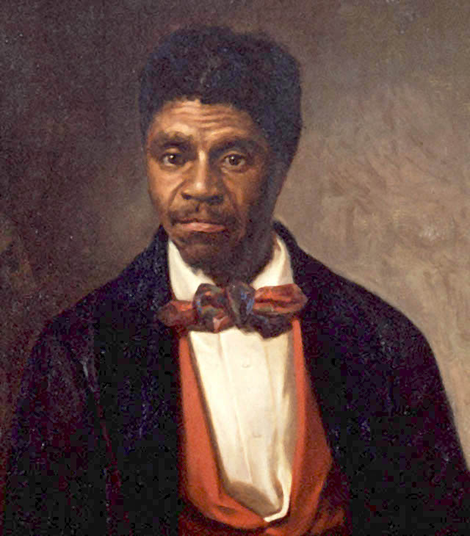
National Supremacy and Slavery
1789 - 1861
National supremacy and slavery: 1789-1861
  McCulloch v. Maryland: federal law declared supreme over state law
  Interstate commerce clause is placed under the authority of federal law; conflicting state law void
  Dred Scott v. Sandford: Negroes were not and could not become free citizens of the United States; a direct cause of the Civil War

Slide 6
Government and the Economy
Civil War - 1936
  Dominant issue of the period: whether the economy could be regulated by state and federal governments
  Private property held to be protected by the Fourteenth Amendment
  States seek to protect local businesses and employees from the predatory activities of national monopolies; judicial activism
  The Supreme Court determines what is "reasonable" regulation
  The Court interprets the Fourteenth and Fifteenth Amendments narrowly as applied to blacks

Slide 7
Government and Political Liberty
1936-Present
Government and political liberty: 1936 to the present
  Court establishes tradition of deferring to the legislature in economic cases
  Court shifts attention to personal liberties and becomes active in defining rights
The revival of state sovereignty
  Supreme Court rules that states have right to resist some forms of federal action
  Hint at some real limits to the supremacy of the federal government

Slide 8
Structure of the Federal Courts

Slide 9
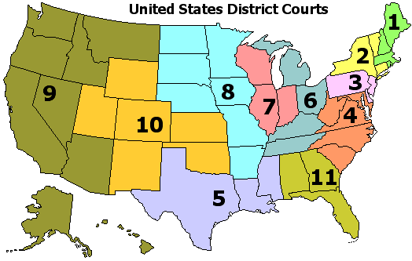
Two Kinds of Federal Courts
  Constitutional courts
    Created under Article III
    Judges serve during good behavior
    Salaries not reduced while in office
    Examples: District Courts (ninety-four), Courts of Appeals (twelve)

Slide 10
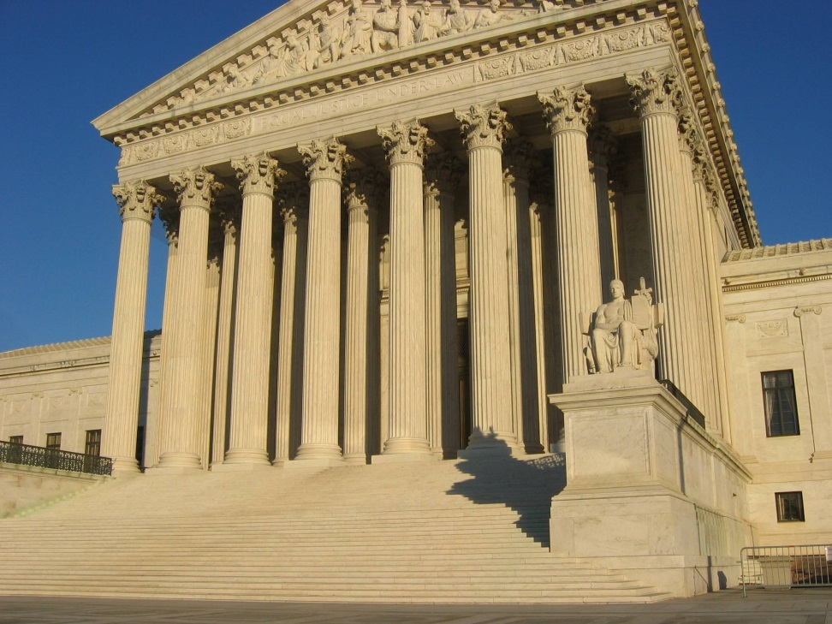
Two Kinds of Federal Courts
Legislative courts
  Created by Congress for specialized purposes
  Judges have fixed terms
  No salary protection

Slide 11
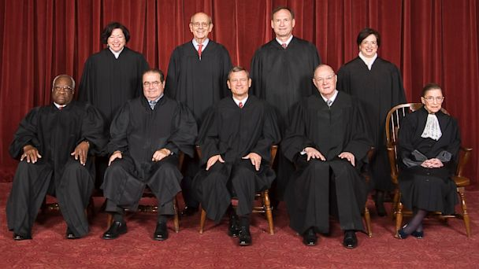
Selecting Judges
Party background some effect on judicial behavior but ideology does not determine behavior
Senatorial courtesy: judges for U.S. district courts must be approved by that state's senators
The litmus test
  Presidential successes in selecting compatible judges
  Concern this may downplay professional qualifications
  Greatest effect on Supreme Court

Slide 12
Jurisdiction of Federal Courts

Slide 13
Dual Court System
One state, one federal
Federal cases listed in Article III and the Eleventh Amendment of the Constitution
  Federal question cases: involving U.S. matters
  Diversity cases: involving citizens of different states
  All others are left to state courts
Some cases can be tried in either court
  Example: if both federal and state laws have been broken (dual sovereignty)
  Justified: each government has right to enact laws, and neither can block prosecution out of sympathy for the accused
State cases sometimes can be appealed to Supreme Court
Exclusive federal jurisdiction over federal criminal laws, appeals from federal regulatory agencies, bankruptcy, and controversies between two states

Slide 14
Route to the Supreme Court
Most federal cases begin in U.S. district courts, are straightforward, and do not lead to new public policy.
The Supreme Court picks the cases it wants to hear on appeal
  Uses writ of certiorari ("cert")
  Requires agreement of four justices to hear case
  Usually deals with significant federal or constitutional question
    Conflicting decisions by circuit courts
    State court decisions involving the Constitution
  Only 3 to 4 percent of appeals are granted certiorari
  Others are left to lower courts; this results in a diversity of constitutional interpretation

Slide 15
Getting to the Court

Slide 16

Deterrents
The Court rejects 95 percent of applications for certiorari
Costs of appeal are high
  But these can be lowered by
    In forma pauperis: plaintiff heard as pauper, with costs paid by the government
    Payment by interest groups who have something to gain (American Civil Liberties Union)
  Each party must pay its own way except for cases in which it is decided
    That losing defendant will pay (fee shifting)
    Section 1983 suits

Slide 17
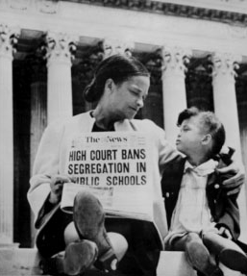
Deterrents
Standing: guidelines
  Must be controversy between adversaries
  Personal harm must be demonstrated
  Being taxpayer not entitlement for suit
  Sovereign immunity
Class Action Suits
  Brought on behalf of all similarly suited
  Financial incentives

Slide 18
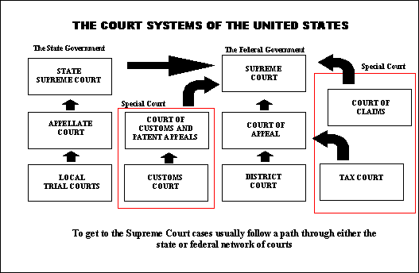
Road to the Court

Slide 19
Supreme Court in Action

Slide 20
Supreme Court in Action
Oral arguments by lawyers after briefs submitted
  Questions by justices cut down to thirty minutes
  Role of solicitor general
  Amicus curiae briefs
  Many sources of influence on justices, such as law journals
Conference procedures
  Role of chief justice: speaking first, voting last
  Selection of opinion writer: concurring and dissenting opinions

Slide 21

Supreme Court in Action
Strategic retirements from the U.S. Supreme Court
  There has been a sharp increase in the rate of retirements (contra deaths)
  Early duties were physically onerous, adverse to one's health
  More recently, retirements occur when justices and presidents share party identification

Slide 22
Power of the Federal Courts

Slide 23
Power of the Federal Courts
The power to make policy
  By interpretation
  By extending reach of existing law
  By designing remedies
Measures of power
  Number of laws declared unconstitutional (more than 120)
  Number of prior cases overturned; not following stare decisis
  Deference to the legislative branch (political questions)
  Kinds of remedies imposed; judges go beyond what justice requires
  Basis for sweeping orders from either the Constitution or the interpretation of federal laws

Slide 24
Power of the Federal Courts
Views of judicial activism
  Supporters
    Courts should correct injustices
    Courts are last resort
Critics
  Judges lack expertise
  Courts not accountable; judges not elected
Various reasons for activism
  Too many lawyers; but real cause adversary culture
  Easier to get standing in courts

Slide 25
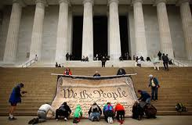
Power of the Federal Courts
Legislation and courts
  Laws and the Constitution are filled with vague language
    Ambiguity gives courts opportunities to design remedies
    Courts can interpret language in different ways
  Federal government is increasingly on the defensive in court cases; laws induce litigation
  The attitudes of federal judges affect their decisions

Slide 26
Checks on Judicial Power

Slide 27
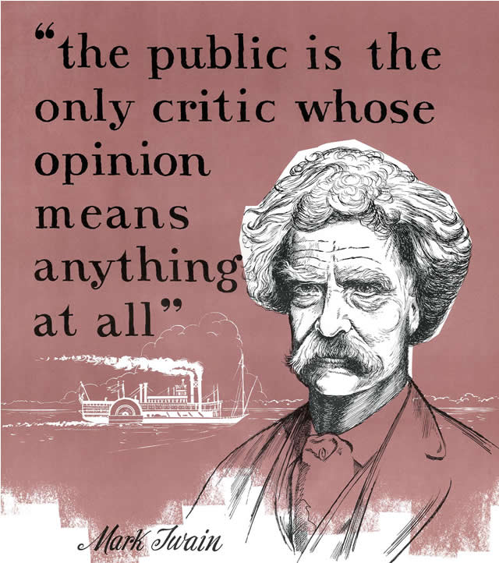
Checks
Judges are not immune to politics or public opinion
  Effects will vary from case to case
  Decisions can be ignored
    Examples: school prayer, segregated schools
    Usually if register is not highly visible

Slide 28
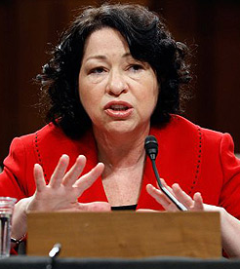
Checks
Congress and the courts
  Confirmation and impeachment proceedings alter the composition of the courts
  Changing the number of judges
  Revising legislation declared unconstitutional
  Altering jurisdiction of the courts and restricting remedies
  Constitutional amendment

Slide 29

Checks
Public opinion and the courts
  Defying public opinion, especially elite opinion, frontally is dangerous
  Opinion in realigning eras may energize court
  Public confidence in court since 1966 has varied
  Change caused by changes of personnel and what government is doing

