Slide 1
Chapter 7
Public Opinion

Slide 2
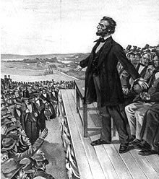
Public Opinion and Democracy
Lincoln and the Gettysburg address "of the people, by the people, for the people."
  Yet the federal government's budget is not balanced
  Yet the people have opposed busing
  Yet the ERA was not ratified
  Yet most Americans opposed Clinton's impeachment
  Yet most Americans favor term limits for Congress

Slide 3
Public Opinion and Democracy
Why government policy and public opinion may appear to be at odds
  Government not intended to do "what the people want"
    Framers of Constitution aimed for substantive goals
    Popular rule was only one of several means toward these goals.
    Large nations feature many "publics" with many "opinions."
      Framers hoped no single opinion would dominate
      Reasonable policies can command support of many factions
  Limits on effectiveness of opinion polling; difficult to know public opinion
  Government may give more weight to political elites who may think differently

Slide 4
What is public opinion?
Influences and limitations
  Public ignorance: Monetary Control Bill ruse, poor name recognition of leaders
  Importance of wording of questions, affects answers
  Questions may focus one side of an issue at the expense of another (benefits / costs)
  Instability of public opinion
  Public has more important things to think about; need clear-cut political choices
  Specific attitudes less important than political culture

Slide 5
The Origins of Political Attitudes

Slide 6
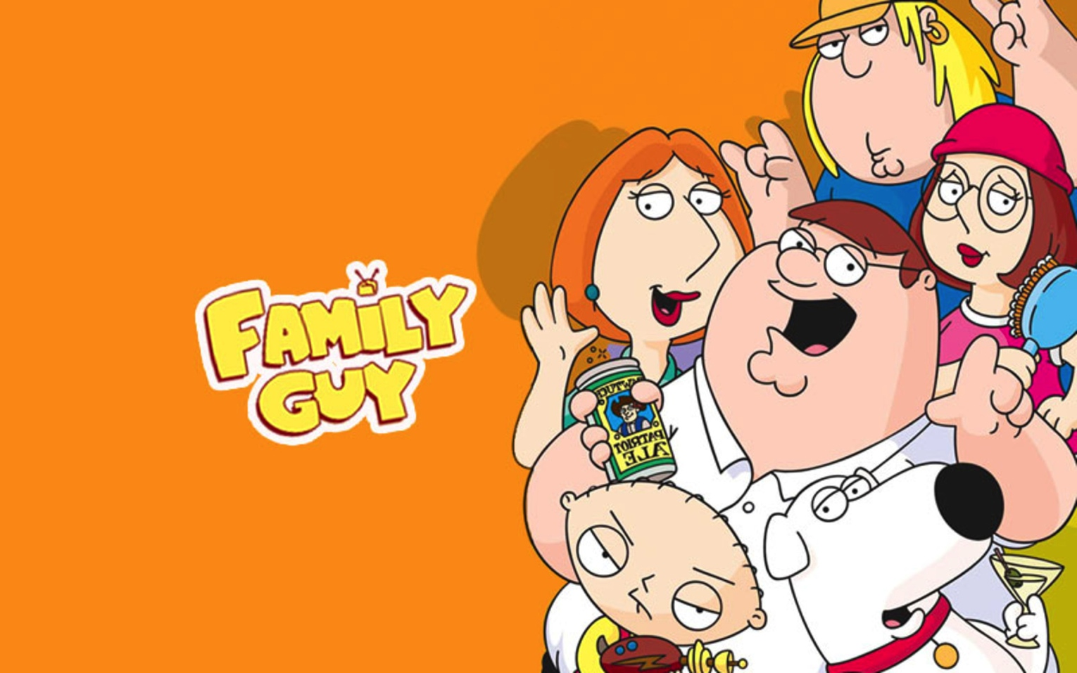
Family
  Child absorbs party identification of family but becomes more independent with age
  Much continuity between generations
  Declining ability to pass on identification
  Younger voters exhibit less partisanship; more likely to be independent
  Meaning of partisanship unclear in most families; less influence on policy preferences
  Few families pass on clear ideologies

Slide 7
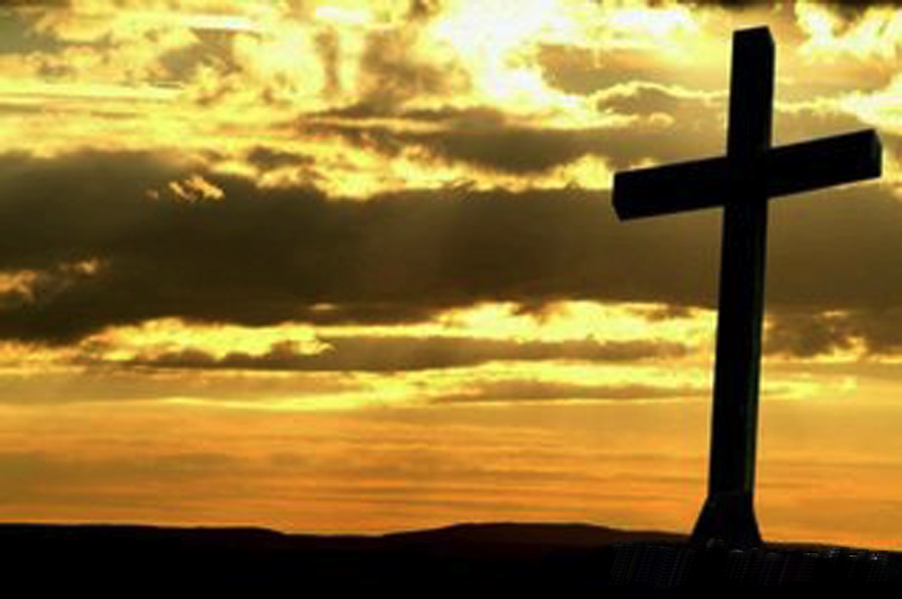
Religion
  Religious traditions affect families
    Catholic families somewhat more liberal
    Protestant families more conservative
    Jewish families decidedly more liberal
  Two theories on differences
    Social status of religious group
    Content of religion's tradition

Slide 8
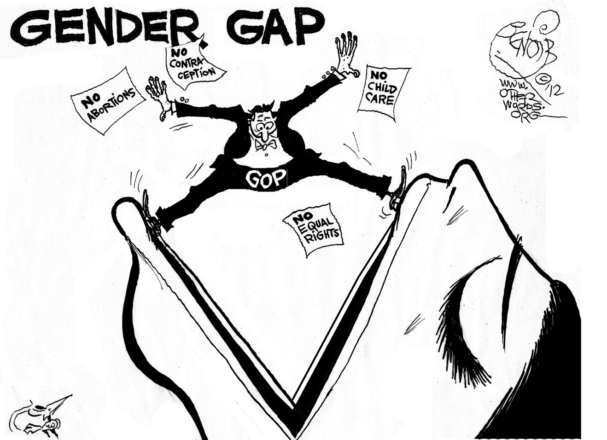
The Gender Gap
  A "problem" that has existed for a long time for both parties
    Men and women both identified with the Democratic Party at about the same levels in the 1950s
    By the 1990's men identified more with the Republican party while women continued to support the Democrats at earlier levels

Slide 9
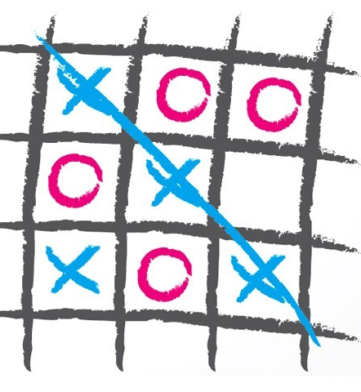
The Gender Gap
  Possible explanations for the "gap"
    Attitudes about size of government, gun control, spending programs for the poor, and gay rights
    The conservative policy positions of men are increasingly matched by their party loyalty
    Presence of Democratic female candidates may also have an impact

Slide 10
Schooling and Information
College education has liberalizing effect; longer in college, more liberal
  Effect extends beyond end of college
  Cause of this liberalization?
    Personal traits: temperament, family, intelligence
    Exposure to information on politics
    Liberalism of professors
  Effect growing as more go to college
  Increasing conservatism since 1960s?
    Yes (legalizing marijuana)
    No (school busing)

Slide 11
Cleavages in Public Opinion

Slide 12

Social Class
Less important in the US than in Europe.
  More important in 1950s on unemployment, education, housing programs
  Less important in 1960s on poverty, health insurance, Vietnam, jobs
  Why the change?
    Education: occupation depends more on schooling
    Noneconomic issues now define liberal and conservative

Slide 13
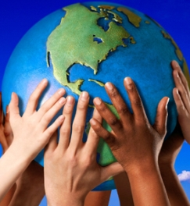
Race and Ethnicity
Social class becoming less clear-cut source of political cleavage
  Impact of race and ethnicity is less clear
    Some clear difference in opinion (party identification, O.J. Simpson, criminal justice system, affirmative action)
    Some similarities (quotas, getting tough on crime, abortion, etc.)
    Evidence that the gap in opinions is narrowing
    Further complication: gaps between the opinions of younger and older blacks

Slide 14
Race and Ethnicity
Big opinion gap between black leaders and black people generally
  Still differences of opinions between blacks and whites on social issues; opinions similar on others
  Evidence that black-white differences are narrowing
Few studies of the opinions of over 30 million Latinos
  California study of Latinos and Asian Americans
  Latinos identified themselves as Democrats / Asian Americans identified themselves as Republicans
  Latinos were somewhat more liberal than Anglo whites and Asian Americans, but less liberal than blacks
  Diversity within ethnic groups and limitations of such studies

Slide 15
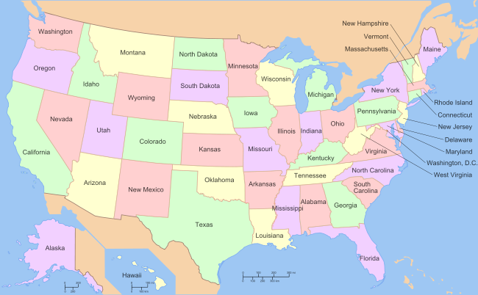
Region
Southerners more conservative than northerners on military and civil rights issues but difference fading overall
Southern lifestyle different
Lessening attachment to Democratic party

Slide 16
Political Ideology

Slide 17
Consistent Attitudes
Consistent attitudes
  Ideology: patterned set of political beliefs about who ought to rule, their principles and policies
  Most citizens display little ideology; moderates dominate
  Yet most citizens may have strong political predispositions
  "Consistency" criterion somewhat arbitrary
  Some believe ideology increased in 1960s
  Others argue that poll questions were merely worded differently in 1960s

Slide 18
What do liberalism and conservatism mean?
Liberal and conservative labels have complex history
  Europe during French Revolution: conservative = church, state authority
  Roosevelt and New Deal: activism = liberalism
  Conservative reaction to activism (Goldwater): free market, states' rights, economic choice
  Today's imprecise and changing meanings

Slide 19
Various Categories
Three useful categories emerge from studies
  Economic policy: liberals favor jobs for all, subsidized medical care and education, taxation of rich
  Civil rights: liberals prefer desegregation, equal opportunity, etc.
  Public and political conduct: liberals tolerant of demonstrations, favor legalization of marijuana, and so on

Slide 20
Analyzing Consistency
Pure liberals: liberal on both economic and personal conduct issues
Pure conservatives: conservative on both economic and personal conduct issues
Libertarians: conservative on economic issues, liberal on personal conduct issues
Populists: liberal on economic issues, conservative on personal conduct issues

Slide 21
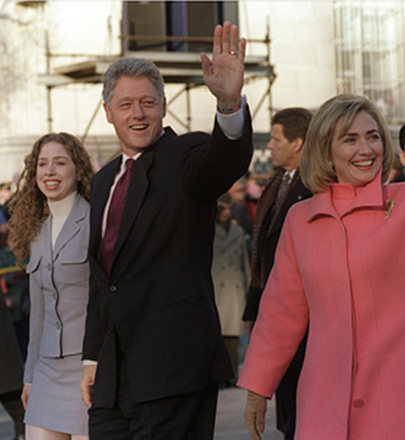
Political Elites
Political elites
  Definition: those who have a disproportionate amount of some valued resource
  Elites, or activists, display greater ideological consistency
    More information than most people
    Peers reinforce consistency and greater difference of opinion than one finds among average voters

Slide 22
Is there a new class?
Definition: those who are advantaged by the power, resources, and growth of government (not business)
Two explanations of well-off individuals who are liberals
  Their direct benefits from government
  Liberal ideology infusing postgraduate education
Traditional middle class: four years of college, suburban, church affiliated, pro-business, conservative on social issues, Republican
Liberal middle class: postgraduate education, urban, critical of business, liberal on social issues, Democratic
Emergence of new class creates strain in Democratic party

Slide 23
Political Elites, Public Opinion, and Public Policy
Elites influence public opinion in three ways
  Raise and form political issues
  State norms by which to settle issues, defining policy options
  Elite views shape mass views
Limits to elite influence on the public
  Elites do not define problems
  Many elites exist; hence many elite opinions

