Slide 1
Chapter 8
Political Participation

Slide 2
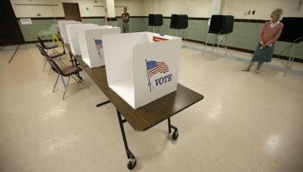
A Closer Look at Nonvoting
Alleged problem: low turnout compared with Europeans, but this compares registered voters with the eligible adult population
Common explanation: voter apathy on election day, but the real problem is low registration rates
Proposed solution: get-out-the-vote drives, but this will not help those who are not registered

Slide 3
A Closer Look at Nonvoting
Apathy not the only cause of non-registration
  Costs here versus no costs in European countries where registration is automatic
  Motor-voter law of 1993 (which took effect in 1995)
    Did not create a general boom in vote turnout
    Did increase registration among eligible voters
    Did not change the two party balance of registrants
    Did increase the number of independent registrants
    May actually add registrants who are less likely to vote
Voting is not the only way of participating

Slide 4
The Rise of the American Electorate

Slide 5
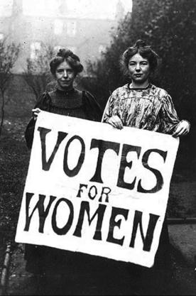
From State to Federal Control
Initially, states decided nearly everything
  This led to wide variation in federal elections
  Congress has since reduced state prerogatives
    1842 law: House members elected by district
    Suffrage to women
    Suffrage to blacks
    Suffrage to eighteen- to twenty-year-olds
    Direct popular election of U.S. senators

Slide 6
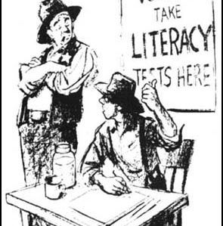
From State to Federal Control
  Black voting rights
    Fifteenth Amendment gutted by Supreme Court as not conferring a right to vote
    Southern states then use evasive strategies
      Literacy test
      Poll tax
      White primaries
      Grandfather clauses
      Intimidation of black voters
    Most of these strategies ruled out by Supreme Court
    Major change with 1965 Voting Rights Act; black vote increases

Slide 7
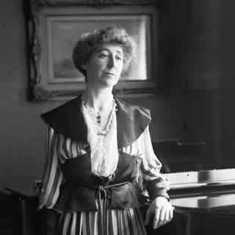
From State to Federal Control
Women's voting rights
  Western states permit women to vote
  Nineteenth Amendment ratified 1920
  No dramatic changes in outcomes
Youth vote
  Voting Rights Act of 1970
  Twenty-sixth Amendment ratified 1971
  Lower turnout; no particular party
National standards now govern most aspects

Slide 8
Voting Turnout
Debate over declining percentages: two theories
  The percentages are real and the result of a decline in popular interest in elections and competitiveness of the two parties
    Parties originally worked hard to increase turnout among all voters
    The election of 1896 locked Democrats in the South and Republicans in the North
    Lopsided Republican victories caused citizens to lose interest
    Leadership in the major parties became conservative and resisted mass participation

Slide 9
Voting Turnout
The percentages represent an apparent decline induced, in part, by more honest ballot counts of today.
  Parties once printed ballots
  Ballots cast in public
  Parties controlled counting
Most scholars see several reasons for some real decline.
  Registration more difficult: longer residency, educational qualifications, and discrimination
  Continuing drop after 1960 cannot be explained
  Refinement of VAP data to VEP data also reveals a decline
Universal turnout probably would not alter election outcomes

Slide 10
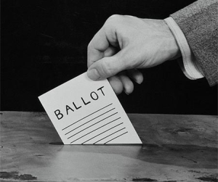
Who Participates in Politics?

Slide 11
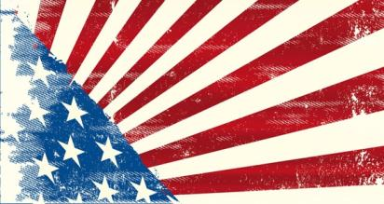
Forms of Participation
Voting the most common, but 8 to 10 percent misreport it
Verba and Nie's six types of participants
  Inactives
  Voting specialists
  Campaigners
  Communalists
  Parochial participants
  Complete activists

Slide 12
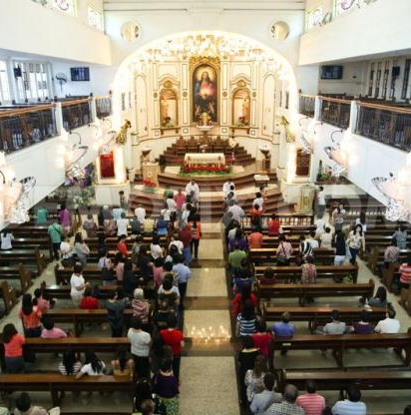
Causes of Participation
Schooling, or political information, more likely to vote
Church-goers vote more
Men and women vote same rate
Race
  Black participation lower than that of whites overall
  But controlling for SES, higher than whites

Slide 13
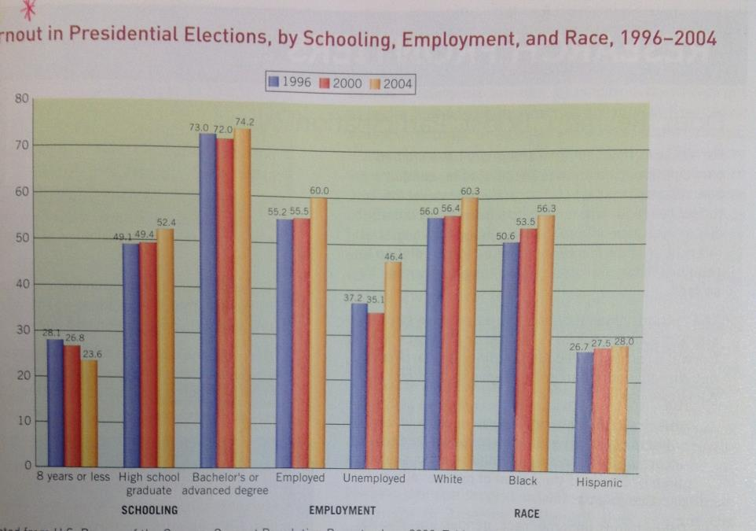

Slide 14
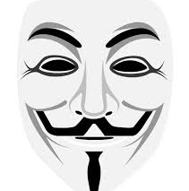
Causes of Participation
Level of trust in government?
  Studies show no correlation
Difficulty of registering; as turnout declines, registration gets easier

Slide 15
Causes of Participation
Several small factors decrease turnout
  More youths, blacks, and other minorities
  Decreasing effectiveness of parties
  Remaining impediments to registration
  Voting compulsory in other nations
  Ethnic minorities encounter language barriers, whereas blacks are involved in nonpolitical institutions
  May feel that elections do not matter

Slide 16
Causes of Participation
Democrats and Republicans fight over solutions
  No one really knows who would be helped
  Nonvoters tend to be poor, black, and so on
  But an increasing percentage of college graduates are also not voting
  Hard to be sure that turnout efforts produce gains for either party: Jesse Jackson in 1984

Slide 17
The Meaning of Participation Rates
Americans vote less but participate more
  Other forms of activity becoming more common
  Some forms more common here than in other countries
Americans elect more officials than Europeans do and have more elections
U.S. turnout rates heavily skewed to higher status; meaning of this is unclear

