Slide 1
Chapter 9
Political Parties

Slide 2
Parties Here and Abroad

Slide 3
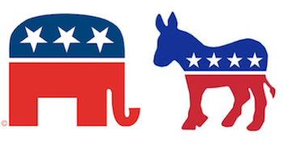
Decentralization
A party is a group that seeks to elect candidates to public office by supplying them with a label.
Arenas
  A label in the minds of the voters
  Set of leaders in government
  Organization recruiting and campaigning
American parties have become weaker in all three arenas
  As labels: more independents
  As organizations: much weaker since the 1960s
  As sets of leaders: the organization of Congress is more or less under their control

Slide 4
Reasons for Differences from European Parties
Federal system decentralizes power
  Early on, most people with political jobs worked for state and local government.
  National parties were coalitions of local parties.
  As political power becomes more centralized, parties become weaker still
Parties closely regulated by state and federal laws
Candidates chosen through primaries, not by party leaders
President elected separately from Congress
Political culture
  Parties unimportant in life; Americans do not join or pay dues
  Parties separate from other aspects of life

Slide 5
The Rise and Decline of the Political Party

Slide 6
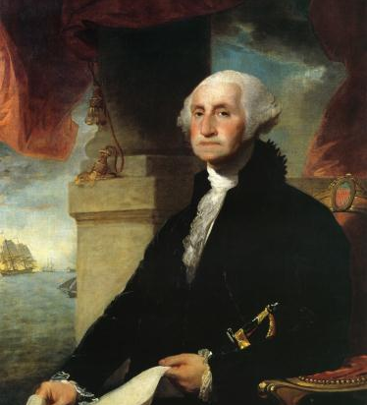
The Founding (to 1820’s)
The Founding (to the 1820s)
  Founders' dislike of factions
  Emergence of Republicans, Federalists: Jefferson versus Hamilton
    Loose caucuses of political notables
    Republicans' success and Federalists' demise
  No representation of clear economic interests

Slide 7
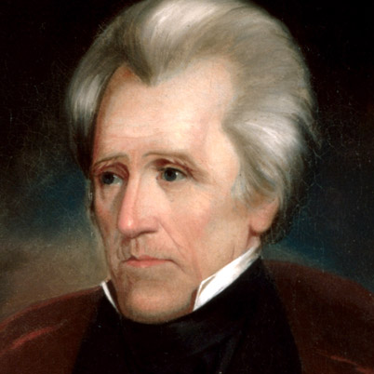
The Jacksonians
Political participation a mass phenomenon
  More voters to reach
  Party built from the bottom up
  Abandonment of presidential caucuses
  Beginning of national conventions to allow local control

Slide 8
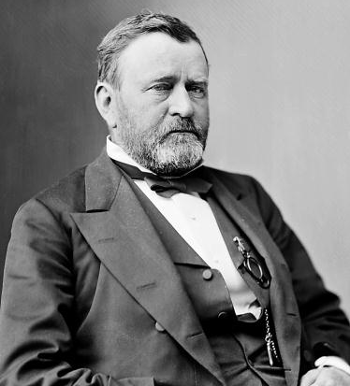
The Civil War & Sectionalism
Jacksonian system unable to survive slavery issue
New Republicans become dominant because of
  Civil War and Republicans on Union side
  Bryan's alienation of northern Democrats in 1896
In most states one party predominates
  Party professionals, or "stalwarts," one faction in GOP
  Mugwumps, Progressives, or "reformers" another faction
    Balance of power at first
    Diminished role later

Slide 9
The Era of Reform
Progressive push measures to curtail parties
  Primary elections
  Nonpartisan elections
  No party-business alliances
  Strict voter registration requirements
  Civil service reform
  Initiative and referendum elections
Effects
  Reduction in worst forms of political corruption
  Weakening of all political parties

Slide 10
Party Realignments
Occurrences: change in issues
  ) 1800: Jeffersonians defeated Federalists
  ) 1828: Jacksonian Democrats came to power
  ) 1860: Whigs collapsed; Republicans won
  ) 1896: Republicans defeated Bryan
  ) 1932: FDR Democrats came to power
Kinds of realignments
  ) Major party disappears and is replaced (1800, 1860)
  ) Voters shift from one party to another (1896, 1932)
Sharp lasting shift in popular coalition supporting one or both parties.

Slide 11
Party Realignments
Clearest cases
  ) 1860: slavery
  ) 1896: economics
  ) 1932: depression
1980 not a realignment
  ) Expressed dissatisfaction with Carter
  ) Also left Congress Democratic
1972-1988: shift in presidential voting patterns in the South
  ) Fewer Democrats, more Republicans, more independents
  ) Independents vote Republican
  ) Now close to fifty-fifty Democratic, Republican
  ) Party dealignment, not realignment
Party decline; evidence for it
  Fewer people identify with either party
  Increase in ticket splitting

Slide 12
National Party Structure Today

Slide 13
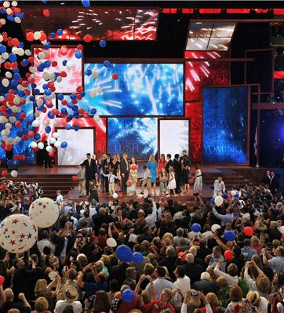
Parties Similar on Paper
  National convention ultimate power; nominates presidential candidate
  National committee composed of delegates from states
  Congressional campaign committees
  National chair manages daily work

Slide 14
Party Structure Diverges in the late 1960’s
  RNC moves to bureaucratic structure; a well-financed party devoted to electing its candidates
  Democrats move to factionalized structure to distribute power
  RNC uses computerized mailing lists to raise money
    Money used to run political consulting firm
    Democrats still manage to outspend GOP
    Public opinion polls used to find issues and to get voter response to issues and candidates
  RNC now tries to help state and local organizations
  Democrats remain a collection of feuding factions

Slide 15
National Conventions
National committee sets time and place; issues call setting number of delegates for each state
Formulas used to allocate delegates
  Democrats shift the formula away from the South to the North and West
  Republicans shift the formula away from the East to the South and Southwest
  Result: Democrats move left, Republicans right
Democratic formula rewards large states and Republican-loyal states

Slide 16
National Conventions
Democrats set new rules
  In the 1970s the rules changed to weaken party leaders and increase the influence of special interests.
  Hunt commission in 1981 reverses 1970s rules by increasing the influence of elected officials and by making convention more deliberative
Consequence of reforms: parties represent different set of upper-middle-class voters
  Republicans represent traditional middle class
  Democrats represent the "new class"
  Democrats hurt because the traditional middle class closer in opinions to most citizens
To become more competitive, Democrats adopt rule changes
  In 1988 the number of superdelegates increased and special interests decreased.
  In 1992 three rules: winner-reward system, proportional representation, and states that violate rules are penalized
Conventions today only ratify choices made in primaries.

Slide 17
State and Local Parties

Slide 18
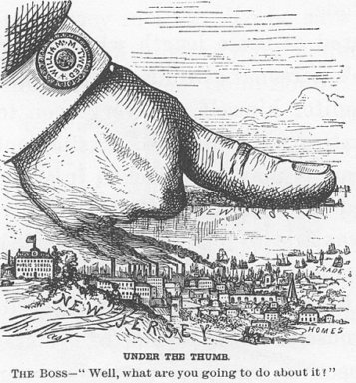
The Machine
Recruitment via tangible incentives
High degree of leadership control
Abuses
  Gradually controlled by reforms
  But machines continued
Both self-serving and public regarding
Winning above all else

Slide 19

Ideological Parties
Principle above all else
Usually outside Democrats and Republicans
But some local reform clubs
Reform clubs replaced by social movements

Slide 20
Solidarity & Sponsored
Solidary groups
  Most common form of party organization
  Members motivated by solidary incentives
  Advantage: neither corrupt nor inflexible
  Disadvantage: not very hard working
Sponsored parties
  Created or sustained by another organization
  Example: Detroit Democrats controlled by UAW
  Not very common

Slide 21
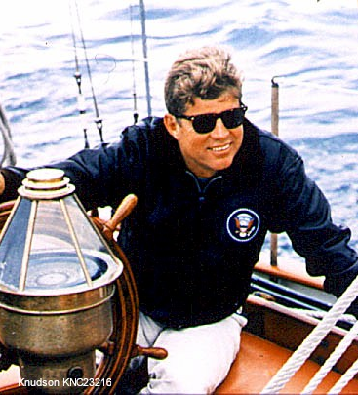
Cult of Personality
Examples: Kennedys, Curley, Talmadges, Longs
Viability today affected by TV and radio
Advantage: vote for the person
Disadvantage: takes time to know the person

Slide 22
The Two Party System
Rarity among nations today
Evenly balanced nationally, not locally
Why such a permanent feature?
  Electoral system: winner-take-all and plurality system
  Opinions of voters: two broad coalitions

Slide 23
Minority Parties
Ideological parties: comprehensive, radical view; most enduring
Examples: Socialist, Communist, Libertarian
One-issue parties: address one concern, avoid others
Examples: Free Soil, Know-Nothing, Prohibition
Economic protest parties: regional, oppose depressions
Examples: Greenback, Populist
Factional parties: from split in a major party
Examples: Bull Moose, Henry Wallace, American Independent
Movements not producing parties; either slim chance of success or major parties accommodate
Examples: civil rights, antiwar, labor
Factional parties have had greatest influence

Slide 24
Nominating a President

Slide 25
Nominating a President
Two contrary forces: party's desire to win motivates it to seek an appealing candidate, but its desire to keep dissidents in party forces a compromise to more extreme views
Are the delegates representative of the voters?
  Democratic delegates much more liberal
  Republican delegates much more conservative
  Explanation of this disparity not quota rules: quota groups have greater diversity of opinion than do the delegates

Slide 26
Who Votes in Primaries
  Primaries now more numerous and more decisive
    Stevenson and Humphrey never entered a primary
    By 1992: forty primaries and twenty caucuses
  Little ideological difference between primary voters and rank-and-file party voters
  Caucus: meeting of party followers at which delegates are picked
    Only most-dedicated partisans attend
    Often choose most ideological candidate: Jackson, Robertson in 1988

Slide 27
Who are New Delegates?
However chosen, today's delegates a new breed unlikely to resemble average citizen: issue-oriented activists
Advantages of new system
  Increased chance for activists within party
  Decreased probability of their bolting the party
Disadvantage: may nominate presidential candidates unacceptable to voters or rank and file

Slide 28
Party vs. Voters
Democrats: win congressional elections but lose presidential contests
  Candidates are out of step with average voters on social and tax issues
  So are delegates, and there's a connection
Republicans had the same problem with Goldwater (1964)
Rank-and-file Democrats and Republicans differ on many political issues, but the differences are usually small
Delegates from two parties differ widely on these same issues
  1996 conventions
    Few conservatives at Democratic convention
    Few liberals at Republican convention
  Formula for winning president
    Nominate candidates with views closer to the average citizen (e.g., 1996 election)
    Fight campaign over issues agreed on by delegates and voters (e.g., 1992 election)

