Slide 1
Chapter 10
Elections and Campaigns

Slide 2
Presidential v. Congressional
Campaigns

Slide 3
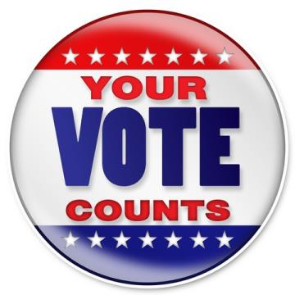
Two Phases
Getting nominated and getting elected.
Getting nominated
  Getting a name on the ballot
  An individual effort (versus organizational effort in Europe)
  Parties play a minor role (compared with Europe)
  Parties used to play a major role

Slide 4
Major Differences
Presidential races are more competitive.
  House races have lately been one-sided for Democrats.
  Presidential winner rarely gets more than 55 percent of vote
  Most House incumbents are reelected (more than 60 percent)
Fewer people vote in congressional elections
  Unless election coincides with presidential election
  Gives greater importance to partisan voters (party regulars)
Congressional incumbents can service their constituents.
  Can take credit for governmental grants, programs, and so forth
  President can't: power is not local

Slide 5
Major Differences
Congressional candidates can duck responsibility.
  "I didn't do it; the people in Washington did!"
  President is stuck with blame
  But local candidates can suffer when their leader's economic policies fail
Benefit of presidential coattails has declined
  Congressional elections have become largely independent
  Reduces meaning (and importance) of party

Slide 6
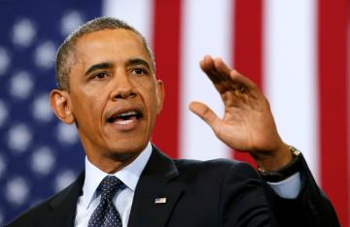
Running for President
Getting mentioned
  Using reporters, trips, speeches, and name recognition
  Sponsoring legislation, governing large state
Setting aside time to run
  Reagan: six years
  May have to resign from office first
Money
  Individuals can give $1,000, political action committees (PACs) $5,000
  Candidates must raise $5,000 in twenty states to qualify for matching grants to pay for primary

Slide 7
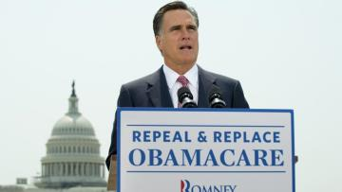
Running for President
Organization
  Need a large (paid) staff
  Need volunteers
  Need advisers on issues: position papers
Strategy and themes
  Incumbent versus challenger: defend or attack?
  Setting the tone (positive or negative)
  Developing a theme: trust, confidence, and so on
  Judging the timing
  Choosing a target voter: who's the audience?

Slide 8
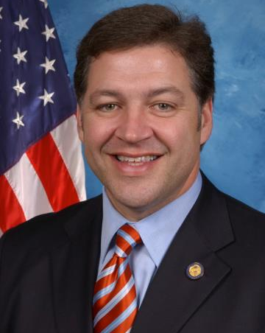
Getting Elected to Congress
Malapportionment and gerrymandering.
Establishing the size of the House
Winning the primary
  Ballot procedures
  Developing a personal following for the "party's" nomination
  Incumbent advantage

Slide 9
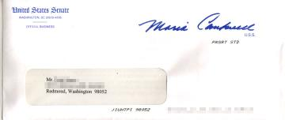
Getting Elected to Congress
Sophomore surge
  Using the perks of office
  Campaigning for / against Congress
Impact of the way we elect individuals to Congress
  Legislators closely tied to local concerns
  Weak party leadership

Slide 10
Primary vs. General
Campaigns

Slide 11
General vs. Primary
Differences between primary and general campaigns
  What works in a general election may not work in a primary
    Different voters, workers, and media attention
    Must mobilize activists with money and motivation to win nomination
    Must play to the politics of activists
  Iowa caucuses
    Held in January of general election year
    Candidates must do well
    Winners tend to be "ideologically correct"
    Most liberal Democrat, most conservative Republican
    The caucus system: "musical chairs and fraternity pledge week"

Slide 12

General vs. Primary
The balancing act
  Being conservative (or liberal) enough to get nominated
  Move to center to get elected
  True nationwide in states where activists are more polarized than average voter
  The "clothespin vote": neither candidate is appealing
Even primary voters can be more extreme ideologically than the average voter
Example: McGovern in 1972

Slide 13
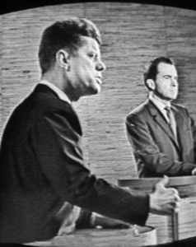
General vs. Primary
Two kinds of campaign issues
  Position issues
  Valence issues
Television, debates, and direct mail
  Paid advertising (spots)
    Has little (or a very subtle) effect on outcome: spots tend to cancel each other out
    Most voters rely on many sources of information.

Slide 14
General vs. Primary
News broadcasts (visuals)
  Cost little
  May have greater credibility with voters
  Rely on having TV camera crew around
  May be less informative than spots
Debates
  Usually an advantage only to the challenger
  Reagan in 1980: reassured voters
  Primary debates: the "dating game" in 1988

Slide 15
General vs. Primary
Risk of slips of the tongue on visuals and debates
  Ford and Poland, Carter and lust, Reagan and trees
  Forces candidates to rely on stock speeches
  Sell yourself, not your ideas
Free television time to major presidential candidates in 1996
The computer
  Makes direct mail campaigns possible
  Allows candidates to address specific voters
  Creates importance of mailing lists
The gap between running a campaign and running the government
  Party leaders had to worry about reelection
  Today's political consultants don't

Slide 16
Money

Slide 17
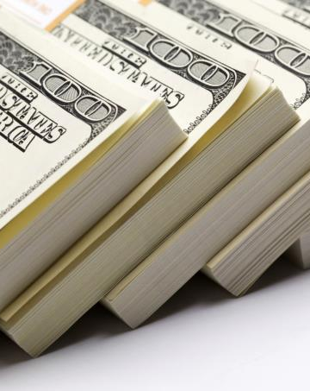
Money
How important is it?
  "Money is the mother's milk of politics."
  Presidential candidates spent $286 million in 1992; up from $177 million in 1988
  Are candidates being "sold" like soap? Answer is not so obvious

Slide 18
Sources of Money
Presidential primaries: part private, part public money
  Federal matching funds
  Only match small donors: less than $250; $5,000 in twenty states
  Gives incentive to raise money from small donors
  Government also gives lump-sum grants to parties to cover conventions
Presidential general elections: all public money
Congressional elections: all private money
  From individuals, PACs, and parties
  Most from individual small donors ($100 to $200 a person)
  $1,000 maximum for individual donors
  Benefit performances by rock stars, etc.
  $5,000 limit from PACs
  But most PACs give only a few hundred dollars
  Tremendous PAC advantage to incumbents: backing the winner
  Challengers have to pay their own way; only one-sixth from PACs

Slide 19
Campaign Finance Rules
Watergate
  Dubious and illegal money raising schemes
  Democrats and Republicans benefited from unenforceable laws.
  Nixon's resignation and a new campaign finance law
Reform law
  Set limit on individual donations ($1,000 per election)
  Reaffirmed ban on corporate and union donations, but allowed them to raise money through PACs
  Set limit on PAC donations ($5,000 per election to individuals, $15,000 per year to a party)
  Federal tax money made available for primaries and general election campaigns.

Slide 20
Campaign Finance Rules
Impact of the law
  Increase in money spent on elections
  Increase in PAC spending
  Additional problems: independent expenditures and soft money
Campaign finance reform
  Reforms can have unintended consequences
  Bipartisan Campaign Finance Reform Act of 2002
    Ban on soft money
    Increase on individual contributions (to $2,000 per candidate per election)
    Restrictions on independent expenditures

Slide 21
Money and Winning
During peacetime, presidential elections usually decided by three things:
  Political party affiliation
  State of the economy
  Character of candidates
Money makes a difference in congressional races
  Challenger must spend to gain recognition
  Jacobson: big-spending challengers do better
  Big-spending incumbents also do better
Party, incumbency, and issues also have a role
Advantages of incumbency
  Easier to raise money
  Can provide services for constituency
  Can use franked mailings
  Can get free publicity through legislation and such

Slide 22
What Decides Elections?

Slide 23

What decides elections?
Party identification, but why don't Democrats always win?
  Democrats less wedded to their party
  GOP does better among independents
  Republicans have higher turnout

Slide 24
What decides elections?
Issues, especially the economy
  V. O. Key: most voters who switch parties do so in their own interests
    They know which issues affect them personally
    They care strongly about emotional issues (abortion, etc.)
  Prospective voting
    Know the issues and vote for the best candidate
    Most common among activists and special interest groups
    Few voters use prospective voting because it requires information.
  Retrospective voting
    Judge the incumbent's performance and vote accordingly
    Have things gotten better or worse, especially economically?
    Examples: presidential campaigns of 1980, 1984, 1988, and 1992
    Usually helps incumbent unless economy has gotten worse
    Most elections decided by retrospective votes
    Midterm election: voters turn against president's party

Slide 25
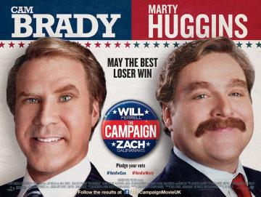
The Campaign
Campaigns do make a difference
  Reawaken voters' partisan loyalties
  Let voters see how candidates handle pressure
  Let voters judge candidates' characters
Campaigns tend to emphasize themes over details
  True throughout American history
  What has changed is the importance of primary elections and tone of campaigns
  Theme campaigns give more influence to single-issue groups

Slide 26
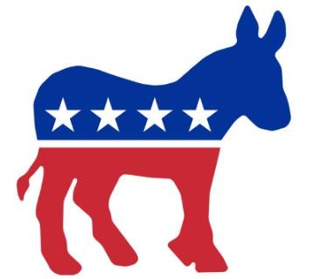
Winning Coalition
Ways of looking at various groups
  How loyal, or percentage voting for party
  How important, or number voting for party
Democratic coalition
  Blacks most loyal
  Jews slipping somewhat
  Hispanics somewhat mixed
  Catholics, southerners, unionists departing the coalition lately

Slide 27
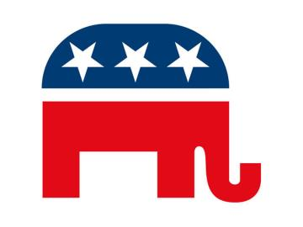
Winning Coalition
Republican coalition
  Party of business and professional people
  Very loyal, defecting only in 1964
  Usually wins vote of poor because of retired, elderly voters
Contribution to Democratic coalition
  Blacks loyal but small proportion
  Catholics, unionists, and southerners largest part but least dependable

Slide 28
The Effect of Elections on Policy
Political scientists are interested broad trends in wining and losing
Cynics: public policy remains more or less the same no matter which official or party is in office
  Comparison: Great Britain, with parliamentary system and strong parties, often sees marked changes, as in 1945
  Reply: evidence indicates that many American elections do make great differences in policy
  Why, then, the perception that elections do not matter? Because change alternates with consolidation; most elections are only retrospective judgments

