Slide 1
Interest Groups
Chapter 11

Slide 2
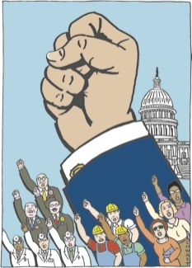
Why are Interest Groups Common in the US?
Many kinds of cleavage in the country
Constitution makes for many access points
Political parties are weak

Slide 3
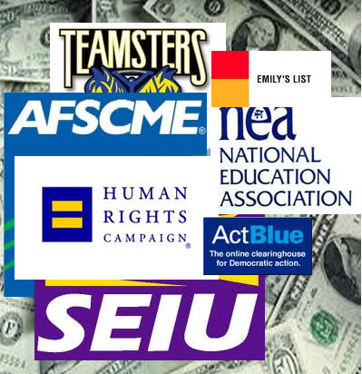
Birth of Interest Groups
Periods of rapid growth
  Since 1960, 70 percent have established an office in Washington, D.C.
  1770s, independence groups
  1830s and 1840s, religious, antislavery groups
  1860s, craft unions
  1880s and 1890s, business associations
  1900s and 1910, most major lobbies of today

Slide 4
Birth of Interest Groups
Factors explaining the rise of interest groups
  Broad economic developments create new interests
    Farmers produce cash crops
    Mass production industries begin
  Government policy itself
    Created veterans' groups--wars
    Encouraged formation of Farm Bureau
    Launched Chamber of Commerce
    Favored growth of unions
  Emergence of strong leaders, usually at certain times
  Expanding role of government

Slide 5
Kinds of Organizations

Slide 6

Institutional Interests
Defined: individuals or organizations representing other organizations
Types
  Businesses: example, General Motors
  Trade or governmental associations
Concerns--bread-and-butter issues of concern to their clients
  Clearly defined, with homogeneous groups
  Diffuse, with diversified groups
Other interests--governments, foundations, universities

Slide 7
Membership Interest
Membership interests
  Americans join some groups more frequently than people in other nations
    Social, business, and so on, same rate as elsewhere
    Unions, less likely to join
    Religious or civic groups, more likely to join
    Greater sense of efficacy and duty explains the tendency to join civic groups
  Most sympathizers do not join because
    Individuals not that significant
    Benefits flow to nonmembers too

Slide 8
Incentives & Influence
Incentives to join
  Solidary incentives--pleasure, companionship (League of Women Voters, AARP, NAACP, Rotary, etc.)
  Material incentives--money, things, services (farm organizations, retired persons, etc.)
  Purpose of the organization itself--public-interest organizations
    Ideological interest groups' appeal is controversial principles
    Engage in research and bring lawsuits
Influence of the staff
  Staff has most influence if members joined for solidary or material benefits
  National Council of Churches and unions are examples

Slide 9
Interest groups and social movements
Social movement is a widely shared demand for change
Environmental movement
Feminist movement: three kinds
  Solidary--LWV and others (widest support)
  Purposive--NOW, NARAL (strong position on divisive issues)
  Caucus--WEAL (material benefits)
Union movement; left over after social movement dies

Slide 10

Funds for Interest Groups
Foundation grants
  Ford Foundation and public-interest groups
  Scaife foundations and conservative groups
Federal grants and contracts
  National Alliance for Business and summer youth job programs
  Jesse Jackson's PUSH
Direct mail
  Unique to modern interest groups through use of computers
  Common Cause a classic example
  Techniques
    Teaser
    Emotional arousal
    Celebrity endorsement
    Personalization of letter

Slide 11
Problem of Bias
Reasons for belief in upper-class bias
  More affluent more likely to join
  Business or professional groups more numerous; better financed
Why these facts do not decide the issue
  Describe inputs but not outputs
  Business groups often divided among themselves
Important to ask what the bias is
  Many conflicts are within upper middle class
  Resource differentials are clues, not conclusions

Slide 12
Activities of Interest Groups

Slide 13

Information
Single most important tactic
  Nonpolitical sources insufficient
  Provide detailed, current information
Most effective on narrow, technical issues
Officials also need cues; ratings systems
Dissemination of information and cues via fax

Slide 14
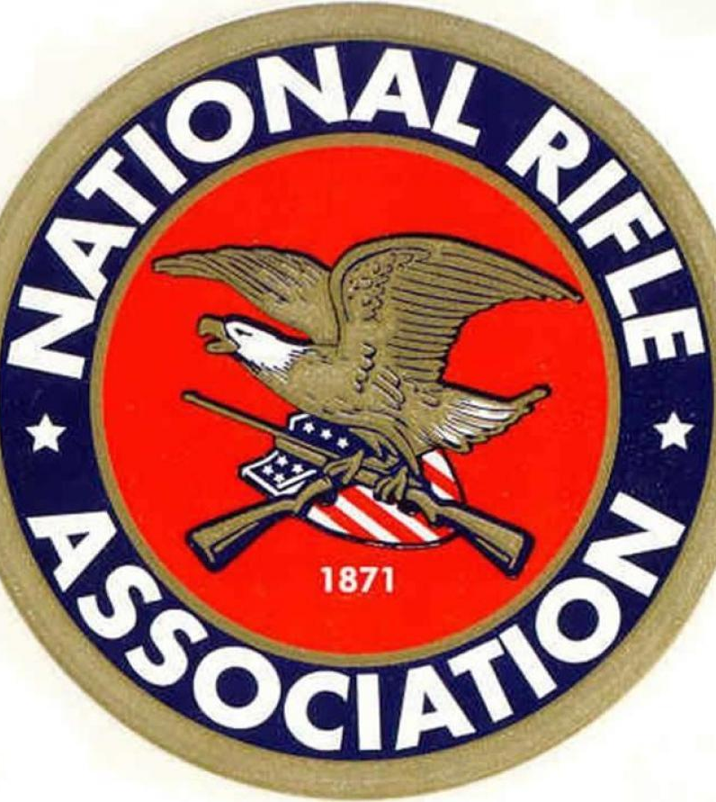
Public Support: Rise of new politics
Outsider strategy replacing insider strategy
New strategy leads to controversy that politicians dislike
Key targets: the undecided
Some groups attack their likely allies to embarrass them
Legislators sometimes buck public opinion, unless issue important
Some groups try for grassroots support
  Saccharin issue
  "Dirty Dozen" environmental polluters
Few large, well-funded interests are all-powerful (e.g., NRA)

Slide 15
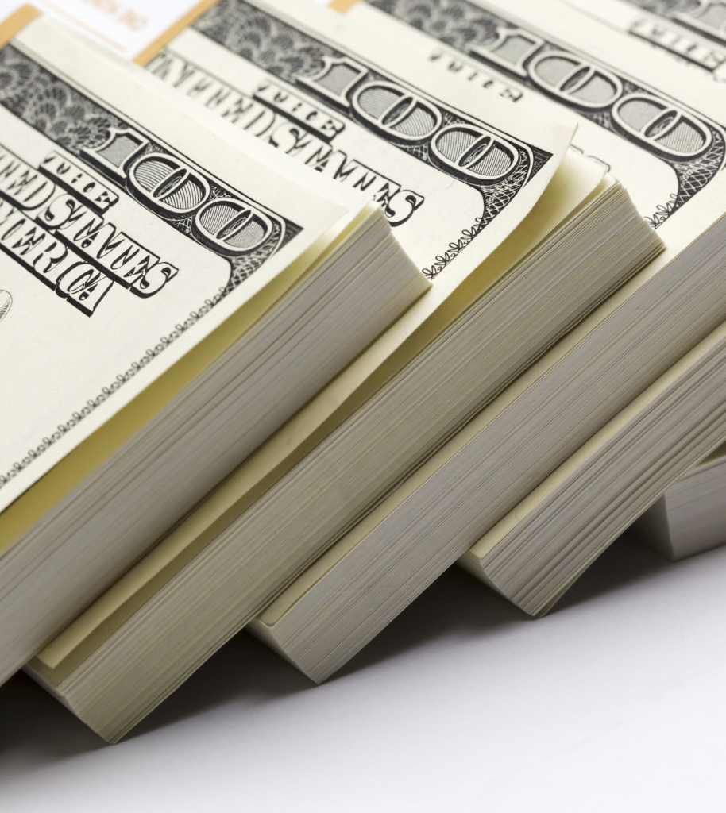
Money and PACs
Money is least effective way to influence politicians
Campaign finance reform law of 1973 had two effects
  Restricted amount interest groups can give to candidates
  Made it legal for corporations and unions to create PACs
Rapid growth in PACs has not led to vote buying.
  More money is available on all sides
  Members of Congress take money but still decide how to vote
Almost any organization can create a PAC.
  More than half of all PACs sponsored by corporations
  Recent increase in ideological PACs; one-third liberal, two-thirds conservative

Slide 16
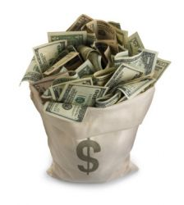
Money and PACs
Ideological PACs raise more but spend less because of cost of raising money
In 2000 unions and business organizations gave most
Incumbents get most PAC money
  Business PACs split money between Democrats and Republicans
  Democrats get most PAC money
PAC contributions small
No evidence PAC money influences votes in Congress
  Most members vote their ideology
  When issue of little concern to voters, slight correlation but may be misleading
  PAC money may influence in other ways, such as access
  PAC money most likely to influence on client politics

Slide 17
Regulating Interest Groups
Protection by First Amendment
1946 law accomplished little in requiring registration
1995 lobby act enacted by Congress
  Broadens definition of a lobbyist
  Lobbyists must report twice annually
  Exempts grassroots organizations
  No enforcement organization created
Significant restraints prior to 1995 still in effect
  Tax code: threat of losing tax exempt status
  Campaign finance laws

