Slide 1
Economic Policy
Chapter 18
By PresenterMedia.com

Slide 2
Deficit Spending
The politics of deficit spending
  1999 / 2000 financial "miracle" (first surplus since 1969)
  Uniform public opinion versus divided politicians
    Cut spending?
    Raise taxes?
  Rapid growth of economy and increase in personal income and incoming taxes reduced deficit
  New Debate: What to do with the extra money?
    Republicans: return it to the taxpayers
    Democrats: spend it on new programs
    Economic Growth and Tax Relief Reconciliation Act of 2001
    2010 expiration and increase in spending on federal programs
    Future economic conditions are difficult to predict

Slide 3
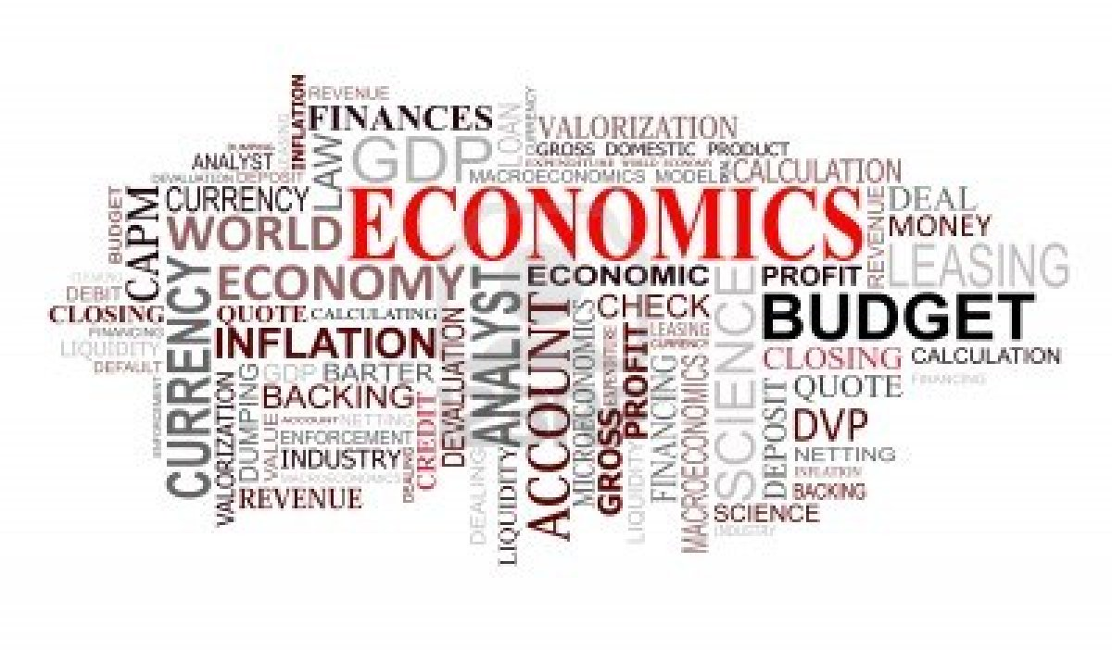
Politics of American Economic Prosperity
Health of American economy creates majoritarian politics
  Voters influenced by their immediate economic situation
  Voters worry about the nation as a whole as well as their own situations
  Voting behavior and economic conditions correlated at the national level but not at the individual level
    People understand what government can and cannot be held accountable for
    People see economic conditions as affecting them indirectly, even when they are doing well

Slide 4

Politics of American Economic Prosperity
What politicians try to do
  Elected officials tempted to take short-term view of the economy
  Government uses money to influence elections, but government will not always do whatever is necessary
    Government does not know how to produce desirable outcomes
    Attempting to cure one economic problem often exacerbates another
  Ideology plays a large role in determining policy
    Democrats tend to want to reduce unemployment
    Republicans tend to want to reduce inflation

Slide 5
Politics of Taxing and spending
Inconsistency in what people want out of majoritarian politics
  No tax increases
  No government deficit
  Continued (or higher) government spending
Proposals to spend projected budget surplus in 1999
  Tax cuts
  New or enlarged government programs
  Reduce the debt
Difficult to make meaningful tax cuts
  Politicians get reelected by spending money
  Increased spending more popular than cutting taxes

Slide 6
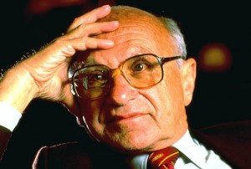
Economic Theories and Political Needs
Monetarism--inflation occurs when there is too much money chasing too few goods (Milton Friedman); advocates increase in money supply about equal to economic growth

Slide 7
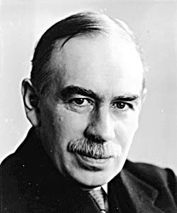
Economic Theories and Political Needs
Keynesianism--government should create right level of demand
  Assumes that health of economy depends on what fraction of their incomes people save or spend
  When demand is too low, government should spend more than it collects in taxes by creating public works programs
  When demand is too high, government should increase taxes

Slide 8
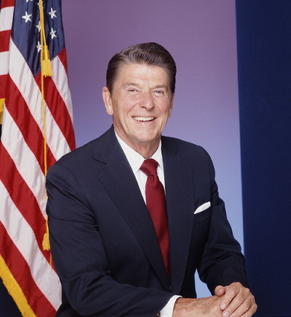
Economic Theories and Political Needs
Planning--free market too undependable to ensure economic efficiency; therefore government should control it (John Kenneth Galbraith)
  Wage-price controls
  Industrial policy--government directs investments toward particular industries
Supply-side tax cuts--need for less government interference and lower taxes (Arthur Laffer)
  Lower taxes would create incentives for investment
  Greater productivity would produce more tax revenue
Ideology and theory: people embrace an economic theory partly because of their political beliefs.

Slide 9
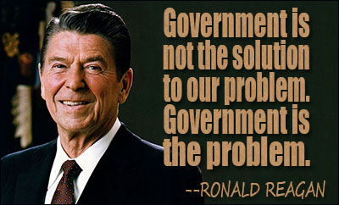
Economic Theories and Political Needs
Reaganomics
  Combination of monetarism, supply-side tax cuts, and domestic budget cutting
  Goals not consistent
    Reduction in size of federal government
    Increase in military strength
  Effects
    Rate of growth of spending slowed (but not spending itself)
    Military spending increased
    Money supply controlled
    Federal taxes decreased
    Large deficits incurred and dramatically increase the size of the national debt
    Unemployment decreased

Slide 10
The machinery of economic policy-making

Slide 11
Fragmented Policy-making
Council of Economic Advisers
  Members chosen are sympathetic to president's view of economics and are experts
  Forecasts economic trends
  Prepares annual economic report for president
Office of Management and Budget
  Prepares estimates of federal government agencies; negotiates department budgets
  Ensures that agencies' legislative proposals are compatible with president's program

Slide 12
Fragmented Policy-making
Secretary of the Treasury
  Reflects point of view of financial community
  Provides estimates of government's revenues
  Recommends tax changes; represents the nation before bankers and other nations
The Fed (Federal Reserve Board)
  Independent of both president and Congress
  Regulates supply and price of money
Congress most important in economic policy making
  Approves taxes and expenditures
  Consents to wage and price controls
  Can alter Fed policy by threatening to reduce its powers

Slide 13
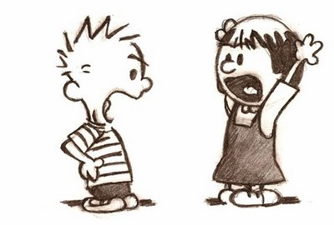
Spending money
Conflict between majoritarian and client or interest group politics
Sources of conflict reflected in inconsistencies in public opinion
Politicians have incentive to make two kinds of appeals
  Keep spending down and cut deficit
  Support favorite programs of voters

Slide 14
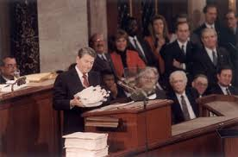
The Budget
Earlier practices
  Merely adding expenditures before 1921
  No unified presidential budget until 1930s
  Separate committee reactions after that

Slide 15
The Budget
Congressional Budget Act of 1974: procedures
  President submits budget
  House and Senate budget committees analyze budget
  Budget resolution in May proposes budget ceilings
  Members informed whether or not spending proposals conform to budget resolutions
  Committees approve appropriations bills, Congress passes them, and sends them to the president for signature
  Hard to make big changes in government spending because of entitlements
  Big loophole: Congress not required to tighten government's financial belt
  Failures of the process after 1981

Slide 16
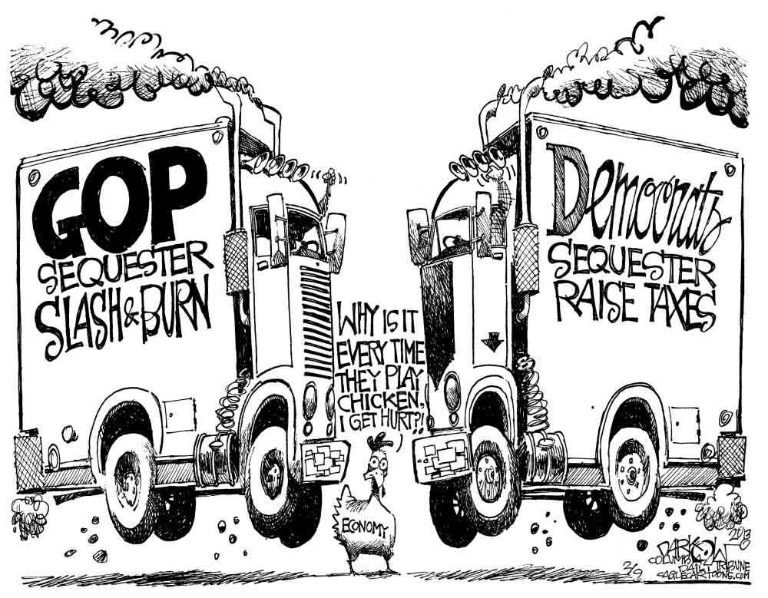
Reducing spending
Gramm-Rudman Balanced Budget Act (1985) called for:
  A target cap on the deficit each year, leading to a balanced budget
  A spending plan within those targets
  If lack of agreement on a spending plan exists, automatic across-the-board percentage budget cuts (a sequester)

Slide 17
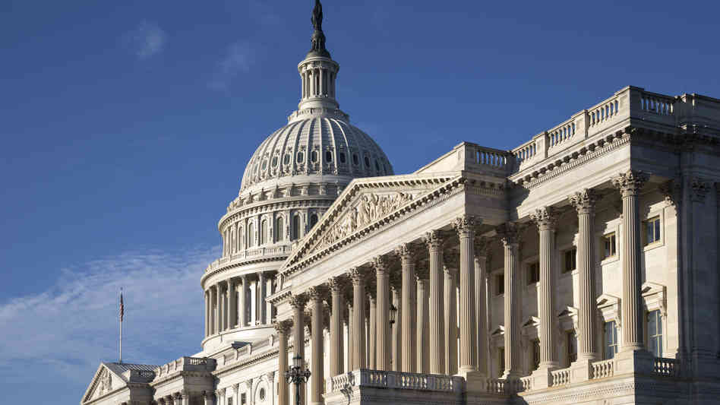
Reducing spending
“Smoke and mirrors" and failure of the Act
  Plan was unpopular, but "necessary"
  Congress and president found ways to increase spending about "target" anyway
New strategies
  Congress votes for a tax increase
  Passage of Budget Enforcement Act of 1990
    Imposed a cap on discretionary spending (i.e., nonentitlements)
    No limit on mandatory spending (i.e., entitlements) but did impose a "pay-as-you-go" approach

Slide 18
Levying taxes
Tax policy reflects blend of majoritarian and client politics
  "What is a 'fair' tax law?" (majoritarian)
    Tax burden is kept low; Americans pay less than citizens in most other countries
    Requires everyone to pay something; Americans cheat less than others
  "How much is in it for me?" (client)
    Requires the better-off to pay more
    Progressiveness is a matter of dispute: hard to calculate
    Many loopholes: example of client politics
  Client politics (special interests) make tax reform difficult, but Tax Reform Act passed (1986)

Slide 19
Levying taxes
The rise of the income tax
  Most revenue derived from tariffs until 1913 and ratification of Sixteenth Amendment
  Taxes then varied with war (high), peace (low)
    High rates offset by many loopholes: compromise
    Constituencies organized around loopholes
  Tax bills before 1986 dealt more with deductions than with rates
  Tax Reform Act of 1986: low rates with smaller deductions
  Will Bush tax cuts expire in 2010 or be made permanent? (they expired).

