Slide 1
Foreign & Military Policy
Chapter 20

Slide 2
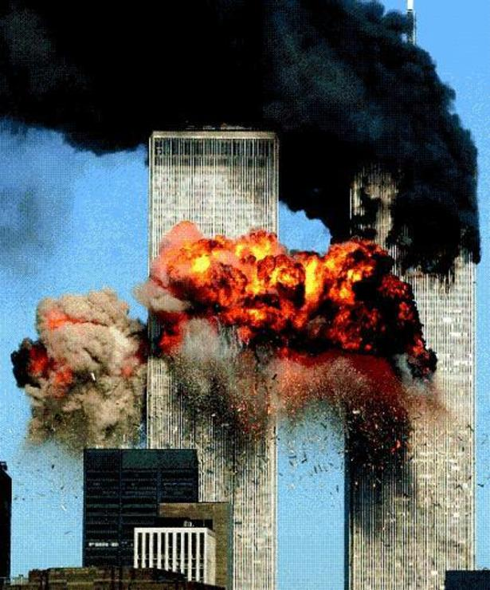
Effects of the September 11 attacks
Public consciousness about international terrorism
Outbursts of patriotism
Confidence in government
Emergence of important fundamental questions
  How to wage a "war" against terrorism?
  How to hold other nations accountable?
  How to act when other nations fight terrorism?
  Does such a war require military to be redesigned?
Reemergence of classic questions
  Do we only support nations that are reasonably free and democratic?
  Are we the world's policemen?

Slide 3
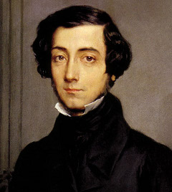
  Democratic Politics and Foreign and Military Policy
Tocqueville and weakness of democracy
Others blame reckless policies of presidents

Slide 4
Kinds of Foreign Policy
Majoritarian politics
  Perceived to confer widespread benefits, impose widespread costs
  Examples
    War
    Military alliances
    Nuclear test ban or strategic arms limitation treaties
    Response to Berlin blockade by Soviets
    Cuban missile crisis
    Covert CIA operations
    Diplomatic recognition of People's Republic of China

Slide 5
Kinds of Foreign policy
Interest group politics
  Identifiable groups pitted against one another for costs, benefits
  Examples
    Cyprus policy: Greeks versus Turks
    Tariffs: Japanese versus steel
Client politics
  Benefits to identifiable group, without apparent costs to any distinct group
  Example: Israel policy (transformation to interest group politics?)
Who has power?
  Majoritarian politics: president dominates; public opinion supports but does not guide
  Interest group or client politics: larger congressional role
  Entrepreneurial politics: Congress the central political arena

Slide 6
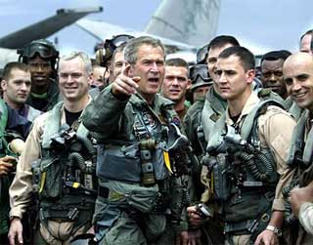
The Constitutional and legal context
The Constitution creates an "invitation to struggle"
  President commander in chief but Congress appropriates money
  President appoints ambassadors, but Senate confirms
  President negotiates treaties, but Senate ratifies
  But Americans think president in charge, which history confirms

Slide 7
Presidential box score
  Presidents relatively strong in foreign affairs
    More successes in Congress on foreign than on domestic affairs
    Unilateral commitments of troops upheld but stronger than Framers intended
      1801: Jefferson sends navy to Barbary
      1845: Polk sends troops to Mexico
      1861: Lincoln blockades Southern ports
      1940: FDR sends destroyers to Britain
      1950: Truman sends troops to Korea
      1960s: Kennedy and Johnson send forces to Vietnam
      1983: Reagan sends troops to Grenada
      1989: Bush orders invasion of Panama
      1990: Bush sends forces into Kuwait
      1999: Clinton orders bombing of Serbian forces
      2002: Bush sends troops to Afghanistan

Slide 8
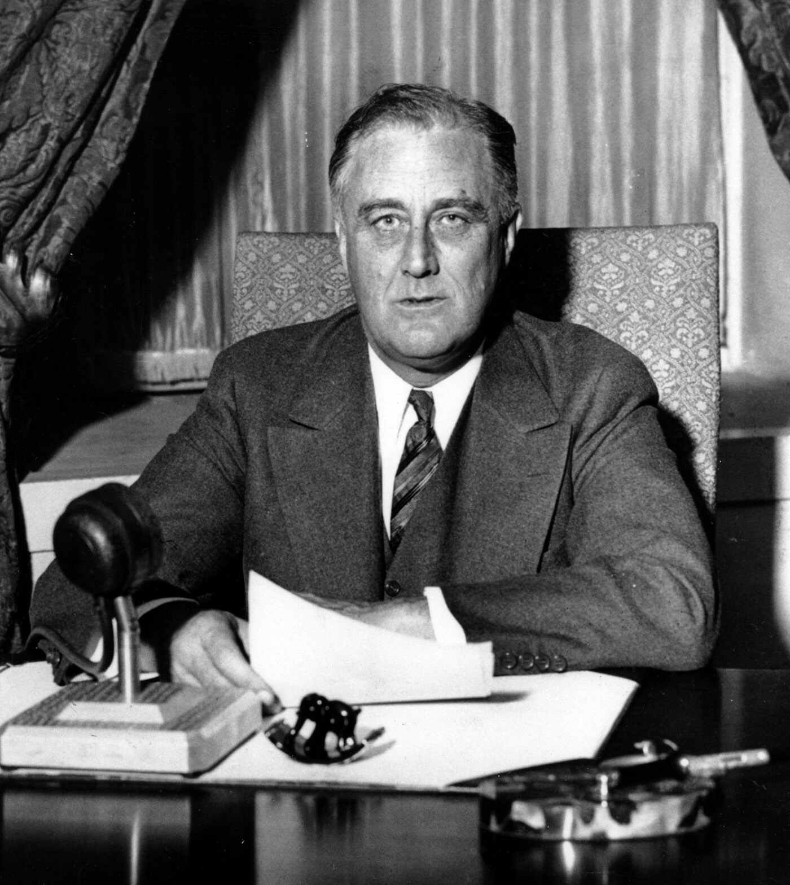
The Constitutional and legal context
Presidents comparatively weak in foreign affairs; other heads of state find U.S. presidents unable to act
  Wilson and Franklin Roosevelt unable to ally with Great Britain before World War I and World War II
  Wilson unable to lead U.S. into the League of Nations
  Reagan criticized on commitments to El Salvador and Lebanon
  Bush debated Congress on declaration of Gulf War

Slide 9
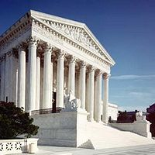
The Constitutional and legal context
Evaluating the power of the president
  Depends on one's agreement/disagreement with policies
  Supreme Court gives federal government wide powers; reluctant to intervene in Congress-president disputes
    Nixon's enlarging of Vietnam war
    Lincoln's illegal measures during Civil War
    Carter's handling of Iranian assets
    Franklin Roosevelt's "relocation" of 100,000 Japanese-Americans

Slide 10
The Constitutional and legal context
Checks on presidential power: political rather than constitutional
  Congress: control of purse strings
  Limitations on the president's ability to give military or economic aid to other countries
    Arms sales to Turkey
    Blockage of intervention in Angola
    Legislative veto (previously) on large sale of arms
  War Powers Act of 1973
    Provisions
      Only sixty-day commitment of troops without declaration of war
      All commitments reported within forty-eight hours
      Legislative veto (previously) to bring troops home
    Observance
      no president has acknowledged constitutionality
      Ford, Carter, Reagan, Bush, and Clinton sent troops without explicit congressional authorization
    Supreme Court action (Chadha case)
      Struck down the legislative veto
      Other provisos to be tested
    Effect of act doubtful even if upheld
      Brief conflicts not likely to be affected; Congress has not challenged a successful operation
      Even extended hostilities continue: Vietnam and Lebanon

Slide 11
The Constitutional and legal context
Checks on presidential power: political rather than constitutional.
  Intelligence oversight
    Only two committees today, not the previous eight
    No authority to disapprove covert action
    But "covert" actions less secret after congressional debate
    Congress sometimes blocks covert action: Boland Amendment
    Congressional concern about CIA after attacks of September 11

Slide 12
The Machinery of foreign policy
Consequences of major power status
  President more involved in foreign affairs
  More agencies shape foreign policy
Numerous agencies not really coordinated by anyone
Secretary of State unable to coordinate
  Job too big for one person
  Most agencies owe no political or bureaucratic loyalty
National Security Council created to coordinate
  Chaired by president and includes vice president, secretaries of State and Defense, director of CIA, chair of joint chiefs
  National security adviser heads staff
  Goal of staff is balanced view
  Grown in influence since Kennedy but downgraded by Reagan
  NSC rivals secretary of state
Consequences of multicentered decision-making machinery
    "It's never over" because of rivalries within and between branches
    Agency positions influenced by agency interests

Slide 13
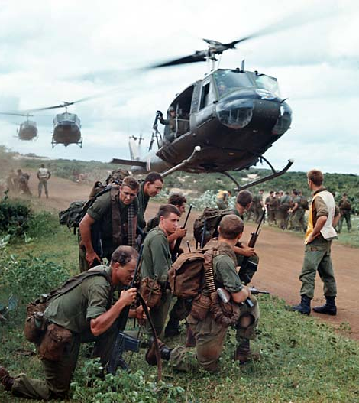
Foreign Policy and public opinion
Outlines of foreign policy shaped by public and elite opinion
  Before World War II, public opposed U.S. involvement
  World War II shifted popular opinion because
    Universally popular war
    War successful
    United States emerged as world's dominant power
  Support for active involvement persisted until Vietnam
    Yet support for internationalism highly general
    Public opinion now mushy and volatile

Slide 14
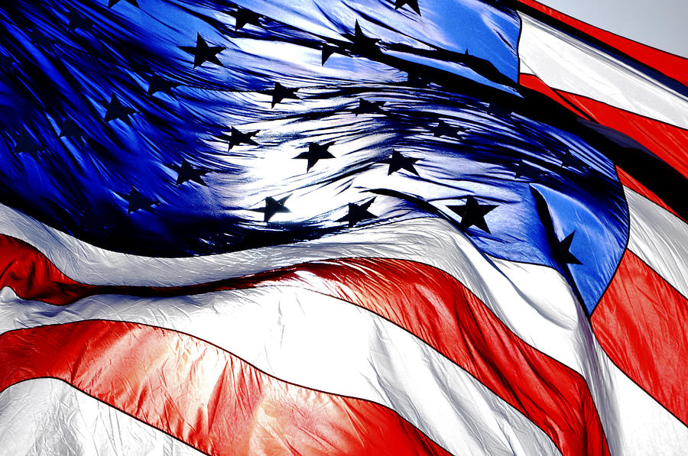
Foreign policy and public opinion
Backing the president
  Public's tendency to support president in crises
    Foreign crises increases presidential level of public approval
    Strong support to rally 'round the flag for some but not all foreign military crises
  Presidential support does not decrease with casualties
  Americans support escalation rather than withdrawal in a conflict

Slide 15
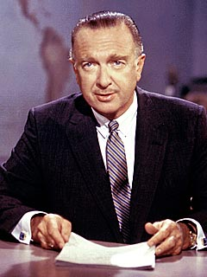
Foreign policy and public opinion
Mass versus elite opinion
  Mass opinion
    Generally poorly informed
    Generally supportive of president
    Conservative, less internationalist
  Elite opinion
    Better informed
    Opinions change more rapidly (Vietnam)
    Protest on moral or philosophical grounds
    More liberal and internationalist

Slide 16

Cleavages among foreign policy elites
Foreign policy elite divided
How a worldview shapes foreign policy
  Definition of worldview: comprehensive mental picture of world issues facing the United States and ways of responding
  Example: Mr. X article on containment of USSR
  Not unanimously accepted but consistent with public's mood, events, and experience

Slide 17
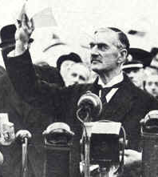
Four Worldviews
Isolation paradigm
  Opposes involvement in European wars
  Adopted after World War I because war accomplished little
Anti-Appeasement (containment) paradigm
  Reaction to appeasement of Hitler in Munich
  Pearl Harbor ended isolationism in United States
  Postwar policy to resist Soviet expansionism

Slide 18
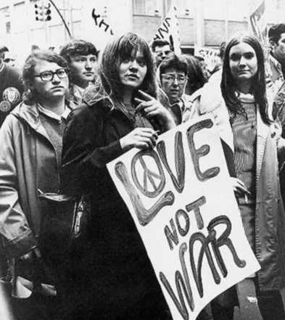
Four worldviews
Disengagement ("Vietnam") paradigm
  Reaction to military defeat and political disaster of Vietnam
  Crisis interpreted in three ways
    Correct worldview but failed to try hard enough
    Correct worldview but applied in wrong place
    Worldview itself wrong
  Critics believed worldview wrong and new one based on new isolationism needed
  Elites with disengagement view in Carter administration but were replaced during Reagan and Bush administrations

Slide 19
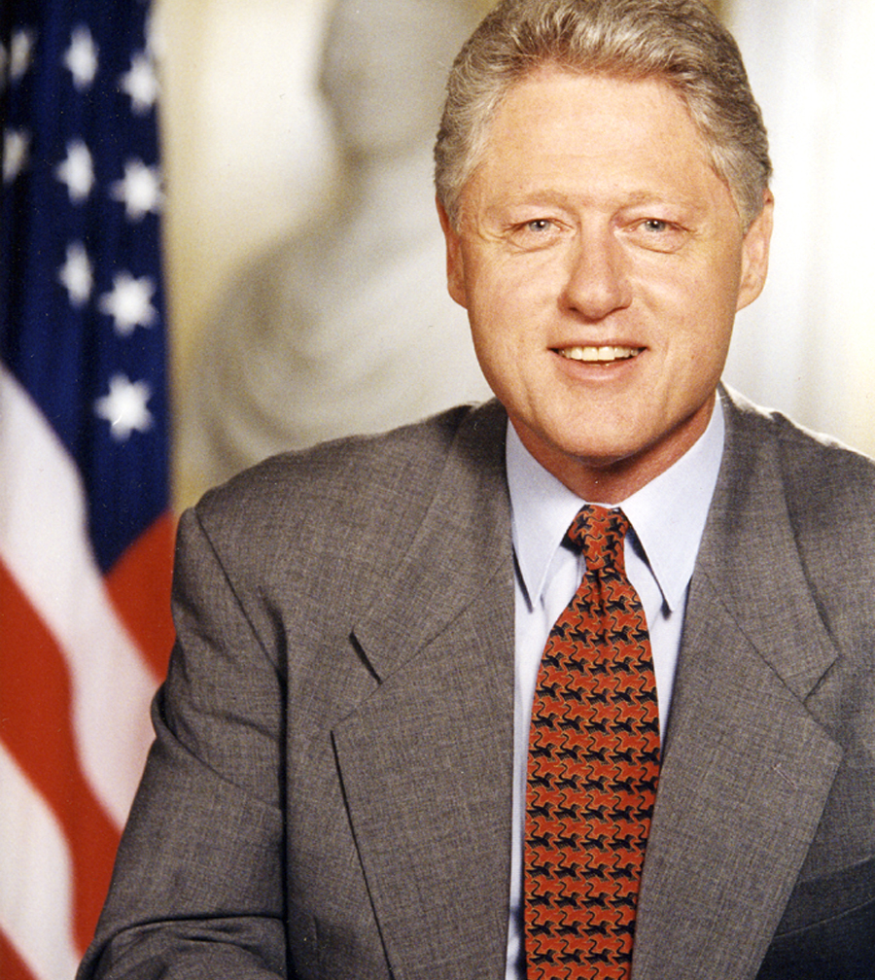
Four worldviews
Human rights
  Clinton had a disinterest in foreign policy and his advisors believed in disengagement.
  Clinton's strongest congressional supporters argued against the Gulf War but advocated military intervention in Kosovo.
  Change in view explained by concern for human rights and belief that situation in Kosovo amounted to genocide
  Conservatives who supported containment in Gulf War urged disengagement in Kosovo
The politics of coalition building
  Should the United States act "alone?"
  If so, in what circumstances?

Slide 20
The use of military force
Military power more important after collapse of Soviet Union and end of Cold War
  Military force used to attack Iraq, defend Kosovo, maintain order in Bosnia, and occupy Haiti and Somalia
  Several nations have long-range rockets and weapons of destruction
  Many nations feel threatened by neighbors
  Russia still has nuclear weapons
Majoritarian view of military
  Almost all Americans benefit, almost all pay
  President is the commander-in-chief
  Congress plays largely a supportive role
Client view of military
  Real beneficiaries of military spending--general, admirals, big corporations, members of Congress whose districts get fat defense contracts--but everyone pays
  Military-industrial complex shapes what is spent

Slide 21
The Defense budget
Total spending
  Small peacetime military until 1950
    No disarmament after Korea because of Soviet threat
    Military system designed to repel Soviet invasion of Europe and small-scale invasions
  Public opinion supports a large military
  Demise of USSR produced debate
    Liberals: sharp defense cuts; United States should not serve as world's police officer
    Conservatives: some cuts but retain well-funded military because world still dangerous
  Desert Storm and Kosovo campaigns made clear no escaping U.S. need to use military force
  Kosovo campaign indicated that military had been reduced too much
  Clinton and Republican Congress called for more military spending

Slide 22
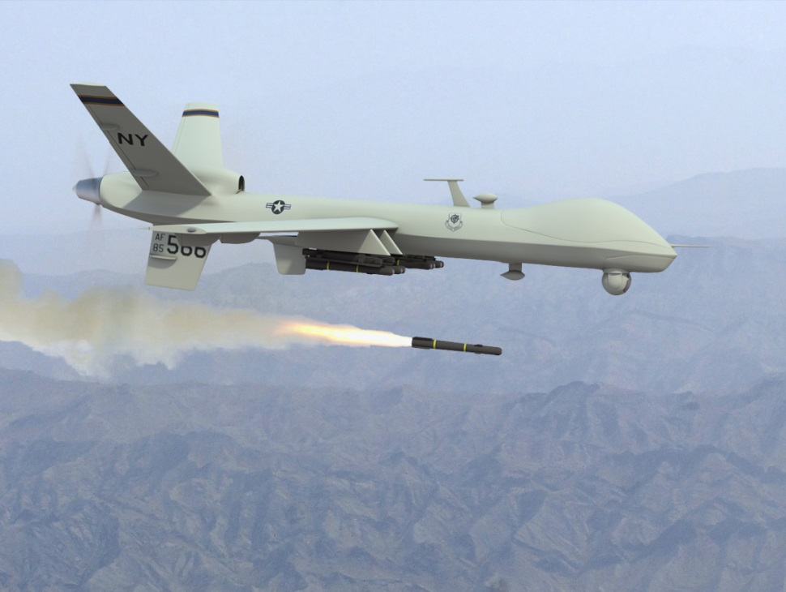
What do we buy with our money
Changing circumstances make justification of expenditures complex
  World War II and Cold War: big armies, artillery, tanks, ships, etc.
  War on Terrorism: small groups, special forces, high-tech communications, precision guided bombs, and rockets
  Joint operations now also seem more necessary
Secretary of defense
  Must transform conventional military for wars on terrorism
  Must budget in an atmosphere of debate and pressure from members of both the military and Congress

Slide 23
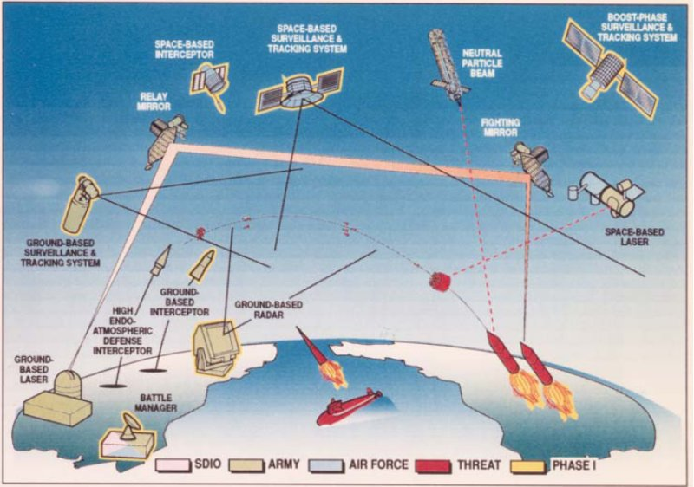
What do we buy with our money
Debating big new weapons
  Washington folks are used to it (B-1, B-2 bombers, MX missiles, M1 tank, etc.)
  Strategic Defense Initiative (SDI, or "Star Wars") debate particularly protracted
    Major scientific and philosophical quarrels
    Reluctance among the military
      Mutually Assured Destruction (MAD) requires more missiles and bombers
      SDI may reduce spending on missiles and bombers
    Concern MAD only works against rational leaders

Slide 24
What do we get for our money
Personnel
  From draft to all-volunteer force in 1973
  Volunteer force improved as result of:
    Increases in military pay
    Rising civilian unemployment
  Changes in military
    More women in military
    Ban of women on combat ships lifted in 1993 but Congress to be consulted if ground combat involved
    "Don't ask, don't tell" compromise adopted by Clinton on homosexuals in military

Slide 25
What do we get for our money
Big-ticket hardware
  Main reasons for cost overruns
    Unpredictability of cost of new items
    Contractor incentives to underestimate at first
    Military chiefs want best weapons money can buy
    "Sole sourcing" of weapons without competitive bids
    Holding down budget by "stretching out" production
  Latter four factors can be controlled; first cannot
Small-ticket items
  Seemingly outrageous prices come from allocation of overhead, small run of items produced
  Others result from "gold-plating" phenomenon

Slide 26
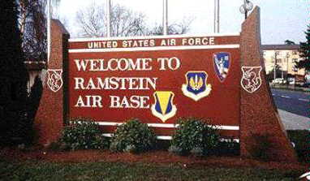
What do we get for our money
Readiness, favorite area for short-term budget cutting
  Other cuts would hurt constituents
  Cuts here show up quickly in money saved
Bases
  At one time, a lot of bases opened and few closed
  Commission on Base Realignment and Closure created to take client politics out of base closings

Slide 27
Structure of defense decision-making
National Security Act of 1947
  Department of Defense
    Secretary of Defense (civilian, as are secretaries of the army, navy, and air force)
    Joint Chiefs of Staff (military)
  Reasons for separate uniformed services
    Fear that unified military will become too powerful
    Desire of services to preserve their autonomy
    Interservice rivalries intended by Congress to receive maximum information

Slide 28
Structure of defense decision-making
1986 defense reorganization plan
  Joint Chiefs of Staff
    Composed of uniformed head of each service with a chair and vice chair appointed by the president and confirmed by the Senate
    Chair since 1986 principal military adviser to president
  Joint Staff
    Officers from each service assisting JCS
    Since 1986 serves chair; promoted at same rate
  The services
    Each service headed by a civilian secretary responsible for purchasing and public affairs
    Senior military officer oversees discipline and training
  The chain of command
    Chair of JCS does not have combat command
    Uncertainty whether 1986 changes will work

