Slide 1
Welcome to
Mrs. McKenzie’s Kindergarten Class!
Contact Information:
Remind 101 App
(334) 347-5383
bmckenzie@enterpriseschools.net

Slide 2
Who Am I?
I was born in Montgomery, Alabama. I am a military brat ( My mother was in the Air Force), and I have one brother.
I married my college best friend, Leander, and we have 3 beautiful girls. Liana(14), Ashlynn (6), and Alannah Grace (2). We also have a dog, she is a miniature schnauzer, named Sadie.
I graduated from Troy University with a degree in Broadcast Journalism, and then earned a Masters degree in Elementary Education through University of Phoenix.
I love my family, friends, Troy Trojans football, University of Alabama football (ROLL TIDE!), reading, shopping, playing Monopoly (striving to win!) and swimming.

Slide 3
Class Supply list
2 boxes Crayola Crayons (24ct.)
1 pack of glue sticks
1 bottle of Elmer’s glue
1 pair scissors (Fiskar/Crayola)
1 large plastic pencil box
1 pkg. of pencils
1 bar eraser
2 black dry erase markers
2 plastic pocket folders (with prongs)
2 plastic pocket folders (no prongs)
3 primary journals (K - 2)
1 red/blue trifold mat

Slide 4
Wish List
Lysol wipes (any brand)
Colored Cardstock
White Cardstock
Mr. Clean Magic Erasers
Tissues
Paper towels
Sharpies (Permanent Markers)
Sanitizer
Amazon gift cards
Walmart gift cards
Scotch Thermal Laminator sheets (Letter sized)

Slide 5

Absences:
Any student with seven unexcused absences during the school year may be referred to Early Warning Court.
Students who are not in class by 8:00am will be counted tardy. Checking out early is also considered tardy
Arrive after 8:00am or check out before 3:00pm, the absence will be counted as an unexcused tardy
Need doctor’s note or parent note
Maximum of 10 parent notes for the year
Pre-approved absences must go through the office.

Slide 6

Medication Procedures:
All medications must be approved and handled through the school nurse, Shelly
Medications MUST be delivered to the school nurse by a guardian.
Parent must make an appointment with the nurse by calling the school office. NO walk up medication drop offs.
Please let me know if your child has any allergies ☺

Slide 7
Lunch/Snack
Breakfast Prices:
K-12 Students: $1.25
Reduced Student: $0.30
Visitor: $2.50
Lunch Prices:
K-6 Students: $2.00
Reduced Student: $0.40
Visitor: $3.50
Please pack one snack and one drink for snack
Please try to refrain from packing snacks that the children cannot open themselves without minimal help.(ex: fruit cups, jello cups)

Slide 8

Transportation
Please make sure that I have information on your child’s way to and from school. (I will send home a sheet for that) and please send me an email as well.
  bmckenzie@enterpriseschools.net
  Any additional transportation changes must be made with a note signed by the office

Slide 9

Communication:
Remind 101: Please sign up with the code for announcements, messages,& changes
  Class code: 4c9cg7b
  I will communicate regularly with you regarding behavior; both positive/negative as well as with anything I feel you should know
  Please make sure the photo permission form is filled out and turned in to me.
  Email me! ☺

Slide 10
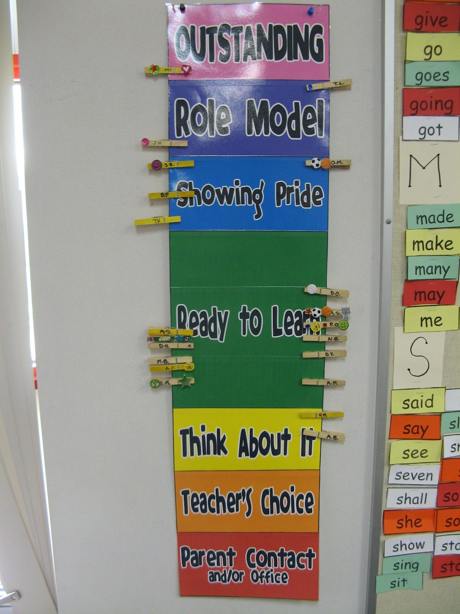
Conduct
This is an “example” of what our class conduct chart looks like. ( Red and pink are switched ☺
Every morning, students will begin on Green and depending on behaviors/choices, both good and bad they will independently move their clips up or down the chart. At the end of the day, inside of their conduct folders, you will see a color circled to indicate how their day went.
At the end of the week, those who have had a good week ( All Pink, or Pink and Blue) will be awarded a trip to the treasure chest for a prize
Students on Red, will have a red circle and note as to what they did to receive that color

Slide 11

Visitors and Volunteers
Visitors and volunteers are not allowed ton school camps until further notice due to Covid-19.
If a conference needs to be held, you can schedule one by appointment

Slide 12
Class Schedule
Mrs. McKenzie’s Class Schedule
7:45a-8:00a | Greet Students/Homeroom Duties/Morning Work
7:45-8:10 | Homeroom Duties/ Morning Work
8:10a-8:20a | Heggerty
8:20a-10:10a | Reading (Tier I) Whole/Small Group
10:10a-10:25a | Recess
Reading (Tier II) | Nap/ Restroom Break
10:50a-11:20a | Lunch
11:35a-11:50a | Nap
11:50a-12:20p | Science/Social Studies
12:20P-1:05P | PE
1:05p-1:20p | Snack
1:20p-1:20p | Math (Tier I) Whole/ Small
2:20p-2:50p | Math (Tier II)
2:50p-2:55p | Prepare for Dismissal
3:00p | Dismissal

Slide 13

Homework Folders
Homework folders will be sent out on Wednesdays and tuned back in the following Monday for a special surprise.
*Please sign your initials after each day after working with your child. (3 days)

Slide 14
Questions???
If you have any questions, please feel free to contact me via email or Remind 101, and I’ll answer them to the best of my ability.

