Slide 1
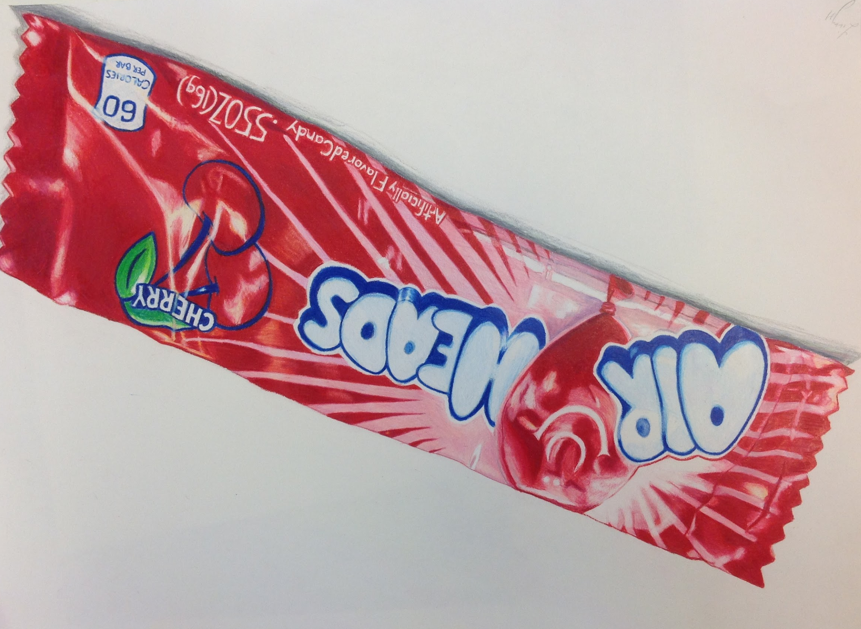
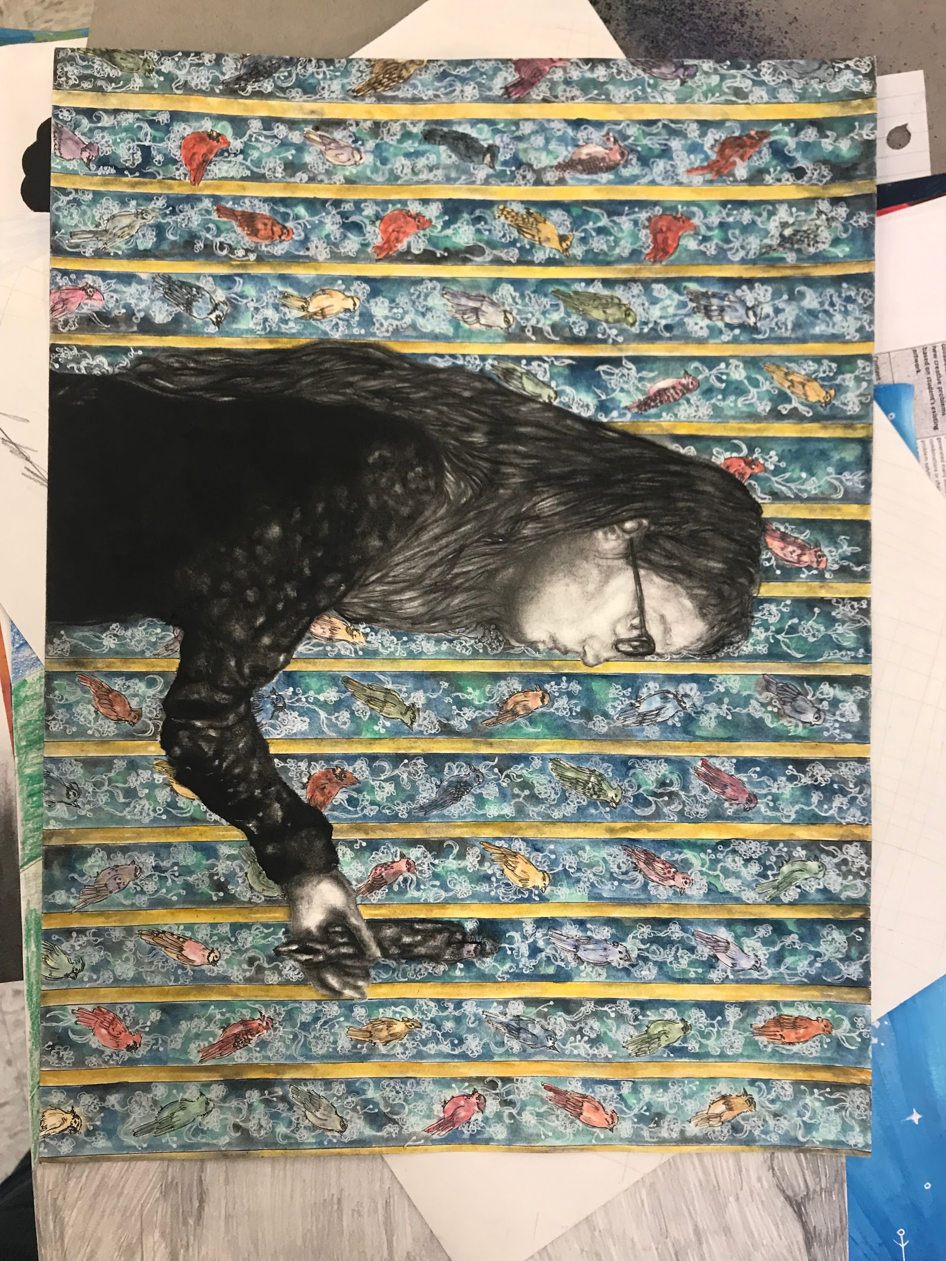
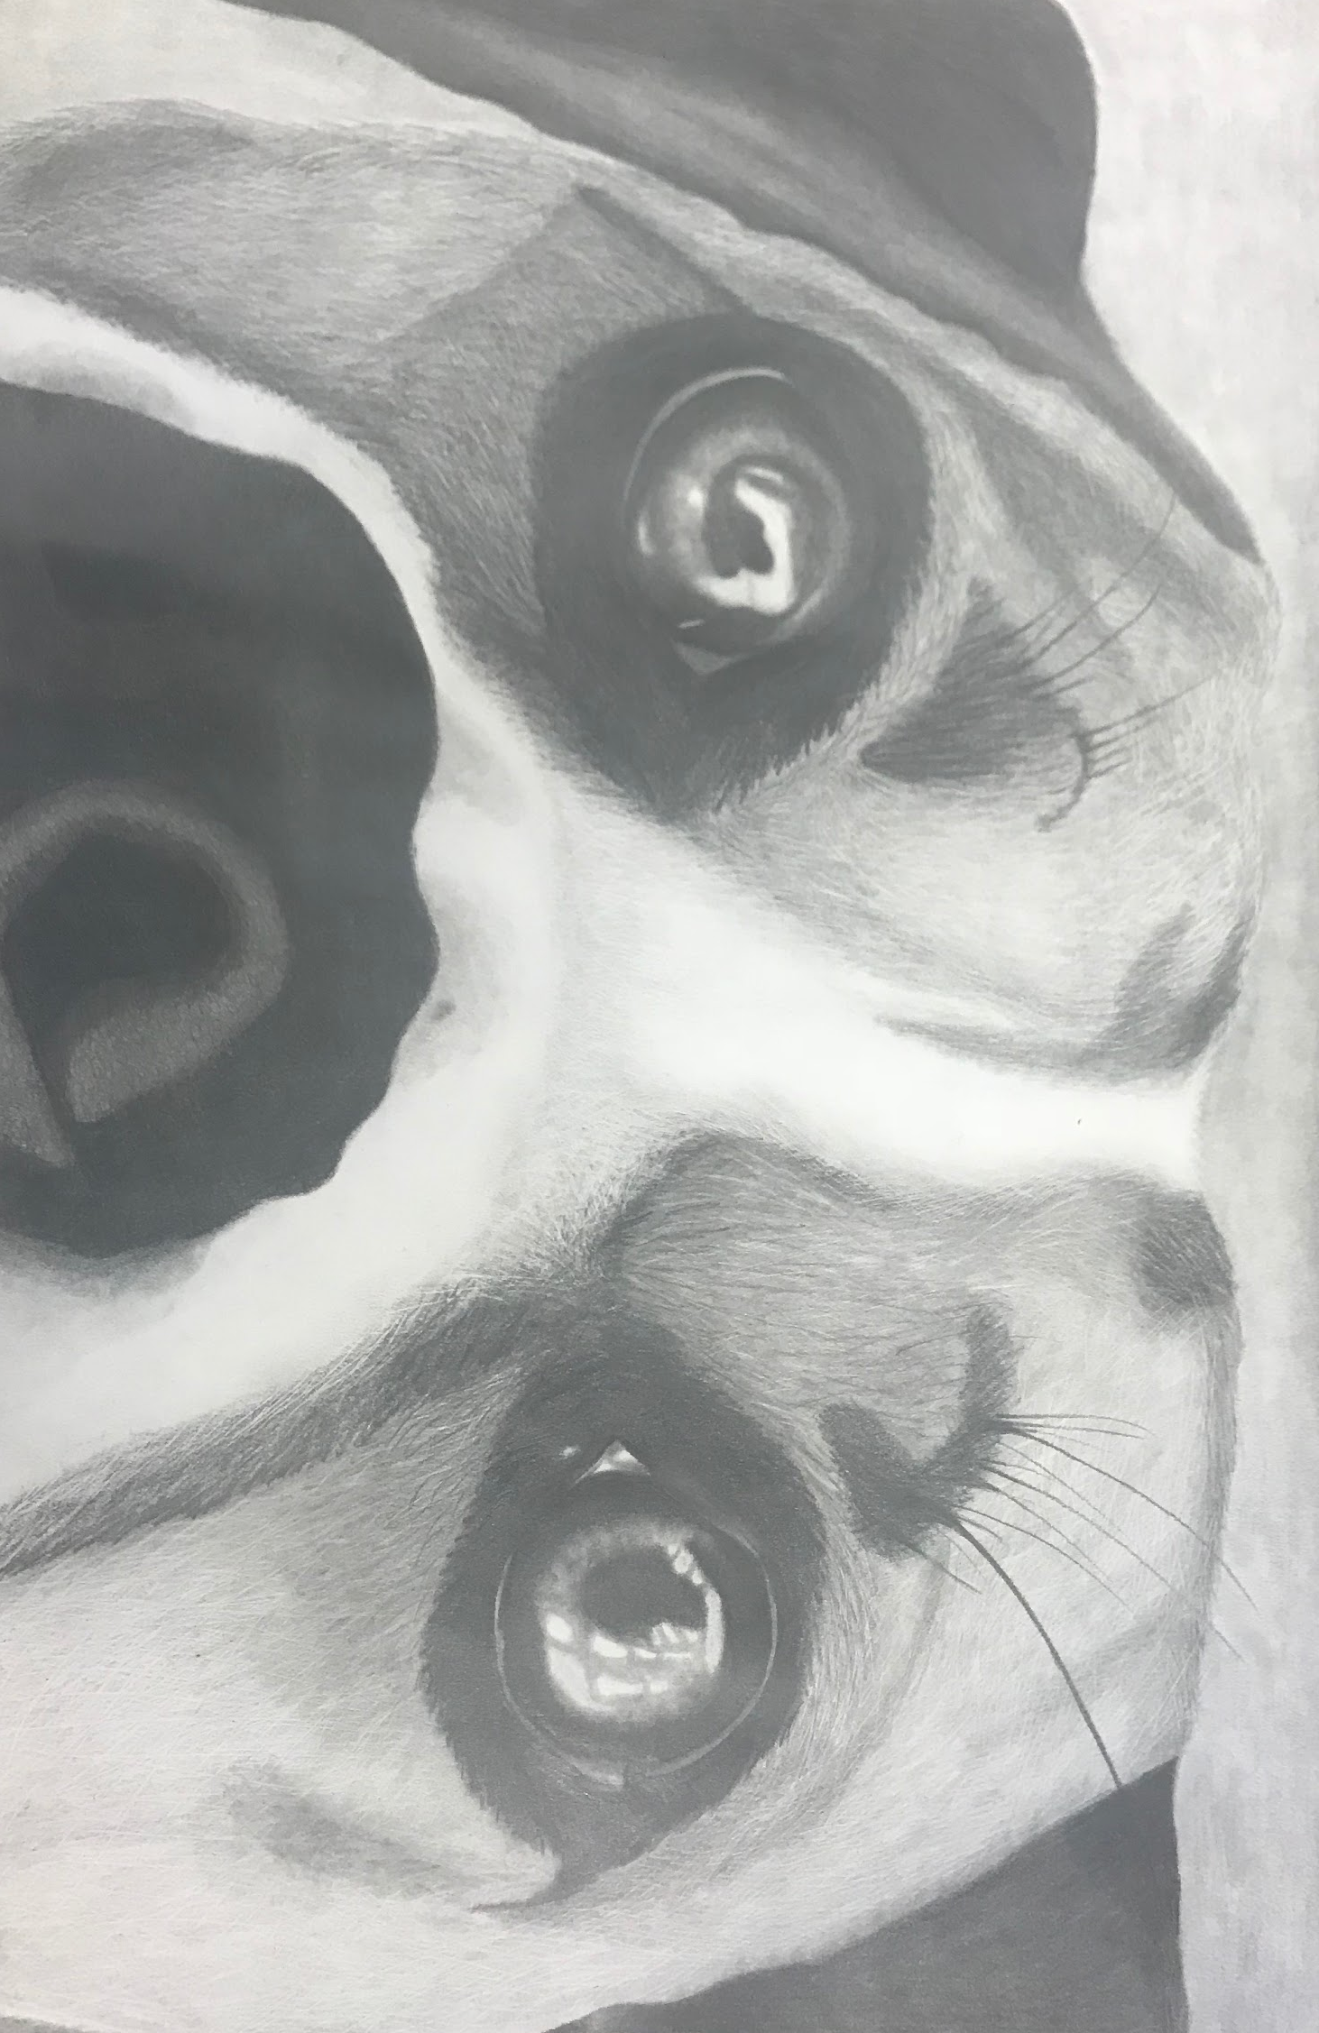
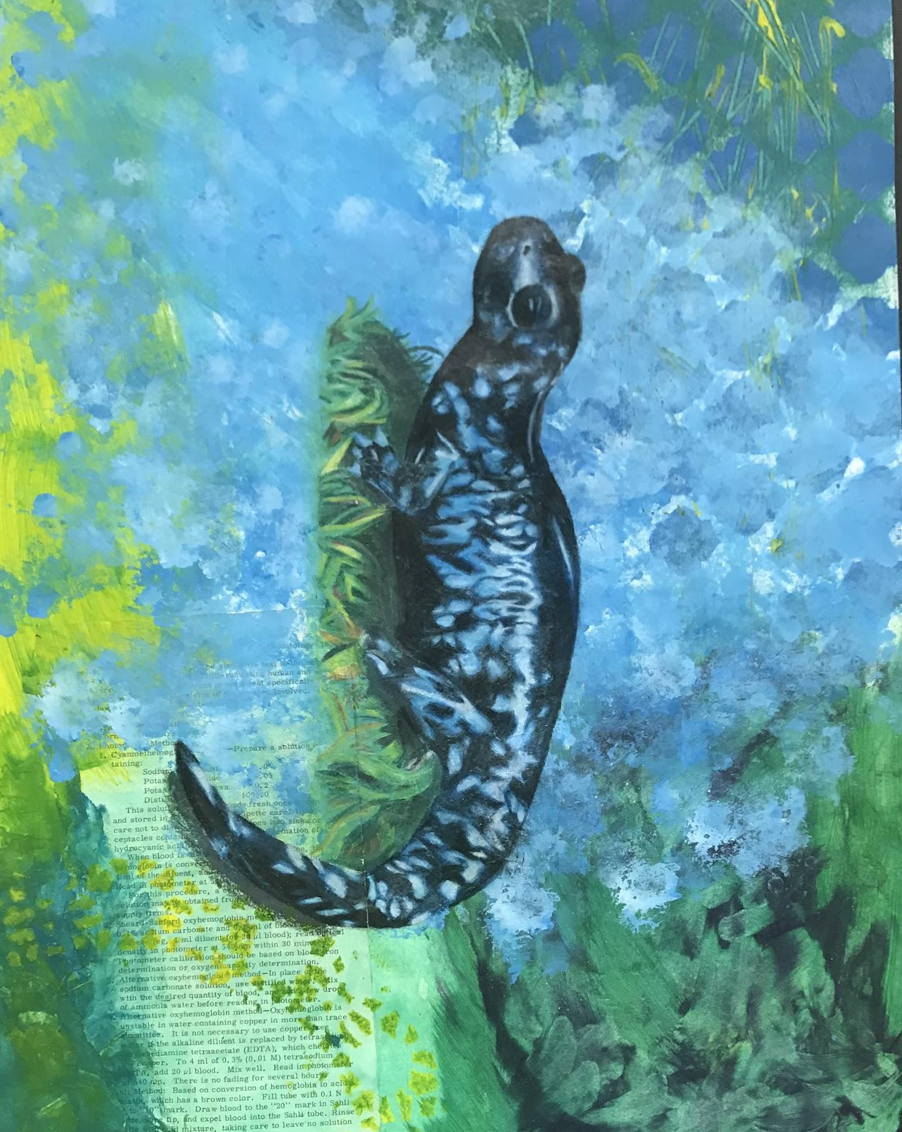
Visual Arts
Level 2
With Ms. Henson

Slide 2
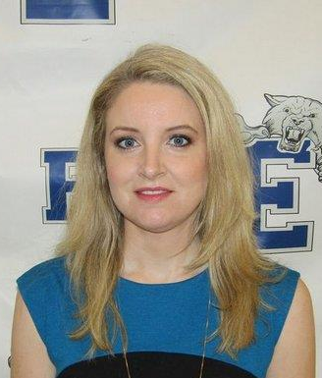
About Me
This is my 9th year at EHS. I previously taught at Dauphin Junior High School and have taught at some local colleges.
I went to EHS for 10th grade and graduated from the Alabama School of Math and Science in 2002.
I received my B.A. in Art and my M.A. in Art History from the University of Alabama at Birmingham.
I enjoy reading, drawing, running and going to the movies in my spare time.

Slide 3
About Me
I am currently pursuing National Board Certification. As a part of this process, I have to submit videos of myself teaching as well as collect samples of student work.
This is why your child may have brought home a release form at the beginning of the semester. Please know the National Board evaluator will be the only one to view these materials and your child will not be identified by their full name in any submitted materials.
If you have any questions or concerns, please email me at ahenson@enterpriseschools.net

Slide 4
What will we learn in Visual Arts Level 2?
You learned how to use some basic art materials in Level 1, and we will continue to build on those skills as well as practice creativity in this course.
By the end of the semester, you should be able to…
X Create work reflecting your own ideas which demonstrates purposeful design.
X Maintain a sketchbook which demonstrates your approach to solving visual problems.
X Demonstrate your ability to reflect on your process and the product of your work and the work of others.
X Produce a final project and artist statement that reflects your own ideas and the skills you have learned in Level 1 and 2.

Slide 5
What do I need to bring?
A sketchbook. If you had Level 1 here at the high school and still have your sketchbook from that class, you may continue to use it in this one. Any size is acceptable, but please no sketchbooks over 9x12 or drawing pads.
Art Class Fee of $22. This can be paid online with MySchoolBucks.
Your willingness to try new things and persevere. This is Level 2, so the work will more challenging than Level 1. If you are willing to work hard, you will improve.

Slide 6
What do I need to do?
Join the Level 2 Remind. You can text @bk4f29 to 81010 or enter the code in the app. I advise both parents and students to join. Not only can you get alerts about assignments from me, but you can also message me if you have a question or issue. If you send or reply to a message, I am the only one who sees it. It does not send to the whole group (some students have been concerned about this in the past).

Slide 7
How do I contact you?
You can email me at ahenson@enterpriseschools.net
OR
You can message me on Remind. The Level 2 code is @bk4f29.
I can respond to you much faster using one of these two methods rather than calling the school and leaving a message.

