Slide 1
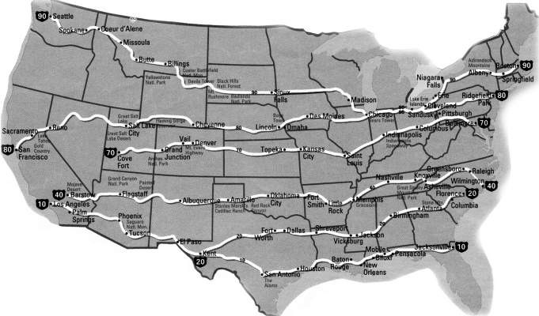
1) Chapter 11: Expressway Driving
Notes:
Some of the East / West interstate expressways.

Slide 2
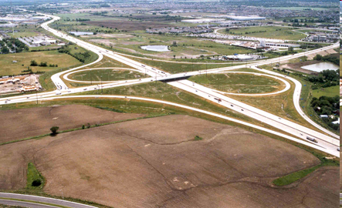
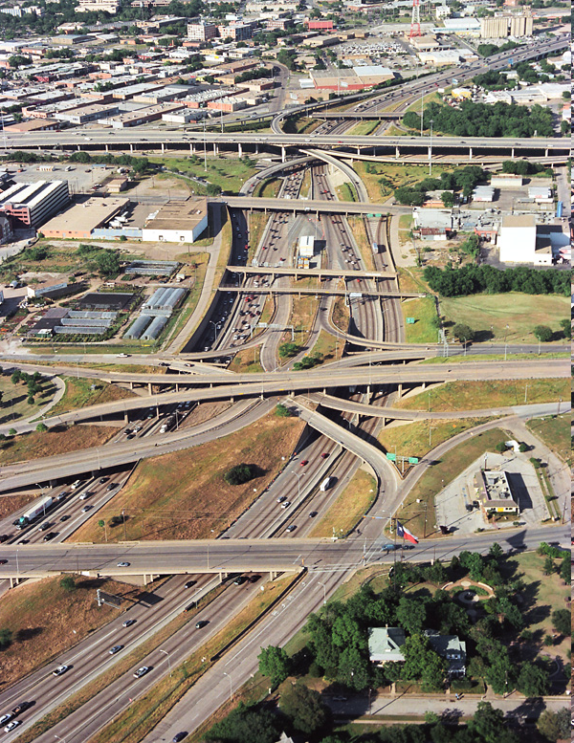
Characteristics of Expressway Driving
  An expressway is a limited access or controlled-access highway.
  Vehicles can enter and leave expressways only @ interchanges.

Slide 3
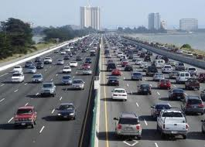
Advantages of Expressway
Designed for low risk higher speed travel.
Despite high speeds and heavy traffic, you are safer on expressways than any other highways.

Slide 4
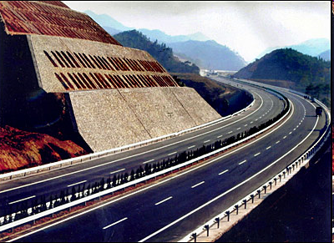
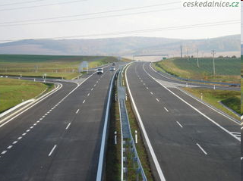
2) Advantages of Expressway
1) No cross Traffic.
2) Median or Barrier separate traffic
3) Pedestrians, non-motorized vehicles and slow moving vehicles are not permitted.
4) Wide Shoulders & extra wide underpasses for good escape paths.
5) Expressway signs to help drivers anticipate conditions well ahead.
Notes:
What are some of the advantages of Expressways?

Slide 5

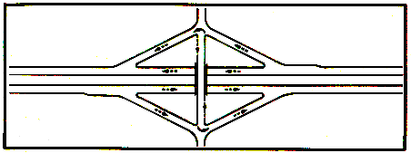
Interchanges
Interchanges are places where drivers can cross over or under as well to enter or exit an expressway
Cloverleaf Diamond
                Rt 59 over 88 Before
Notes:
Here are a couple of examples of different interchanges. Trumpet is another one and All directional is another.

Slide 6
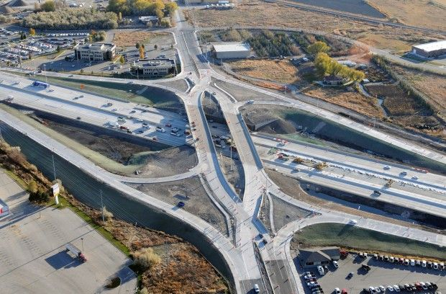
I-88 Interchange Construction at RT. 59
Improvements to the Interstate 88 Interchange.
An innovative diverging diamond configuration will be implemented on the Route 59 bridge over Interstate 88 that will enhance traffic flow on and off I-88.

Slide 7
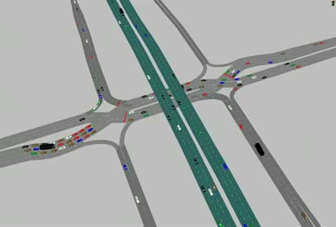
I-88 Interchange Construction at RT. 59

Slide 8
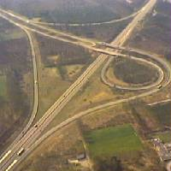
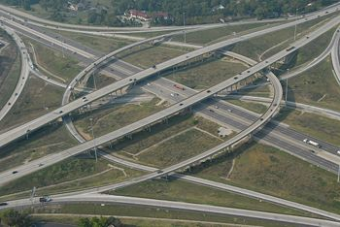
Interchanges
Trumpet Interchange
All direction Interchange

Slide 9
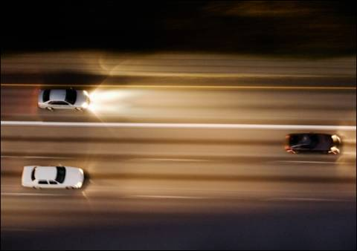

Safe Driving Strategies
Collisions on expressways are often more serious.
Why?
Higher speeds

Slide 10
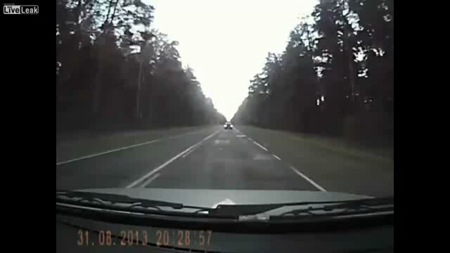
Watch here

Slide 11
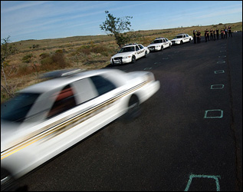
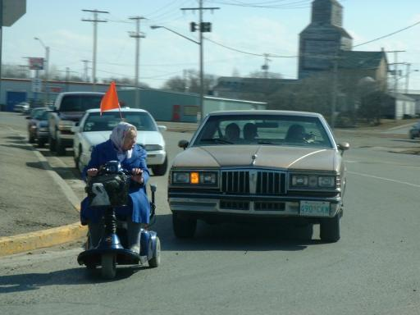
Safe Driving Strategies
When on an expressway you should drive @ about the same speed as other vehicles.
Not faster
Not slower
7) IPDE Process can be more difficult because of HIGHER SPEEDS, MULTIPLE LANES, AND MORE TRAFFIC

Slide 12
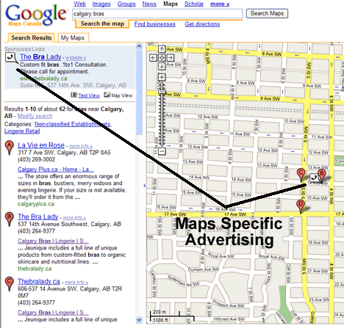
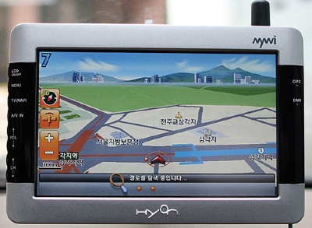
Safe Driving Strategies
Prepare Yourself and your car
Know the name, route number and exit and entrance numbers for your trip
Keep your car in good condition, plan for stops for food, fuel and rest stops
Notes:
Collisions can be more serious due to higher speeds. It is important to build experience gradually and prepare yourself & car.

Slide 13


Slide 14
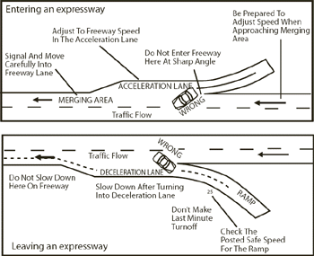
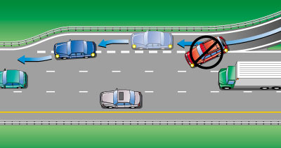
3/4/5/6) Entering the Expressway
Notes:
The entrance ramp gives you time to evaluate conditions and determine the best speed to enter.
The acceleration lane lets you search for a gap in traffic and adjust to the correct speed

Slide 15

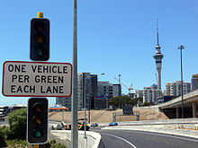
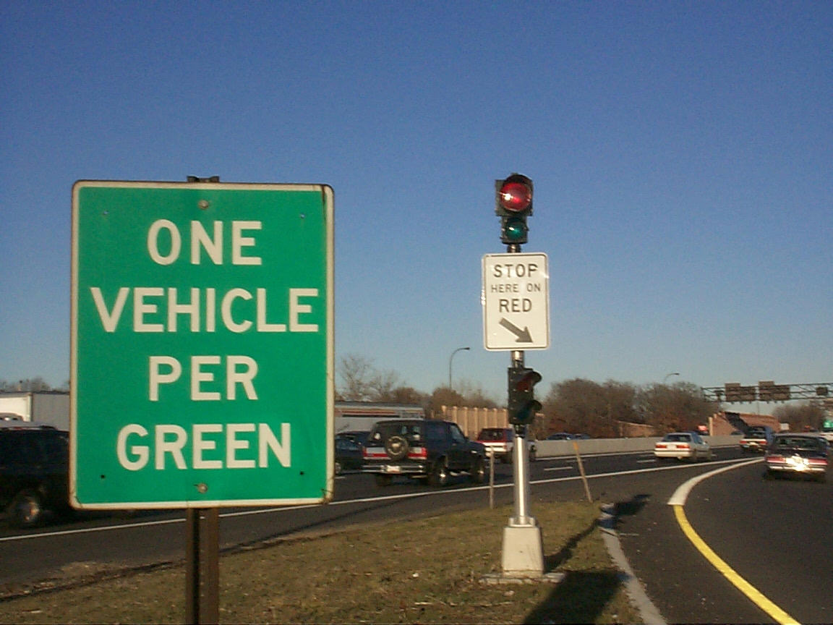
Never back up on an expressway or the entrance ramp!!
Some entrance ramps have traffic lights to help space traffic. How can this help?

Slide 16
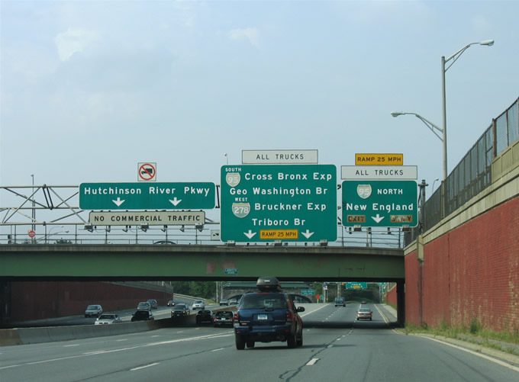
Entering the Expressway
Some times you have an entrance on to the left lane of the expressway. Why can this be difficult?

Slide 17
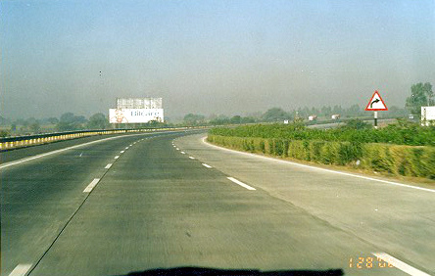
Lane Choice
It is generally safer to drive in the right lane and pass on the left
Left lane is the fastest & most stressful
Right lane may have lots of entrances & exits.
Middle lane is probably best for expressway driving.

Slide 18


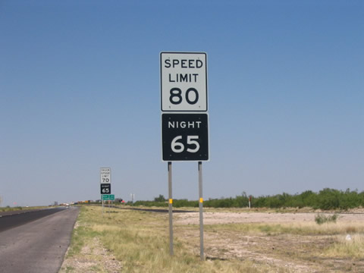
Signs & Roadway Markings
Pay attention to where you are going!!
Know your speed limits
Know your exits!

Slide 19
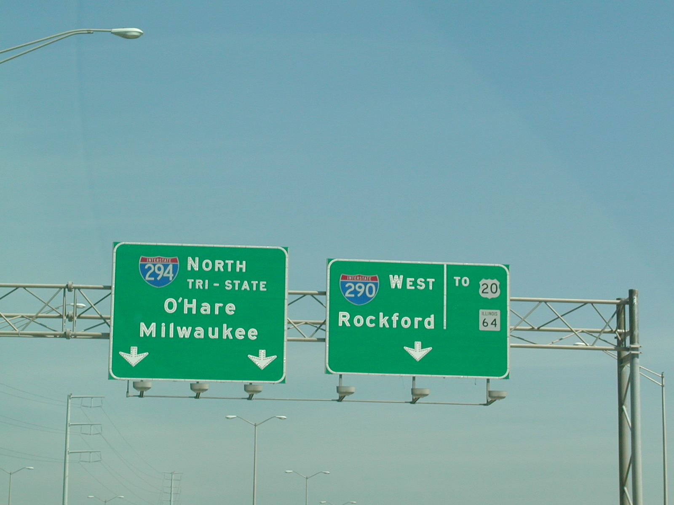
Overhead Signs
Notes:
Signs gives compass direction, names of cities, states

Slide 20
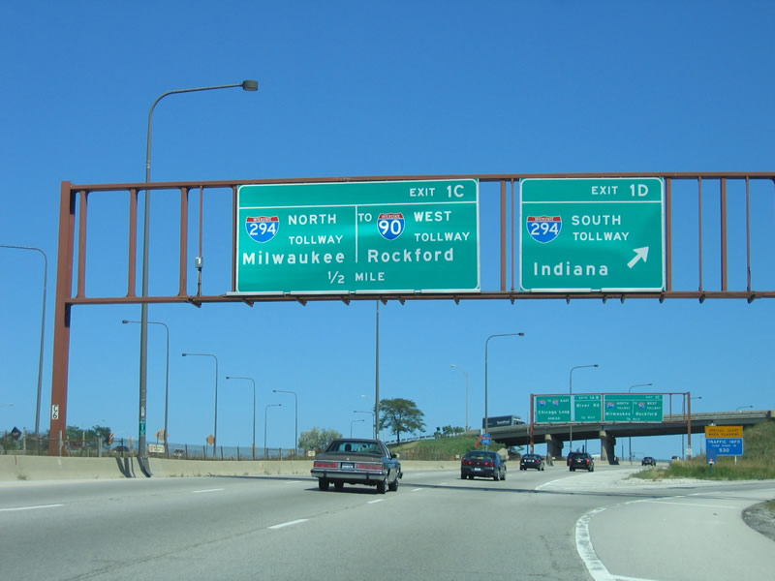
Overhead Signs

Slide 21
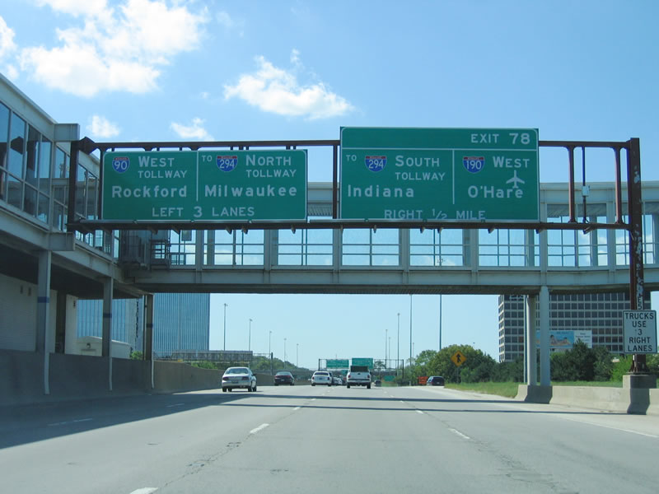
Notes:
Exit 78 means at mile maker number 78

Slide 22
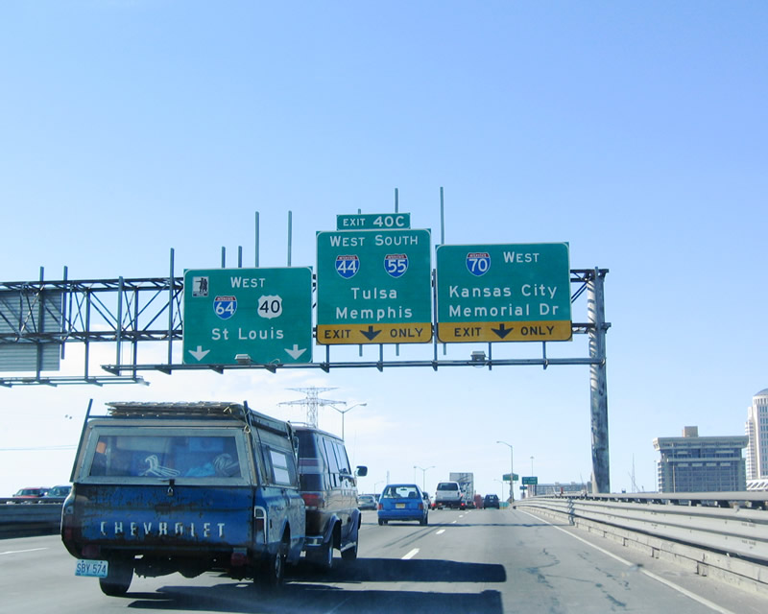
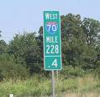
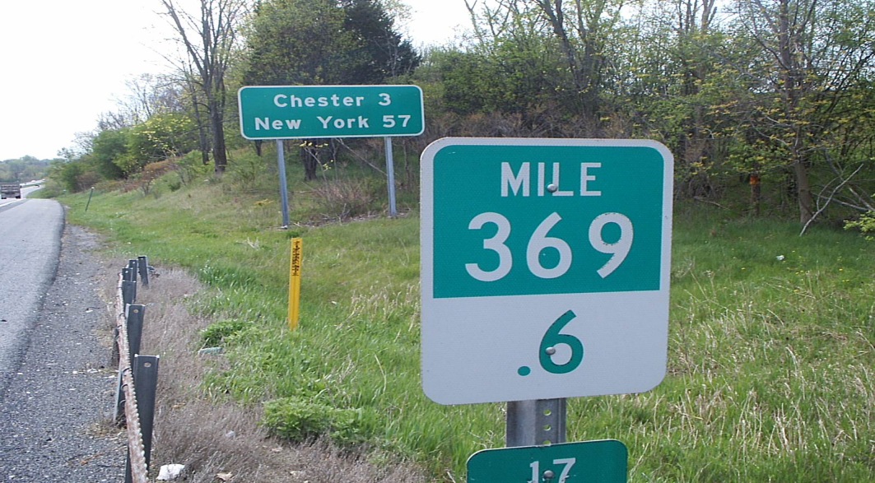
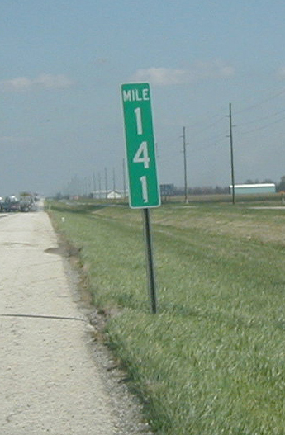
Mile Markers
Notes:
They tell you your direction< interstate number and number of miles from zero.

Slide 23
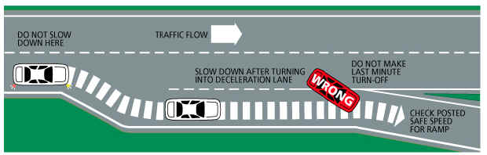
Exit Ramps

Slide 24
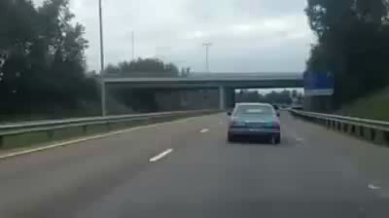
Never Exit Like This!

Slide 25
http://wgntv.com/2018/05/02/whats-the-right-way-to-merge-miscues-often-create-tension-in-traffic/

Slide 26
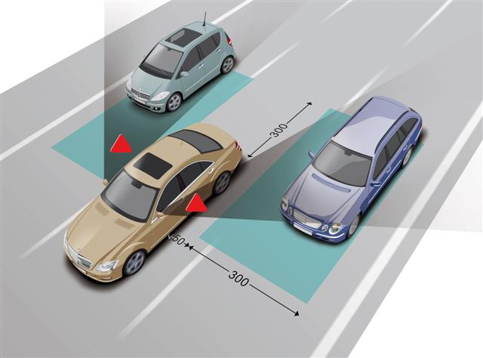
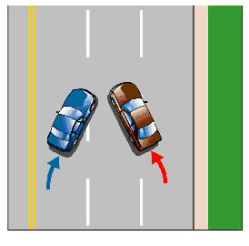

Lane changing
Check your blind spots.
Watch for lane changes in front of you.

Slide 27
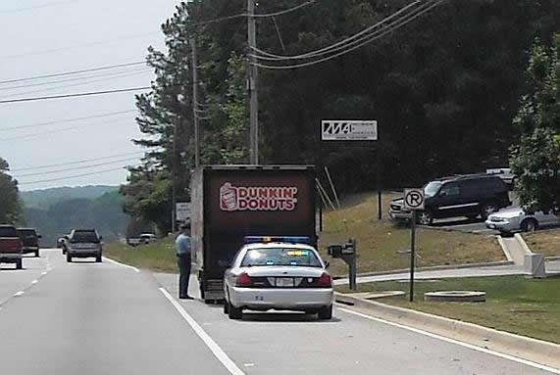
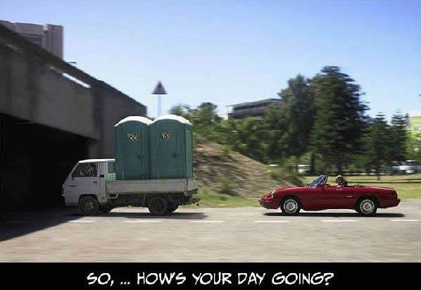
Special Expressway Problems
Driving for long periods of time can affect drivers.
Be alert for problems that can affect you and others on the road.

Slide 28

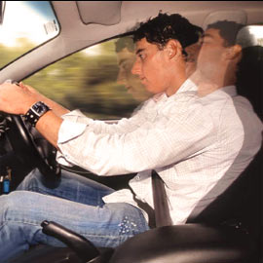

Special Expressway Problems
Highway Hypnosis
Staying alert can be a problem when you travel long distances on expressways.
You can be lulled into an inattentive, drowsy state known as highway hypnosis.

Slide 29
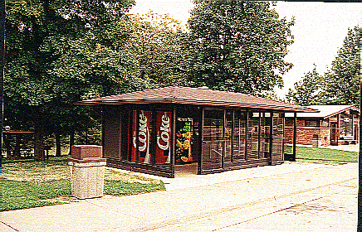

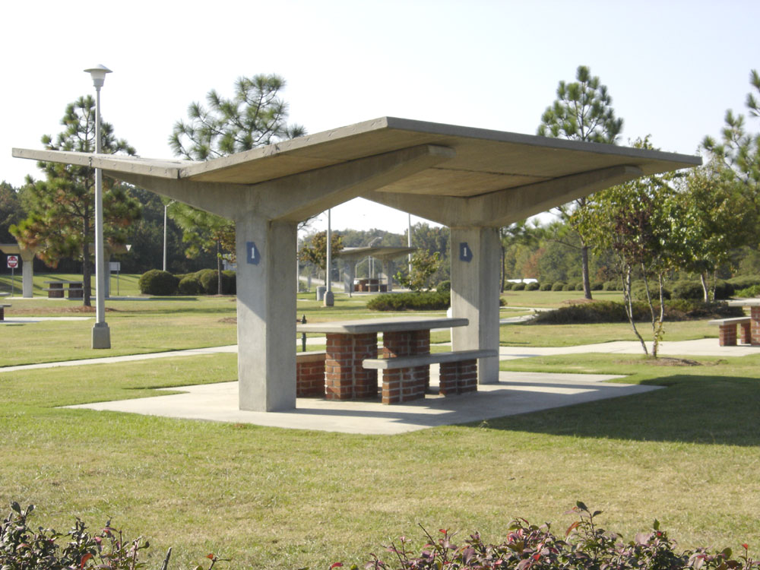
Highway Hypnosis
If you start to notice you’re becoming drowsy or less focused:
Sit up straighter
Open a window
Stop at the next exit and stretch
Stop at a rest stop (safe spot) take a nap.

Slide 30
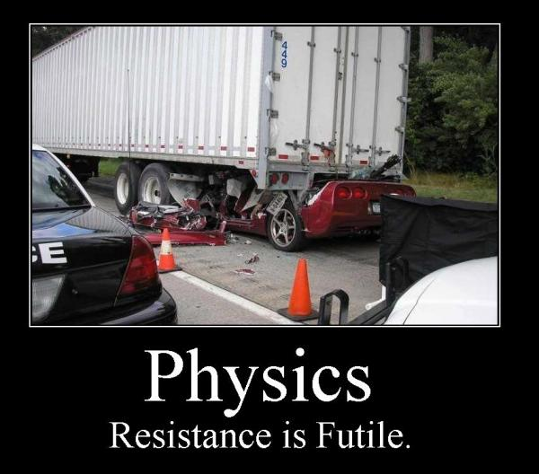
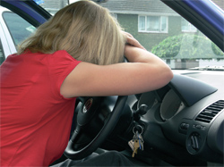

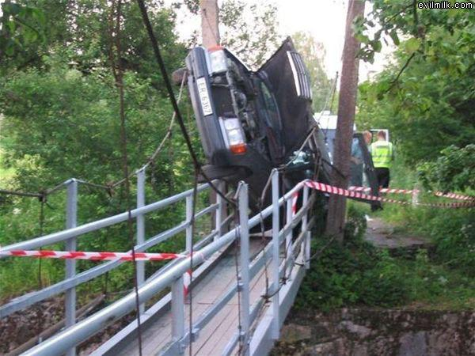
Fall asleep collisions
More than 100,000 collisions a year in the USA are caused by sleepiness.

Slide 31
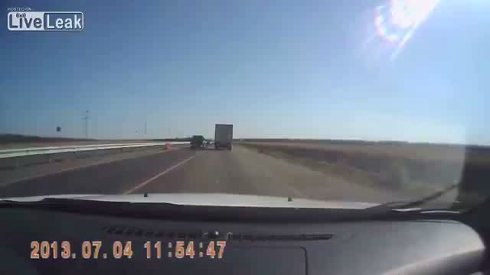

Slide 32
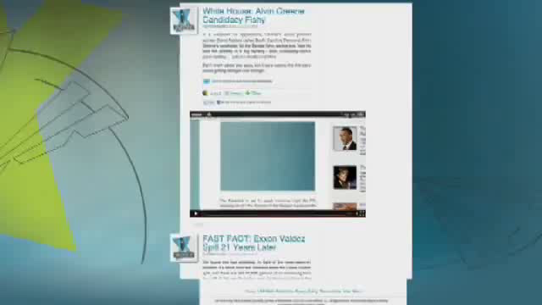

Slide 33

Unusual Expressways

Slide 34
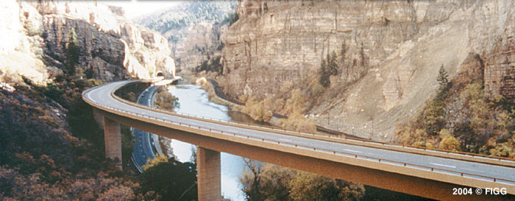
Glenwood Canyon Colorado

Slide 35
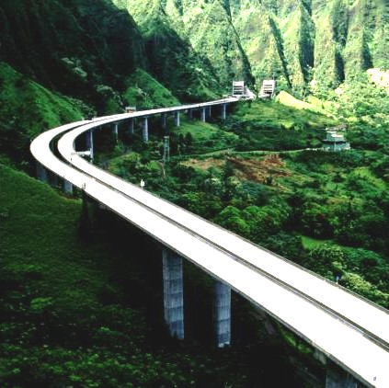

Slide 36
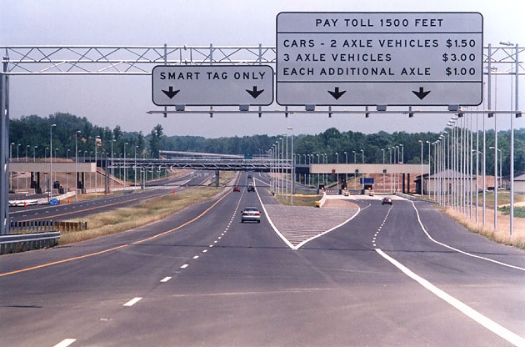
Open Road Tolling

Slide 37


Slide 38
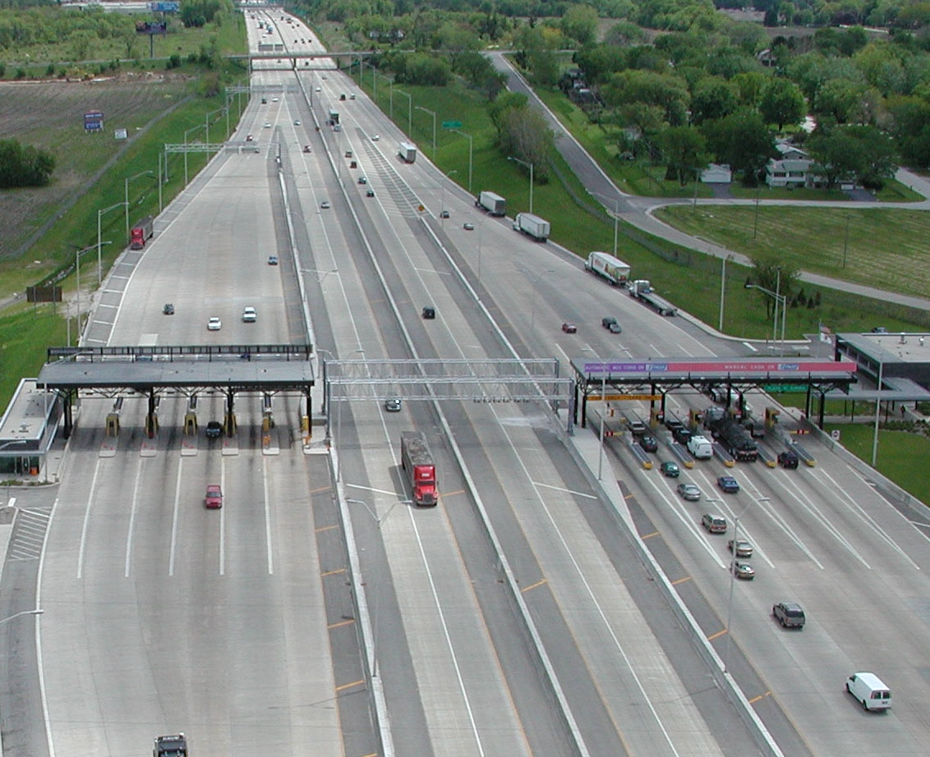

Slide 39
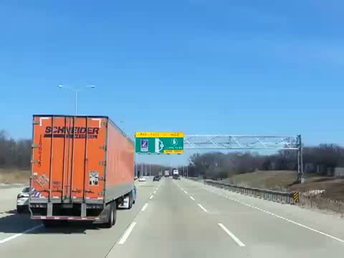

Slide 40

Notes:
Dallas High 5

Slide 41

Epic Fail Just Because

Slide 42
Review It Q’s
FINISH NOTES PAGE AND ANSWER THESE REVIEW IT Q’S
11.1 #2
11.2 #3
11.3 #3
11.4 #3
11.5 #1

