Slide 1
How do you interact with life around you when using your cell phone?
Are you missing out on anything important?

Slide 2

It is certain that modern cellular technologies have changed the world.
It seems there is almost nothing they cannot do. Almost!!!

Slide 3
Please view the slide show and ponder what is going on.
Is there something important being missed as we constantly stare into our digital screens?

Slide 4

Please number from 1 to 10
and then jot down anything
you notice in each slide for
discussion after the slide show.

Slide 5
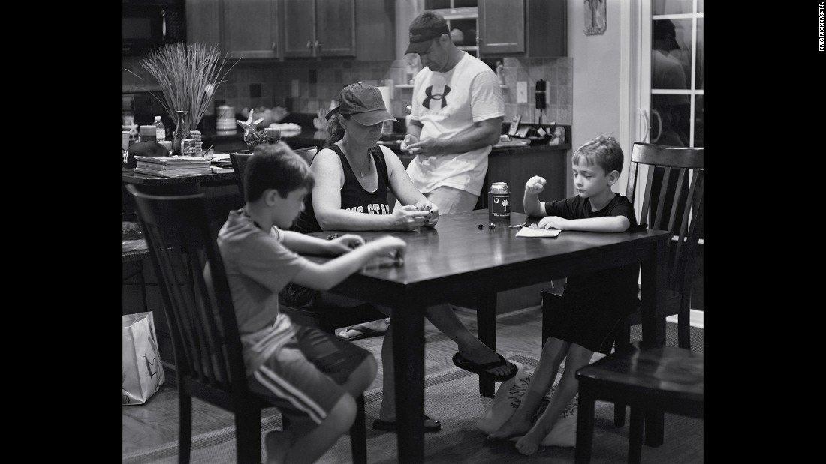

Slide 6
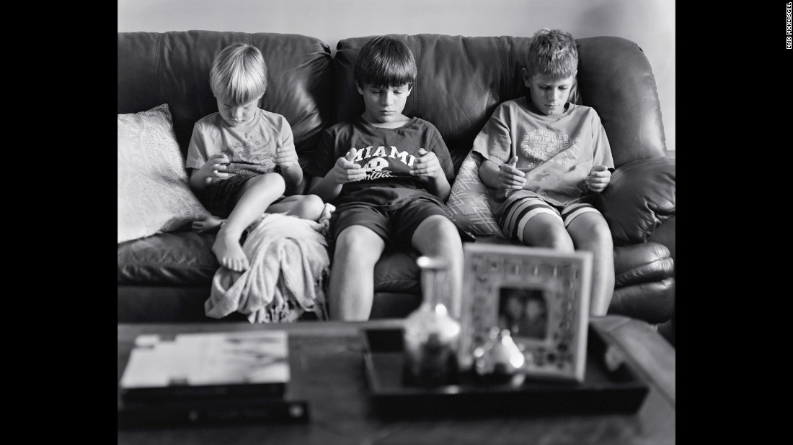

Slide 7
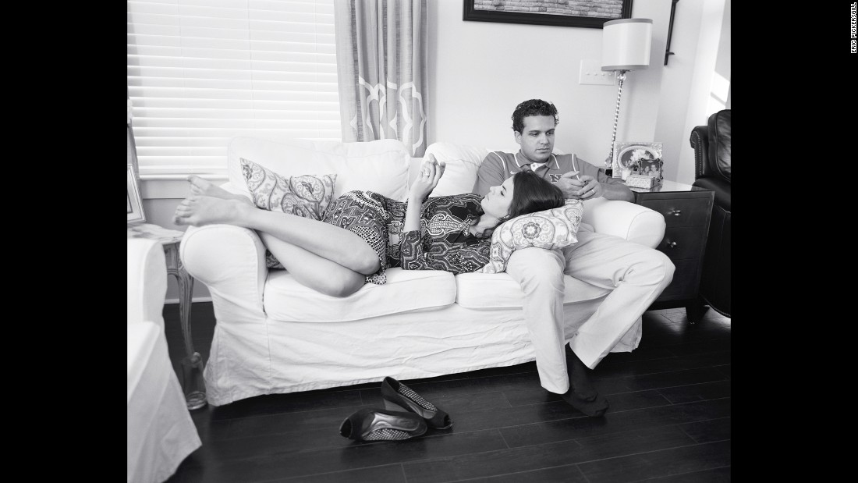

Slide 8
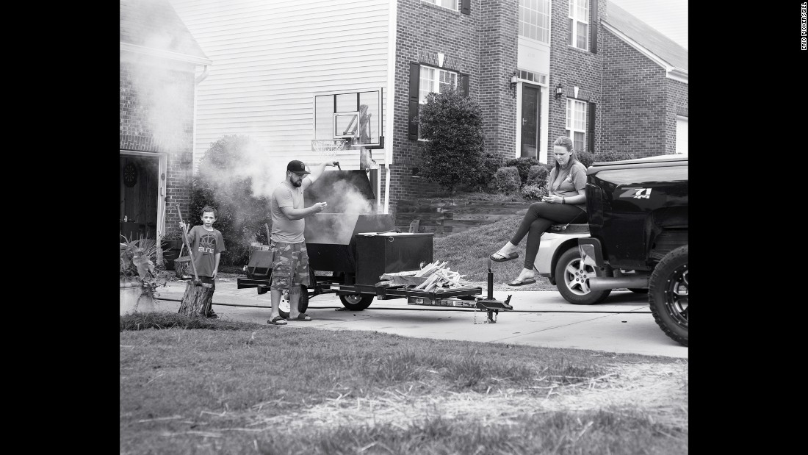

Slide 9
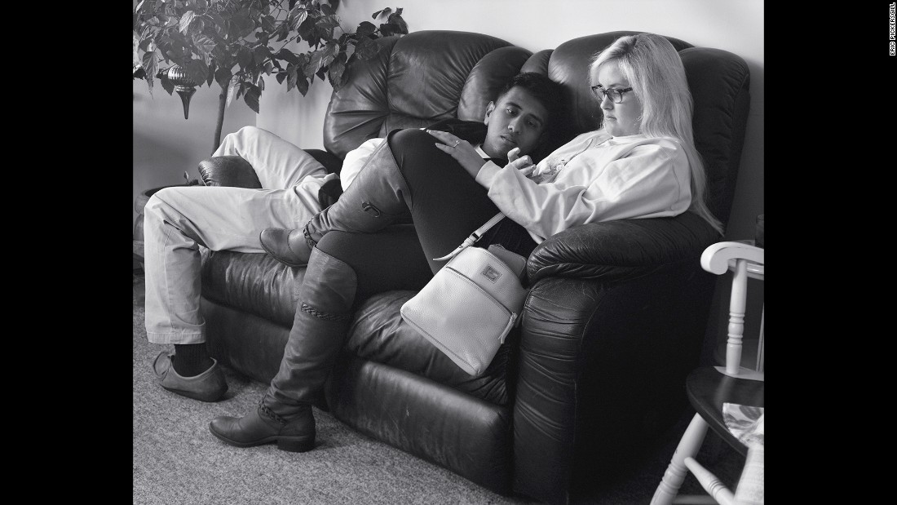

Slide 10
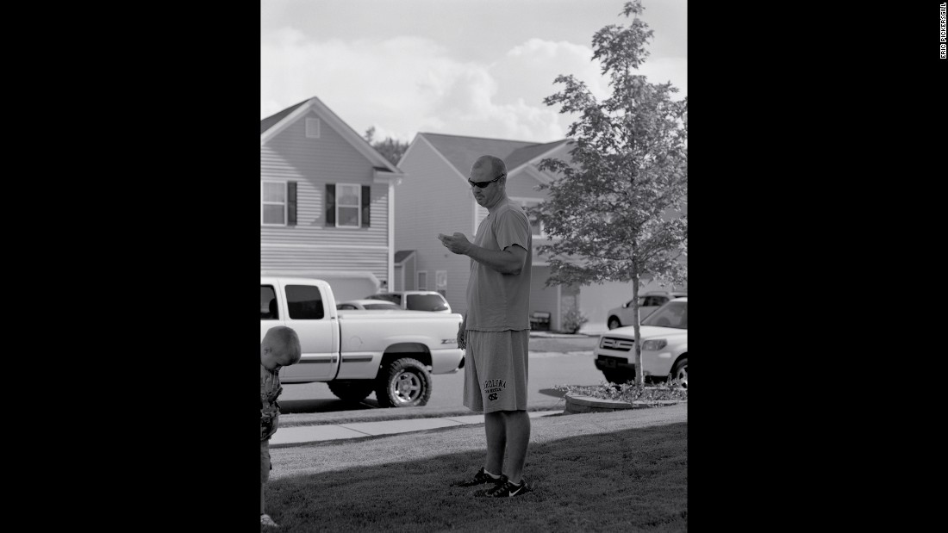

Slide 11
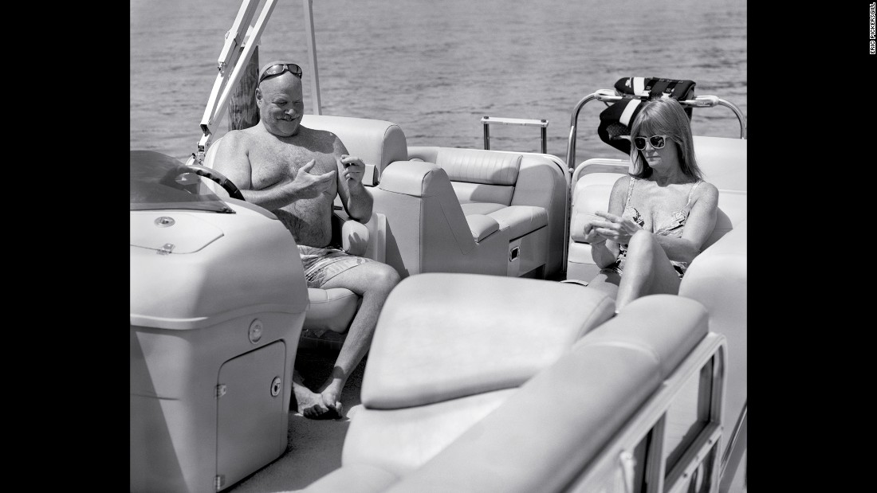

Slide 12
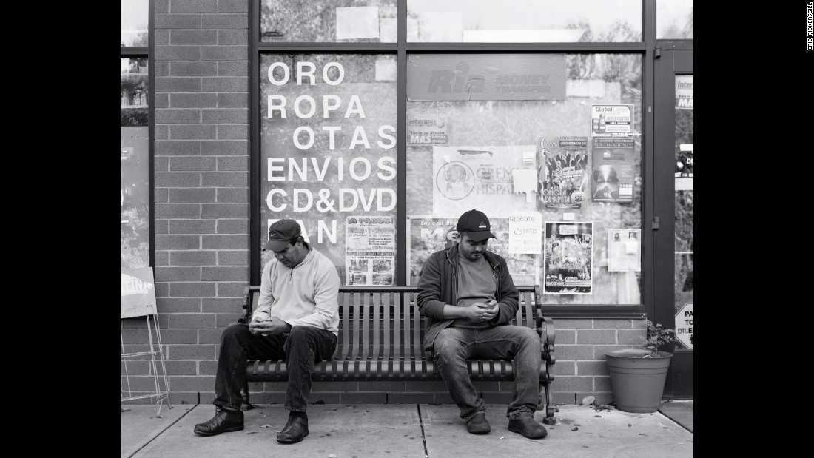

Slide 13
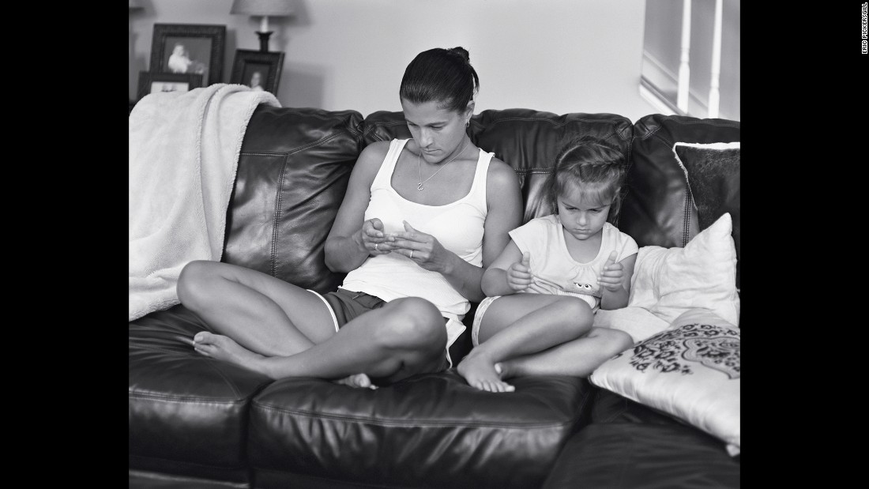

Slide 14
Take time to look back at the ten slides
and share with your homeroom what
you noticed.

