Slide 1
What to expect when you are
18!
Information taken from On Being 18 by the State Bar of Wisconsin

Slide 2
Rights and Responsibilities
Some rights and responsibilities include:
Vote
Jury Duty
Apply for Credit
Enter in to a contract
Rent an apartment/sign a lease
Selective Service for males

Slide 3

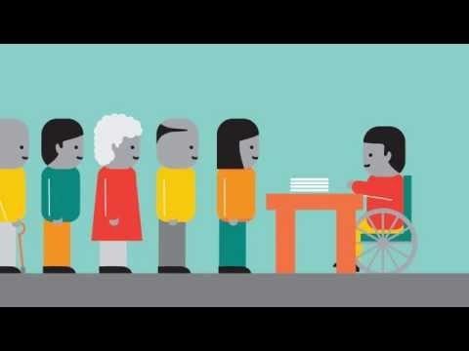
Voting Requirements
18 years old.
Proof of residence (can be a current driver’s license)
Photo ID (video) Bring It To the Ballot
Register to vote
  At school
  At a polling site
  Online
More information needed?(gab@wi.gov)

Slide 4

Jury Duty
Selected from voter registration lists and drivers’ records.
MUST serve if called.
No occupation automatically excused.
Employer must allow you to serve.

Slide 5

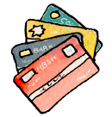
Credit
Good credit is needed to:
  Rent an apartment
  Get some jobs
  Get a loan
  Get credit cards

Slide 6

Contracts
Types of contracts: Employment, loans, insurance, medical care, credit cards.
Contracts are:
  Legal Documents
  Don’t sign written contract unless you understand the agreement
  Get a complete, accurate, signed copy

Slide 7
Renting/Leasing
Have a job or source of income.
Landlord may require a parent co-sign the lease.
Must have good credit.
Look at the apartment before renting.
Don’t sign unless you have read the lease/agreement.
Get renter’s insurance.
Make sure you know what is included in a lease (ex. Utilities)
Make a list of damages or repairs needed – take pictures if you feel necessary.

Slide 8

Selective Service for Males
Register the month of 18th Birthday
www.sss.gov
Must be registered to get financial aid for college.
Males must register……..IT”S THE LAW!

Slide 9
Things I Wish Someone Told Me When I was 18.
Find hard work you love doing.
Invest time and energy in yourself every day.
It is o.k. to make mistakes.
Don’t base your career choice on other people’s ideas, goals and recommendations.
Remain true to yourself and follow your own interests and values.
The right career choice is based on finding hard work you love doing.
When you invest in yourself, you can never lose, and over time you will change the path of your life.
Take control of your own life.
Mistakes teach you important lessons.
The biggest mistake you can make is doing nothing because of being too scared to make a mistake.
Take responsibility for your mistakes.

Slide 10
Things I Wish Someone Told Me When I was 18.
Don’t worry too much about what other think.
Talk to a lot of people about your career.
Be yourself.
Don’t let the opinions of others stand in your way. What is important is how you feel about yourself.
Always be honest with yourself.
Continue talking to new people you meet through school and work.
Over time, you will continue talking to new people. Always be respectful.
Laugh when you can, apologize when you should and let go of what you can’t change.

Slide 11
Things I Wish Someone Told Me When I was 18.
Friendship
Budget
Friendship is about quality not quantity.
Live within your means.
Avoid getting in to debt.
Save your paycheck – pay yourself first!

Slide 12


Slide 13

THE MEANING – Jim Carrey video link
Absolute motivation

