Slide 1

Course
Registration
Guidelines
Notes:
For juniors:
add info about how to get senior priv
Add math sequence following Alg 2>Functions and Stats
Slide to ignore the final page kids get where it says to print and sign

Slide 2

A-D Mrs. Kapanke
E-J Mr. Hochstetler
K-N Mrs. Moss
O-St Mrs. Erickson
St-Z + EL Mr. Vang

Slide 3
Academic and Career Planning Guide (ACP)
8th Graders receive it in the mail
Also available on Memorial’s Website
Refer to the ACP Guide:
For course descriptions, requirements, prerequisites, etc.
For additional information regarding post secondary success, college admission requirements, advanced high school coursework, etc

Slide 4
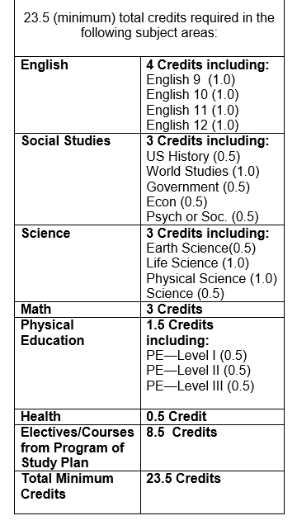

Plan to earn a minimum of
6.0 credits
per year
for 4 years.
You will graduate with a minimum of 24 credits!

Slide 5
Advanced Course Opportunities
Challenge yourself! Make an educational goal to complete at least one college credit opportunity while in high school!
Advanced Placement
AP courses can be taken to fulfill required credits or elective credits!
Transcripted credit
Advanced Standing
Project Lead the Way courses
Start College Now
Early College Credit
CVTC Academies
Aim to exceed the minimums!
See chart in the ACP Guide

Slide 6
When choosing classes, pay attention to:
Prerequisites for the courses you select
Course grade level
Course credit
Year vs semester class
Elective vs required

Slide 7
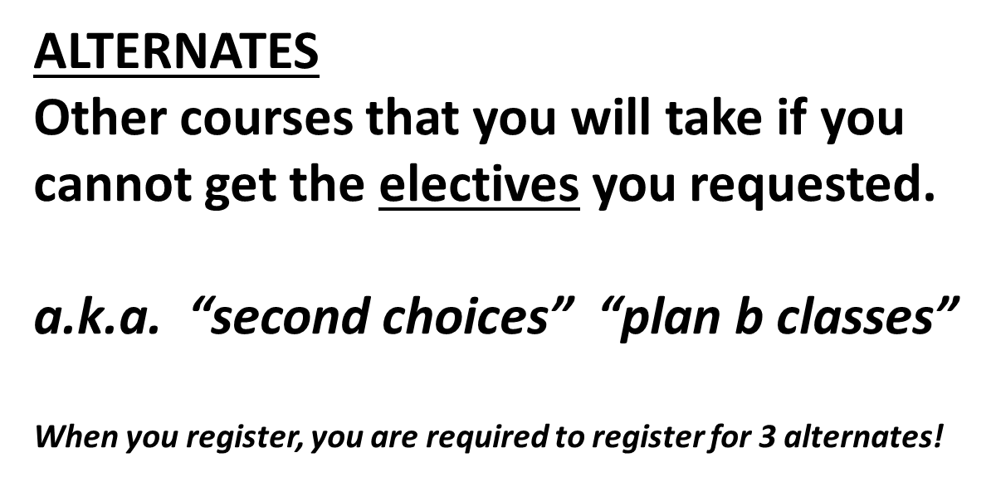
ELECTIVES
Classes other than the 15 required credits of classes.
The classes you choose

Slide 8
PLAN AHEAD!
COURSES OFFERED ALTERNATING YEARS only:
Digital Marketing
AP Human Geography
Web Design Applications
AP US History

Slide 9
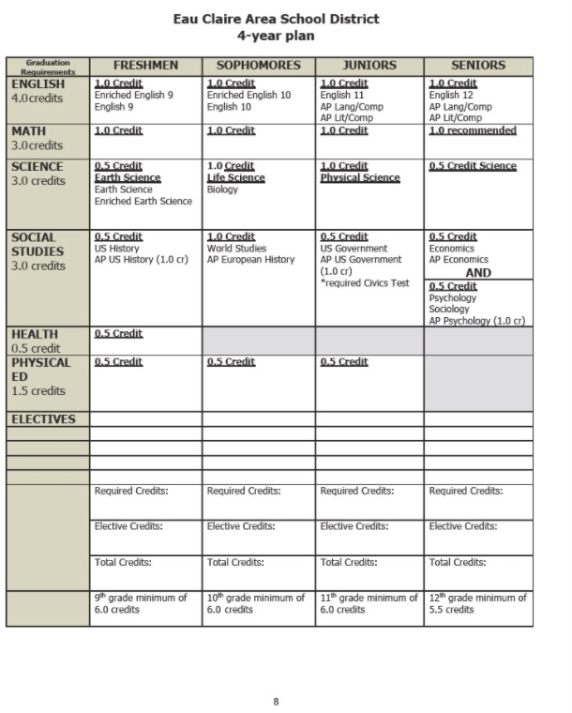

Slide 10
Study halls are automatically added later by the computer to fill empty class periods.
7.0 Credits = no study hall
6.5 credits = study hall one semester
6.0 credits = study hall all year

Slide 11
Dual credit opportunity
Students commit to completing all courses in Academy
Students Sign up for Full Academy in Skyward
See your counselor for questions
CVTC Embedded Diploma Opportunity
  Business Management Associate Degree
CVTC ACADEMIES

Slide 12
Signing up for CVTC Academies
If an ECASD course number is listed for the Academy course you want to take, register for that class at Memorial.
Then apply for the Academy by googling
CVTC high school academies
If the Academy course you want to take does not have an ECASD course number, then apply for the desired Academy at the website above.
Your application for a CVTC Academy is first approved by ECASD. Then if space is available you will be
registered for the Academy.

Slide 13
You will earn transcripted credit with CVTC for each course you successfully
complete in the Academy and
a certificate from CVTC
when you complete the Academy.
By applying for a CVTC Academy, you are expressing a commitment to complete the entire academy.

Slide 14
NEW STUDENTS!!!
If you are new to Memorial this year, please
make an appointment to meet
with your counselor this week
to make sure you register for
the classes you need!!!!

Slide 15
Choose your courses carefully.
Opportunities to make schedule changes are limited!
Please be ready with course choices by the end of 1st Semester
Counselors will be visiting English classes early in 2nd Semester to help you input your choices.

Slide 16


