Slide 1


Redlands Unified School District

Slide 2
School Site Council Composition
Per Education Code, the composition of SSCs ensure parity between School Staff and Community/Students- a balance of stakeholder voices.
    Elementary and K-8 Schools Middle and High Schools
    (10 members min) (12 members min)
School Staff (5) | Community (5)
Principal | Parent/Community Member
Classroom Teacher | Parent/Community Member
Classroom Teacher | Parent/Community Member
Classroom Teacher | Parent/Community Member
Other School Personnel | Parent/Community Member
School Staff (6) | Community (6)
Principal | Parent/Community Member
Classroom Teacher | Parent/Community Member
Classroom Teacher | Parent/Community Member
Classroom Teacher | Student
Classroom Teacher | Student
Other School Personnel | Student
Principal is a mandated member and cannot name a proxy
Teacher is one who has students assigned and is the “record keeper” for the students
Other School Personnel is a employee who is not a teacher of record (Librarian, Clerk, pull-out TOSA, Classified Staff)
Parent/Community Member is not an employee of the school site.
Student is enrolled at the school and cannot be appointed. A student member must be voted in by other students.

Slide 3
Duties of Officers/Members
The council shall elect officers, including:
Chairperson to organize, convene, and lead meetings of the council
2. Vice-Chairperson to serve in the absence of the chairperson
3. Secretary/recorder to record minutes taken at council meetings
*(optional) Parliamentarian to resolve questions of procedure, often with the help of “Robert’s Rules of Order”
3

Slide 4
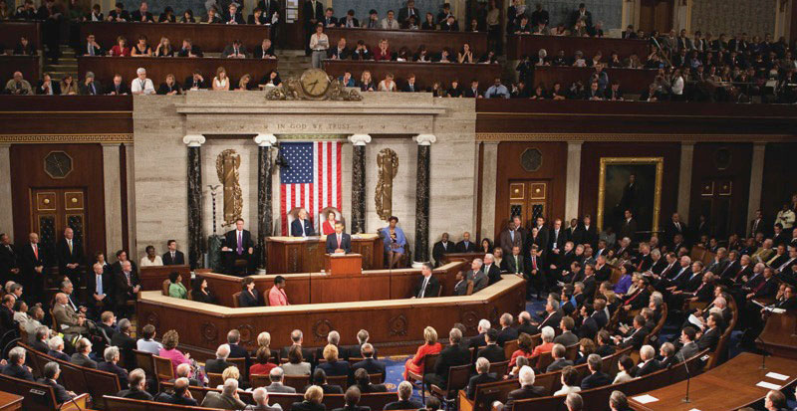
Basic Expectations of SSC Members:
To attend all meetings
Participate; ask questions; share your ideas
Be committed to the process and respectful of other members
Remember that you were elected as a
representative of your peers and you represent
them in the council:
- Teachers elected teachers
- Other staff elected other staff
- Parents elected parents
- Students elected students*
(*secondary schools)

Slide 5
Role of the School Site Council
The School Site Council is generally responsible for:
Assessing needs of students and using data to set goals
Gathering information from the school’s English Learners Advisory Committee and other advisory groups on campus
Revising the School Plan for Student Achievement with budgetary allocations
Evaluating the effectiveness of the school plan
Revising the Parent Involvement Guidelines, as needed
Revising School Site Council Bylaws, as needed
*The governing board (Redlands Unified Board of Education) holds the final authority.

Slide 6
The BIG picture
ELAC
  ELAC is in an advisory role to the SSC. It is responsible for making recommendations to the SSC about activities to increase the achievement of EL students. The SSC receives the recommendations of ELAC and gives feedback as to those recommendations in an ongoing cycle of advisement and feedback.
SSC Authority
  SSC is the only site council that can approve the SPSA and the accompanying budget– one decision-making body for all site discretionary funds.
  Board of Education Authority
  RUSD Board of Ed is the final authority on all SPSAs and their activities and budgets. The Board must ensure that all SPSAs are complete, compliant and aligned with the LCAP and District priorities.

Slide 7
School Plan for Student Achievement
Purpose
Coordinate all educational services at the school to improve the academic performance of all students, as well as provide interventions for students who are not meeting academic standards.
SSC must annually develop and approve the plan which must address how funds will be used to improve academic performance.
Components
Comprehensive Needs Assessment
Goals (Reading, Writing, Math, Safety)
Accountability Measures:
      AM1: Student Achievement (Core & Supplemental Interventions)
      AM2: School Climate (Safe/Civil, Attendance, Suspensions, Health)
      AM3: Professional Development
      AM4: Parent Involvement (including Home-School Compact; Parent Involvement Guidelines)
  Assurances

Slide 8


The foundation… Prioritizing Student Needs
All SSCs are engaged in the delicate balance of ensuring the needs of the students are met within the precious budget of funds.
Ask yourselves:
What data do we have to say this is a priority for us to fund?
Is this activity allowable and do we have enough funds?
Does this activity meet the needs of our students?
Is this activity targeting our students who are having difficulty in school?

Slide 9
Areas Outside the Scope of School Site Councils
A school management committee
A policy-making body
A political organization
A personnel committee
A grievance committee
A fund-raising organization
An extension of the PTA
A social group
9

Slide 10
During the SSC Meeting
Sign-in
Provide copies of agenda and all materials to SSC members and the public (post 72 hours in advance)
Use an agreed upon procedure (e.g., Robert’s Rules of Order) for conducting business
Follow the posted agenda
Provide opportunities for discussion of items on agenda
At the conclusion of the meeting, maintain minutes, agendas, and sign-in sheets for compliance records
10

Slide 11
SSC Meeting Minutes
Contents:
Attendance (sign in sheet required for compliance)
Approval of minutes from previous meeting
A record of what was discussed. Must briefly state who said what.
Advisory committee reports (DCAC, ELAC, DELAC, etc.) and input
Motions – a) the wording in which each motion was adopted, and
b) whether motion was debated, amended
When a count is taken, the number of votes on each side should be recorded
The time of adjournment
*School Site Council minutes are public record.
11

Slide 12
Effective Communication
Be respectful; every member will have an opportunity to speak at an appropriate time
Don’t let personality conflicts or prior policy disagreements spill over into committee meetings or public comments
Be respectful of committee decisions; if you disagree with the position taken by the committee, the time to express that opinion is prior to when that position is adopted
Remember that you and every SSC member have a duty to act in the best interest of the entire school community
12

Slide 13

Increasing Effectiveness by Sticking Together
Committees take collective responsibility for their performance
If you vote in favor of an action that passes, you consent to that action, and are expected to support it
If you vote against an action that nevertheless passes, you are expected to support the majority and not attempt to sabotage or subvert the action
Committees operate by consensus
If you are not in the room when the vote is taken, you nevertheless consent to the action
13

Slide 14
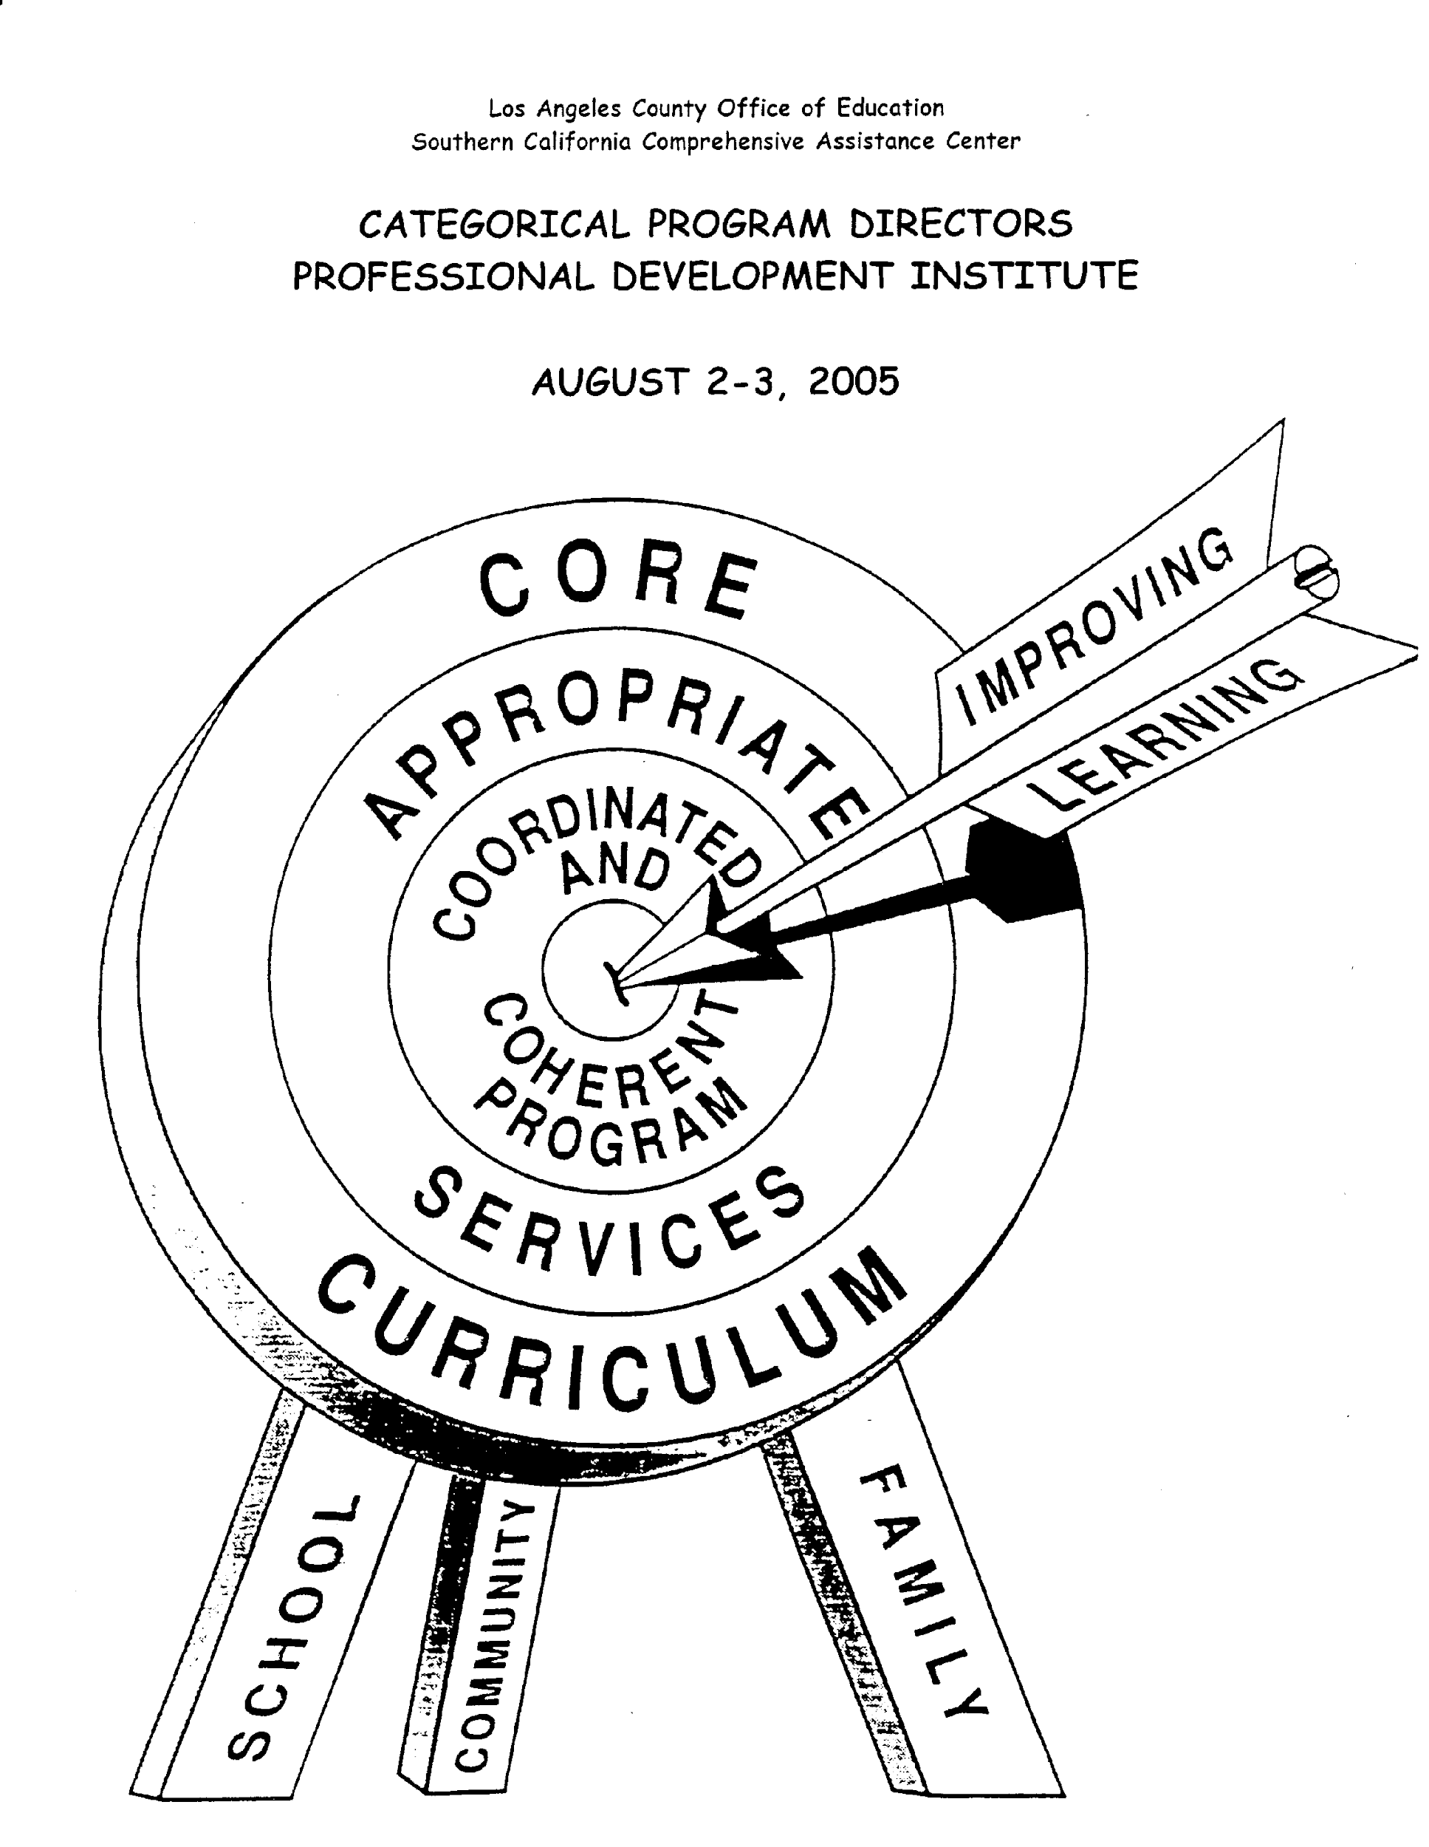
14
Will Your SPSA
Hit the Target?
The SSC must evaluate the effectiveness of planned activities.

Slide 15

Questions? Comments?

