Slide 1


Kindergarten Readiness:
Enrollment Strategies
Maria Sujo, MA
CSM PLC 2
12/7/2018

Slide 2
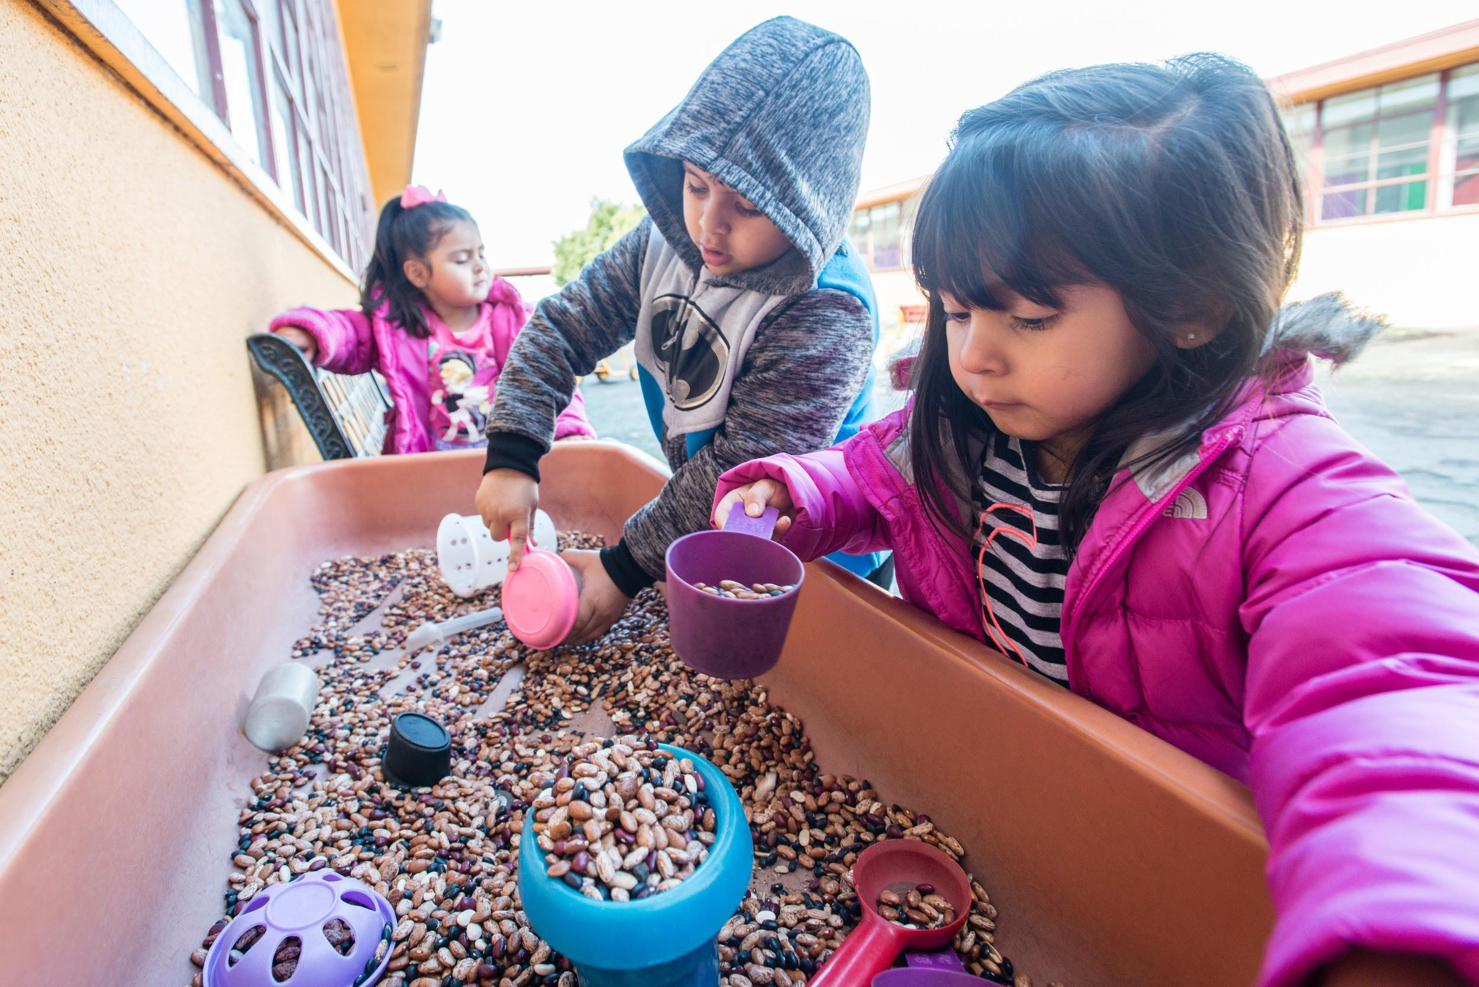
Agenda
Kindergarten Readiness & enrollment
K/TK Enrollment Patterns
Strategies & tools for school enrollment
Notes:
class size, IEPS, class articulation

Slide 3

School Readiness
..entails the combined efforts of families, the community and schools to come together to support student achievement both in school and in the community
Notes:
showing up to school on time is a crucial first step

Slide 4
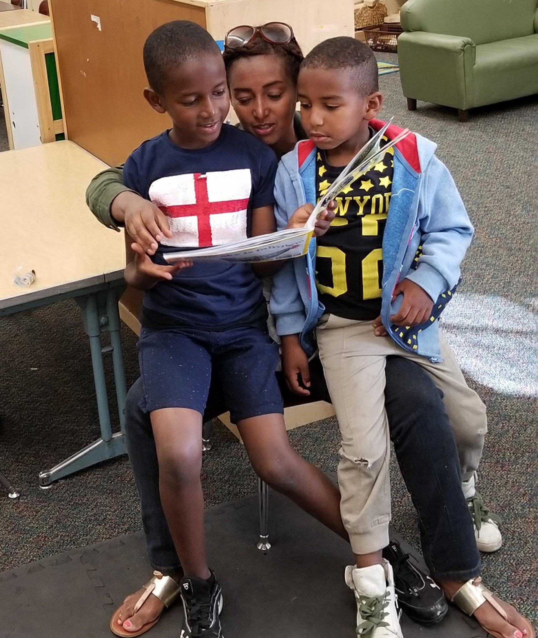
Impact of timely enrollment
Teachers & staff are prepared to welcome families
+School Climate
Smooth transition (everyone!)
Feeder patterns with CDC
Notes:
class size, IEPS, class articulation

Slide 5
School Readiness: Engaging families before they start school
What are some of the barriers that families face that prevent them from participating in the options process?
Notes:
peek at a data point to see how families are participating in enrollment options, by region

Slide 6
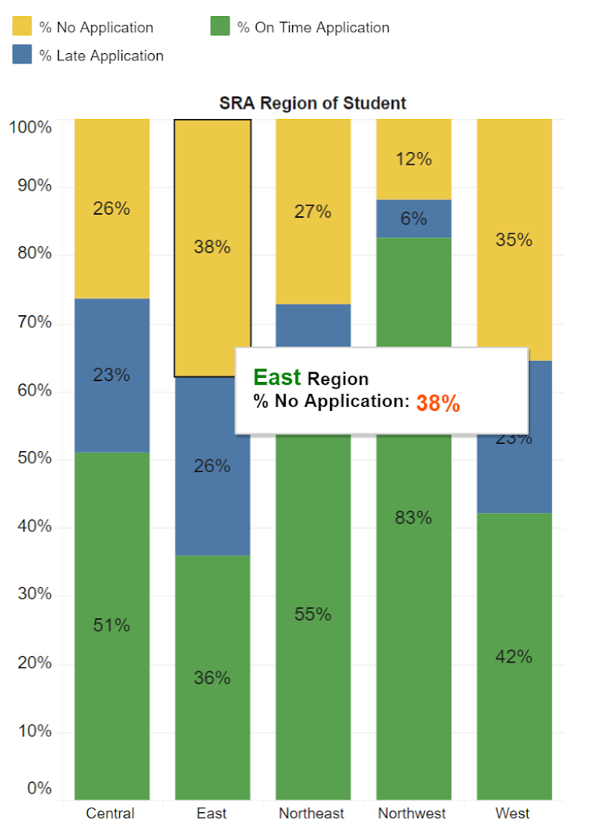
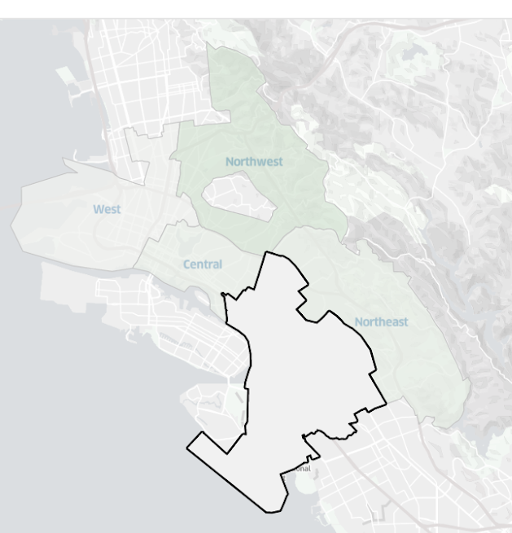
Strategic Regional Analysis
2017-2018
East Oakland K/TK
Notes:
Incoming K/TK students participation in school-choice
Pose many disruptions to student learning, classroom climate and declining enrollment numbers

Slide 7


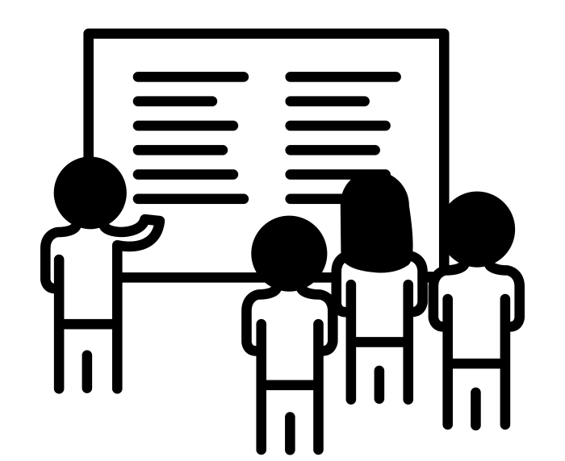
Strategies and Tools
Engage families before they start school (on site CDC, neighboring preschools)
Partner with our district and community partners to support enrollment and reach families (ELLMA, SA, OPL, Head Start)
Provide families with resources to participate in timely enrollment and make informed decisions
Notes:
What are schools doing to get in front of this?
engage families as it is meaningful to your community
draw from social capital

Slide 8
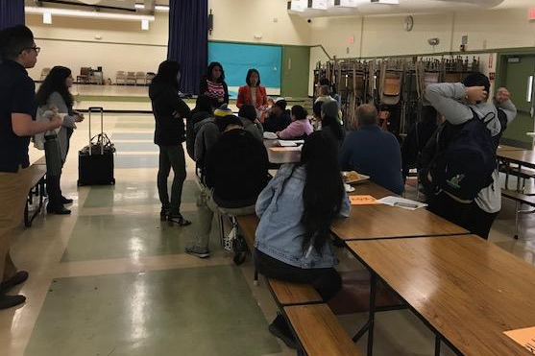
K/TK Enrollment Session Highlights
K/TK Enrollment Session
Bridges (2)
Garfield
MLK (Jan)
Hoover (Jan)
REACH (Jan)

Slide 9
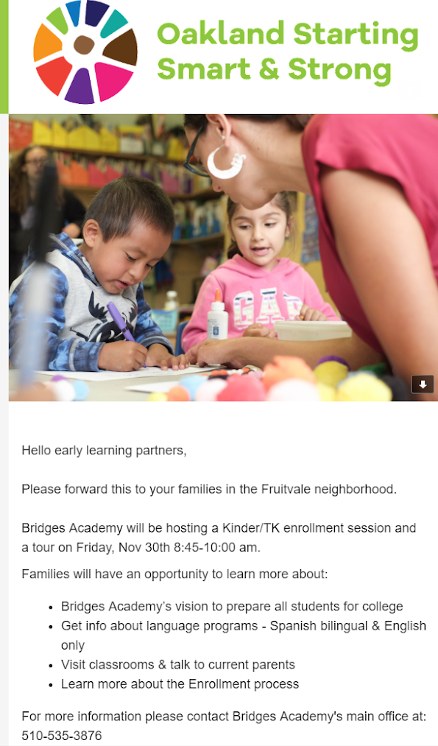
Outreach
CDC families
Neighborhood PreK’s
Agencies serving young children
Enrollment Session:
Principal’s Welcome
School highlights
Tour K/TK
Parent speakers
Enrollment support
Notes:
Outreach: flyers, robos,family liaison: families with little kids in tow social media
Bridges: invited families to share about their experience

Slide 10
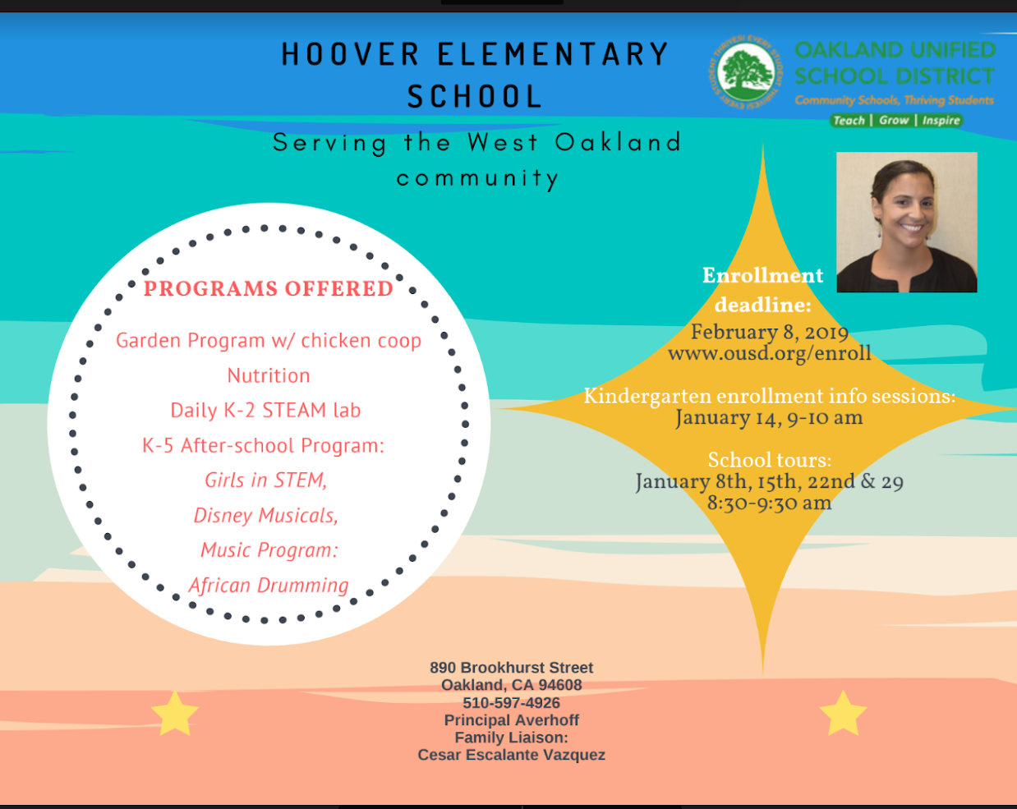
Notes:
outreach: promote your school

Slide 11

Enrollment Info
Encourage online apps: SA can support with this!
Paper apps
deadline Feb 8th (extended)
Residency documents are flexible

Slide 12

K/TK Enrollment Session Tool Kit
Flyers
Presentation Slides/Agenda
Enrollment Info (SA) slides
Support Cluster
Resources for families: Attendance in K/TK & Early literacy
Notes:
Community and district partners

