Slide 1
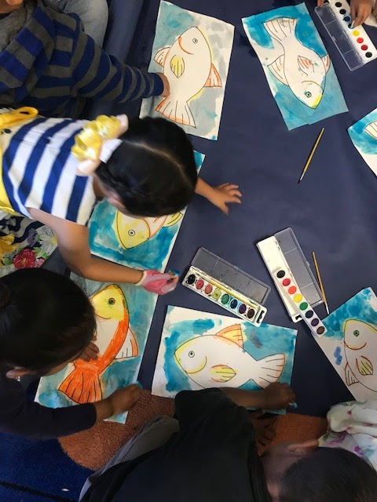
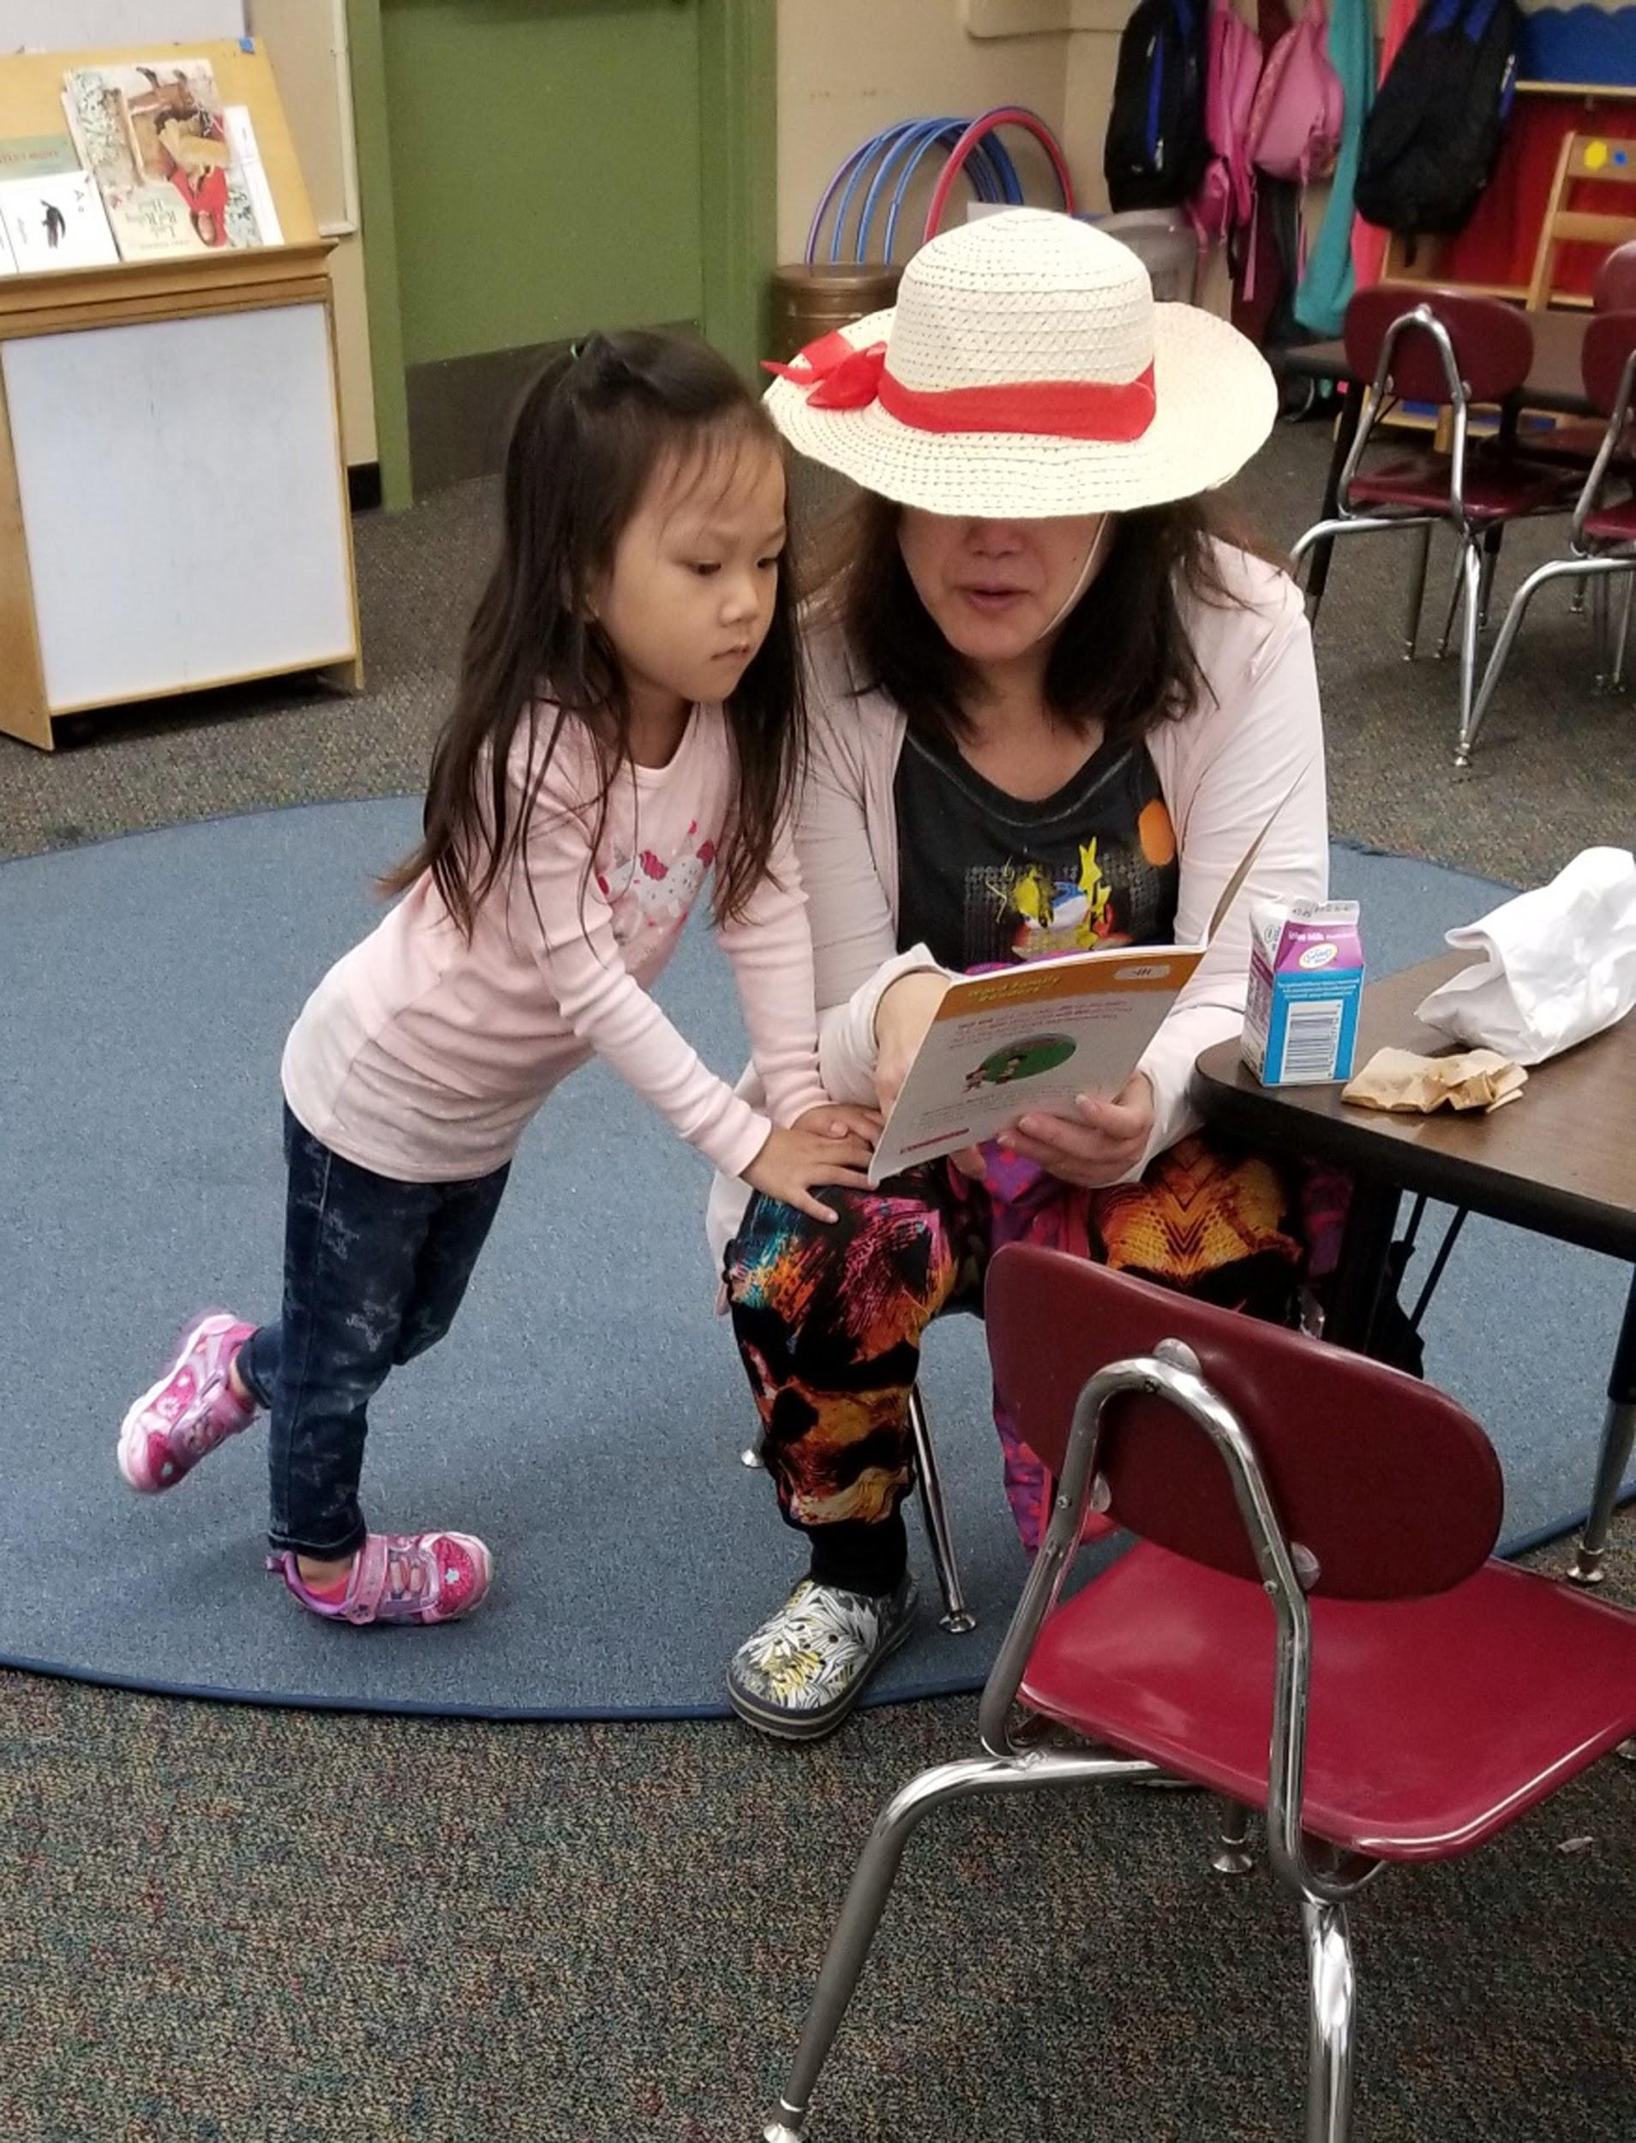
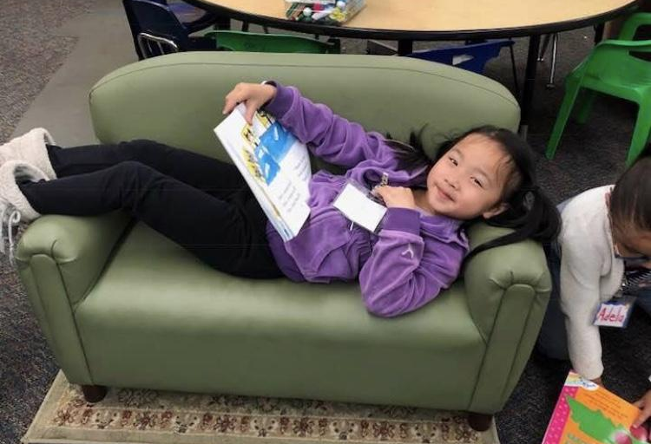

Kindergarten/TK Family Welcome!
Garfield Elementary School
Maria Sujo Kindergarten Readiness Manager
Friday August 10, 2018
10-11 am

Slide 2

Welcome!
Introductions
School support offerings
Ensuring your child’s success: Attendance
Family school partnership
Notes:
info packet from pricipal principal

Slide 3
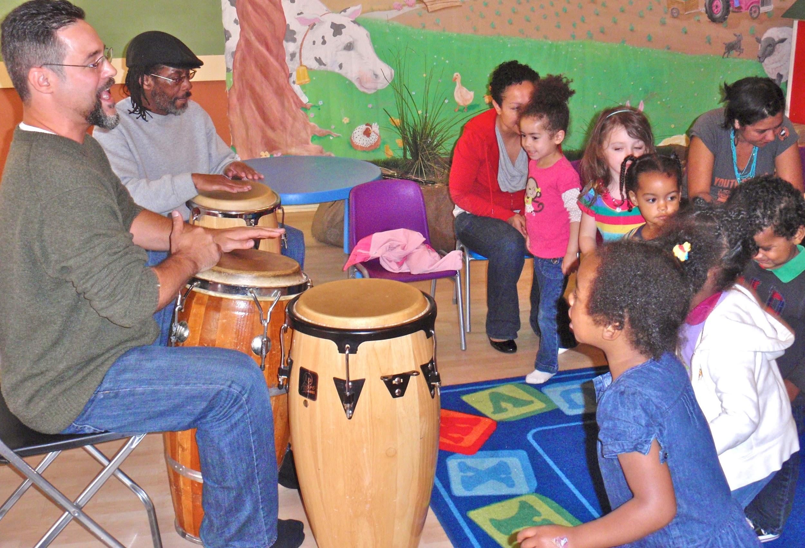
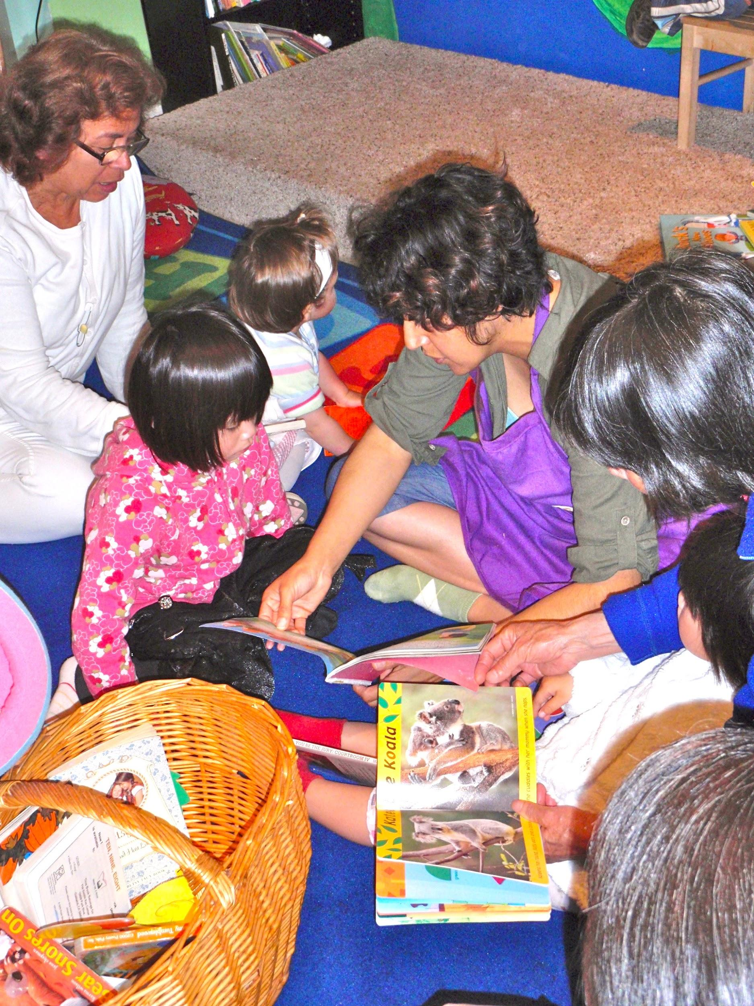
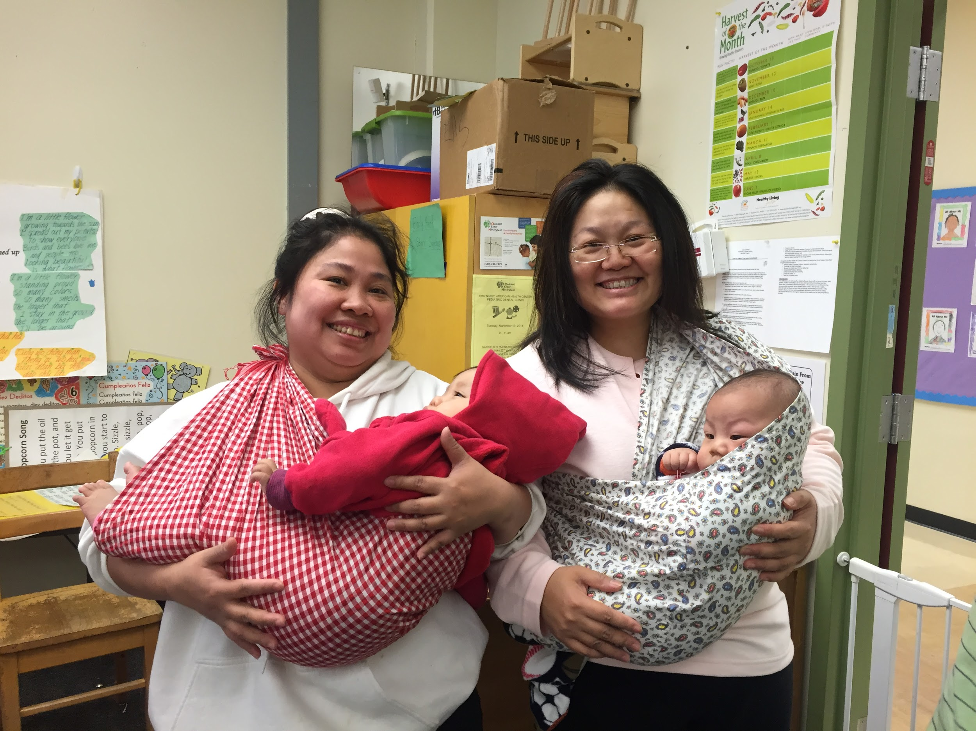
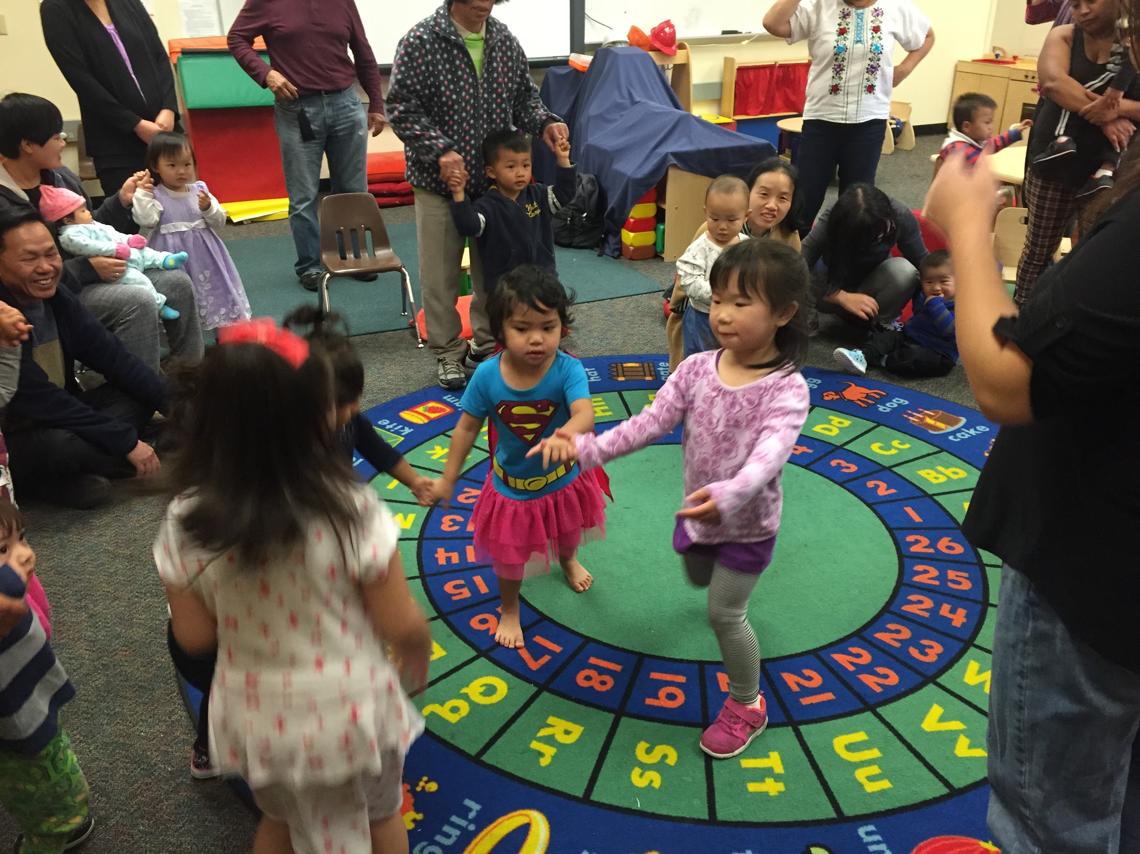
Lotus Bloom

Slide 4
Lotus Bloom
Location | Monday Lunes 星期一 | Tuesday Martes 星期二 | Wednesday Miércoles 星期三 | Thursday Jueves 星期四 | Friday Viernes 星期五
Lotus Bloom Downtown 555 19th St, Unit 131 Oakland, CA 94612 (510) 735-9222 | Multicultural Playgroup (0-48 months) drop in 9:30am-12:00pm | Developmental Playgroup (ages 1-5) enrolled program 9:30am-11:30am | Multicultural Playgroup (0-48 months) drop in 9:30am-12:00pm | Developmental Playgroup (ages 1-5) enrolled program 9:30am-11:30am | Multicultural Playgroup (0-48 months) drop in 9:30am-11:00am
Allendale 3670 Penniman Ave, Room 9 Oakland, CA 94619 (510) 545-6128 |  | Allendale Playgroup (ages 0-5) drop-in 8:45am-11:15am |  | Allendale Playgroup (ages 0-5) drop-in 8:45am-11:15am
San Antonio Family Resource Center (At Garfield) 1640 22nd Ave Portable 31 Oakland, CA 94606 (510) 735-9222 | School Readiness Playgroup (ages 0-5) drop-in 9:00am-11:30am | Developmental Playgroup (ages 1-5) enrolled program 9:00am-11:00am | School Readiness Playgroup (ages 0-5) drop-in 9:00am-11:30am |  | Garfield Playgroup (0-48 months) drop in 9:00am-11:00am
Room to Bloom 8711 MacArthur Blvd, Portable B Oakland, CA 94605 (510) 878-1778 | Multicultural Playgroup (0-5 years old) drop in 9:30am-12:00pm | AfroPlay (0-5 years old) drop in 9:30am-11:30am | Multicultural Playgroup (0-5 years old) drop in 9:30am-12:00pm | Developmental Playgroup (ages 1-5) Enrolled program 9:30am-11:30am | Multicultural Playgroup (0-5 years old) drop in 9:30am-11:00am

Slide 5
Garfield Excellence Team
Mrs. Arenas, Principal
Mr. Rodriguez-Ramirez, AP
Nikita Williams, Community School Manager
Naz Johnson & Rocio Cisneros; Family Advocates
Transitional Kindergarten Teachers:
Ms. Witherspoon
Ms. Plante (combo)
Kindergarten Teachers:
Mrs. Tyler
Ms. Hawkins
Ms. Quach
Ms. Stimpson
Notes:
one wish for families students

Slide 6
School Schedule First 3 weeks
Aug 13-Aug 31 minum days p/u 1:25 pm
Parent Teacher Meetings: Wednesday, August 15th - Friday, August 24th
1:35-4:05 pm (30 min sessions)
Sign up at the end of Welcome.
Each Wednesday, school will end at 1:25pm
Farmers Market TBD

Slide 7

Determinant for School Success: Attendance
Chronic Absenteeism: Missing 10% of days (2 days/month)
2017-2018
OUSD: 14%
Garfield: ~10%
Garfield K/TK: ~13% (20 kids)
Attendance Works, 2014
http://www.attendanceworks.org/infographic/
Notes:
20 kids/155 fro 17-18
2 days per month, a month of the school year

Slide 8
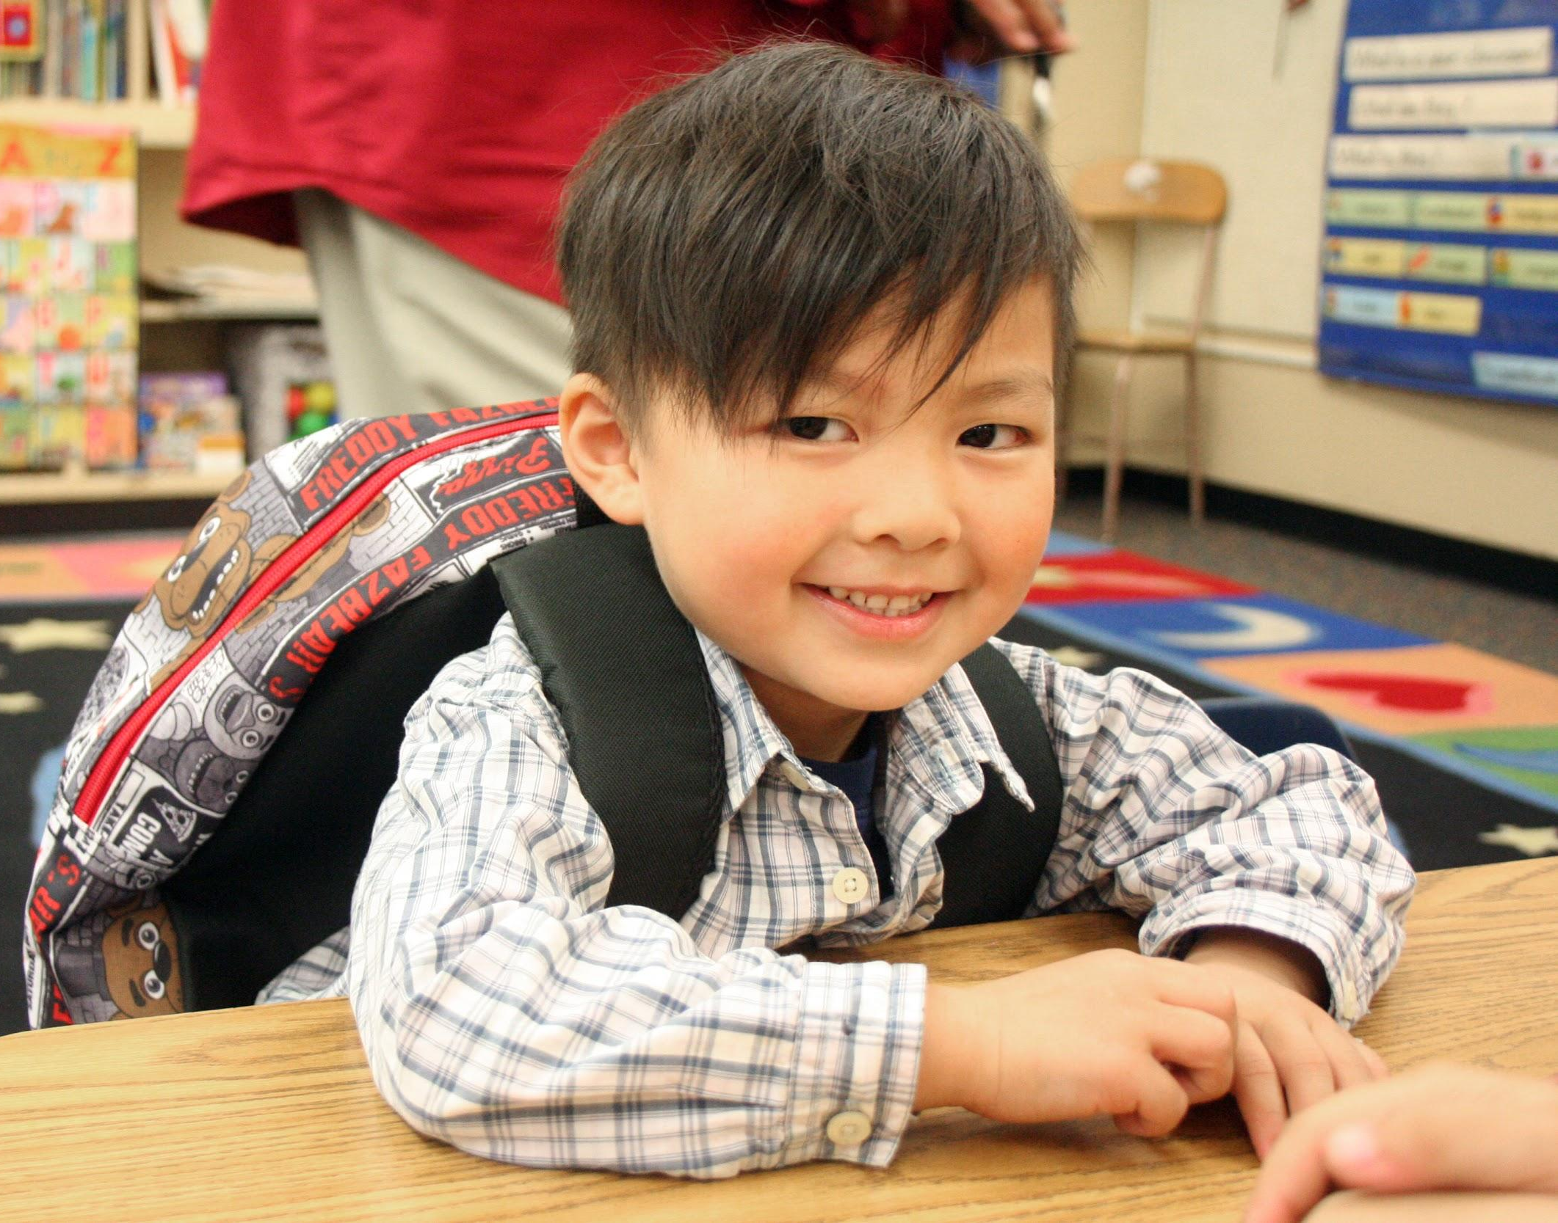
Long term effects of chronic absenteeism
less likely to read at grade level by 3rd grade
More likely to drop-out of school
Behavior problems
Lower earning potential in adulthood

Slide 9
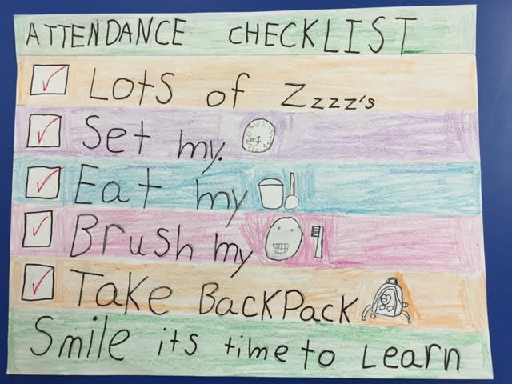
What can families do? Routines for Success

Slide 10
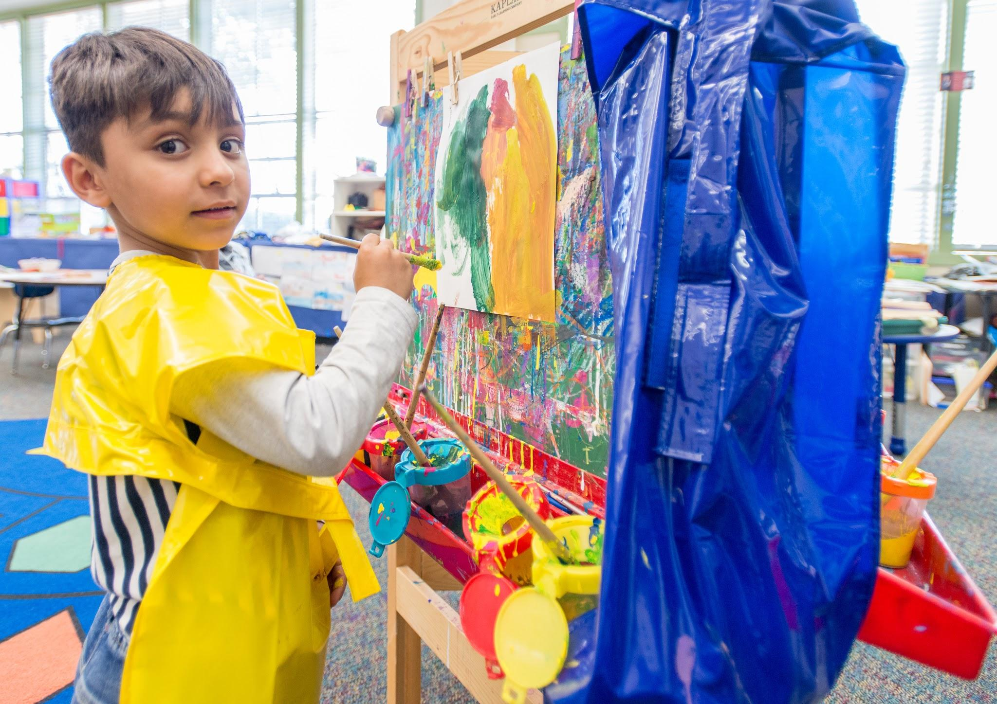
Building a Foundation for Reading
Have fun sharing books
Draw pictures and write together
Sing songs and tell stories
Look out for family workshops!

Slide 11
Garfield’s Family Resource Center
Naz and Rocio, Garfield Family Advocates
Family support services
Days/hrs. of operation
Location
Notes:
naz and Rocio

Slide 12
After school programming info:
Carmen Flores Recreation Center
EBAYC afterschool program: 2nd-5th grade
Superstar of Literacy by teacher recommendation
Oakland Parks and Recreations Services
Carmen Flores Rec Center 535 5631
1637 Fruitvale Ave 94601,
Contact Juan or Anjelica
facebook page:carmen flores
must be +4 years old
Notes:
Nikita~

Slide 13
Finishing Thoughts...
Don't forget!
Sign-up for parent-teacher conference/Registration
Visit resource table
All IN
Talk to your child about the first day of school
Notes:
Nikita~

