Slide 1
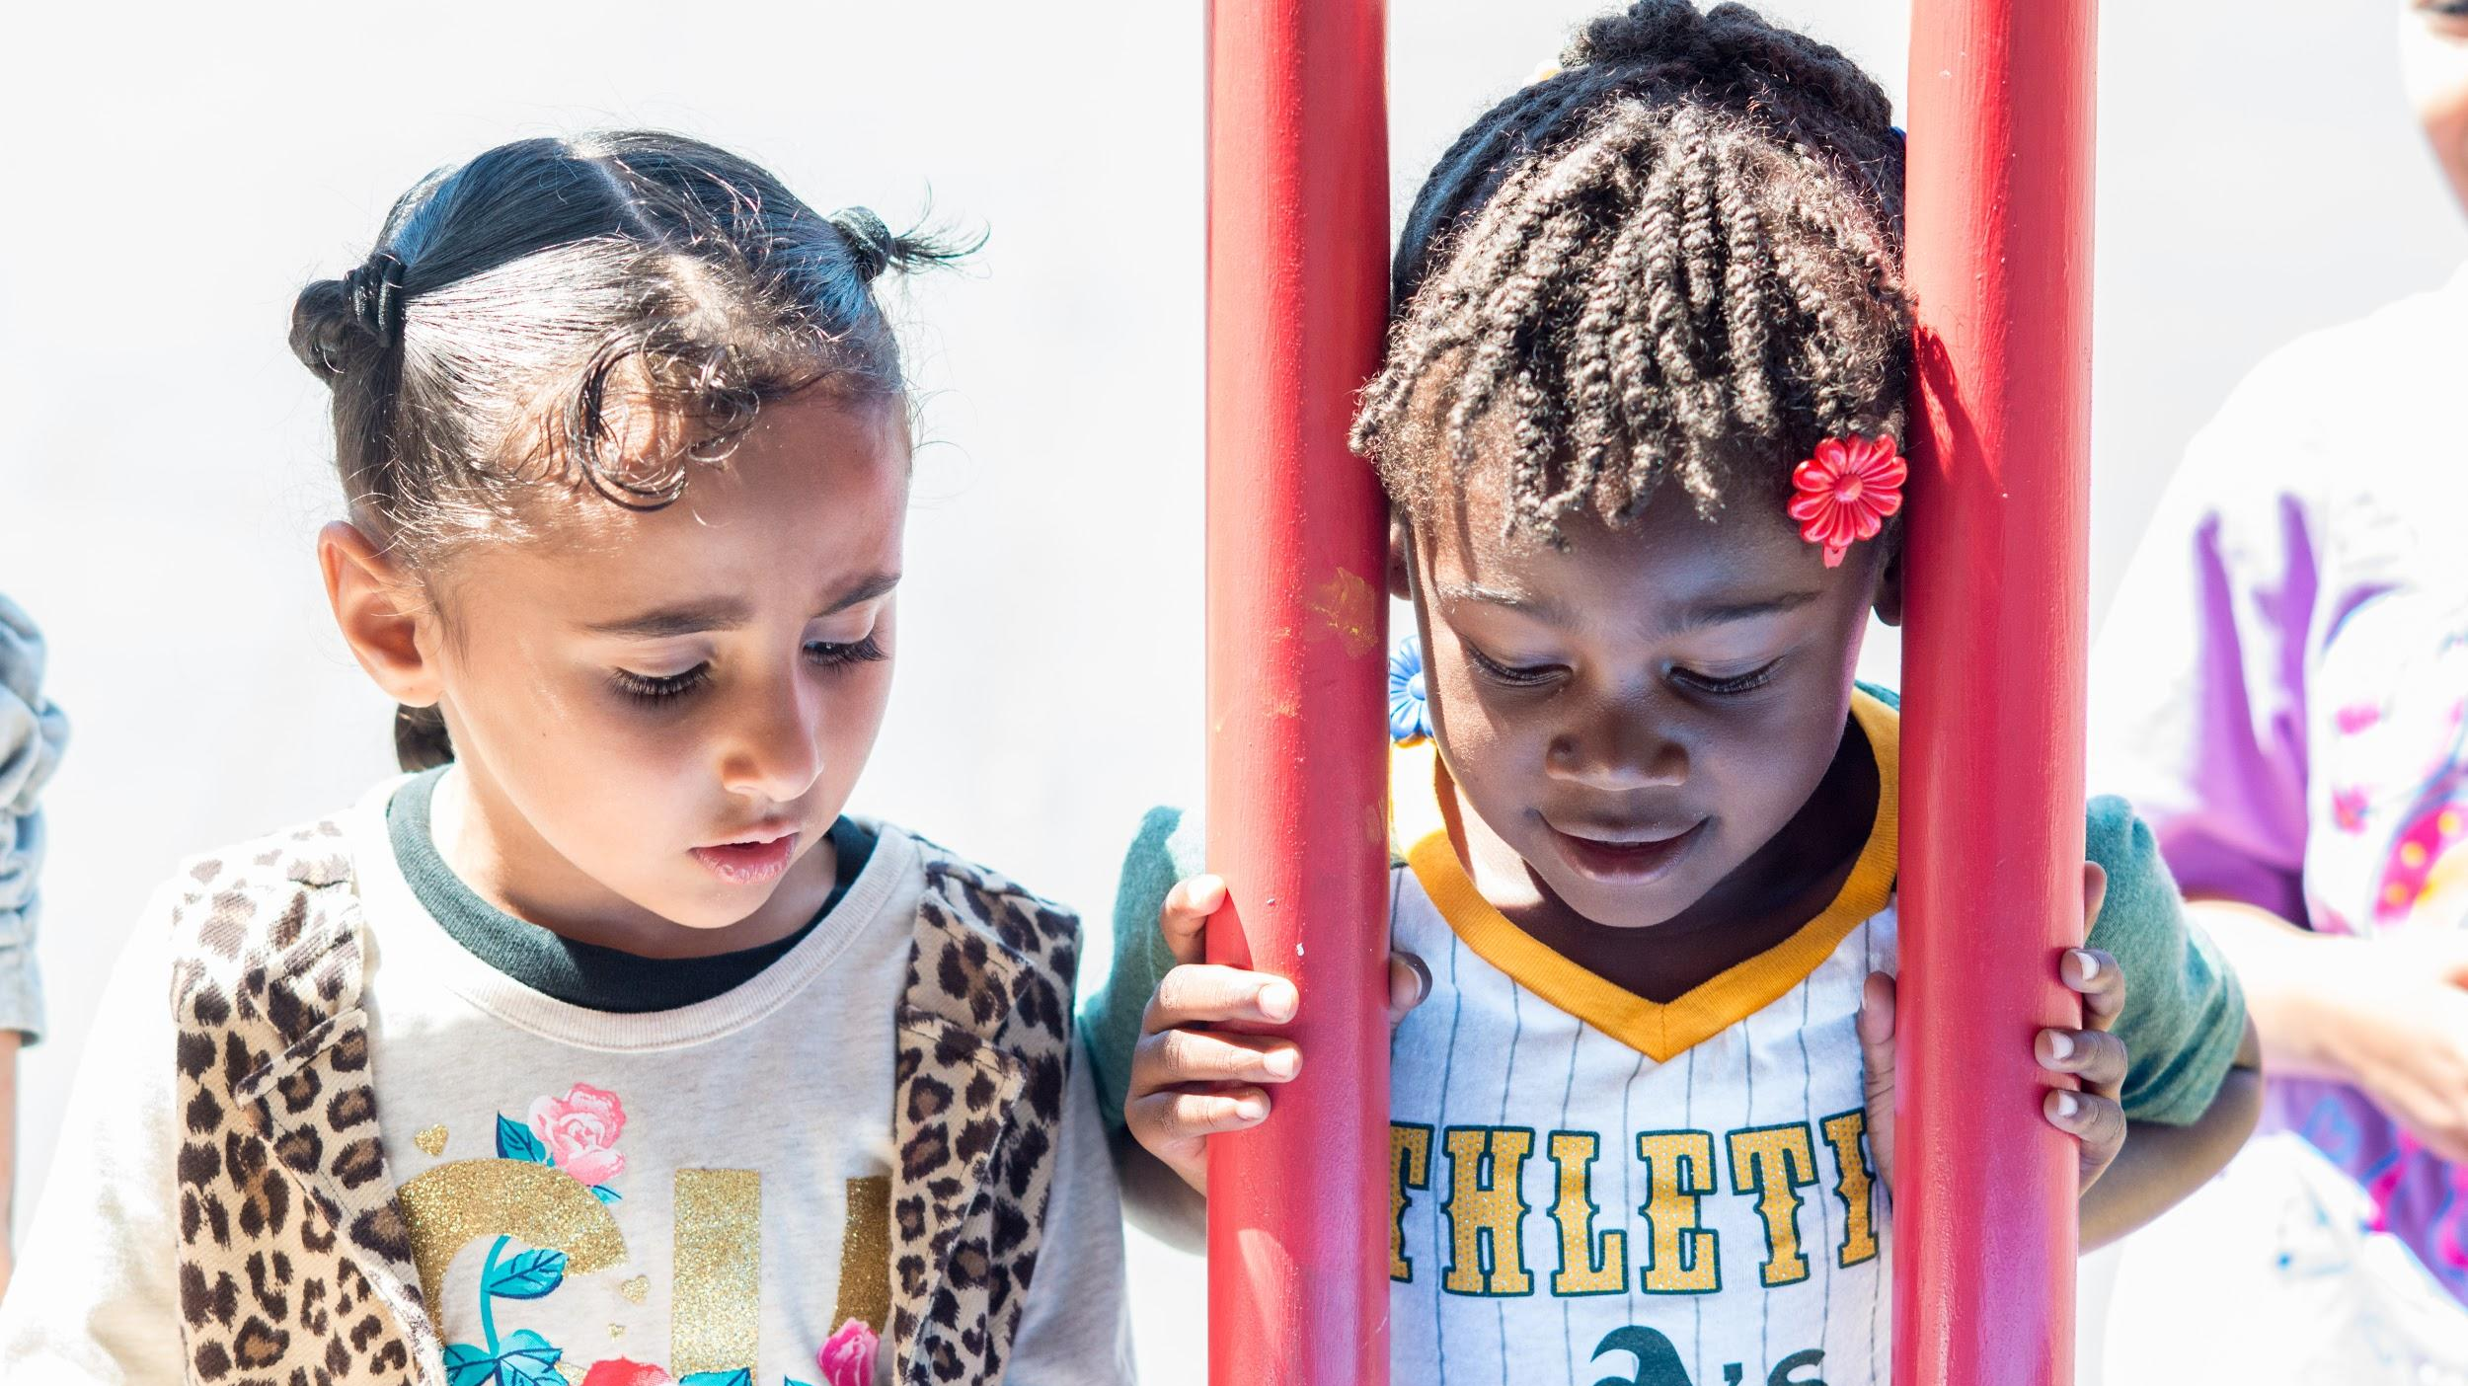
What is Kindergarten Readiness?
Children having the necessary skills, knowledge and dispositions for learning and early school success.
It entails the combined efforts of families, the community and schools to come together to support student achievement both in school and in the community.

Slide 2
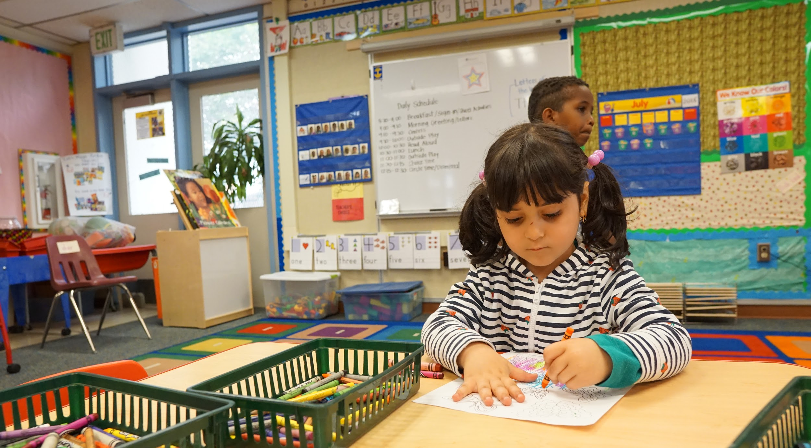
Kindergarten Readiness Goals for our Kids
Build trustful & welcoming environments for children/families of co-located preschool
Support a smooth transition to TK/K
Continue supports that have been successful in Pre-K
Notes:
These goals ensure
A smooth transition into K/TK class & creates a natural feeder pattern
Early family engagement: sets the stage for attendance and academic outcomes

Slide 3
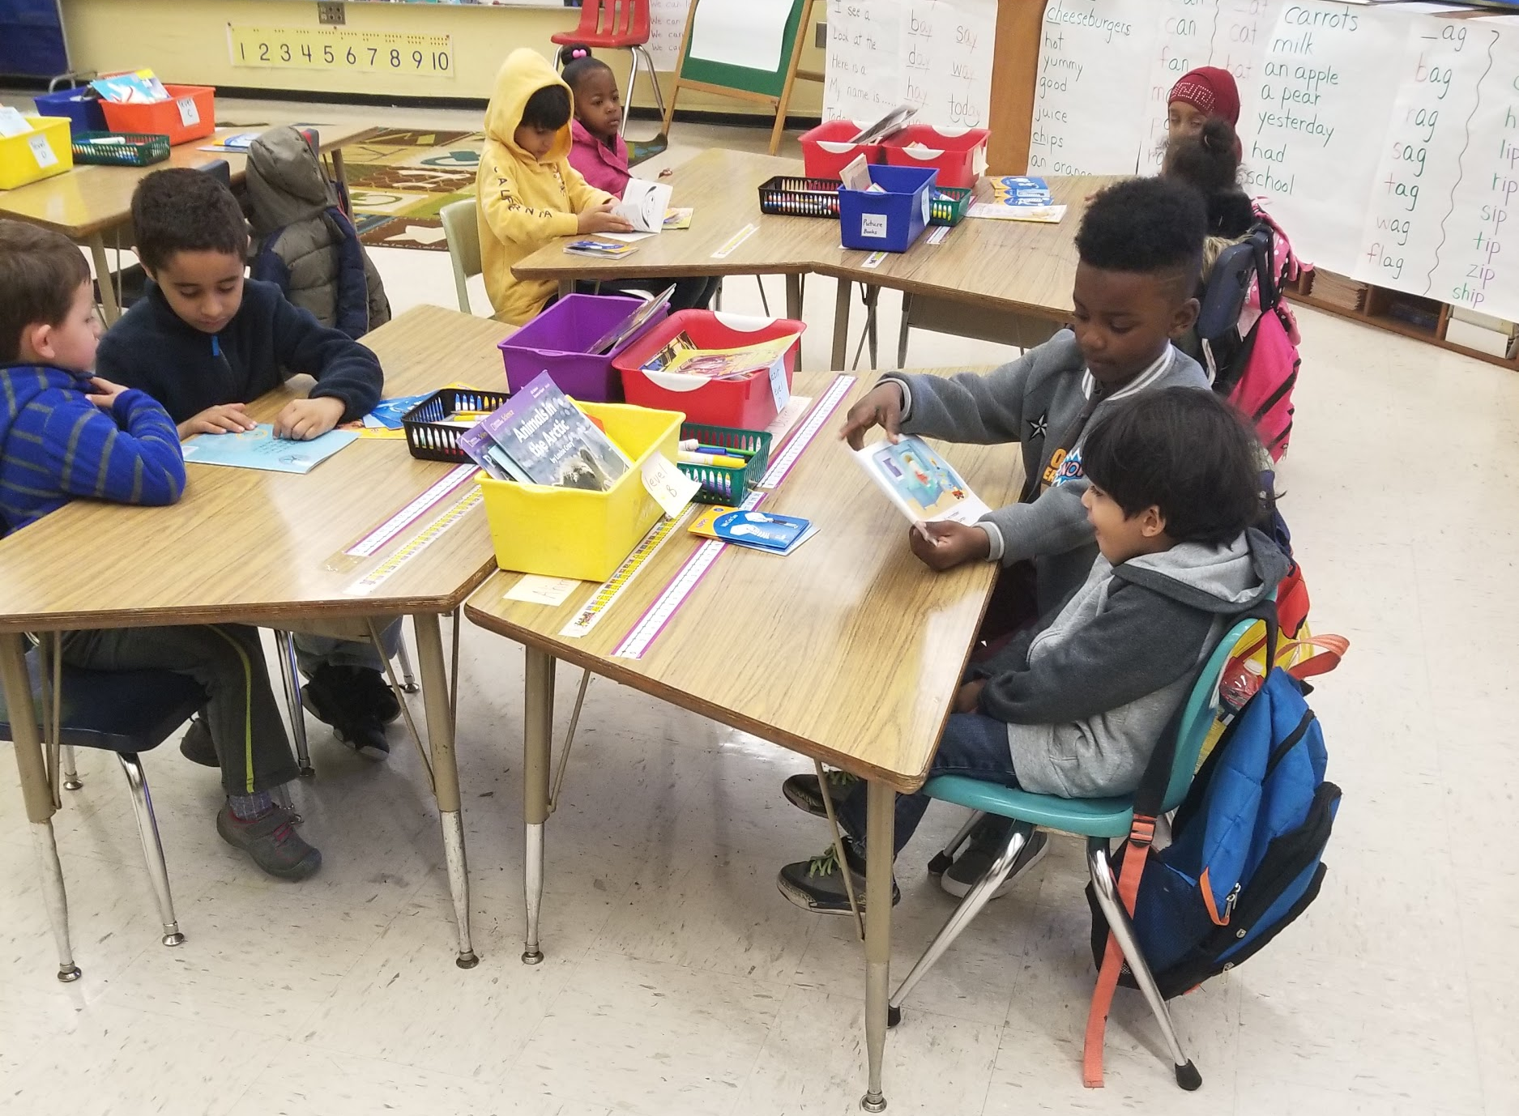
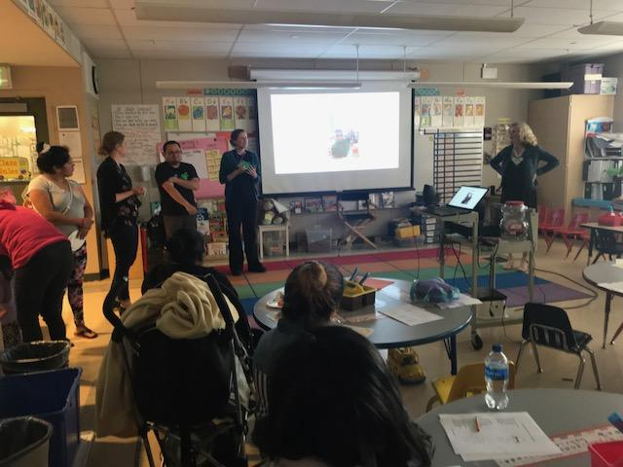
Kindergarten Readiness Strategies
Increase child, family and school connections with your co-located preschool
Implementation of Kinder Transition Plans (PreK-K transition forms)
Collaboration with Kinder Transition Teacher Leaders
Notes:
kinder class visits joint family engagement events: opportunities for families of preschooler (0-5’s) to partake in es resources (dental, foodbank, family literacy)

Slide 4
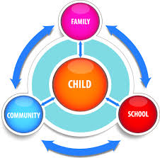
Kinder Transition Plans:
Connections between:
Child-School: class visits, assemblies, garden projects
Family-School: Kinder/TK welcomes, family engagement events
School-Community: health screeners, shared resources

Slide 5
Why Kinder Transition Practices Matter:
More positive approaches to learning (SE Skills)
Transition activities were most helpful for children who experience instability
Teachers are better prepared to meet children’s needs
Attendance & academic skills
Natural feeder pattern between CDC-ES*
National center on Quality teaching and learning (NCQTL), U.S Dept. of Health and Human Service
Notes:
Kinder transition practices are about engagement and relationship building
Process not a program

Slide 6
Feeder Pattern Data
Incoming feeders patterns about PreK-ES
Where prek’s are going
Where your K/K’s come from
OUSD data website
Dashboards >enrollment >preschool experience > feeder patterns
Notes:
What preks in the community you should connect with
inform how you enage your cdc

