Slide 1

Palmer High School
Freshman Registration

Slide 2

Fall 2022
Schedule Data
1,465 student visits to counseling center over 4- week schedule change period
1,465 times students missed class
1,387 times a student left or joined one of your classes at the start of the year
1,387 changes made to student schedules

Slide 3
New Year, New Process!
Step 3: Complete your registration form.
Step 4: Register for classes - Tuesday, Feb. 21 and Wednedsay, Feb. 22.
BRING YOUR LAPTOP!
Step 1: Pre-registration presentation – TODAY!
Step 2: Talk to your teachers, families, and counselors for input.
Step 6: NO schedule changes in August 2023. Choose wisely now!
Step 5: Final fall schedules may be available before summer break.

Slide 4
Goals for Today
1- Graduation Requirements –
    Credits, CCRD & ICAP
2- Course Registration
    Typical Sophomore Year – walk through courses
    Options
    Course Registration form
    Follow up – 2/21 & 2/22

Slide 5
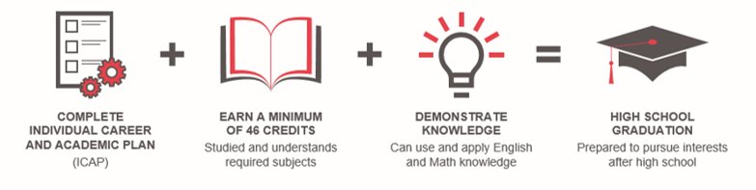
Graduation Requirements
Your class must meet district expectations for graduation​:
1. Individual Career & Academic Plan (ICAP)​
2. Credit Completion​
3. College & Career Readiness Demonstration (CCRD)

Slide 6
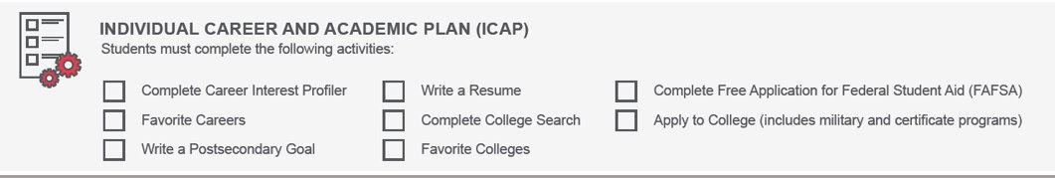
Individual Career and Academic Plan (ICAP)
(Graduation Requirement)

Slide 7
Credits | Subject Areas
8 | English
7 | Social Studies (US History 1,2; Government; Economics required)
6 | Mathematics (Algebra 1,2, or equivalent, or higher required)
6 | Science (Biology 1,2 required and 1 year of Physical Science)
3 | Physical Education
1 | Health
2 | Humanities (World Language, Music or Art)
1 | Computer
1 | Postsecondary Workforce Readiness – PWR (Cons. & Family Studies, Digital Media)
11 | Electives
46 | Total Credits

Slide 8
College & Career Readiness Demonstration (CCRD)
Demonstration​ | English​ | Math​
SAT​ | 470+​ | 500+​
ACT​ | 18+​ | 19+​
ACCUPLACER​ | NexGen: 241+ (Read) or 236+ (Write)​ | NexGen: 255+ (AR) or 236+ (QAS)​
ASVAB​ | 31+​
District Capstone​ | Pass a D11 Approved Capstone Project​
Concurrent Enrollment​ | Passing grade per district and school policy​
Industry Certificate​ | Individualized​
ACT WorkKeys​ | Bronze level or higher​
Standards-based performance assessment​ | For Students with Individualized Education Program (IEP)​

Slide 9
IB MYP at Palmer
ALL 9th and 10th grade students are IB MYP
It offers students opportunities to:
  develop their potential
  explore their own learning preferences
  take appropriate risks
  reflect on, and develop, a strong sense of personal identity.
The skills that are emphasized in all 9th and 10th grade classes are:
  Communication skills
  Information literacy skills
  Thinking
  Collaborative skills
  Self-management skills

Slide 10
IB MYP Personal Project
Personal Project – This may be your only opportunity in your academic career to have complete freedom to choose whatever topic and project your heart desires. This is your chance to learn something, be creative, develop old skills and learn new ones, and take action.
  ALL Sophomores will complete the Personal Project –
  Independent in nature with support of a staff member
  Work will be done OUTSIDE of any one class – information coming this spring
  Excellent preparation for IB classes as juniors and seniors including the Career Pathways at RJWAC and the IB Career Related Program at Palmer

Slide 11
Career Pathways
Agriculture and Urban Farming​
Automotive​
Business and Social Innovation ​
Computer Science & Telecommunication ​
Education (Teaching & Training)​
Hospitality & Culinary Arts​
Outdoor Rec Leadership & Project Bike Tech​
Visual and Design Arts
Located at RJWAC
Transportation is provided
Talk to your counselor

Slide 12

PowerSchool – How many credits do I have?
9th Grade – 1 semester complete – Students should have 5-6 credits to be considered on track at this point.
What can I use PowerSchool for?
Grades
Attendance
Transcripts

Slide 13
Typical Sophomore Year
  English
  Math
  Social Studies (US History)
  Science
  2nd year World Language
  IBMYP PE/IBMYP Health
  14 -16 total classes (14-16 boxes)
  Talk to your teachers
  College Entrance Recommendations do not equal Graduation Requirements
    Start to check language, math and science requirements at any schools of interest.

Slide 14
Registration Sheet
Box 1 – English
MYP English 3,4 - Grade Level
MYP English 3,4 H - Honors
Box 2 – Math
Algebra 1,2 (Honors)
Integrated Math 1,2 – Grade Level
MYP Inter Alg/Geo 1,2 – Honors
MYP Adv. Alg/Geo 1,2 – Honors
IB Math Applications or IB Math Analysis

Slide 15
Registration Sheet
Box 3 – Social Studies
MYP US History 3,4 – Grade Level
MYP US History 3,4 H – Honors
Box 4 - Science
Physical Earth Science 1,2 – Grade Level
MYP Chemistry 3,4H - Honors

Slide 16
Registration Sheet
World Language (Chinese, French, German & Spanish)
1,2 – First year
3,4 – Second year
Honors –French, Spanish, German, Chinese
MYP PE/Health or MYP Honors-PE/Honors-Health
Most Sophomores will take PE/Health as year-long course

Slide 17
Registration Reminders
1- Talk to your teachers for questions on placement, ie. math
2- Talk to your parents
3- See you February 21st or 22nd during your social studies class. Bring your completed paperwork and computer!!
AND…
GET INVOLVED!!! Join a club, sport, theater, music, student council, tutor or volunteer – build your leadership skills!! Build your resume!!

