Slide 1

The 5Essentials
Colorado Springs District 11 – February 26, 2020

Slide 2
Checking In
Before we begin, quickly check in with yourself:
As you think about the 5Essentials and the work we are kicking off together today, are you feeling more hopeful / excited or more anxious / concerned? Something else?
Let’s go around the room and share the following:
Name and role
How you are feeling about this work

Slide 3
Agenda
Topic | Time | Purpose
Introductions and Framing | 15 min | Overview of the day
Defining School Improvement | 25 min | A collaborative activity
The 5Essentials System | 30 min | Build background knowledge on the 5Essentials
Unpacking the 5Essentials | 30 min | Deepening our knowledge of the 5Essentials Framework
Unpacking 5Essentials Scoring | 20 min | Deepening our knowledge of 5Essentials Scoring
Report Exploration | 30 min | Exploring the 5Essentials Reporting Site
Adult Learning | 25 min | Deepening our understanding of adult learning as a key for successfully using the 5Essentials
Key Practices and Lessons Learned | 5 min | UChicago Impact’s Lessons Learned from the Field
Topic
Time
Purpose
Notes:
255 minutes
This leaves 15 minutes for breaks

Slide 4
Defining School Improvement:
A Collaborative Activity

Slide 5

Step 1: Brainstorming
Individually respond to the prompt: What does it take to improve a school?
Record one idea per Post-It™
Time: 3 minutes

Slide 6


Step 2: Sharing and Grouping
At your table, one person at a time:
  Place each of your Post-Its™ on the chart paper, clarifying each item as necessary
  Sort Post-Its™ into categories
  Circle and name the categories
Time: 10 minutes
Resources

Slide 7

Step 3: Gallery Walk
Visit other groups’ charts, noticing themes that run across charts.
Time: 3 minutes
Resources
Instructional Coaching
Consistent Consequences
Money

Slide 8
Step 4: Discussion
What themes did you notice across different charts?
What topics were new, interesting, or different?
Keep these ideas in mind…
Time: 3 minutes
Resources
Instructional Coaching
Consistent Consequences
Money

Slide 9
The 5Essentials System

Slide 10


30 years ago, Education Secretary
William J. Bennett said Chicago’s public schools were “the worst in the nation”
New York Times, November 8, 1987
Notes:
30 years ago when then Secretary Bennett referred to CPS as the worst district in the nation.
http://www.nytimes.com/1987/11/08/us/schools-in-chicago-are-called-the-worst-by-education-chief.html

Slide 11
Tale of Two Schools
Similar Schools
  Same area of the Chicago
  100% African American enrollment and 100% low income
  Among 100 poorest-performing schools in reading and math in 1989
  Different Outcomes
  Hancock moves dramatically forward
  Alexander stagnates
Notes:
-The 5Essentials came out of research that began at the University of Chicago in the late 1980s/early 1990s. Researchers from CCSR studied a variety of schools throughout the city that shared characteristics. However, some of these schools began to show very different outcomes.

Slide 12
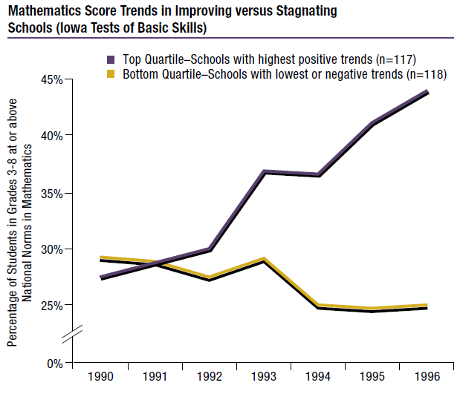
Observation
Notes:
Specifically, they noticed two very different trend lines between Alexander and Hancock.

Slide 13
Essential Question
  Why did Hancock improve while Alexander stagnated?
Notes:
-As the researches noticed differences between schools, they asked themselves the questions: “Why did Hancock improve, while Alexander stagnated?”

Slide 14
Discovery
A comprehensive set of practices and conditions that made schools much more likely to improve student outcomes emerged
The researchers called them the Five Essential Supports
Notes:
As the University of Chicago researchers dug into what made certain schools effective at promoting student outcomes, and what held others back, they noticed a similar set of practices and conditions that made schools more likely to improve than others. These 5Essential Supports are: Ambitious Instruction, Supportive Environment, Effective Leaders, Collaborative Teachers, and Involved Families.
Most educators, if asked, would point to categories similar to the 5Essentails, as what is need to foster school improvement.

Slide 15
Central Theme: Organization is Essential
“How we organize schools is critical
for student achievement. Improving schools entails coherent, orchestrated action across
all five essential supports.
Put simply, there is no one silver bullet.”
Anthony Bryk, “Organizing Schools for Improvement.” Phi Delta Kappan, April 2010.

Slide 16
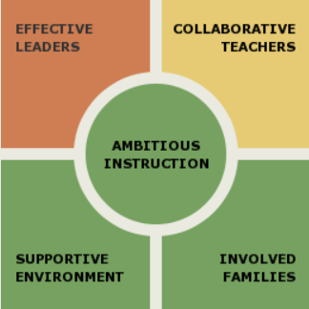
5Essentials Framework
Ambitious Instruction
Classes are challenging and engaging
Effective Leaders
Principals and teachers implement a shared vision for success
Collaborative Teachers
Teachers collaborate to promote professional growth
Involved Families
The entire staff builds strong external relationships
Supportive Environment
The school is safe, demanding, and supportive

Slide 17


5Essentials Research
25+ years of research, 15 years of data
School improvement framework built from research on organizational factors that matter most in promoting improvement
Research validated survey of teachers and students (4th – 12th grade) that provides actionable data and insights into a school
Analyzed at scale across the state of Illinois and used by over 6000 schools
Positive relationships with:
  Test scores and test score gains
  Attendance rate changes
  Graduation rates and rate changes
  Teacher mobility / retention
  Freshman On-Track

Slide 18
Key Research Findings
10x vs. <10%
More likely to improve student outcomes if strong on three or more Essentials than schools weak on three or more
Chance of improving student outcomes over time when a sustained weakness exists

Slide 19
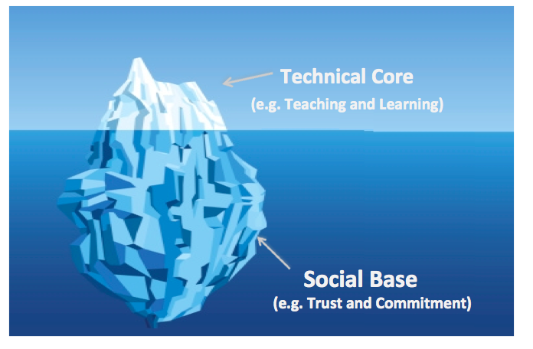
Expanded Conversations are Necessary for Improvement
The 5Essentials System expands the conversation beyond just technical components of school improvement and digs beneath the surface into more social concepts that are vital to any improvement effort.

Slide 20
Understanding the Role of the Framework and Survey
The Framework is the key to school improvement and pushes us to consider:
How are we growing trust between teachers, students, families, and school leadership?
How are we incorporating teacher influence throughout key school decisions and priorities?
How are we aligning our work and our improvement efforts to ensure coherence?
How are we creating safe, supportive environments focused on high expectations, rigorous instruction, and academic excellence for all students?
The Survey provides data and evidence of progress towards improved conditions within a school relative to the Framework.
The data from the Survey sit alongside and supplement other data points that also gauge progress and inform school improvement: standardized tests, discipline, attendance, etc.

Slide 21
Questions
What questions do you have thus far?

Slide 22
Unpacking the 5Essentials

Slide 23
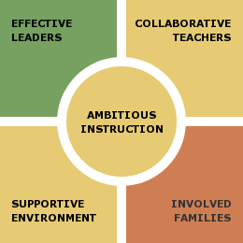
5Essentials and Core Measures
Ambitious Instruction
Academic Press
English Instruction
Math Instruction
Quality of Student Discussion
Effective Leaders
Instructional Leadership
Program Coherence
Teacher Influence
Teacher-Principal Trust
Collaborative Teachers
  Collaborative Practices Collective Responsibility Quality Professional Development
  School Commitment
  Teacher-Teacher Trust
Supportive Environment
Academic Personalism
Peer Support for Academic Work
Safety
Student-Teacher Trust
Expectations for Postsecondary Education
Schoolwide Future Orientation
Involved Families
  Parent Influence on Decision Making in Schools
  Parent Involvement in School
  Teacher-Parent Trust

Slide 24

Ambitious Instruction
Classes are challenging and engaging. The instruction is clear, well-structured, aligned across grade levels, and encourages students to build and apply knowledge. When combined with a supportive environment, Ambitious Instruction has the most direct effect on student learning.
English Instruction
  Students interact with course material and one another to build and apply critical reading and writing skills.
Math Instruction
  Students interact with course material and one another to build and apply knowledge in their math classes.
Academic Press
  Teachers expect students to do their best and to meet academic demands.
Quality of Student Discussion
  Students participate in classroom discussions that build their critical thinking skills.

Slide 25

Supportive Environment
The school is safe, demanding, and supportive. In such schools, students feel safe in and around the school, they find teachers trust-worthy and responsive to their academic needs, all students value hard work, and teachers push all students toward high academic performance.
Peer Support for Academic Work (ES)
  Students demonstrate behaviors that lead to academic achievement.
School-Wide Future Orientation (HS)
  The school engages all students in planning for life after graduation.
Expectations for Post-Secondary Education (HS)
  The school expects all students to attend college and promotes college-readiness.
Academic Personalism (ES)
  Teachers connect with students in the classroom and support them in achieving academic goals.
Student-Teacher Trust
  Students and teachers share a high level of mutual trust and respect.
Safety
  Students feel safe both in and around the school building, and while they travel to and from home.
Notes:
Academic Personalism: Teachers connect with students in the classroom and support them in achieving academic goals.
Peer Support for Academic Work: Students demonstrate behaviors that lead to academic achievement.
Safety: Students feel safe both in and around the school building, and while they travel to and from home.
Student-Teacher Trust: Students and teachers share a high level of mutual trust and respect.
Expectations for Postsecondary Education: The school expects all students to attend college and promotes college-readiness.
School-wide Future Orientation: The school engages all students in planning for life after graduation.

Slide 26

Effective Leaders
Principals and teachers work together to implement a shared vision. In such schools, people, programs, and resources are focused on a vision for sustained improvement. Leaders practice shared leadership, set high goals for quality instruction, maintain mutually trusting and respectful relationships, and support professional advancement for faculty and staff.
Teacher Influence
  Teachers have influence in a broad range of decisions regarding school policies and practices.
Program Coherence
  School programs are coordinated and consistent with its goals for student learning.
Teacher-Principal Trust
  Teachers and principals share a high level of mutual trust and respect.
Instructional Leadership
  The school leadership team sets high standards for teaching and student learning.
Notes:
Instructional Leadership: The school leadership team sets high standards for teaching and student learning.
Program Coherence: School programs are coordinated and consistent with its goals for student learning.
Teacher Influence: Teachers have influence in a broad range of decisions regarding school policies and practices.
Teacher-Principal Trust: Teachers and principals share a high level of mutual trust and respect.

Slide 27

Collaborative Teachers
All teachers collaborate to promote professional growth. In such schools, teachers are active partners in school improvement, committed to the school, and focused on professional development.
Collaborative Practices
  Teachers observe each others' practice and work together to review assessment data and develop instructional strategies.
Collective Responsibility
  Teachers share a strong sense of responsibility for student development, school improvement, and professional growth.
School Commitment
  Teachers are deeply committed to the school.
Teacher-Teacher Trust
  Teachers are supportive and respectful of one another, personally and professionally.
Quality of Professional Development
  Professional development is rigorous and focused on student learning.
Notes:
Collaborative Practices: Teachers observe each others' practice and work together to review assessment data and develop instructional strategies.
Collective Responsibility: Teachers share a strong sense of responsibility for student development, school improvement, and professional growth.
Quality Professional Development: Professional development is rigorous and focused on student learning.
School Commitment: Teachers are deeply committed to the school.
Teacher-Teacher Trust: Teachers are supportive and respectful of one another, personally and professionally.

Slide 28

Involved Families
The entire staff builds strong external relationships. Such schools see parents as partners in helping students learn, value parents' input and participation in advancing the school's mission, and support efforts to strengthen its students' community resources.
Parent Influence on Decision Making
  The school has created opportunities for parents to participate in developing academic programs and influencing school curricula.
Teacher-Parent Trust
  Teachers and parents are partners in improving student learning.
Parent Involvement in School
  Parents are active participants in their child’s schooling.
Notes:
Parent Influence on Decision Making in Schools: The school has created opportunities for parents to participate in developing academic programs and influencing school curricula.
Parent Involvement in School: Parents are active participants in their child's schooling.
Teacher-Parent Trust: Teachers and parents are partners in improving student learning.

Slide 29
Reflection Across Measures
Activity | Time | Guidance
Chart | 15 min | Using the 5Essentials Definitions sheet, review the Measures and definitions. At your table, discuss and chart the following: Which Measure do you believe represents the greatest strength within your district? Why? Which Measure do you believe represents the biggest opportunity for growth in your district? Why? What can you, as a district, do to help improve this area across the schools in the district?
Share | 5 min | Each group quickly presents their thinking with the larger group.

Slide 30
Break
5 Minutes

Slide 31
Unpacking 5Essentials Scoring

Slide 32
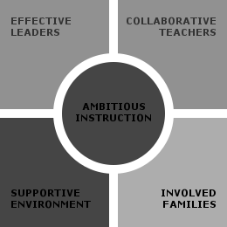
Unpacking an Essential: Items
Measures
Items
The teacher asks difficult questions in class.
This class challenges me.
This class requires me to work hard to do well.
The teacher expects us to become better thinkers, not just memorize things.
The teacher expects me to do my best all the time.
The teacher expects everyone to work hard.
English Instruction
Math Instruction
Academic Press
Quality of Student Discussion
Notes:
The 5Essentials is also robust in its depth and breadth. If we peel back another layer, you can see that each Essential is built on a series of related concepts. These concepts are the measures for each Essential. Underneath each measure are the items from the student and teacher surveys that serve as the source of data for the framework.
Here, for example, if you dig into Ambitious Instruction, you will see four measures underneath. You can then dig into each of the measures to see the items that comprise that measure. These items are the questions that teachers or students encounter on the survey. Supportive environment is comprised of student responses, ambitious instruction is comprised of both, involved families, collaborative teachers, and effective leaders are made up of teacher responses
-Items are developed over the course of 20+ years by:
consulting nationally-based research on school improvement
conferring with diverse groups of stakeholders
testing items to make them clear and understandable
review items to keep the questions fresh and relevant

Slide 33
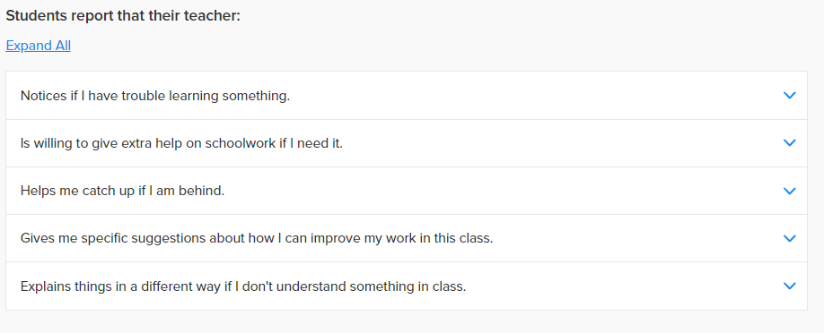
Items
Items are the individual questions asked of teachers and students
Participants may select one response per item
Responses are added together and displayed as a percentage of the total responses
Notes:
This is a screenshot from the reporting site. Here you can see the question stem, and the related questions that follow.
The questions displayed are from the Academic Personalism measure which is a part of the Supportive Environment Essential.

Slide 34
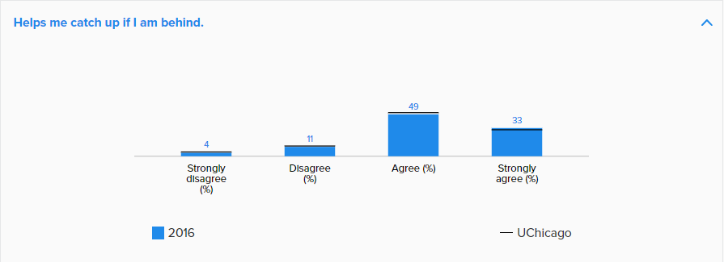
Response Categories
Each response category is distinct and should not be grouped together
  Combining the percentages from the positive categories into one group (combining strongly agree and agree) conflates really strong feelings with lukewarm feelings
Notes:
*Read 1st Bullet
In a standard customer satisfaction survey or employee opinion survey, positive categories like agree and strongly agree are grouped together for an overall favorable rating.
A common question we receive about this is – The majority of my staff/students responded positively, but our score is low. Why?
*Read 2nd Bullet
If you think about a 1-10 scale and ask students about their experience in the classroom, a student who says it’s a 10 vs one that says it’s a 6 is having a very difference experience, which is why conflating those two response categories is problematic. This is why each response category has its own benchmark. If your school scored below the benchmark in either of these categories, your score will likely be below average.

Slide 35
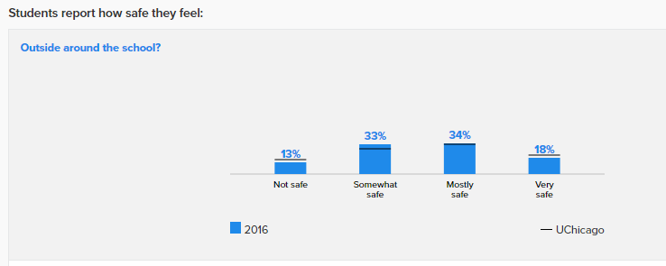
Benchmark
The benchmark gives your scores context
Exceeding the benchmark in positive categories raises your measure score*
Exceeding the benchmark in negative categories lowers your measure score*
Notes:
Once unreliable respondents are identified, your school’s responses are then compared to the benchmark (displayed as a black line)
The benchmark is the average response from over 650 schools across Chicago Public Schools in 2013, 2011.
Socioeconomically & racially diverse group
*Read bullet points
Without the benchmark, you would not know the significance of, for example, 18% of students reporting they feel “very safe” outside and around the school. The benchmark lends context to these percentages.

Slide 36
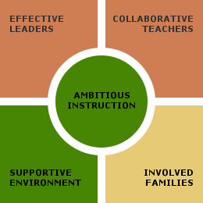
Unpacking an Essential: Measures
Measures
Items
The teacher asks difficult questions in class.
This class challenges me.
This class requires me to work hard to do well.
The teacher expects us to become better thinkers, not just memorize things.
The teacher expects me to do my best all the time.
The teacher expects everyone to work hard.
English Instruction
Math Instruction
Academic Press
Quality of Student Discussion
Notes:
The 5Essentials is also robust in its depth and breadth. If we peel back another layer, you can see that each Essential is built on a series of related concepts. These concepts are the measures for each Essential. Underneath each measure are the items from the student and teacher surveys that serve as the source of data for the framework.
Here, for example, if you dig into Ambitious Instruction, you will see four measures underneath. You can then dig into each of the measures to see the items that comprise that measure. These items are the questions that teachers or students encounter on the survey. Supportive environment is comprised of student responses, ambitious instruction is comprised of both, involved families, collaborative teachers, and effective leaders are made up of teacher responses
-Items are developed over the course of 20+ years by:
consulting nationally-based research on school improvement
conferring with diverse groups of stakeholders
testing items to make them clear and understandable
review items to keep the questions fresh and relevant

Slide 37
Measures
Measures are made up of related items
  Example: Academic Press
    The teacher asks difficult questions…in class/on tests
    This class challenges me
    The teacher expects everyone to work hard
    The teacher wants us to become better thinkers, not just memorize things
    The teacher expects me to do my best all the time
    This class really makes me think
    This class requires me to work hard to do well
    I really learn a lot in this class
Measure scores are related to improved outcomes for schools and students
  Individual questions alone are not related to improved student outcomes, and thus are not given a score on their own
Notes:
*Read Bullet points
Over 25 years of research at the Consortium shows that measure scores are positively related to test score gains in math and reading, attendance rate changes, and graduation rates.

Slide 38
Rasch Analysis
A Measure score is calculated using a method called Rasch analysis.
  Identifies and addresses “unreliable” respondents
  Compares your results against a benchmark
  Allows for data to be compared over time
  Not a simple average
Notes:
*Read 1st Bullet
A measure score is a summary indicator describing how teachers or students responded to the specific items that are grouped together within that measure.
This method uses statistical models to combine survey questions together into a raw score for each responding individual.
*Read Sub-Bullets
This method has several advantages over simply averaging responses: a) It allows us to ask a relatively small number of questions and still get a valid and reliable indicator, measuring a broad range of experiences; b) It can handle missing data easily; and c) it provides a “standard error” for each individual, which tells us how reliable the person’s responses were.

Slide 39
Unusual Responses
Rasch Analysis can identify respondents who answer very differently than your school’s average respondent. These may include respondents who:
  Skip many questions
  Answer all questions in a strongly positive or negative manner
  Answer in ways that vary wildly and do not conform to other respondents in the building or expected patterns based on research
These unusual respondents are down-weighted because their standard error as a respondent increases
Notes:
We use Rasch analysis to identify people who are responding in an unusual pattern. This may include answering all strongly positive; all strongly negative; or answering erratically or randomly. For example: It is extremely unlikely that a student reports feeling not safe in his classes but very safe outside and around the school. Since these response patterns are so unusual, it’s likely that they’re due to some kind of error, such as students not paying attention to the questions.
This response pattern affects the respondent’s standard error (part of each participant’s score). If a respondent’s answer pattern is very different from the average response pattern in your school, the scores of these respondents are down weighted in calculating the school average.
THIS IS A LOT OF DETAIL THAT COULD BE MORE CONFUSING THAN NOT – ONLY EXPOUND IF NECESSARY
Rasch analysis produces a measure score at the individual (student) level as well as a standard error at the individual level. This standard error represents how reliable/unreliable the student’s overall responses are. It also takes into account missing data—so if a student only has responded to two out of four items, they’ll still get an individual measure score, but they’ll get a large standard error.
When we create the school-level measure scores, we weight students by the inverse of the standard error. That is, students with lots of missing data or extremely unusual response patterns are down-weighted.

Slide 40
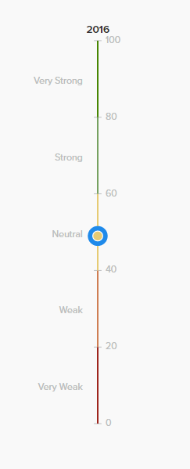
Measures (cont’d)
Measures are scored on a normed scale ranging from 1-99
  Not a percentile rank, percentage, or average
A score of 50 represents the benchmark
There are a total of 5 categories on this scale: Very Strong, Strong, Neutral, Weak and Very Weak
Each category (every 20 points) is one standard deviation
Notes:
Measure scores are based on benchmarks established in [SWAP BASED ON CLIENT: 2013 using data from schools across Illinois OR 2011 using data from schools across Chicago Public Schools]. A Measure score is an indicator of how teachers or students responded to the specific questions making up each Measure. They are scored on a 1-99 scale, which is neither a rank nor a percentile. A score of 50 represents the average; a score above 50 is above average, and a score below 50 is below average (as compared to the established 2011/2013 benchmarks).

Slide 41
Unpacking an Essential: Essentials
Measures
Items
The teacher asks difficult questions in class.
This class challenges me.
This class requires me to work hard to do well.
The teacher expects us to become better thinkers, not just memorize things.
The teacher expects me to do my best all the time.
The teacher expects everyone to work hard.
English Instruction
Math Instruction
Academic Press
Quality of Student Discussion
Notes:
The 5Essentials is also robust in its depth and breadth. If we peel back another layer, you can see that each Essential is built on a series of related concepts. These concepts are the measures for each Essential. Underneath each measure are the items from the student and teacher surveys that serve as the source of data for the framework.
Here, for example, if you dig into Ambitious Instruction, you will see four measures underneath. You can then dig into each of the measures to see the items that comprise that measure. These items are the questions that teachers or students encounter on the survey. Supportive environment is comprised of student responses, ambitious instruction is comprised of both, involved families, collaborative teachers, and effective leaders are made up of teacher responses
-Items are developed over the course of 20+ years by:
consulting nationally-based research on school improvement
conferring with diverse groups of stakeholders
testing items to make them clear and understandable
review items to keep the questions fresh and relevant

Slide 42
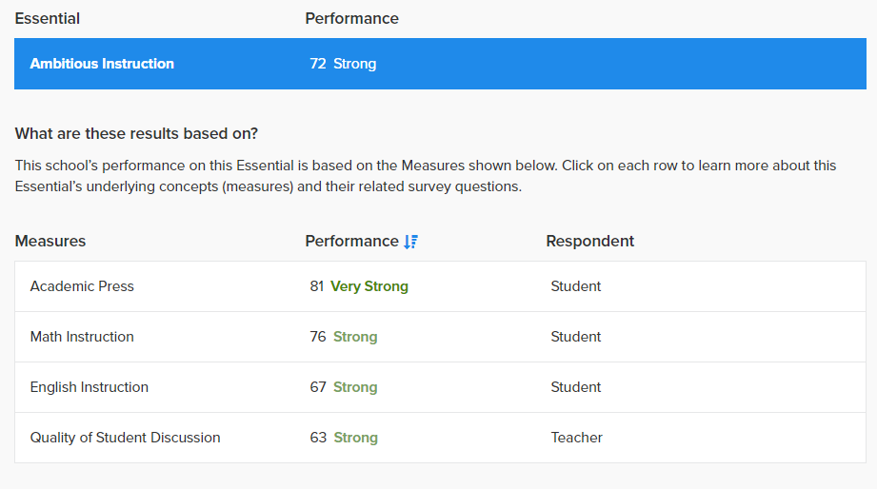
Essentials Composition
Essentials are made up of related Measures
Example: Ambitious Instruction
  English Instruction
  Math Instruction
  Academic Press
  Quality of Student Discussion
An Essential score is the average of its Measure scores
Notes:
An Essential score is the average of all measures that comprise that essential. Here if you take the average of the 4 measures, you will receive an average of 72 which is the measure score for Ambitious Instruction.

Slide 43
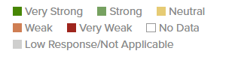
5Essentials Scoring Legend
Dark Green (80-99) = Very Strong
Light Green (60-79) = Strong
Yellow (40-59) = Neutral
Orange (20-39) = Weak
Red (1-19) = Very Weak
Notes:
The positive categories, Very Strong and Strong are each worth 1 point, while neutral range is assigned 0 as a value. The negative categories, weak and very weak are worth negative 1.

Slide 44
5Essentials Overall Scores
Well-Organized (+3, 4, or 5)
Organized (+1 or 2)
Moderately Organized (0)
Partially Organized (-1 or 2)
Not Yet Organized (-3, 4, or 5)
Notes:
You then add the value of each essential score to calculate the Overall 5Essentials category for your school – Well Organized, Organized, Moderately Organized, Partially Organized and Not yet Organized…for improvement
Your school’s category score indicates how organized your school is for improvement. Extensive empirical evidence indicates that there is a strong correlation between a school’s score on the 5Essentials survey and their capacity for improving student outcomes. Thus, schools that score strong in 3 or more of the 5Essentials, without a sustained weakness in the other essentials, will be classified as “organized” or “well organized” for improvement.

Slide 45
Think-Pair-Share
Activity | Time | Guidance
Think | 3 min | Take a moment to gather your thoughts on the content you have heard thus far: What about the 5Essentials history, research, framework, and scoring is most compelling to you? How might it influence the way you help lead / support using the 5Essentials in D11? What questions do you still have about the 5Essentials?
Pair | 5 min | Discuss your thoughts with an elbow partner.
Share | 5 min | Share your thinking with the larger group.

Slide 46
5Essentials Report Exploration

Slide 47
Online Diagnostic Reports
Activity | Time | Guidance
Explore | 15 min | With a partner, explore a 5Essentials sample report using the exploration “bingo” board: https://www.5-essentials.org/demo/2017
Share | 5 min | Share key features or characteristics you discovered

Slide 48
5Essentials Demo Report Exploration
What is the school’s overall summary statement? | How many Essentials are: Very Strong or Strong? Neutral? Weak or Very Weak? | What is the: Student response rate? Teacher response rate? | Which Essential is the highest performing? How much did it change in the last year?
Which Essential decreased the most in the past year? By how much? | Three years ago, which Essential was the lowest performing? Is it still the lowest performing? | Which Measure is the strongest? What is the Measure Score? | What Essential is the lowest performing Measure in? Is it a Student or a Teacher Measure?
Which Measures improved the most in the past year? How big was the biggest improvement? | Did the lowest performing Measure improve or decrease in the past year? | What is the highest performing Supplemental Measure? | If you were the school leader, which Measure would you prioritize? Why?

Slide 49
Initial Exploration of District Results
Activity | Time | Guidance
Explore | 10 min | With a partner, explore the District group report (All Colorado Springs Schools): https://5-essentials.org/SD11/5e/2020/ Take note of the following: Strengths across the district at the Essential and Measure levels Opportunities for growth at the Essential and Measure levels

Slide 50
Adult Learning

Slide 51
How do adults learn?
    “To build learning organizations in schools… suggests that we need to know something about guiding adult learners.”
    - Elena Aguilar

Slide 52
How do adults learn?
Activity | Time | Guidance
Read | 8 min | At your table, count off by two and read each section: Group 1: "What the Research Says” up to “Adults Need to Know” (191) Group 2: "Adults Need to Know (191)” up to "Common Challenges” (194)
Small Group Share | 10 min | Group 1 begins by sharing their thoughts on the following: What are the main points of your section? What resonated with you in the reading? What are the implications for your change efforts? Switch and have Group 2 answer the same questions.
Group Share | 5 min | Share reflections with the Group

Slide 53
Key Practices and Lessons Learned

Slide 54
Lessons from the Field: Key Ideas
Utilize a cycle of improvement
Don’t boil the ocean
Democratize the process
Broaden the base of leadership
Be vulnerable

Slide 55
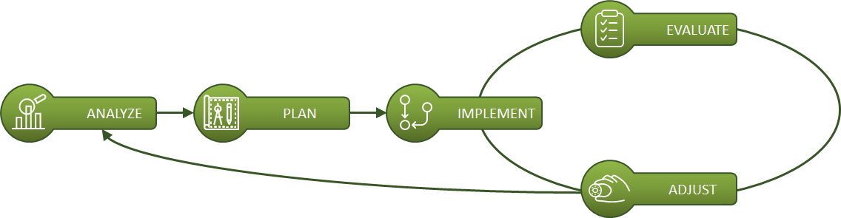
Utilize a Cycle of Improvement
Be disciplined in your approach to leveraging data and creating change

Slide 56

Don’t Boil the Ocean
Do not try to tackle everything at once
Inch wide, mile deep
Go slow to go fast
Notes:
As we can all agree, trying to boil the ocean would be a futile and frustrating endeavor. The same is true if you, as a district or a school, try to take everything on at once. But when you slow down and enable yourself to go deep, you can often times make more progress and that progress is more likely to last. In other words, go slow to go fast.

Slide 57

Democratize the Process
Create equity of voice
Include diverse perspectives to ensure broader buy-in
Use norms and protocols to help
Notes:
When you include others in the decision making process, especially people with diverse perspectives, you often times create a better solution with better buy-in. However, in doing this, you need to ensure that you create or allow for equity of voice. Norms and protocols are tremendously helpful here.

Slide 58

Broaden the Base of Leadership
Lead but do not do it alone
Foster alignment and consistent understanding
Push beyond buy-in to ownership
Notes:
As an extension to democratizing the process, when you broaden the base of leadership, you enhance the likelihood of success. Yes, you need to lead, but you do not need to do it alone. Bringing others into the mix can help foster understanding and alignment, while also pushing people beyond buy-in to ownership.

Slide 59

Be Vulnerable
Adopt a reflective stance with an open-mind
Own what is and take responsibility for what could be
Be courageous…be counter-cultural
Notes:
As you probably observed in Isaac’s story, he made himself vulnerable. He reflected, with an open-mind, on the year and his practice. He did not make excuses, but instead he owned his actions and took responsibility for what could be. He was vulnerable with his staff and courageous in his pursuit of something better.

Slide 60
Principles of Improvement Science
Colorado Springs District 11 – February 26, 2020

Slide 61
Agenda
Topic | Time | Purpose
Overview | 5 min | Overview of the afternoon
Improvement Discipline in Practice | 25 min | Setting the stage for improvement
Seeing the System | 60 min | Stepping back to expand our view
Variation in Performance | 60 min | Narrowing our focus to understand variance
Topic
Time
Purpose
Notes:
255 minutes
This leaves 15 minutes for breaks

Slide 62
Objectives
By the end of the session, district leadership will be able to:
Understand the Core Principles of Improvement and build capacity to embed them within school improvement efforts
Set the stage for improvement through engaging in a disciplined approach to improvement
Build capacity to “See the System” and account for it when working to improve
Gain a deeper understanding of variance as the core problem to solve

Slide 63
Carnegie Foundation
The Six Core Principles of Improvement
Make the work problem-specific and user-centered.
It starts with a single question: “What specifically is the problem we are trying to solve?” It enlivens a co-development orientation: engage key participants early and often.
Variation in performance is the core problem to address.
The critical issue is not what works, but rather what works, for whom and under what set of conditions. Aim to produce the desired results reliably at scale.
See the system that produces the current outcomes.
It is hard to improve what you do not fully understand. Go and see how local conditions shape work processes. Make your hypotheses for change public and clear.

Slide 64
Carnegie Foundation
The Six Core Principles of Improvement
We cannot improve at scale what we cannot measure.
Embed measures of key outcomes and processes to track if change is an improvement. We intervene in complex organizations. Anticipate unintended consequences and measure these too.
Anchor practice improvement in disciplined inquiry.
Engage rapid cycles of Plan, Do, Study, Act (PDSA) to learn fast, fail fast, and improve quickly. That failures may occur is not the problem; that we fail to learn from them is.
Accelerate improvements through networked communities.
Embrace the wisdom of crowds. We can accomplish more together than even the best of us can accomplish alone.

Slide 65
Improvement Discipline in Practice

Slide 66
Basic Premise
How Schools Can Get Better
5Essentials
Improvement Cycle
School Improvement

Slide 67
Improvement Cycle
Notes:
5E Team uses the thinking model promoted by Anthony Bryk.
Urge teams to think through the lens of convergence and integration. Rather than listing all potential areas or measures for improvement, how, for example, did teams integrate targeted 5E improvement measures with a specific CIWP strategy?

Slide 68
Shared Learning
Activity | Time | Guidance
Individually Read and Reflect | 10 min | Alicia Grunow: “Improvement Discipline in Practice” Reflection Questions: What resonated with you from this reading? How can you apply this to supporting schools in their improvement efforts?
Discuss at Your Table | 5 min | Share reflections
Whole Group Share | 5 min | Key thoughts discussed at your table
Notes:
Need to print this article

Slide 69
Guiding Questions
What, specifically, are we trying to accomplish?
What change(s) might we introduce and why?
How will we know that a change is actually an improvement?
Notes:
The circle indicates that this is the section we will focus on today. We will dive into the other two boxes during implementation planning on our next visit.

Slide 70
Seeing the System

Slide 71
Seeing the System
“Every system is perfectly designed to achieve
exactly the results it gets.”
- Don Berwick, founder of the Institute for Healthcare Improvement (IHI)
Notes:
Ask participants to do a close read, and unpack their interpretation of the quote. Share thinking with small groups, then with whole.

Slide 72
Seeing the System
Activity | Time | Guidance
Watch and Reflect | 15 min | Watch Atul Gawande, “How Do We Heal Medicine?” Reflect as you watch: What connections do you see to the educational space? What application do you see to District improvement efforts? What connections do you see at the individual school level?
Share | 5 min | Whole group share
Notes:
Play the first 12 minutes of the video

Slide 73
Seeing Our System
The key question to explore is:
What is our system designed to achieve?

Slide 74
Seeing the System
To help us see our system, we need to reflect on all of the things happening in the district to help achieve our mission. And the 5Essentials can help us think more concretely about what each action is seeking to achieve.
Activity | Time | Guidance
List | 3 min | Individually, spend 3 minutes writing down programs, activities, initiatives, partnerships, etc. that the district has in place or recently had in place (“What change(s) did we introduce?”). Write one idea per post-it note.
Notes:
Play the first 12 minutes of the video

Slide 75
Seeing the System
To help us see our system, we need to reflect on all of the things happening in the district to help achieve our mission. And the 5Essentials can help us think more concretely about what each action is seeking to achieve.
Activity | Time | Guidance
List | 3 min | Individually, spend 3 minutes writing down programs, activities, initiatives, partnerships, etc. that the district has in place or recently had in place (“What change(s) did we introduce?”). Write one idea per post-it note.
Share and Sort | 12 min | At your table: Create a mock-up of the 5Essentials Framework on a piece of chart paper. Take turns sharing the programs, activities, initiatives, partnerships, etc. you wrote down, including briefly describing what it is intended to achieve (“What, specifically, were we trying to accomplish?”). Place the post-its into the most closely aligned Essential (use your Essentials and Measures Definitions page from earlier to help). Set aside those that do not align to an Essential.
Notes:
Play the first 12 minutes of the video

Slide 76
Seeing the System
To help us see our system, we need to reflect on all of the things happening in the district to help achieve our mission. And the 5Essentials can help us think more concretely about what each action is seeking to achieve.
Activity | Time | Guidance
List | 3 min | Individually, spend 3 minutes writing down programs, activities, initiatives, partnerships, etc. that the district has in place or recently had in place (“What change(s) did we introduce?”). Write one idea per post-it note.
Share and Sort | 12 min | At your table: Create a mock-up of the 5Essentials Framework on a piece of chart paper. Take turns sharing the programs, activities, initiatives, partnerships, etc. you wrote down, including briefly describing what it is intended to achieve (“What, specifically, were we trying to accomplish?”). Place the post-its into the most closely aligned Essential (use your Essentials and Measures Definitions page from earlier to help). Set aside those that do not align to an Essential.
Observe and Discuss | 5 min | Once all post-its have been placed, discuss observations with your colleagues.
Notes:
Play the first 12 minutes of the video

Slide 77
Seeing the System
Activity | Time | Guidance
Narrow and Evaluate | 5 min | Select one of the Essentials to dive deeper into. Once chosen: Consider each program, activity, etc. that was listed and determine if it has been successful (+) in achieving its purpose, unsuccessful (-) in achieving its purpose, or if the impact / outcome is unknown (?). Discuss any observations. (“Was the change actually an improvement?”)
Notes:
Play the first 12 minutes of the video

Slide 78
Seeing the System
Activity | Time | Guidance
Narrow and Evaluate | 5 min | Select one of the Essentials to dive deeper into. Once chosen: Consider each program, activity, etc. that was listed and determine if it has been successful (+) in achieving its purpose, unsuccessful (-) in achieving its purpose, or if the impact / outcome is unknown (?). Discuss any observations. (“Was the change actually an improvement?”)
Reflect More Deeply | 12 min | From the programs, etc. that you labeled as unsuccessful or unknown, choose one to reflect on more deeply. Record your thoughts on the following on a new piece of chart paper: What is the school-level understanding and experience of this program? What data do you have to support this? Who is held accountable for the implementation of the program? For the success of the program? How is a school supported in effectively using / implementing this program? What barriers exist that make success for this program challenging? What is one thing the district can do to help remove these barriers to success? What enabling conditions need to be in place for the program to be successful? What is one thing the district could do to help this program be more successful in achieving its purpose?
Notes:
Play the first 12 minutes of the video

Slide 79
Seeing the System
Activity | Time | Guidance
Narrow and Evaluate | 5 min | Select one of the Essentials to dive deeper into. Once chosen: Consider each program, activity, etc. that was listed and determine if it has been successful (+) in achieving its purpose, unsuccessful (-) in achieving its purpose, or if the impact / outcome is unknown (?). Discuss any observations. (“Was the change actually an improvement?”)
Reflect More Deeply | 12 min | From the programs, etc. that you labeled as unsuccessful or unknown, choose one to reflect on more deeply. Record your thoughts on the following on a new piece of chart paper: What is the school-level understanding and experience of this program? What data do you have to support this? Who is held accountable for the implementation of the program? For the success of the program? How is a school supported in effectively using / implementing this program? What barriers exist that make success for this program challenging? What is one thing the district can do to help remove these barriers to success? What enabling conditions need to be in place for the program to be successful? What is one thing the district could do to help this program be more successful in achieving its purpose?
Share | 3 min | Share highlights from your table’s work with your colleagues and reflections on the importance of seeing the system
Notes:
Play the first 12 minutes of the video

Slide 80
A Call for Focusing on Variation
“Achieving improvements at scale is not about what works on average. It is about getting quality results under a variety of conditions. Understanding the sources of variation in outcomes, and responding effectively to them, lies at the heart of quality improvement.”
- Anthony Bryk

Slide 81
Variation in Performance:
Case Study Review

Slide 82
Variation through the lens of the 5Essentials
Activity | Time | Guidance
Read and Analyze | 20 min | Principals are the second most influential school-based factor affecting student achievement. How do principals influence student achievement, and how do their actions intersect with the 5Essentials Framework? Find a partner and decide if you will read the Elementary (K-8) or HS (9-12) case studies Each partner reads a different case study. Using the 5Essentials definition sheet, tag the described conditions according to the Measures you see present Also note leadership beliefs and actions and any 5Essentials-related themes
Notes:
Explain that they will tag the Measures directly onto the case study.
Thereafter, they can note the 5E related trends in their participant packets.

Slide 83
Variation through the lens of the 5Essentials
Activity | Time | Guidance
Discuss and Diagram | 15 min | Explain your case to your partner, focus on 5Essentials-related themes and observed leadership beliefs and actions. After reviewing both case studies, create a Venn diagram highlighting the 5Essentials-related themes (or Measures) and leadership beliefs and actions you noted across the two cases. Note: focus on the themes, beliefs, and actions only, not the affect of these.
School 1
School 2
Academic Personalism
Student-Teacher Trust
Teacher Influence
Expectations for Postsecondary Education
Teacher-Teacher Trust
Program Coherence
Notes:
Explain that they will tag the Measures directly onto the case study.
Thereafter, they can note the 5E related trends in their participant packets.

Slide 84
Variation through the lens of the 5Essentials
Activity | Time | Guidance
Group and Extend | 10 min | Find another similar grade level pair (form a group of 4) Using chart paper, create a new Venn diagram to compare and contrast the affect of the themes, actions, and beliefs you noted from both scenarios
Summarize | 5 min | Which school is fostering improved student outcomes, and which is not? Explain your thinking.
School 1
School 2
Program Coherence: Teachers do not meet with colleagues in other grade levels and infrequently meet as grade-level teams.
Teacher Influence: Teachers have voice and influence over how they use common prep time.
Program Coherence: Principal regularly meets with teachers in GL and Vertical Planning meetings to evaluate and strategize on student progress toward pre-established goals
Notes:
Explain that they will tag the Measures directly onto the case study.
Thereafter, they can note the 5E related trends in their participant packets.

Slide 85
Variation through the lens of the 5Essentials
Group discussion:
Should we seek to eliminate all forms of variance? Why or why not?
Can variance be good or beneficial? If so, how?

Slide 86
Concluding Thought
“[V]ariability in performance is a major problem to solve,” but “individual professional judgment will continue to play a central role in practice.”
– Learning to Improve (pg. 50)

Slide 87
Thank you!
Thank you for your participation today!
We will continue our learning tomorrow by starting the process of embedding the 5Essentials work into a cycle of improvement with a specific focus on data and root cause analysis as the precursor to effective planning.

Slide 88
Data and Root Cause Analysis
Colorado Springs District 11 – February 27, 2020

Slide 89
A Quick Note About This Session
Today you will engage in and experience the Data and Root Cause Analysis Session.
To do this, we will be using the district-level 5Essentials results, even though the 5Essentials, as a framework for improvement and a data set, is first and foremost about school-level organizational conditions.
As a result, it may feel a bit funny or challenging at times…lean in to this because chances are schools will also feel uncomfortable or funny at times.
The goal is to:
  Learn from experiencing so you can help support schools in this process
  Gain insights into conditions across the district and variance within the district
  Think strategically about work the system can take on to help remove barriers or create the conditions for success at the school level
  Avoid coming up with a one-size-fits all, prescriptive improvement initiative

Slide 90
Norms
Purpose:
Build a shared understanding of expectations for adult behavior
Our Norms:
Give yourself the gift of presence
Embrace feedback
Accept and expect non-closure
Challenge yourself and one another (with good intent)

Slide 91
Reminder:
The Relationship Between Framework and Survey
The Framework is the key to school improvement and pushes us to consider:
How are we growing trust between teachers, students, families, and school leadership?
How are we incorporating teacher influence throughout key school decisions and priorities?
How are we aligning our work and our improvement efforts to ensure coherence?
How are we creating safe, supportive environments focused on high expectations, rigorous instruction, and academic excellence for all students?
The Survey provides data and evidence of progress towards improved conditions within a school relative to the Framework.

Slide 92
Improvement Discipline in Practice

Slide 93
Improvement Cycle
Notes:
5E Team uses the thinking model promoted by Anthony Bryk.
Urge teams to think through the lens of convergence and integration. Rather than listing all potential areas or measures for improvement, how, for example, did teams integrate targeted 5E improvement measures with a specific CIWP strategy?

Slide 94
Previewing the Approach
Nonjudgmental Observations
Measure Prioritization
Root Cause Analysis
Establishing a Vision
Planning
Progress Monitoring

Slide 95
Guiding Questions
What, specifically, are we trying to accomplish?
“What specific problem are we trying to solve?”
“Why did we get these results?”
“What is our vision for success?”
What change(s) might we introduce and why?
How will we know that a change is actually an improvement?
Notes:
The circle indicates that this is the section we will focus on today. We will dive into the other two boxes during implementation planning on our next visit.

Slide 96
Data Exploration

Slide 97
Data Exploration
Activity | Time | Guidance
Explore | 10 min | With a partner, go back to the District group report (All Colorado Springs Schools): https://5-essentials.org/SD11/5e/2020/ Take notes on what you noticed and what was: Surprising Affirming Consistent Frustrating Where is the district performing the highest? The lowest? Consider both Essentials and Measures. Do you notice variance by schools across the district or in your portfolio?
Page 1

Slide 98
Other Data Sources

Slide 99
Other Data Sources
Schools have many data points that reflect progress and areas for growth.
Triangulating data sources is an effective way to build a robust picture of what is happening at your school.
As you consider your 5Essentials results, reflect on and leverage other data sources (test scores, attendance rates, behavior data, teacher observation data, etc.) to push to a deeper understanding of the school.

Slide 100
Prioritizing a Measure

Slide 101
Prioritizing a Measure
What, specifically, are we trying to accomplish? What specific problem are we trying to solve?
Activity | Time | Guidance
Prioritize | 5 min | Collectively prioritize 1 Measure that provides opportunity for growth and improvement for the district. Ask yourselves: Is this Measure high leverage and high impact? Explain. Will narrowing focus on this Measure help support and advance other district improvement priorities? Explain.
Page 2

Slide 102
Root Causes

Slide 103
Root Cause: Prioritized Measure for Growth
Essential Question: Why did we get these results for our prioritized Measure for Growth?
What actions, beliefs, or initiatives caused this Measure to be a Measure for Growth?
Think about adult beliefs and mindsets
Consider the knowledge and skills of adults that led to this Measure for Growth
Think about district-wide systems and structures (or lack thereof) and how they contributed to this Measure for Growth
Consider how other data sources might help uncover root causes

Slide 104
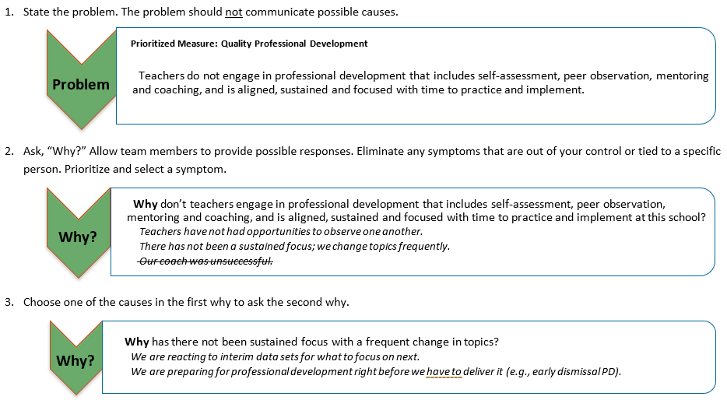
The 5 Whys Example
Prioritized Measure: Quality Professional Development
Page 3

Slide 105
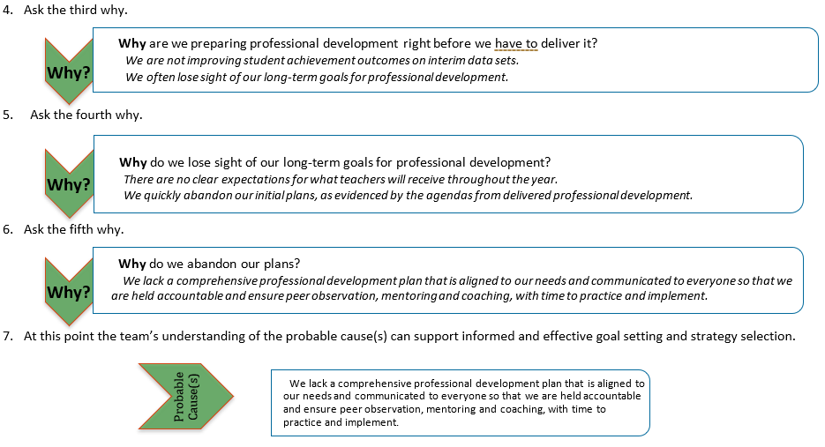
The 5 Whys Example
Page 4

Slide 106
Root Cause: Prioritized Measure for Growth
Why did we get these results for our prioritized Measure for Growth?
Activity | Time | Guidance
State the Problem | 10 min | Collectively: Articulate the problem posed by the prioritized Measure for Growth
Pages 5-7

Slide 107
Root Cause: Prioritized Measure for Growth
Why did we get these results for our prioritized Measure for Growth?
Activity | Time | Guidance
State the Problem | 10 min | Collectively: Articulate the problem posed by the prioritized Measure for Growth
Brainstorm | 10 min | Individually: Using the 5 Whys process, why do you think the district got this outcome?
Pages 5-7

Slide 108
Root Cause: Prioritized Measure for Growth
Why did we get these results for our prioritized Measure for Growth?
Activity | Time | Guidance
State the Problem | 10 min | Collectively: Articulate the problem posed by the prioritized Measure for Growth
Brainstorm | 10 min | Individually: Using the 5 Whys process, why do you think the district got this outcome?
Naming a Probable Cause | 15 min | As a team, discuss and narrow your root causes for your Measure for Growth. Come to consensus on and articulate a “Probable Cause”.
Pages 5-7

Slide 109
Crafting a Vision for Improvement

Slide 110
“Something Stunning for Our Students”
If leaders and teachers were to attain piercing clarity about what actions matter most; if we were equally clear about the value and impact of those actions; if we learned and practiced them with “simplicity and diligence” — something stunning would happen for our students.
- Mike Schmoker

Slide 111
Vision Setting
What, specifically, are we trying to accomplish? “What is our vision for success?”
Activity | Time | Guidance
Discuss | 10 min | What would it look like in your district if you dramatically increased your performance in your Measure for Growth? What would students, teachers, staff, and/or families be saying or doing differently/ more of/ less of? (Consider: How does improvement on this Measure relate to your current district improvement plans and goals? How can you align them to current goals and plans so that they complement already established priorities?)
Page 8
Notes:
**Imperative to stress that participants are doing this hypothetically to learn the process so they can support schools. The schools themselves know their reality better than anyone. Our job is to support them through the process ensuring they do this honestly and reflectively. Must not get too wed to the hypothetical visions you created here when learning the process.
What if you were to turn this Measure for Growth into a strength? What if your school were to become an exemplar of success for this indicator? What would it look like? What would teachers, students, leaders, parents, and adult staff be doing and saying?

Slide 112
Vision Setting
What, specifically, are we trying to accomplish? “What is our vision for success?”
Activity | Time | Guidance
Discuss | 10 min | What would it look like in your district if you dramatically increased your performance in your Measure for Growth? What would students, teachers, staff, and/or families be saying or doing differently/ more of/ less of? (Consider: How does improvement on this Measure relate to your current district improvement plans and goals? How can you align them to current goals and plans so that they complement already established priorities?)
Articulate your vision | 10 min | Collectively: Craft a Vision Statement that addresses the questions above (see exemplar)
Page 8
Notes:
**Imperative to stress that participants are doing this hypothetically to learn the process so they can support schools. The schools themselves know their reality better than anyone. Our job is to support them through the process ensuring they do this honestly and reflectively. Must not get too wed to the hypothetical visions you created here when learning the process.
What if you were to turn this Measure for Growth into a strength? What if your school were to become an exemplar of success for this indicator? What would it look like? What would teachers, students, leaders, parents, and adult staff be doing and saying?

Slide 113
Vision Setting
What, specifically, are we trying to accomplish? “What is our vision for success?”
Activity | Time | Guidance
Discuss | 10 min | What would it look like in your district if you dramatically increased your performance in your Measure for Growth? What would students, teachers, staff, and/or families be saying or doing differently/ more of/ less of? (Consider: How does improvement on this Measure relate to your current district improvement plans and goals? How can you align them to current goals and plans so that they complement already established priorities?)
Articulate your vision | 10 min | Collectively: Craft a Vision Statement that addresses the questions above (see exemplar)
Plan | 5 min | When and how will we communicate this vision and how it aligns to our overall improvement picture with the rest of our staff/ community?
Page 8
Notes:
**Imperative to stress that participants are doing this hypothetically to learn the process so they can support schools. The schools themselves know their reality better than anyone. Our job is to support them through the process ensuring they do this honestly and reflectively. Must not get too wed to the hypothetical visions you created here when learning the process.
What if you were to turn this Measure for Growth into a strength? What if your school were to become an exemplar of success for this indicator? What would it look like? What would teachers, students, leaders, parents, and adult staff be doing and saying?

Slide 114
Vision Exemplar: Academic Press
If Academic Press was a signature strength, we would see substantial evidence that a persistent environment of high expectations exists for all students. All classroom instruction would be rigorous with individual needs of students met to ensure grade level performance. All students consistently engage in level 3 and level 4 DoK tasks and experiences. Inquiry would be commonplace, and student engagement would be consistently high across all classrooms.

Slide 115
Planning for Improvement

Slide 116
Guiding Questions
What, specifically, are we trying to accomplish?
“What specific problem are we trying to solve?”
“Why did we get these results?”
“What is our vision for success?”
What change(s) might we introduce and why?
How will we know that a change is actually an improvement?
Notes:
The circle indicates that this is the section we will focus on today. We will dive into the other two boxes during implementation planning on our next visit.

Slide 117
Planning for Improvement
What changes might we introduce? Why?
Activity | Time | Guidance
Brainstorm | 10 min | Think about changes related to the following: What systems, structures, and / or routines do we need to change to accomplish our vision? (technical changes) What practices, actions, beliefs, or mindsets of leadership need to change to accomplish our vision? (adaptive changes) What practices, actions, beliefs, or mindsets of teachers need to change to accomplish our vision? (adaptive changes)
Pages 9-10

Slide 118
Planning for Improvement
What changes might we introduce? Why?
Activity | Time | Guidance
Brainstorm | 10 min | Think about changes related to the following: What systems, structures, and / or routines do we need to change to accomplish our vision? (technical changes) What practices, actions, beliefs, or mindsets of leadership need to change to accomplish our vision? (adaptive changes) What practices, actions, beliefs, or mindsets of teachers need to change to accomplish our vision? (adaptive changes)
Share | 10 min | Take turns sharing the potential changes you brainstormed and your rationale for the change / how the change will help the district accomplish its vision.
Pages 9-10

Slide 119
Planning for Improvement
What changes might we introduce? Why?
Activity | Time | Guidance
Brainstorm | 10 min | Think about changes related to the following: What systems, structures, and / or routines do we need to change to accomplish our vision? (technical changes) What practices, actions, beliefs, or mindsets of leadership need to change to accomplish our vision? (adaptive changes) What practices, actions, beliefs, or mindsets of teachers need to change to accomplish our vision? (adaptive changes)
Share | 10 min | Take turns sharing the potential changes you brainstormed and your rationale for the change / how the change will help the district accomplish its vision.
Prioritize | 10 min | Once all ideas have been shared, collectively work to prioritize the top 3 changes you believe will address the problem you have identified and enable you to accomplish your vision. NOTE: Pause to reflect and ensure alignment between the changes, your problem statement, and vision.
Pages 9-10

Slide 120
Planning for Improvement
What changes might we introduce? Why?
Activity | Time | Guidance
Plan | 30 min | For each proposed change, address the following questions: In order for the changes to take root and our vision to be realized, what do we need to share with / communicate to staff? What do we need to teach, model, and practice as a staff? When, where, and how will we communicate about and work on making the changes? Whole-school PD Teacher team meetings / PLCs Ongoing coaching of teams / individuals Visuals Online / electronic communications Reminder: Keep the following key themes of the 5Essentials in mind as you plan: -How can we incorporate teacher influence? -How can our plan build relational trust and foster inclusive, facilitative leadership?
Pages 11-16

Slide 121
Progress Monitoring

Slide 122
Guiding Questions
What, specifically, are we trying to accomplish?
“What specific problem are we trying to solve?”
“Why did we get these results?”
“What is our vision for success?”
What change(s) might we introduce and why?
How will we know that a change is actually an improvement?
Notes:
The circle indicates that this is the section we will focus on today. We will dive into the other two boxes during implementation planning on our next visit.

Slide 123
Progress Monitoring
How will we know that a change is an improvement?
Activity | Time | Guidance
Discuss and Record | 15 min | Think about changes you articulated. How will you know that the work you are doing to create change and accomplish your vision has resulted in improvement? What evidence do we need to collect and review to determine if the changes are resulting in improvement? How and when will we reflect on this evidence as a leadership team? How can we ensure our school teams also reflect on this evidence and engage in cycles of inquiry? How will we communicate information, share feedback, and celebrate successes?
Pages 12-17

Slide 124
“We delight in the beauty of the butterfly, but rarely admit the changes it has gone through to achieve that beauty.”
- Maya Angelou

