Slide 1

Leveraging 5 Essentials Survey Results to Guide School Improvement
March 4 K12 Principals Meeting

Slide 2
5 Essentials Survey – Quick Check in
As you think about the 5Essentials and the work today, are you feeling more hopeful / excited or more anxious / concerned? Something else?
Share with a trusted shoulder partner...
Notes:
2 min: 8:45 –8:47

Slide 3

5 Essentials Survey
#1 This Data is intended to be Developmental, not Judgmental; part of an ongoing commitment to improvement.
#2 – no actions yet, just
learning and exploring!
Notes:
(1 min) 8 48

Slide 4
5 Essentials Survey – Agenda
Why & Connections to Strategic Plan
The Framework and Research behind it
Scoring Methods
Platform Use – with Practice Time
Next Steps – Slowly getting ready for improvement planning
Notes:
1 min - 849

Slide 5
5 Essentials Survey – Why, Purpose
The data from this annual survey will help the district and schools measure and respond to factors aligned to the strategic plan that go beyond & complement traditional School Performance Framework (SPF) scores.
We needed a more comprehensive instrument that takes into account relational trust as a key factor for school improvement.
D11 Vision
We are a dynamic, collaborative community of energized educators, engaged students and supportive partners with a passion for continuous learning.
Notes:
2 min 8:51; As evidenced by World Cafes, metrics team, school improvement teams, Strategic plan

Slide 6

5 Essentials Survey - Research
Identify organizational strengths and areas of opportunity on the five essential factors that research has shown to drive school improvement.
Notes:
2 min; 8:53

Slide 7
5 Essentials Survey - Research
<10%
10X
Research demonstrates that schools strong on at least 3 of the 5 Essentials were 10 times more likely to show substantial gains in students’ learning than schools weak on 3 or more.
A sustained low score in just one of the core measures reduced the likelihood of improvement to less than 10%.
Notes:
2 min; 8:55

Slide 8
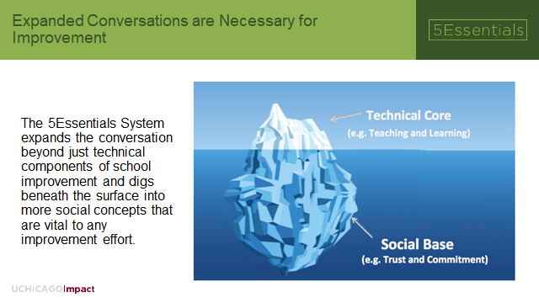
Notes:
1 min; 8:56

Slide 9
Framework & Survey Data
The Framework is the key to school improvement and pushes us to consider:
  How are we growing trust between teachers, students, families, and school leadership?
  How are we incorporating teacher influence throughout key school decisions and priorities?
  How are we aligning our work and our improvement efforts to ensure coherence?
  How are we creating safe, supportive environments focused on high expectations, rigorous instruction, and academic excellence for all students?
The Survey provides data and evidence of progress towards improved conditions within a school relative to the Framework.
The data from the Survey sit alongside and supplement other data points that also gauge progress and inform school improvement: standardized tests, discipline, attendance, etc.
Notes:
3 min 8:59 - Culture and Climate survey focusing on relational trust and backed by 2 decades of research linked to school improvement

Slide 10
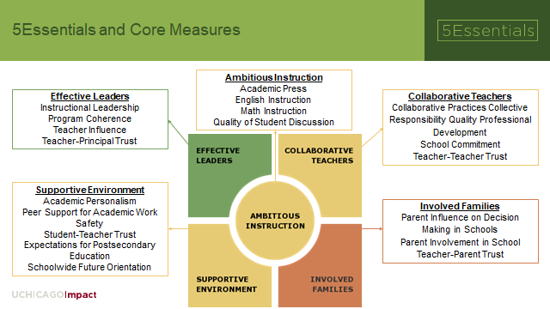
Notes:
2 min; 9:01 - Integrated improvement across the 5 Essentials is key – they are all interconnected.

Slide 11
Core Measures - Deeper Dive
Read over the 2-page document and
  Mark the core measure(s) your current School Improvement Plan attends to most intentionally.
  Mark the core measures you believe the district is
  most helpful with supporting
  &
  least helpful with supporting
Notes:
12 min; 9:13 - Read – 4 minutes; 3 minutes to mark up; 4 minutes to discuss; Document on your handout; school name on top; share with 1 or 2 colleagues at your table; we will make copies of this and return to you.

Slide 12

5 Essentials Survey Structure
Notes:
2 min; 9:13 – 9:15 Items (questions) are intended to be illustrative, aggregated to form a picture of health about the measures, which are then averaged into a scale score for the Essential.

Slide 13
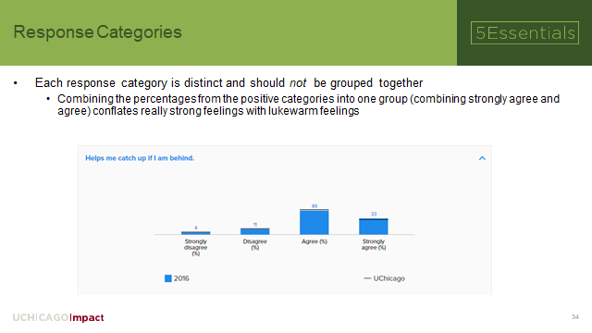
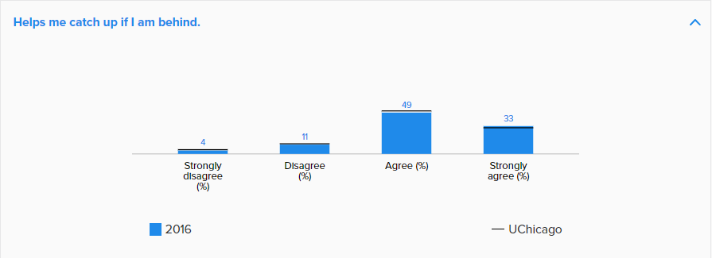
Notes:
1 min; 9:15 – 9:16

Slide 14
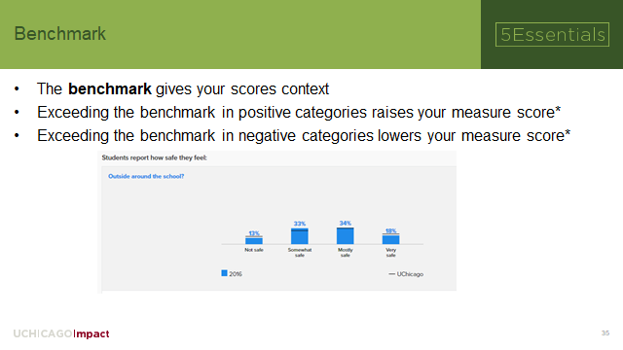
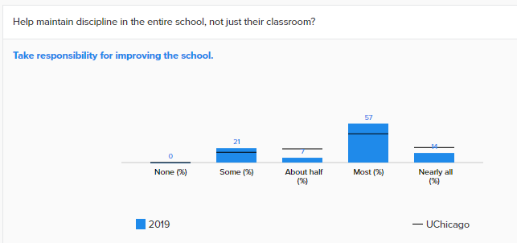
Notes:
2 min; 9:16 – 9:18

Slide 15
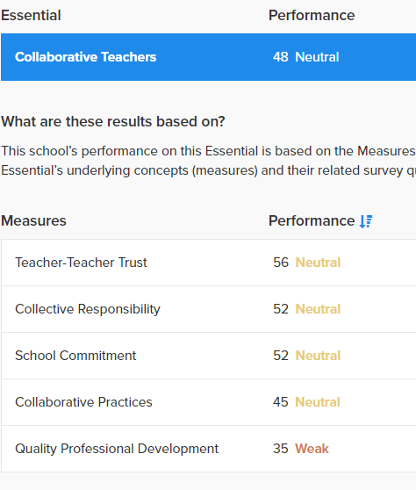
Item scores are combined into a Rausch Score for each Measure, based on IRT (Normed Scale 1-99), like RIT from MAPs
An Essential is an Average of Measure Scores
Notes:
3 min – 9:18-9:21; Item scores are combined for a Rausch score - Not %, not %ile, not raw scores; Rausch like RIT – normed scale values;

Slide 16
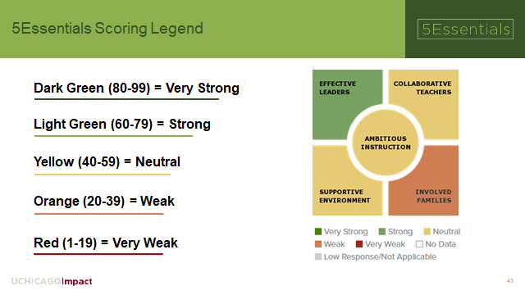
Notes:
(2 min); 9:21– 9:22; Every 20 points = 1 Standard Deviation; Normed Scale = 1-99 based on Item Response Theory (HLM, all voices included but downweighted if unreliable)

Slide 17

Navigation Tips – Click Path Practice
Possible Reasons?
Strongest Essential
Strongest Core Measure
How to Leverage this Strength?
Strongest Item
Notes:
(16 min) 9:22 – 9:38 16 minutes of - Click Path Navigation Practice: NEED 2 HANDOUTs
(1) Look at your own data, focus on highest performing Essential; Use Scavenger Hunt Grid; ask for help if needed!

Slide 18
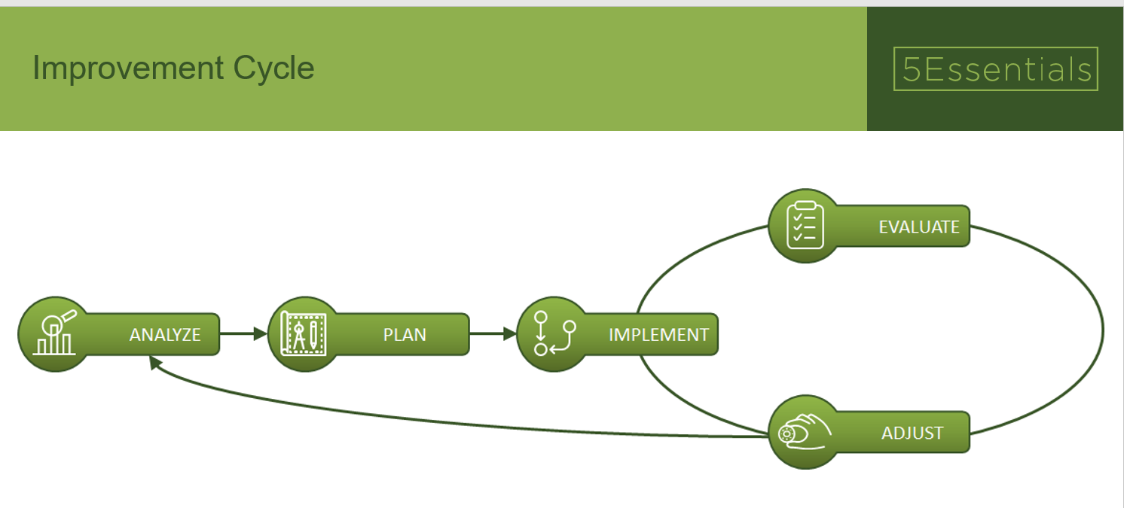
Notes:
(1 min) 9:38 – 9:39

Slide 19
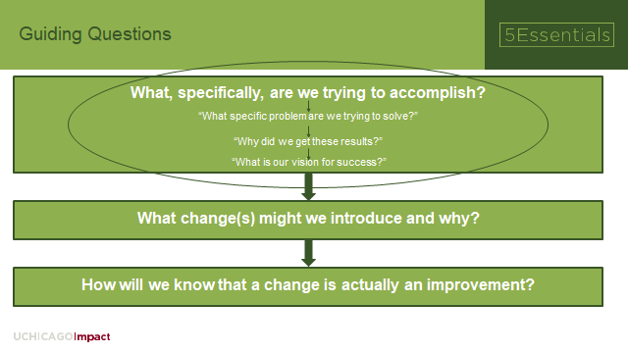
Notes:
(2 min) – 9:39 -9:41

Slide 20
Prioritization & Triangulation
1. Prioritize - From an identified Essential of concern, select 1 Core Measure to Hyper-Focus improvement efforts upon (reminder that items are illustrative, not exhaustive).
2. Triangulate - Consider this data set with other data sets – don't treat in isolation, seek deeper understanding
Notes:
( 1min ) 9:41 – 9:42; Focusing on 1 high leverage will help turn other parts of the cog. HYPER FOCUS

Slide 21
Strategic Delimiters
We will not:
  Allow past practices to create barriers to new and innovative ideas.
  Avoid conflict or difficult conversations, nor engage in problem solving through the lens of blame.
  Engage in initiatives that are misaligned with our mission.
Notes:
1 min: 9:42 – 9:43

Slide 22
Next Steps
BREATHE and take time to learn – no actions required of you yet! This is part of an on-going process (Not a 1 and done)!
1 on 1 with K12 EDs After Spring Break
If sharing with Building Leadership team before 1 on 1 – focus on today's learning around scoring, platform use, & framework (hold off on improvement planning)
School-wide and SACs – how best to share results and collaboratively plan for improvement? Will depend on context
Notes:
9:43 – 9:45; (2 min) Email leveled folks to offer support if desired

Slide 23
Help and Support
Go to d11.org/5essentialssurvey for details and supporting resources for analyzing the results
For additional clarification & support, please contact Jeremy Koselak (System Improvement) or Eric Mason (EDSS)
Notes:
https://brenebrown.com/videos/anatomy-trust-video/

