Slide 1

College Night for Juniors and Their Parents

Slide 2

INTRODUCTIONS
Lynne Kennedy-Counselor
415-945-3757
lkennedy@tamdistrict.org
Julie Gannon-College and Career Specialist
415-945-3779
jgannon@tamdistrict.org

Slide 3

Take a Deeeeeep Breath!
This is a period of growth for you, your child and your family
We are your allies -you are not alone!
Managing Stress
Notes:
—you just think it’s one of the last and most important

Slide 4

Being a Resource
Assisting vs. Doing
Respecting choices
Listening and talking

Slide 5
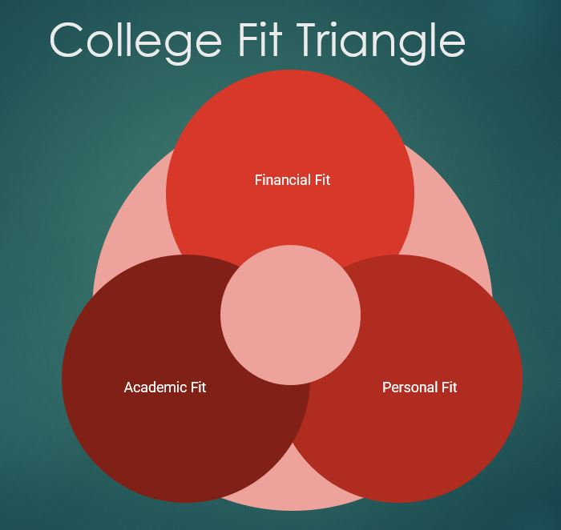
What is a good fit college?
Notes:
Location/environment you like; academics you are interested in; will be appropriately challenging; offers academic and career pursuits you are interested in: internships, research opportunities, career placement) is affordable for your family. Has activities you’re interested in.

Slide 6

The List
Narrowing down the search
  Pay close attention to the details that are important to you.
  Try to picture yourself on campus or in class.
Organize schools based on academics: Safety, Match, Reach. The bulk of your schools should be Matches and Safeties.
  Safety: A school in which a student is well above the average admissions statistics.
  Match: A school in which a student is matching the average admissions statistics.
  Reach: A school in which a student is well below the average admissions statistics.
Organize schools based on finances
  Have a “financial safety” in each section of safety, match, or reach.
Be Realistic
Taking Stock
  Temper Hope with Reality: What are my reasonable chances?
  Compare your record: Look at published admission standards & patterns.
  Assess supply and demand: Determine space vs. size of pool, distribution, etc.
  Discuss finances: The sooner the better!

Slide 7

College Search: Resources
Naviance
College Board and other online resources
College Fairs
College and Career Center

Slide 8

Community College
To enroll as a college student at any of the 116 colleges, must be EITHER 18 years old or be a high school graduate
No ACT/SAT required
Applications and registration are done in the spring. Tuition is currently $46 per unit plus fees
Generally, 60 units are required to transfer from community college to a UC/CSU
Many UC campuses offer a TAG (transfer admission guarantee) with a 3.0-3.4 GPA and 60 completed general education units

Slide 9

Testing
UC and CSU have permanently eliminated testing
SAT Subject tests and Essay are no longer offered
ACT or SAT is accepted at every college in the U.S.

Slide 10
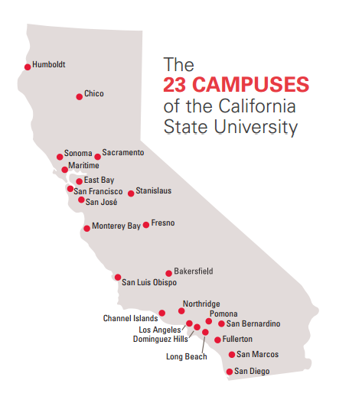
California State University System
23 Campuses throughout CA with a more career focused approach than UC.
How competitive admissions is varies by campus
Application window: October 1-November 30
Students must meet coursework (A-G List), and GPA (2.5 required to be eligible but 2.0-2.5 will be considered) No essay or short answers on application=simple data entry. All info is self-reported.
Qualifying Tam District students are automatic admits to SFSU and Sonoma State-but student MUST apply

Slide 11

University of California
9 Undergraduate campuses:( Berkeley, Davis, Santa Cruz, Merced, Santa Barbara, UCLA, Riverside, Irvine and San Diego)
Research and theory often more of a focus compared to the what one might typically experience at a CSU.
Applications go online on August 1st and can be filed October 1-November 30.
Students must meet coursework (A-G List) and GPA requirement of a 3.0 in the 15 A-G classes
UC Merced has been accepting all students that meet minimum eligibility.

Slide 12

Letters of Recommendation & Counselor Letter
(Mostly for Private Schools)
Student should expect to complete a Letter of Recommendation packet. (On Tamiscal’s website)
Pay attention to your counselor’s deadlines
No Letters of Rec needed for UC or CSU and most out of state public schools

Slide 13

The Common Application
Complete one application for over 1000 private and public schools
Students answer school specific questions & may have more writing
All high schools hold workshops on completing the Common App
One copy of student’s transcript, LOR, school profile and counselor letter are uploaded to Common App
Students invite teachers electronically and teachers submit letters directly to the Common App
Students must pay application fee per school

Slide 14

Out of State Public Schools
Generally less expensive than private school
Usually do not require letters of recommendation
Unless school is on the Common Application, students must send transcripts to each school if required

Slide 15
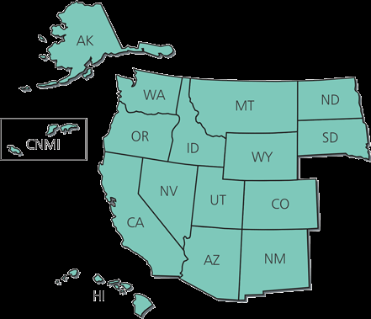
WUE http://wiche.edu/wue
Western Undergraduate Exchange
Allows CA students to attend a variety of public schools in the west for 150% of the in-state rate
Many schools have major and/or GPA restrictions but there are some that award WUE to all qualifying students
Apply as early as possible

Slide 16

Financial Aid!!!
Financial aid consists of grants, scholarships and loans from federal government, state and school
FAFSA is starting point for all federal aid
FAFSA may be submitted started October 1st, 2024 and will use income information from 2023
Deadline for most CA public schools is March 2nd
Workshops through 10,000 Degrees to help students and parents complete FAFSA
Aid is available for most certificate programs and community colleges, as well as four year schools

Slide 17

Net Price Calculator
Net Price Calculator: Net price refers to the difference between the colleges' average Total Cost of Attendance (tuition and fees, room and board, books and other expenses) for first-time students less the amount of need and merit-based grant aid estimated to be awarded. It's the amount you'd be expected to pay after the college awards you financial aid.
Every college is required to have a Net Price Calculator on their website.

Slide 18

The Junior Conference
Sign-ups start in late January
Tamiscal students schedule a private one hour conference which includes the student and parents

Slide 19

Do I need a Junior Conference?
Yes! This is your opportunity to get individual answers and advice
The meeting starts with a review of the student’s transcript and academic progress
Topics we cover in depth include: developing the college list, UC and/or CSU programs, testing, community college, financial aid and options other than college

Slide 20

Thank you!!

