Slide 1

How To Structure And
Plan A Presentation
Giulia Welch, MPA
Dominican University

Slide 2

Why Do We Communicate?
Be clear on your purpose
https://www.youtube.com/watch?v=-4EDhdAHrOg

Slide 3
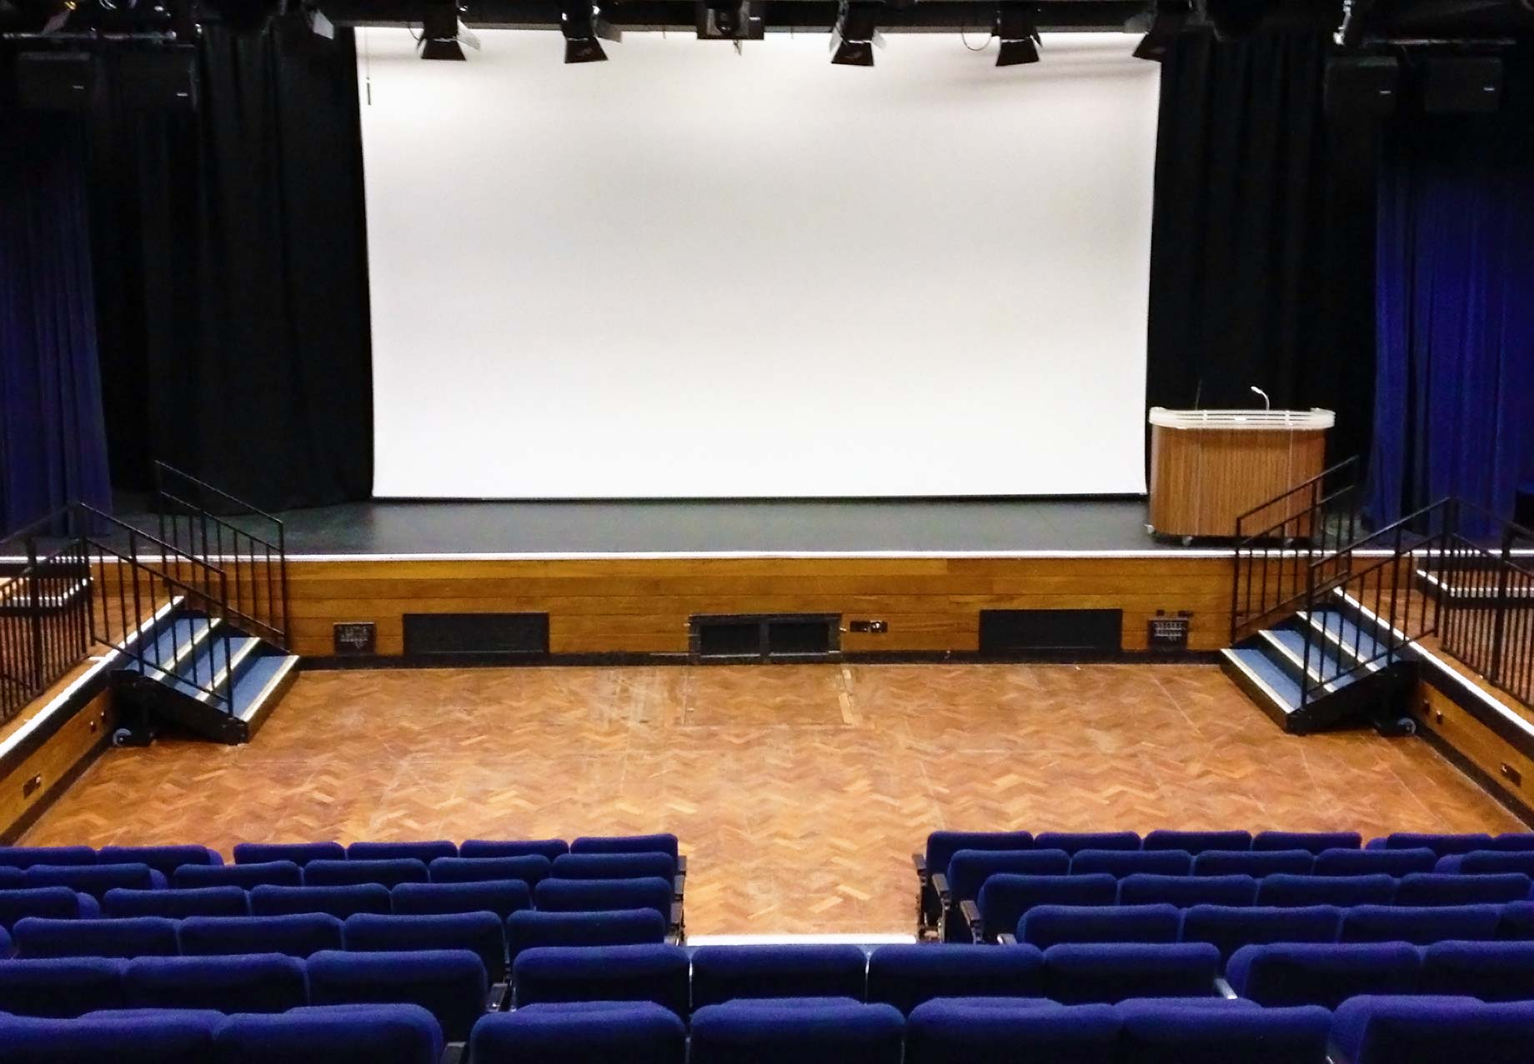
Today We Will Cover…
How we communicate
How Presentations Are Different
How to structure effective presentation
How to deliver an effective presentation

Slide 4
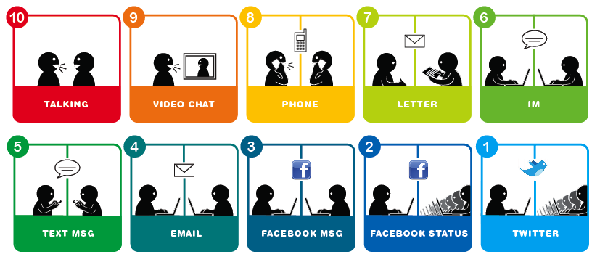
How Do We Communicate?

Slide 5

How Are Presentations Different?

Slide 6
Design for Understanding
Presenter
Message
Support
Logic
Structure
Environment
Delivery
Message
Support
Logic
Structure
Delivery
Environment
Audience

Slide 7
The PASED Method for Presentation Development
Purpose
Audience
Strategy
Environment
Delivery

Slide 8


Define The Presenter's Purpose
Clearly define your purpose
Have one major goal
If you can not say it in one sentence, it is not clear enough

Slide 9
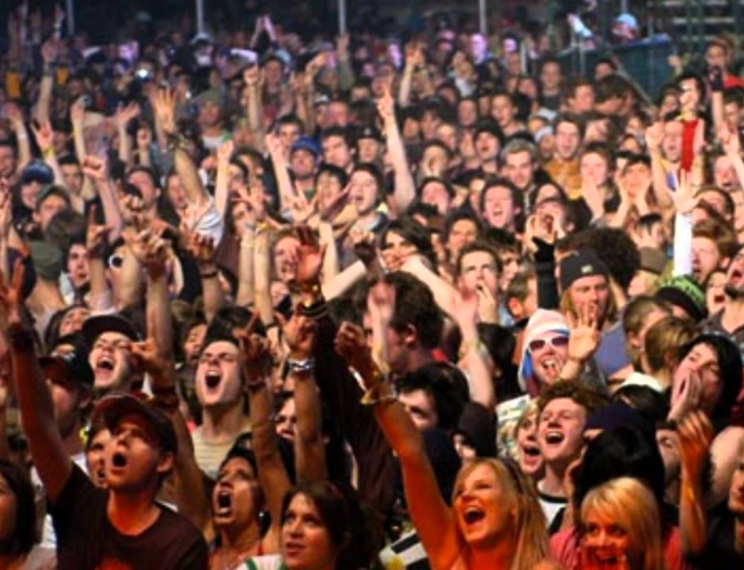
Analyze Your Audience
What are their needs?
What approach will they respond to?
Design your presentation strategy to fit the audience

Slide 10

Strategy Must Facilitate Message
How can you best present your information?
How should you organize your material?

Slide 11

Environment Key To Delivery
Where is the presentation being delivered?
Is it comfortable and welcoming?
What staging lighting and sound considerations must me included?

Slide 12

Delivery Spelled With P
Practice, Practice, Practice!
Plan your use of voice gesture and movement
Arrive early and get comfortable

Slide 13
Simple Structure Is Best
Introduction
Research Question
Supporting Arguments
Supporting Arguments
Conclusion
Tell them at you are going to tell them
Tell them
Tell them what you told them
https://www.youtube.com/watch?v=XLs78Or59gg

Slide 14

Open With A Hook
Attention getting message
  Share an anecdote
  Make an analogy
  Offer a startling fact or statistic
  Cite a quotation
  Unusual detail
  Begin a dialog
  http://www.youtube.com/watch?v=EHWRkuDlNOE&feature=gv#

Slide 15

Presentation Road Maps Help Keep the
Presenter and Audience Anchored
Slide 1
Title
Identify Presenter
Slide 2
Attention
Getter
Slide 3
Roadmap
Review Main Points
Slide 4
Supporting points & Examples
Slide 5
Supporting points & Examples
Slide 6
Supporting points & Examples
Slide 7
Conclusions
Slide 8
References
Use a story board to organize your thoughts

Slide 16
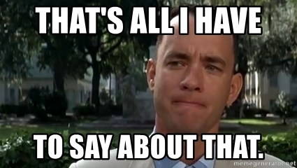
Conclusion Is The Most Important
Do not say: Ok that’s it – any questions?
What do you want the audience to walk away with?
Plan your final point ahead of time.
Conclude with a strong point, pause, thank the audience, and then solicit questions.

Slide 17
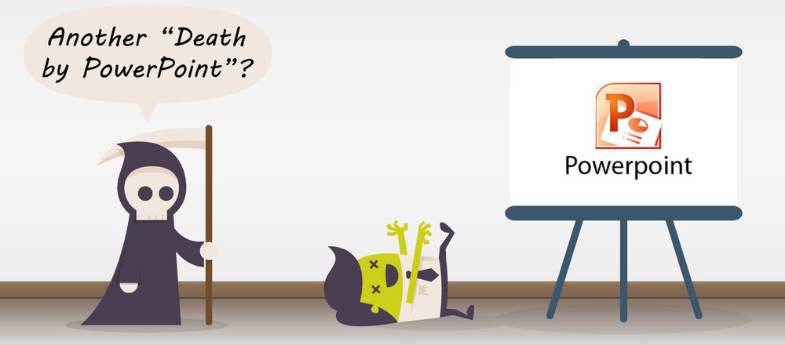
Use Visuals To Enhance Slides
  Concepts require simplification
  Words are not enough or accurate
  Visuals will help you sell
  Audience attention span is limited
https://www.youtube.com/watch?v=KbSPPFYxx3o

Slide 18
Design Gives First Impression
Fonts
  Must be used in a consistent and cautions fashion
Backgrounds
  Serve no purpose other than to affect visual appeal
Whitespace
Color
  Creates visual appeal and variation but can wash out on Projection
Audio ♪ ♫ ♫ ♪ ♫ ♪ ♪
  Tool or just noise?

Slide 19

Action Headers Lead the Way
A properly composed action header:
  Reveals content and message
  Grabs the audience’s attention
  Draws conclusions
  Uses active verbs
  Creates skim value
  Delivers the bottom line
"Let me ‘splain… no, there is too much. let me sum up.” – Inigo Montoya

Slide 20

There's A Reason We know These…
"We try harder”
"Every kiss begins with Kay”
"Think different"
"Got milk?"
"Imagination at work"
"When it absolutely positively has to be there overnight“
“Maybe she’s born with it …”
“I’m loving it“
“Good to the last drop"
“What happens here, stays here…”
"Breakfast of champions"
"Just do it“
“You’re in good hands”

Slide 21
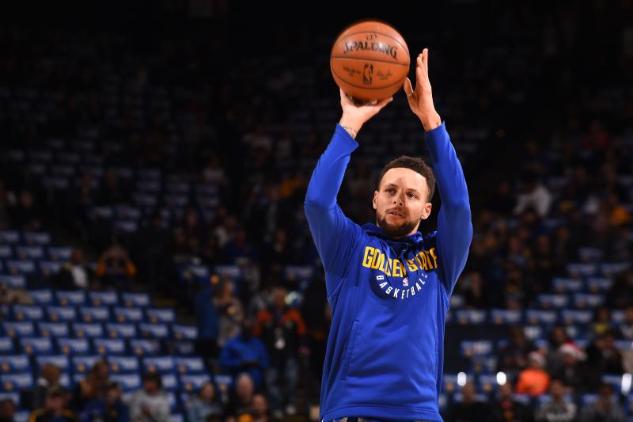
3Ps: Practice, Practice, Practice
The More You
Sweat In Practice,
The Less You
Bleed In Battle

Slide 22

Eight Steps To An Effective Practice
Practice at site or similar venue
Envision the audience
Set-up any support materials/technology
Review and outline of the presentation
Time each practice
Deliver the presentation
  Get video or live if possible
Make changes
Repeat

Slide 23

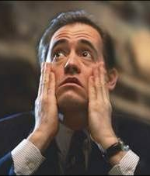
What Does Nervousness Look Like?

Slide 24

The “7-38-55” Rule of
Personal Communication
Actual Wording/Content
7%
38%
55%
Vocal
Characteristics
Body
Language

Slide 25

Key Aspects Of Voice
Volume
Speed
Tone
Range
Emphasis
Enunciation
Verbal Crutches
Slang idioms

Slide 26
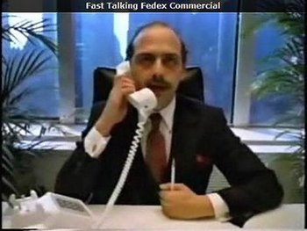
The Fast Talker Cycle
Speed kills!
  Increased Speech Speed
  Faster breathing
  Increased Speech Speed
  Faster breathing
  Increased Speech Speed
  Faster breathing
Too Slow Bores the audience!
http://www.youtube.com/watch?v=NeK5ZjtpO-M

Slide 27

Speaker Presence
Begin standing on the right
Interact with slides
Interact with audience
  Ask questions
  Allow time for discussion
Do not read word for word
Make eye contact
  (but don’t be creepy)

Slide 28
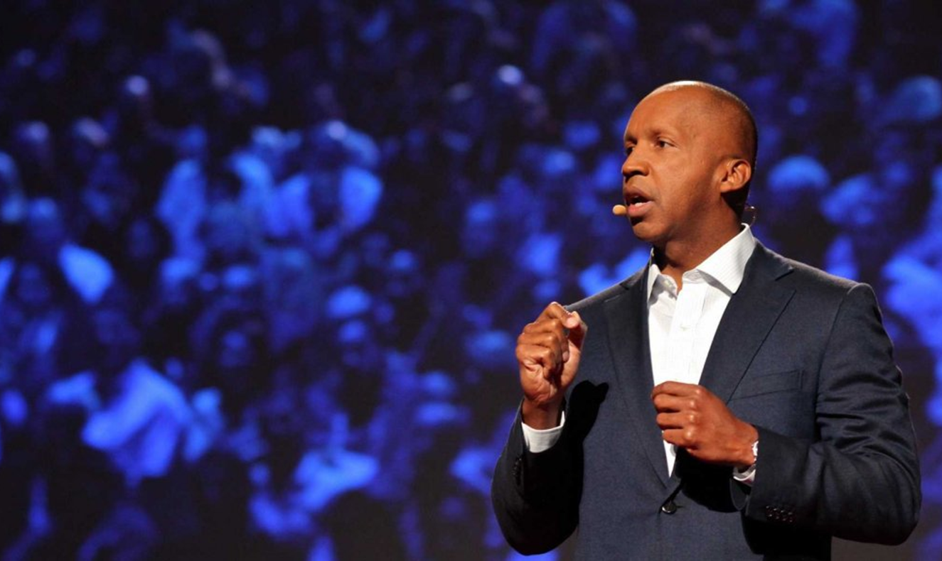
What Have You Learned?
Effective speakers are not necessarily born that way

Slide 29
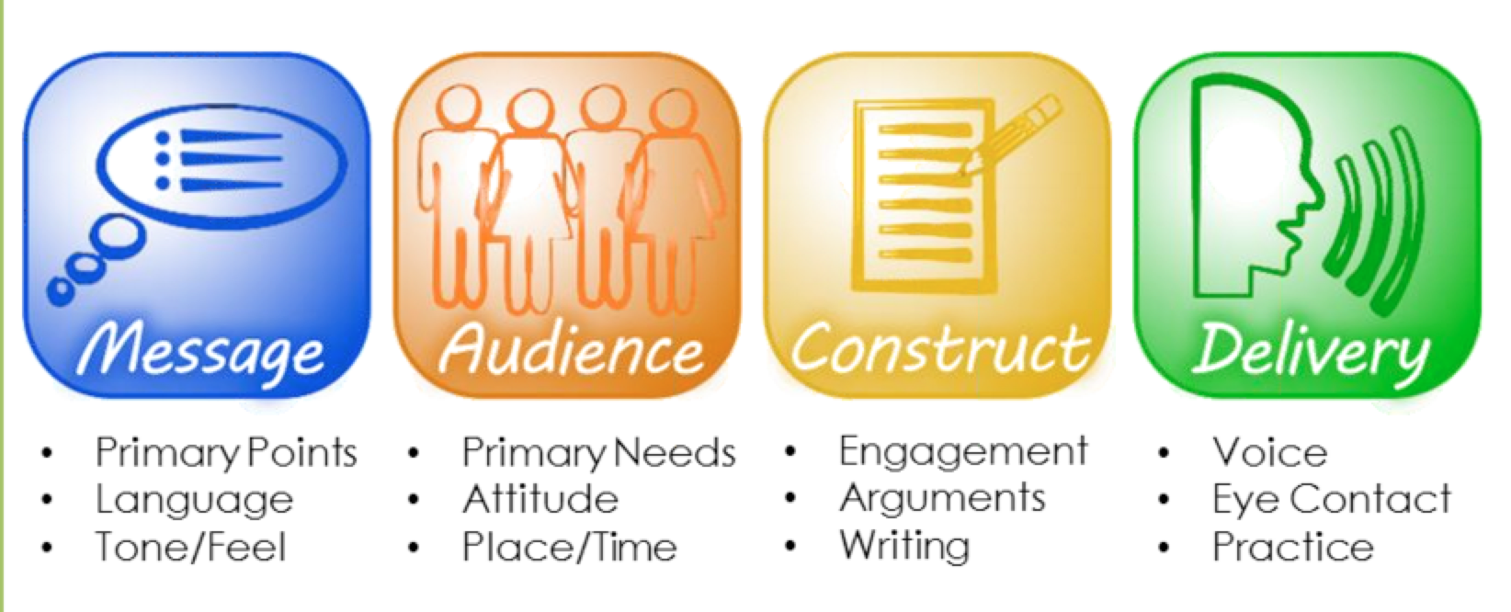
You Can Improve With Practice!

Slide 30
Sources
Young, Dona J. (2006). Foundations of Business Communications, An Interactive Approach. New York, NY: McGraw Hill - Irwin.
Adler, Ronald B. & Elmhorst, Jeanne Marquardt (2008). Communicating at Work, Principles and Practices for Business and the Professions (9th ed.). New York, NY: McGraw Hill - Irwin.
Rose, K. (2007). Power Language: Effective Communication for Executive Development. Ann Arbor: XanEdu Original Works.
Leeds, C. (2008). Effective Communication through Presentations. Ann Arbor: XanEdu Original Works.

