Slide 1
Next Steps for Seniors
College of Marin

Slide 2


Slide 3
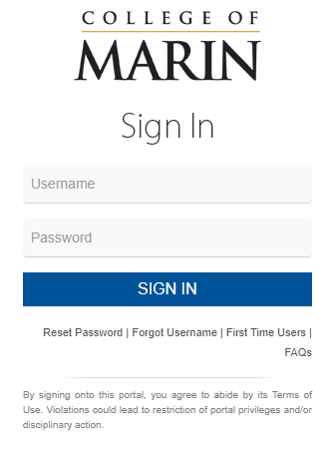

Set Up MyCOM Portal
Log-In info was sent to you
via email
ID Number and Username
First Time Users link
Access to CANVAS (app available for download)

Slide 4
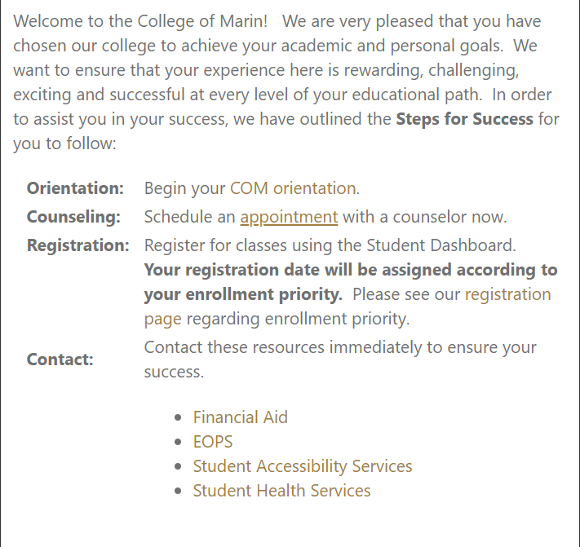
Complete Student Orientation

Slide 5
Counseling – Ed Plan
Make an Appointment now
Follow the link here: General Counseling
Select classes for Summer and Fall Semesters
Crucial step for Priority Registration

Slide 6
Register for
College Success Saturday
Gain early Priority by Signing up for CSS
  bit.ly/comcss21
Saturday, May 1st

Slide 7

Summer Bridge
Summer College Prep
        June 14 – July 1
  July 6 – July 22
Earn 1 transferable unit
Get ready to start at COM
ESL section available
  June 14 – July 22

Slide 8
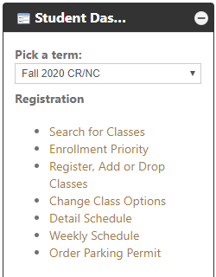
Registering for Classes
Enroll in your class through your MyCOM portal
You can pay Student Fees via the MyCOM portal

Slide 9
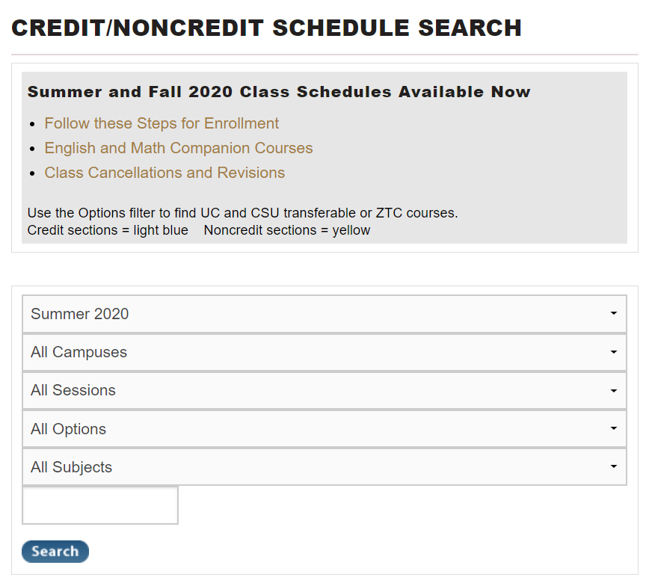
Summer/
Fall 2021 Schedules available soon

Slide 10
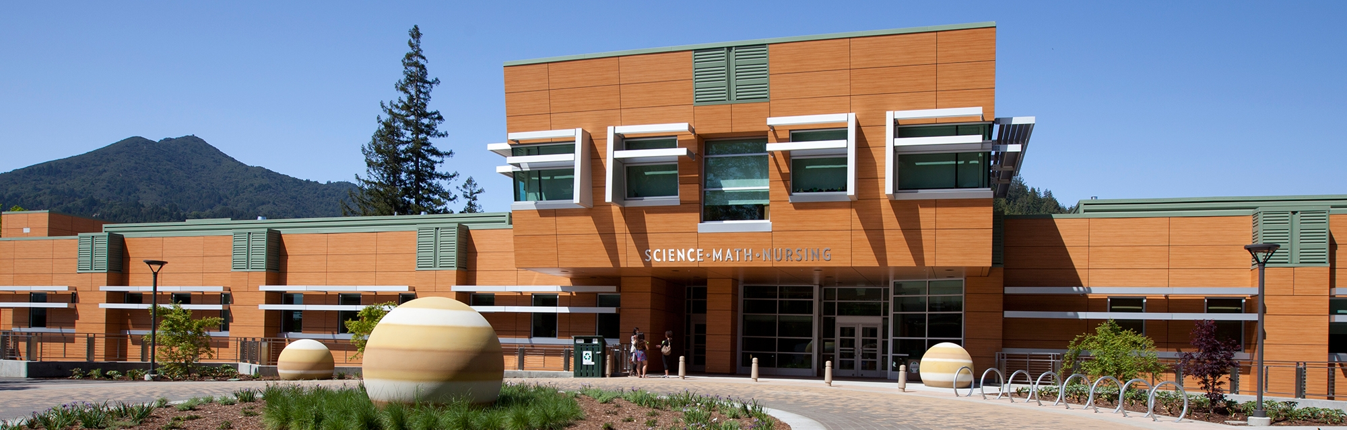
Questions?
Please email outreach@marin.edu

