Slide 1

Advanced Math and Science Academy Charter School
Charter Renewal
2025-2030

Slide 2
Renewal Process Timeline
Renewal Application
Renewal Inspection Visit
Summary of Review
School Response
Commissioner Approval
Accountability Plan

Slide 3

The Application is an opportunity for AMSA to present evidence of the school’s performance during the current charter term in three areas:

Slide 4
Faithfulness to the terms of the charter
Academic program success
Organizational viability

Slide 5
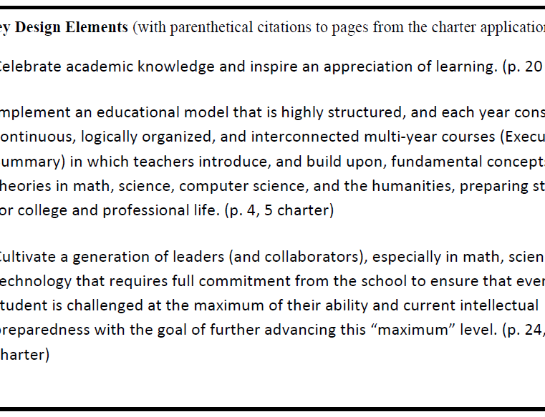
Faithfulness to the terms of the charter
Mission and Key Design Elements
Access and Equity
Compliance
Dissemination

Slide 6
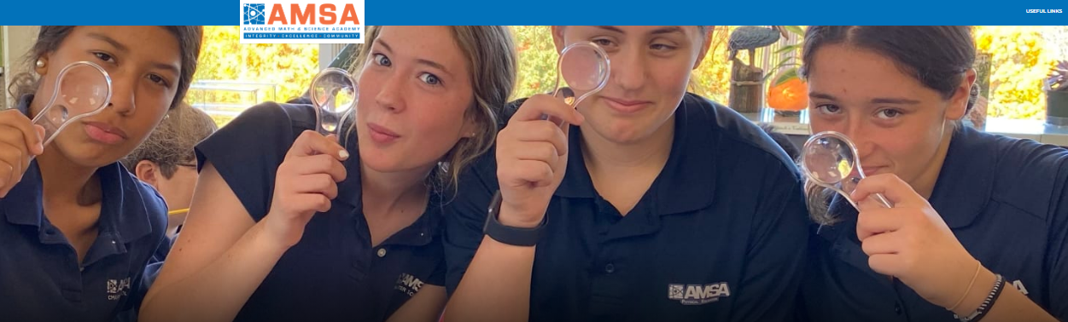

Academic Program Success
Student Performance
Program Delivery
School Climate and Family Engagement

Slide 7

Organizational Viability
Capacity
School Systems and Leadership Professional Climate and Standards for Performance
Governance
Responsibilities of the Board of Trustees
Financial Stability

Slide 8
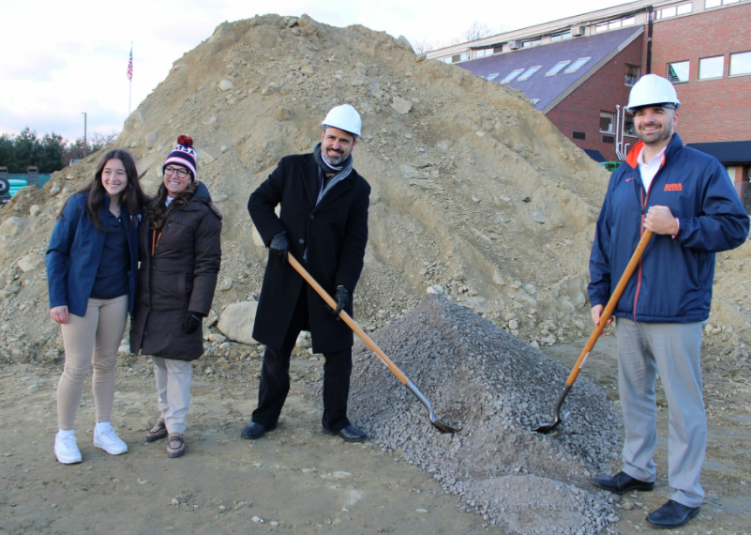
Plans for the next five years… building a future

Slide 9
The Department will review the application and prepare a
Renewal Inspection Template
AMSA is required to submit documents to the Department by August 5, 2024, that will include class schedules, recruitment materials, translated documents, staff roster, classroom observation form, Org Chart, all Board Minutes and Committee Minutes for the 2023-2024 school year, current Bylaws, Board Self-Evaluation, School Leader Evaluation, Student Data, Strategic Plan (if available), Board Succession Plan, School Leader Succession Plan, etc.

Slide 10

Renewal Inspection Visit
The SchoolWorks Inspection Team will conduct a one-day review in early September 2024, gathering evidence related to the following criteria and indicators:
Mission and Key Design Elements
Instruction
Governance

Slide 11

Site Visit
Focus Groups
Board of Trustees
School Leaders and Administrators
Teachers

Slide 12

Summary of Review and School Response
AMSA may correct any factual errors in the Summary of Review
If we disagree with a finding, we may provide an addendum to the report.

Slide 13

Possible Outcomes
Renewal
Renewal with conditions
Renewal with probation
Non-renewal

Slide 14
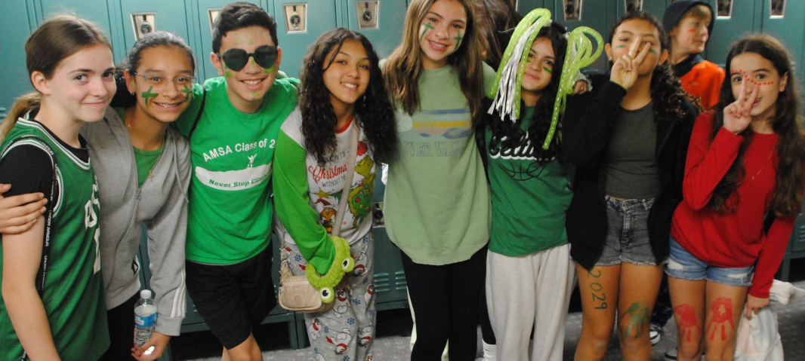
Accountability Plan 2025-2030 …will be created for these kiddos

Slide 15
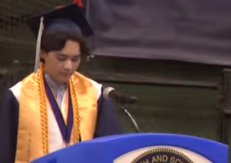
Class of 2024
Valedictorian
Ian Gifford

Slide 16

