Slide 1

WELCOME!
PURCHASING
TRAINING
August 7, 2023

Slide 2



Thank you so much to the following Sponsors!
Educator’s Depot - Breakfast Sponsor
BuyBoard – Lunch Sponsor
Kona Ice – Afternoon Snow Cones

Slide 3


Welcome Connie Burkett from BuyBoard (TASB)

Slide 4

Welcome Jeff Drury (Choice Partners)
Choice Partners national cooperative contracts include:
Facility contracts to meet needs for repair, remediation, renovation, and remodeling.
Supplies, including a unique school supply catalog.
Service contracts
Food contracts for bread, dairy, grocery, produce, and cleaning/ware washing products.
Technology products, cloud services, software, consulting, and resources for today's electronic demands.

Slide 5

Welcome Dean Overdyk from Amazon Business

Slide 6
Purchasing - Who to contact
Title - Duties | Name | Ext.
Director | Carmella Shafer | 5408
Buyer/Textbook Specialist–Bids, Textbooks, Records Retention, PO Approvals over $500, Commodity Codes, Federal Funds | Jennifer Hairell | 5449
Purchasing Specialist– Produces POs, Outgoing Shipping (FedEx/UPS), Warehouse Catalog/Inventory, New Product Request, Commodity Codes, Federal Funds | Jennifer Byroad (Jenn) | 5820
Purchasing Specialist– Produces POs, New Vendor Setup, Vendor Updates, Deposit/Change Order Pick up, Awarded Vendors List, Commodity Codes, Federal Funds | Adrienne Watson | 5408
Warehouse Supervisor – Central Receiving, Deliveries, Surplus, Warehouse Requisitions, Records Retention | Jarius San Angelo | 5541
Lead Warehouse Courier | Chris Lightsey | 5696

Slide 7
Purchasing Website
-Useful Links
Procedures Manual
How to Enter a Requisition
Awarded Vendors/Contracts & Cooperatives Google Documents
Commodity Codes (Like Items) Google Documents
New Product Request Form
Asset Deletion Form
If there is something you would like us to add, just let us know

Slide 8
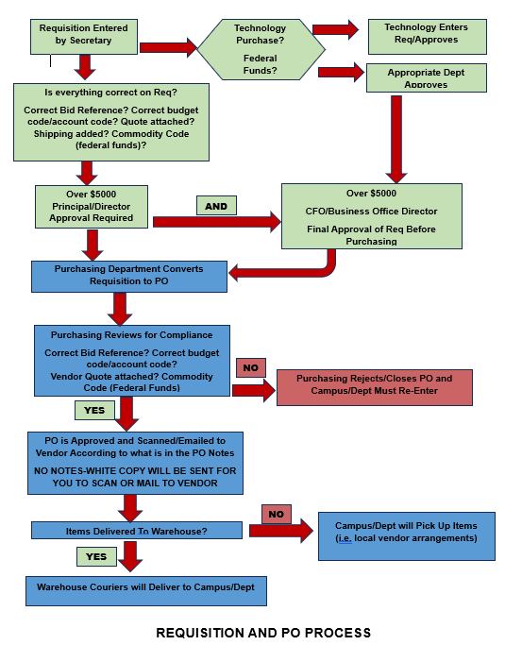

Slide 9
Requisition to PO Process
Requisitions are converted to POs every morning and printed at 7:30 am
Once a requisition has been approved, it will be ready to convert/print. It will not be converted if it is still requiring an approval. If any questions, please call Jenn or Adrienne
“Needs Corrections” – If you approved requisition and it has not been converted to a PO, you can call Jenn or Adrienne and request that it be returned to you. This allows you to correct a requisition before it is converted to a PO.
“Needs Corrections” report (be sure to check this first thing in morning)
Notes:
You can also check to see if any approvals screen to see the status of requisitions that needs corrections.

Slide 10
Requisitions – Common errors and Omissions
No Bid, Co-op, or Quotes in the comments,
Expired/Wrong Bid (Always Use Awarded Vendor Google Doc)
Items purchased do not fall into category of bid referenced
Notes missing ordering instructions (“Scan to [vendor’s email]”).
Must have email (no FAX numbers). Be specific.
Inadequate descriptions of items being purchased. Should include description as well as item number, if available.
Items should be listed individually on the PO.
No quotes attached in eFinance or the quote is expired
No freight/shipping charges entered (estimate shipping if uncertain)
  Email rep the cart and request formal quote with shipping
Notes:
Exceptions-library books, online orders (Amazon, Wilton’s…)

Slide 11
Needs Corrections-Requisition Status
BUD CODE-BUDGET CODE
ACCT CODE-ACCOUNT CODE
BID REF-ADD BID REFERENCE
COMM CODE-COMMODITY CODE
SHIPPING-ADD SHIPPING
LINE ITEM DESCRIPTION-MISSING DETAILS
NOTES-MISSING OR QUOTE NOT ATTACHED OR QUOTE # MISSING
Notes:
Jenn and A will discuss specifics. Bid reference missing, incomplete, expired or wrong…. Go to Req approval screen to see if anything out there

Slide 12
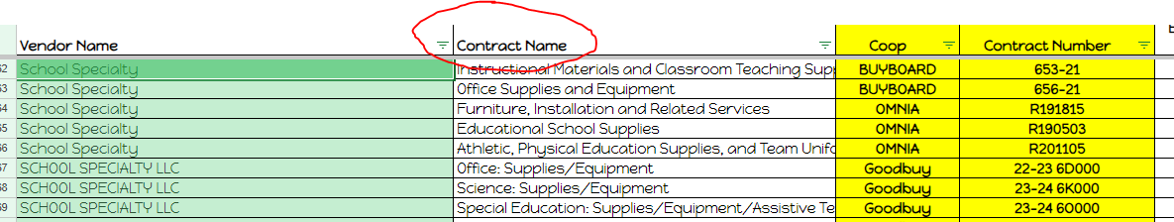
Choosing the Correct Bid Reference
Look at your quote—always use the bid reference on the quote.
2. What are you ordering? Who is it for? Look at Contract Name
on the Google Doc to help choose.
Always use our current “live” version of Awarded Vendors
And Contracts List/Spreadsheet when choosing bid reference

Slide 13
NOTES Section of PO:
Include order number, quote #, cart #, RPO, etc.
Scan to [email]…give the email address
If ordering instructions are not included, then you will receive the white copy of the PO to place the order yourself
Put a blank line before and after the notes to make them more visible
Document in notes if check needs to be sent to a specific person or campus/department
If RPO, include type of items ordered/dept (i.e. instructional supplies, nurse supplies, counselor, classroom, office, etc…)
Not in “Comments” Section – Bid Reference
NO
T
E
S
S
E
C
T
I
O
N
NO
T
E
S
S
E
C
T
I
O
N
Notes:
RPO—express how specific we want them to be. Instructional, office supplies, nurse, counselor supplies—be specific

Slide 14
Running Purchase Orders (RPO)
All RPOs must have “RPO” in the NOTES section
Line item description should have items being ordered
(i.e. “Food/drink for staff development lunch for June”)
Be specific as to who it is for (instr. staff, administration, students?)
Tracking PO balance: When you have a charge on a RPO, make a white copy of the PO, write partial pay, the date, who/for what and amount on the PO (don't use the ''extension'' column on the right of the PO), sign and date the PO, attach receipt, and send to the Business Office for payment.
The green copy should be sent Business Office when the balance
on the PO is too low to use again.
Keep a running total as we cannot pay over the RPO amount.
Notes:
Talk about specifics—function code matches description, etc

Slide 15
Requisitions
– Description & Attachments
1st 21 characters of description print on the check stub, your reports, and check register.
Catering - include the who, what, when, where, why
Attachments to include in efinance:
  Quotes (double check for current shipping, bid/contract #, expiration date)
  Registration forms
  Order forms
  Invoices (should be rare)
Notes:
We have a lot of people not attaching quotes and we NEED the quotes attached.

Slide 16
Door prizes!
Remember Bid Reference
Did you remember Bid Reference ???

Slide 17
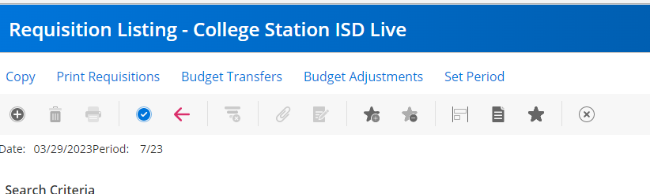
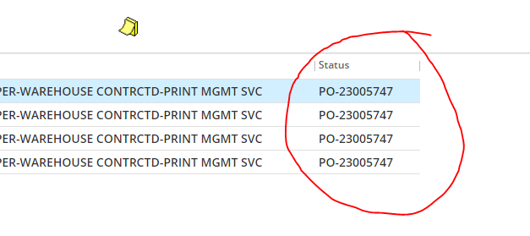
REQUISITION APPROVAL STATUS IN EFINANCE
1. Open Requisition Listing-looks like this…
Enter Req number and hit enter.
Double click Req to open it.
If you see a PO number in the Status box, it has already been
converted/printed and no further approval needed.

Slide 18
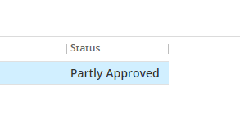
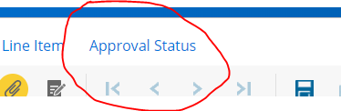
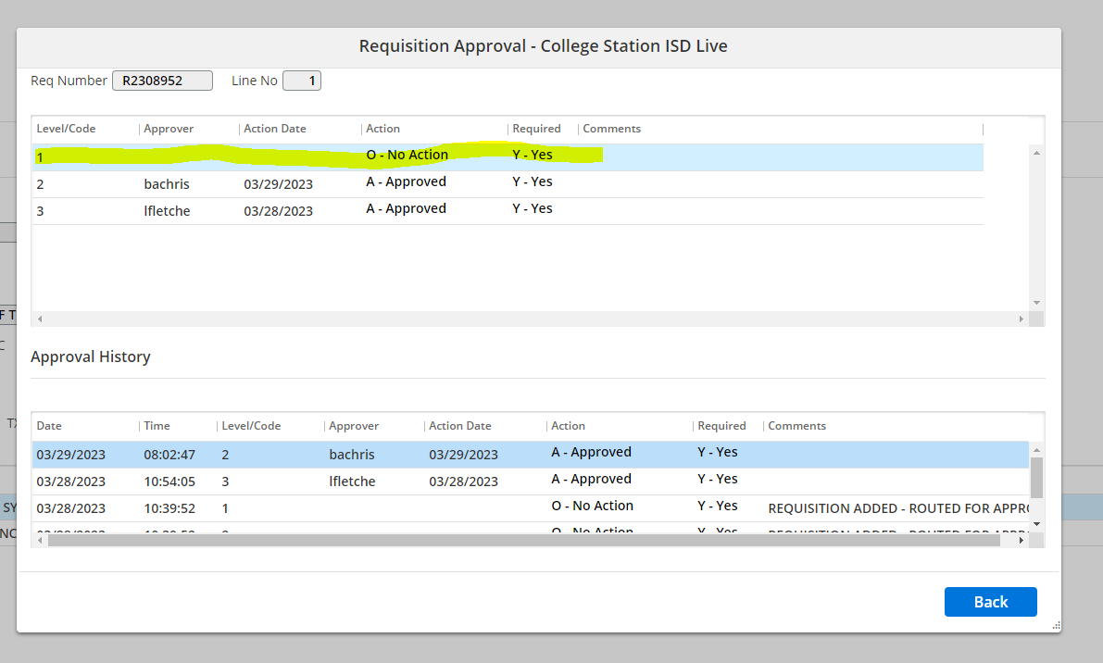
REQUISITION APPROVAL STATUS CONTINUED
If you see “Partly Approved” in Status box, it is waiting on approval
from someone.
Click on the item and you will see “Approval Status” at the top
of the page. Click on that.
7. This box will open.

Slide 19
In the example above, you can see that the secretary (Level/Code 3) has approved it as well as Level/Code 2 approver and is waiting on one more approval –Level/Code 1 (highlighted). This example only has 3 levels of approval. Some campuses/departments could have up to 5 levels of approval based on what the funds are used for as well as if the purchase is over $5000, etc.
Level/Code 1 is always Purchasing—if you see that waiting, it is ready to be converted/printed
Level/Code 2 is always Chris Neely or Amy Drozd.
Level Code 3 is usually the principal/director if it is over $5000 or specific person that is designated (could also be a dept secretary in some cases)
Level/Code 4 is for a campus/department secretary who entered it or is the next approver (Most campus/dept secretaries will be at this level)
Level/Code 5 is usually the person that entered the requisition (first approver)—this code is usually only on requisitions using federal funds (i.e. Title I)

Slide 20
Purchase Order Change Requests
(Change Orders)
Email: Reason(s) for the change, PO # etc
Budget code changes
  Please mark changes on your PO copy, scan to purchasing@csisd.org for the changes to be made
Additional Shipping
  If you forgot your shipping, please contact purchasing@csisd.org to add shipping charges to PO
Pricing or Quantity Changes
  should be very rare and only due to an error
  Mark on your greens and scan to purchasing@csisd.org

Slide 21
Cancelling or Voiding a PO
If you have the white/green/yellow copies, the PO will need to be voided by the business office
Write on the front of the PO why it is being cancelled along with your signature and the date—send to BO
PO’s will not be voided for items that have been shipped and returned/refunded – invoice will need to be paid and credit memo applied to close out the PO
If the order was placed and then cancelled before anything was shipped, attach confirmation from the vendor that the order was cancelled
Notes:
If we don’t have all 4 copies in our office, they need to contact business office to cancel/void a PO

Slide 22
Important Dates/Deadlines
August 17th – Last day to enter requisition to vendors for catering to be used through 8/31.
August 24th - Last day to enter online orders to Amazon, ODP, Staples, Michaels, Lowes, etc
August 24th - Last day to enter any req for this year! Please check with the BO for any vendors that may have an earlier cut-off date
August 24th - Last day to enter requisitions for local orders. A very limited number of vendors and items must be picked up and invoices delivered to the Business Office ASAP for payment.
August 28th - Warehouse orders- Please enter all final warehouse orders by 2:00 p.m.!!!

Slide 23

Remember Shipping

Slide 24
Outgoing Shipments
If outgoing shipping is needed AND You are Paying for it
Which company? Fed Ex or UPS
Sender: Campus/Dept, Contact Name, Contact Email
Recipient: Company Name, Contact, Address, Phone, Email
Any reference information required by recipient
Return label needed?
Insurance? (if yes, give estimated value)
Dimensions and weight (Jennifer Byroad can estimate if needed)
Create a requisition to UPS or Fed Ex
Send all of the above info to jbyroad@csisd.org
A label will be created once this info has been received

Slide 25
Registration
Conference/Event Registration being paid with a Purchase Order
Include on requisition:
  Who is going, where to, date of event, cost
  Enter a separate line item for each person.
  Please note if it needs to be paid in advance. If not, it will be paid after invoice is rec’d
  Have PO with registration attachments scanned to vendor when possible (put this in “Notes” on requisition)

Slide 26
Amazon
Remember, order deletes from Amazon in 7 days if not approved—we will not approve if a requisition has not been entered
Paste Amazon order numbers into the requisition notes
Your requisition total MUST match your cart total (remember to include shipping and discounts)
If any items are available in warehouse, they will be removed from your order
Track your orders closely to ensure timely payment
Request refunds from Amazon ASAP for items missing, damaged, or lost in transit

Slide 27
Awarded Vendors
Awarded Vendors/Contracts and Cooperatives
How do I know which bid/contract to use if under more than one?
Be sure to read the description/summary to determine if it matches the items being purchased
Always use the LIVE version of our list on Google drive—don’t save or download it as it is updated on a regular basis
  Control-F is very handy!
Notes:
Email rep and ask what is the best pricing based on the following purchasing contracts? (Buyboard, Epic 6, TIPS, etc) Always use first tab as your default search for vendors

Slide 28
Quotes:
When should one be requested?
Always if you want to stretch your budget further (recommended)
We have over 10,318 vendors currently awarded under a district or Co-op bid.
Vendors have the flexibility to quote better prices than what was originally submitted with the bid. We have seen a savings of over $20,000 on one quote.
With the use of email getting quotes is now easier than ever.
  Email multiple vendors using (BCC) at the same time to request quotes.
  Email the vendors and thank them for their quote, that you have selected a vendor with a better value, and that you will contact them for future orders.
Notes:
Pull up email to show how to easily access drive and show how to set up an email template

Slide 29
Quotes:
When is it required?
Always if you are not using an awarded vendor no matter how much the requisition is.
Requisitions $50,000 or more, required to use an awarded contract, and must go to the board before a PO or order is placed.
If using federal funds, a minimum of 2 quotes are required when the commodity code balance reaches $50,000, including the current purchase requisition.
Notes:
Pull up email to show how to easily access drive and show how to set up an email template

Slide 30

Door prizes!
Remember to add shipping!!!!

Slide 31
CSISD Vendor Performance Quality Report
Vendor Performance Quality Report
Short survey about vendor performance
Take a few minutes and let us know if you are having a problem with one of our vendors.
Need to know: Vendor Name & eFinance #, Vendor contact, PO#, Delivery dates, Item Numbers and Bid Reference.
There will be a place to attach any supporting data (pictures, samples etc.) This is strictly optional.
Good or services that are unsatisfactory.
Technically the warehouse is one of your vendors so feel free to use this to let us know about product or service issues with warehouse items also.
Notes:
Let us know how our vendors are performing—good or bad?

Slide 32
Warehouse Orders
As always, please check warehouse inventory before placing orders with other vendors—if we have it in warehouse, it needs to be ordered from the warehouse
Warehouse Returns—email Jarius (jsanangelo@csisd.org)
or Chris (clightsey@csisd.org). Include warehouse request #, stock #, quantity and description of items being returned
Exchanges are not possible - Enter a new request for the correct item
If there is an item we don’t carry in the warehouse and you would like to request it, please fill out the New Product Request Form
If any items are available in warehouse, they will be removed from your order
Notes:
Optional :candy bar, chips or drink accepted in lieu of a restocking fee!!

Slide 33
Specialty Office Supplies
& Quote Requests
Astrobright paper? – contact Joe Jordan at Bosworth jtjordan@ovol.us 713 253 3773 cell Or enter a quote request at Choice Partners or Buyboard.
Need campus Envelopes, Business cards - These can be ordered on the Staples website or contact our rep: Zack Baker T: 407-475-4407 Zackary.Baker@staples.com. Much Cheaper than Alphagraphics.
When you are requesting a quote include the following:
State the items needed (include any identifying numbers)
State the quantity
Tell them the date and time you need the quote
Ask them to give you the best pricing based on a CSISD bid or one of the coop bids – find on the awarded vendor list
If you are getting quotes from multiple vendors just enter the email for each vendor in bcc
Door prizes!
Notes:
When you need that specific color of astrobright paper and it isn’t available in the warehouse contact Joe at Bosworth.
Campus Envelopes and Business cards? Staples

Slide 34
Surplus in Warehouse
Must view in person—no email requests!
With principal’s approval, bring ID badge.
First come, first serve! You may take measurements, etc.
Work order must be entered after an item is marked for delivery.
--include campus, name and room number
No work order, no delivery. Item is still up for grabs.
Surplus Removal—mark the items that are to be removed
--if possible, move items to be removed to one location
--tape asset deletion form to the items “Form Here”
Notes:
DO NOT CALL AND ASK QUESTIONS ABOUT SIZE OR ASK ME TO TAKE PICS

Slide 35
Asset Deletion Procedures
1. Complete an Asset Deletion Form: Must have signatures in the deletion requested by and approved by lines.
2. Put in a Work Order to request the Asset Deletion.
3. Scan and attach the Asset Deletion to the Work Order in Eduphoria
4. Attach the Asset Deletion to the item(s) being deleted.
5. Warehouse supervisor will schedule pickup based on other requests.
Most likely, the items will be picked up before/after hours, so make
sure they are marked clearly and the Asset Deletion form is attached.
6. No form attached to the item(s), no pick up and work order will be
canceled/closed.

Slide 36
Records Management and Retention
Required by law and local board policy (CPC)
Identify what is being kept on paper and digitally.
What is a local gov. record? Any document, paper, letter, book, photo, tape, including digital.
What is NOT a record? Extra identical copies (convenience copies), notes, journals, diaries, and similar documents created by an employee for their own personal convenience, and blank forms.
  For example, the yellow PO copy and supporting documents. So these items do not need to be boxed up and sent to records, they can be destroyed when you no longer need them at the campus.

Slide 37
Records Management and Retention – Duties of Campus
Identify a records custodian on campus.
Records Custodian is to ensure compliance with the district’s records mgmt. plan,
Ensure all records are covered by approved retention schedules
Ensure regular, systematic file purging and rotating is established.
Identify all records by position, title or office.
Ensure retention period for a record applies to the record regardless of the medium which it is maintained
  This includes e-mail, websites, digital data.
  Unless otherwise stated, the retention period for a record is in calendar years from the date of its creation.

Slide 38
Records Management and Retention – Retention Period?
The Texas State Library and Archives Commission (TSLAC).
Two Records Schedules pertain to the school district
  The two schedules below dictate the retention period for the various records created by the district. It is very important to know what records we are required to keep and for how long.
    Schedule GR – All Local Governments (link)
    Schedule SD – Public School Districts (link)
Destruction of Records
  Unauthorized destruction is a Class A misdemeanor and potentially a 3rd degree felony.
  Only the purchasing department is authorized to destroy any required records (this does not include convenience copies/records)

Slide 39
Records Management and Retention – Destruction
Destruction of Records
  Unauthorized destruction is a Class A misdemeanor and potentially a 3rd degree felony.
  Only the purchasing department is authorized to destroy any required records at the end of the life of the record (this does not include convenience copies/records because they are not required)
  Why Destroy records?
    Storage costs money
    liability for records not destroyed.

Slide 40
Records Management and Retention – Digital
Digital Records
  There are some records that are required to be kept permanently.
    Our permanent storage is growing each year, so we need your/campuses help in determining if these permanent records are also being kept digitally or can a process be changed to keep the record digitally to reduce the required physical storage space?
  We are noticing that there are some records that are being kept digitally and in paper.
    We are only required to keep one copy of the record.
    When the time comes this fall to begin submitting records boxes for storage we are going to need more detailed information about the records to help determine the retention period, if it is a convenience copy, if it is also kept digitally (eschool, efinance, any other software?)

Slide 41

  We can Press Pause and take Response-ability for our response(s).
  Values and feelings that enable us to respond differently like: empathy, confidence, optimism, courage and calmness, to name a few.

Slide 42
Questions, Comments, Concerns
Thanks for taking the time to come to our training!
What can we do for you?
Do you need anything from us?
Here are links to our commonly used forms.
Procedures Manual
Awarded Vendors/Contracts and Cooperatives
Commodity Codes (Like Items)
New Warehouse Product Request Form

Slide 43
The High-Performer Mindset
Good, Better, Best.
Never Let it Rest.
‘Til the Good is Better.
And the Better is Best!

Slide 44







Thanks Again to All of Our Sponsors!!

Slide 45


Remember
the shipping!!!!

Slide 46


Slide 47

Door prizes!
Success
Doesn’t come from what you do Occasionally
………………………………………………...
It comes from what you do Consistently.
Door prizes!
Door prizes!
Door prizes!
Door prizes!
Door prizes!

Slide 48
Lunch Break
Thank you, BuyBoard for sponsoring our lunch today!!!!

