Slide 1
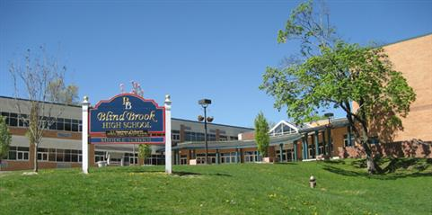
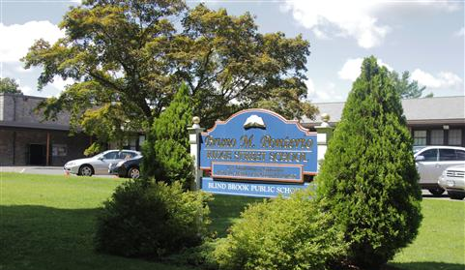
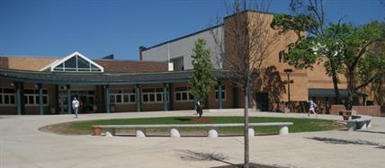
Budget Update
2019-2020
Blind Brook-Rye UFSD
April 8, 2019

Slide 2
Budget Changes since 3/18/19
With the final NYS Budget, the Blind Brook School District is projected to receive $41,872 more in State Aid for the 2019-2020 fiscal year.
Westchester County sales tax increase authorization was not included as part of the NYS Budget

Slide 3
Budget Changes since 3/18/19
The Superintendent’s recommendation is to use this $41,872 in additional state aid to reduce the amount originally proposed to come from the unassigned fund balance (appropriated surplus) to help balance the revenue budget.
State Aid Appropriated Surplus
3/18/19 3,199,927 $1,373,369
4/8/19 $3,241,799 $1,331,497
_____________________________________________________________
Difference + $41,872 - $41,872

Slide 4
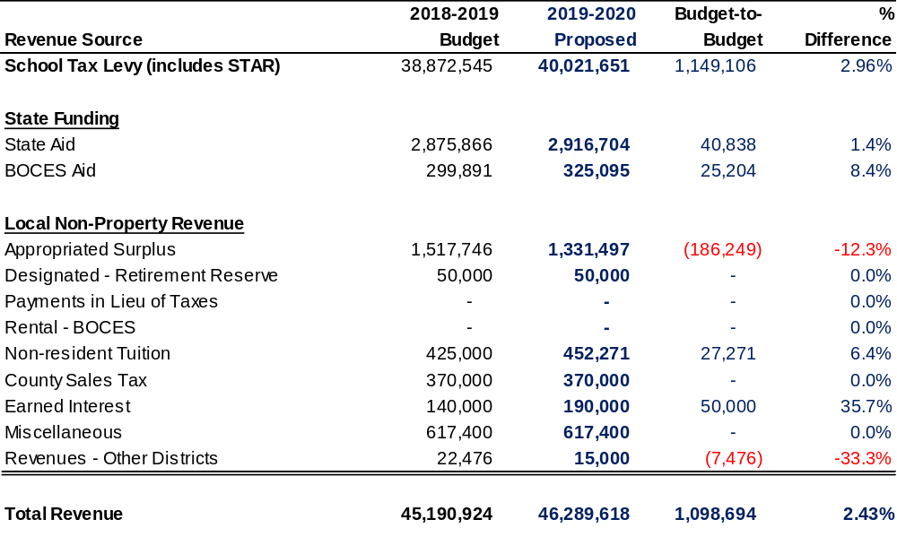

2019-2020 Proposed Revenues by Account
At the maximum allowable tax levy limit

Slide 5
Blind Brook’s Available Reserves
6/30/18 Actual 3/31/19 Actual 6/30/19 Projected
Tax Cert $368,161 $39,558 $39,558
Employee Benefit $376,413 $351,979 $351,979
Accrued Liability
Retirement Reserve $225,535 $225,535 $175,535
Unassigned $1,760,369 $1,448,369 $1,700,000
_________________________________________________________________________
Total $2,730,478 $2,065,441 $2,267,072

Slide 6
Analysis of Fund Balances Used
Amount Used Reason
Tax Cert $328,603 Tax refunds to 900 King Street & Blind Brook Club
Employee Benefit $24,434 For employee separation payments
Accrued Liability
Retirement Reserve $50,000 Amount budgeted to be used in 2018-2019
Unassigned $312,000 Transferred to Capital Fund (track repairs)
____________________________________________________________________________
Total Used $715,037
2018-2019

Slide 7
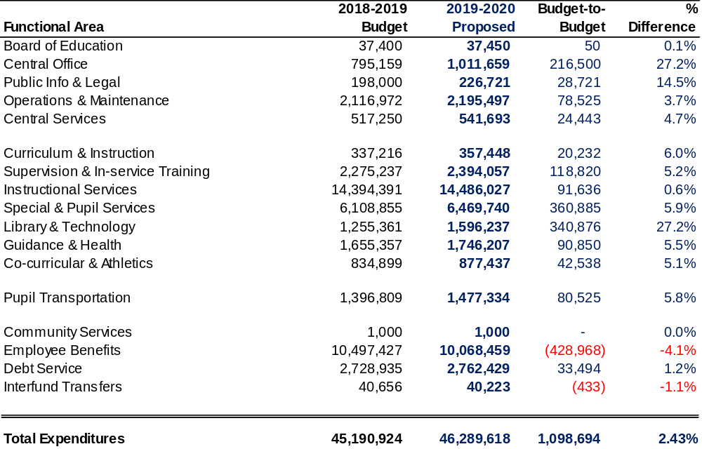
2019-2020 Proposed Expenditures by Function

Slide 8
2019-2020 Proposed Budget
2019-2020
BUDGET
Budget: $46,289,618
$ Increase: $1,098,694
% Increase: 2.43%
Tax Levy: $40,021,651
$ Increase: $1,149,106
% Increase: 2.96%
At Tax Levy Cap Limit
Budget Highlights
Core instructional programs maintained.
Significant increases in special education costs – increase in number of teacher aides and cost of BOCES out-of-district tuitions.
Urgent need to purchase new computers that are able to run Windows 10 and wiring/cabling installations related to construction projects.
Addition of a school social worker position at BMPRSS.
Addition of a School Business Official position.

Slide 9
Important Budget Decision Dates
April 15, 2019 Board Adoption of 2019-2020 Budget
April 23, 2019 BOCES 2019-2020 Budget & Board Member Vote
May 13, 2019 Public Budget Hearing
May 21, 2019 2019-2020 Budget Vote & Board Member Election

Slide 10

Board & Community Discussion

