Slide 1

2021 Bond Update
SEPTEMBER 20, 2022

Slide 2
General Bond Information
  Dates
  Projects
Bond Purchases Approved to Date
General Project Details
  Southwood Valley Elementary
  Safety Improvements
  A&M Consolidated HS
  Pebble Creek Elementary
  Cypress Grove Intermediate
  CTE Center
Agenda

Slide 3
General Bond Information
Bond Call Date – July 20, 2021
Election Date - November 2, 2021
Passed - 3 of 4 propositions totaling $78,125,000

Slide 4
Purchases January 2022 – March 2022
Band Uniforms (AMCHS) Fire Alarm Upgrade (RPE) Student laptops (District Wide) Band & Orchestra Instruments (Int – HS) HS Band Trailer Upgrades (AMCHS & CSHS) Marching Band Tower (AMCHS) Fine Arts Enclosed Trailer (Int – HS) Server Battery Backup HVAC (Barbara Bush Parenting Center) Auditorium Lighting (AMCHS & CSHS) Staff technology devices (Middle School & High School) Running Track Resurfacing (AMCMS) Southwood Valley Elementary – (Phase 1) Interactive Display Boards (District Wide) Buses
Received, and Complete or Substantially Complete
Received, and 50% Complete
Ordered, not received

Slide 5
Purchases April 2022 – August 2022
AV Upgrades (District Wide) Student laptops (District Wide) Misc. Technology Network Upgrades (District Wide) Cafeteria Serving Line (AMCMS) Music Instruments (Elementary) Fine Arts Furniture (Int - HS) Network Video Security Recorder (District Wide) Staff Technology Devices (Elementary – Int) AMCHS Restroom & Glass Wall Between Cafeteria and Gym Canopies to Expand CTE Instructional Space (HS) (The above is not all inclusive.)
Ordered, many items are in progress

Slide 6
Bond Balances as of August 31, 2022
Proposition | Total Authorized | Expended | Committed | Balance
General | $ 70,630,000 | $ 8,510,924 | $ 5,347,233 | $ 56,771,843
Technology / Personal Device | $ 4,525,000 | $ 2,057,168 | $ 1,088,955 | $ 1,378,877
Natatorium Renovations | $ 2,970,000 | $ 0 | $ 165,047 | $ 2,804,953
Total | $ 78,125,000 | $ 10,568,092 | $ 6,601,235 | $ 60,955,673

Slide 7
Southwood Valley Elementary
Phase 1

Slide 8
Southwood Valley Elementary
Phase 1 - Summer of 2022 – Substantially complete in August of 2022
  Relocation of the Principal’s Office suite and connecting new security vestibule
  Relocation of kindergarten classrooms and breakout rooms
  New exterior elevation with new windows and masonry at the front of the building

Slide 9
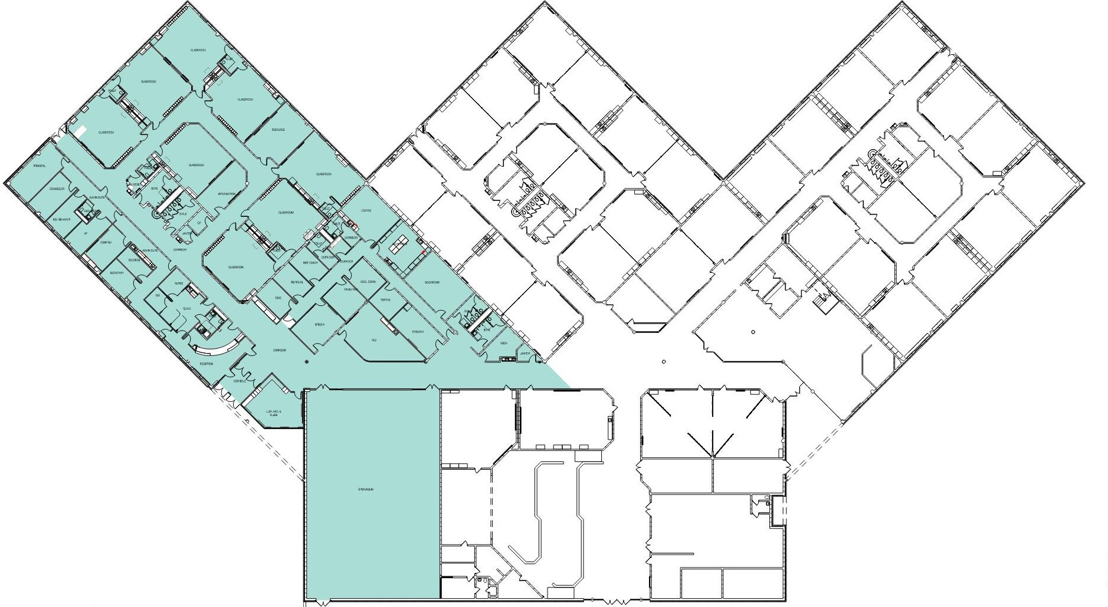
Southwood Valley Floor Plan– Phase 1

Slide 10
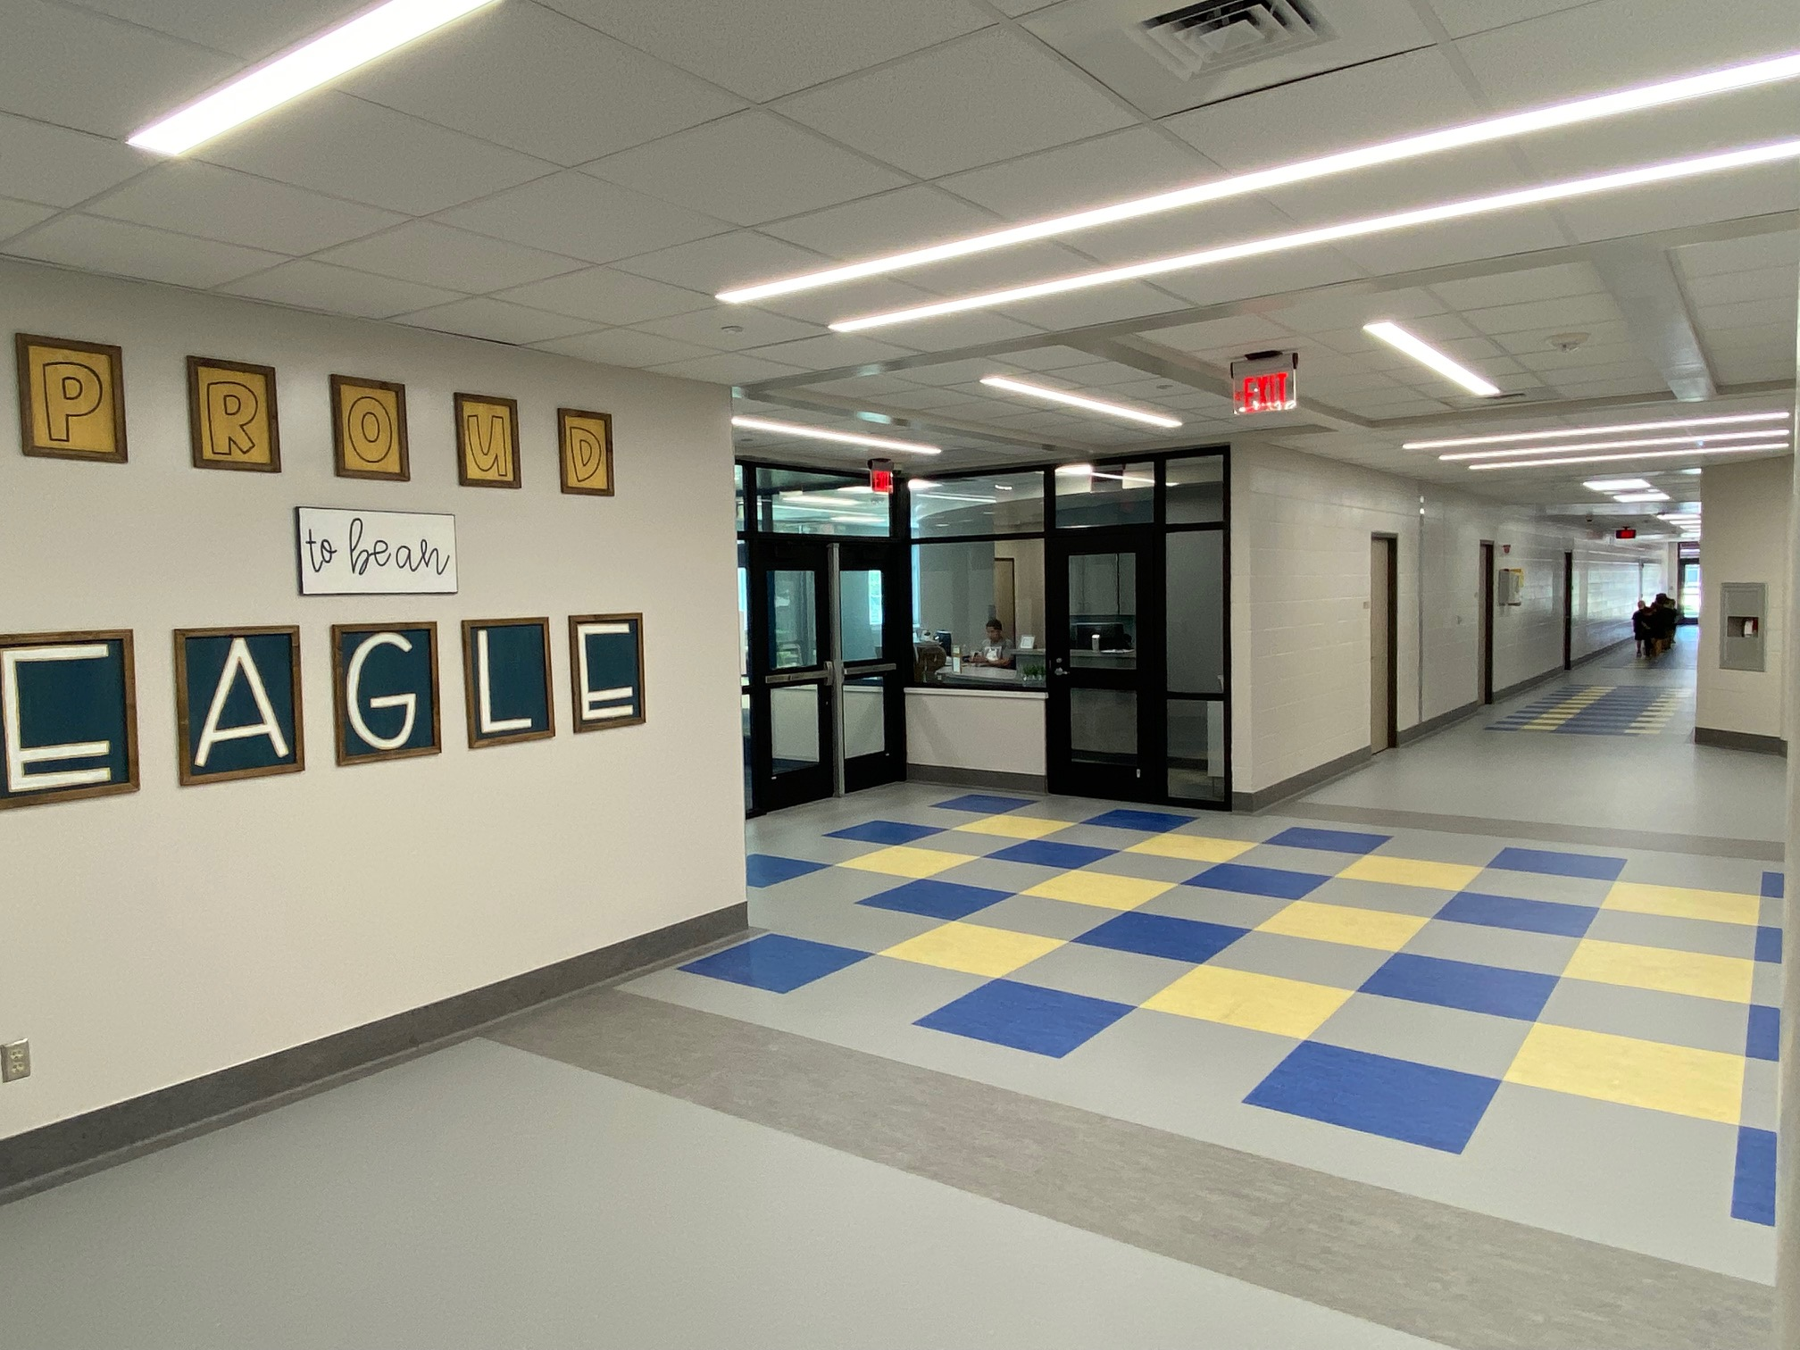
Southwood Valley – Phase 1

Slide 11
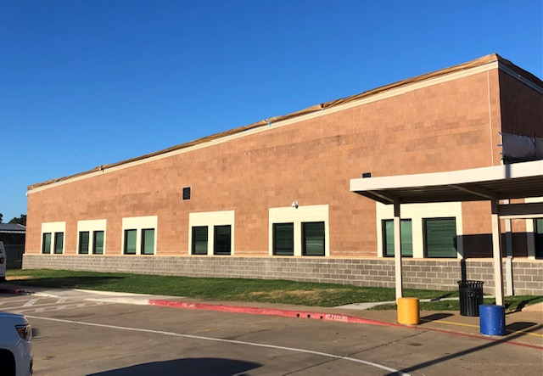
Southwood Valley – Phase 1

Slide 12
Southwood Valley Elementary – Phase 2
Phase 2 - Summer of 2023
  Primarily refreshing finishes like carpet, hard flooring, paint, restrooms, doors, cabinets, in the remainder of the building
  Library will have a new layout to make it more efficient
  Cafetorium layout will change to remove lowest level

Slide 13
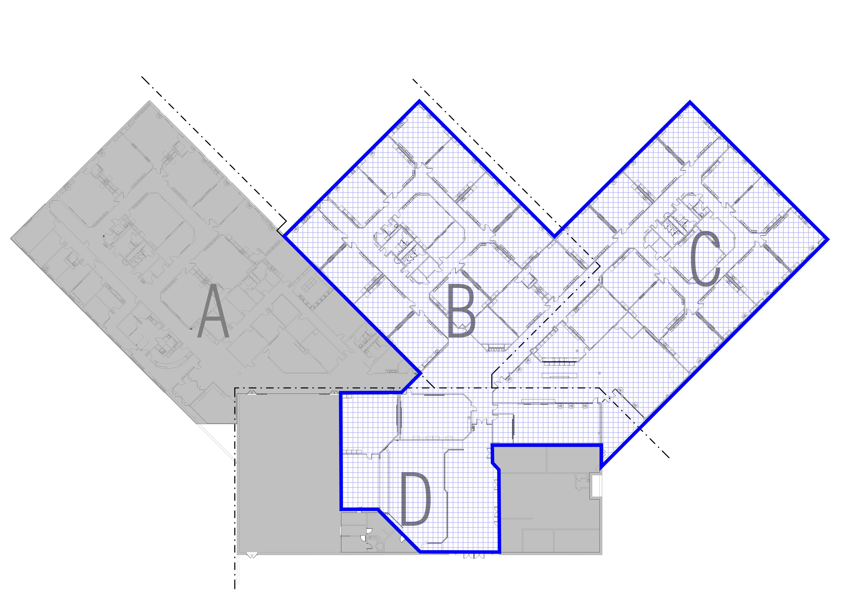
Southwood Valley Floor Plan– Phase 2

Slide 14
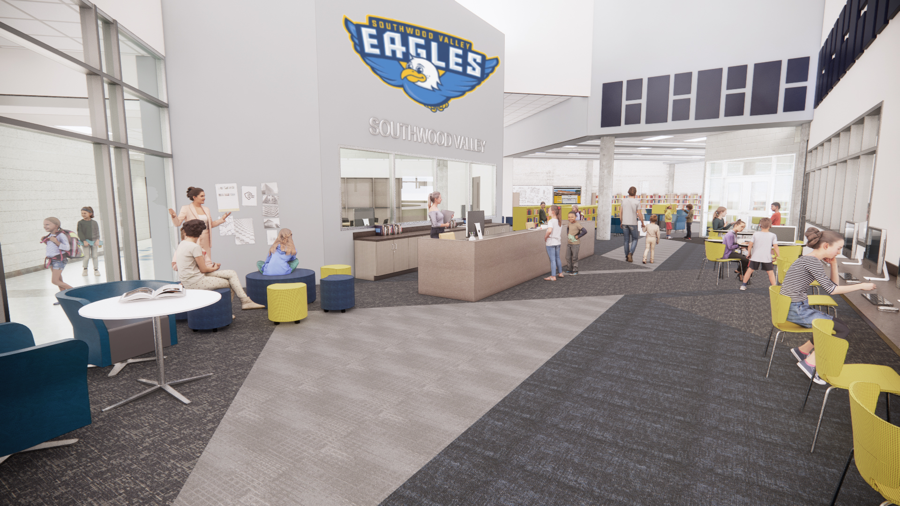
Southwood Valley Floor Plan– Phase 2

Slide 15
Safety Improvements
Phase 1 - Security Vestibule hardening
  All Elementary and Intermediate campuses
  Scheduled to bring to Trustees for approval in November of 2022
Phase 2 would include the remaining security vestibules hardening
  High School and Middle School campuses – begin summer 2023
Miscellaneous other projects:
  Fencing at Pecan Trail and Cypress Grove Intermediate Schools
  Bollards at key locations for prevention of vehicle incursion
  Rock Prairie Elementary School fire alarm replacement – summer of 2022

Slide 16
A&M Consolidated High School
Biggest renovation project in the 2021 Bond Package
Entire renovation will be broken up into at least 4 phases
  Summers from 2022 through 2025
Focus will be on refreshing interior finishes such as carpet, hard flooring, paint, restrooms, doors, cabinets, etc. for classrooms and public areas
Fine Arts areas including the Auditorium renovation
Science Lab upgrades for safety and mechanical/electrical/plumbing improvements

Slide 17
A&M Consolidated High School
Phase 1 – Summer of 2022 – Complete in August of 2022
  Restroom renovations for about half of the restrooms in the main campus building
Cafetorium area storefront to secure and separate Athletics wing during events
  Installation scheduled for October of 2022

Slide 18
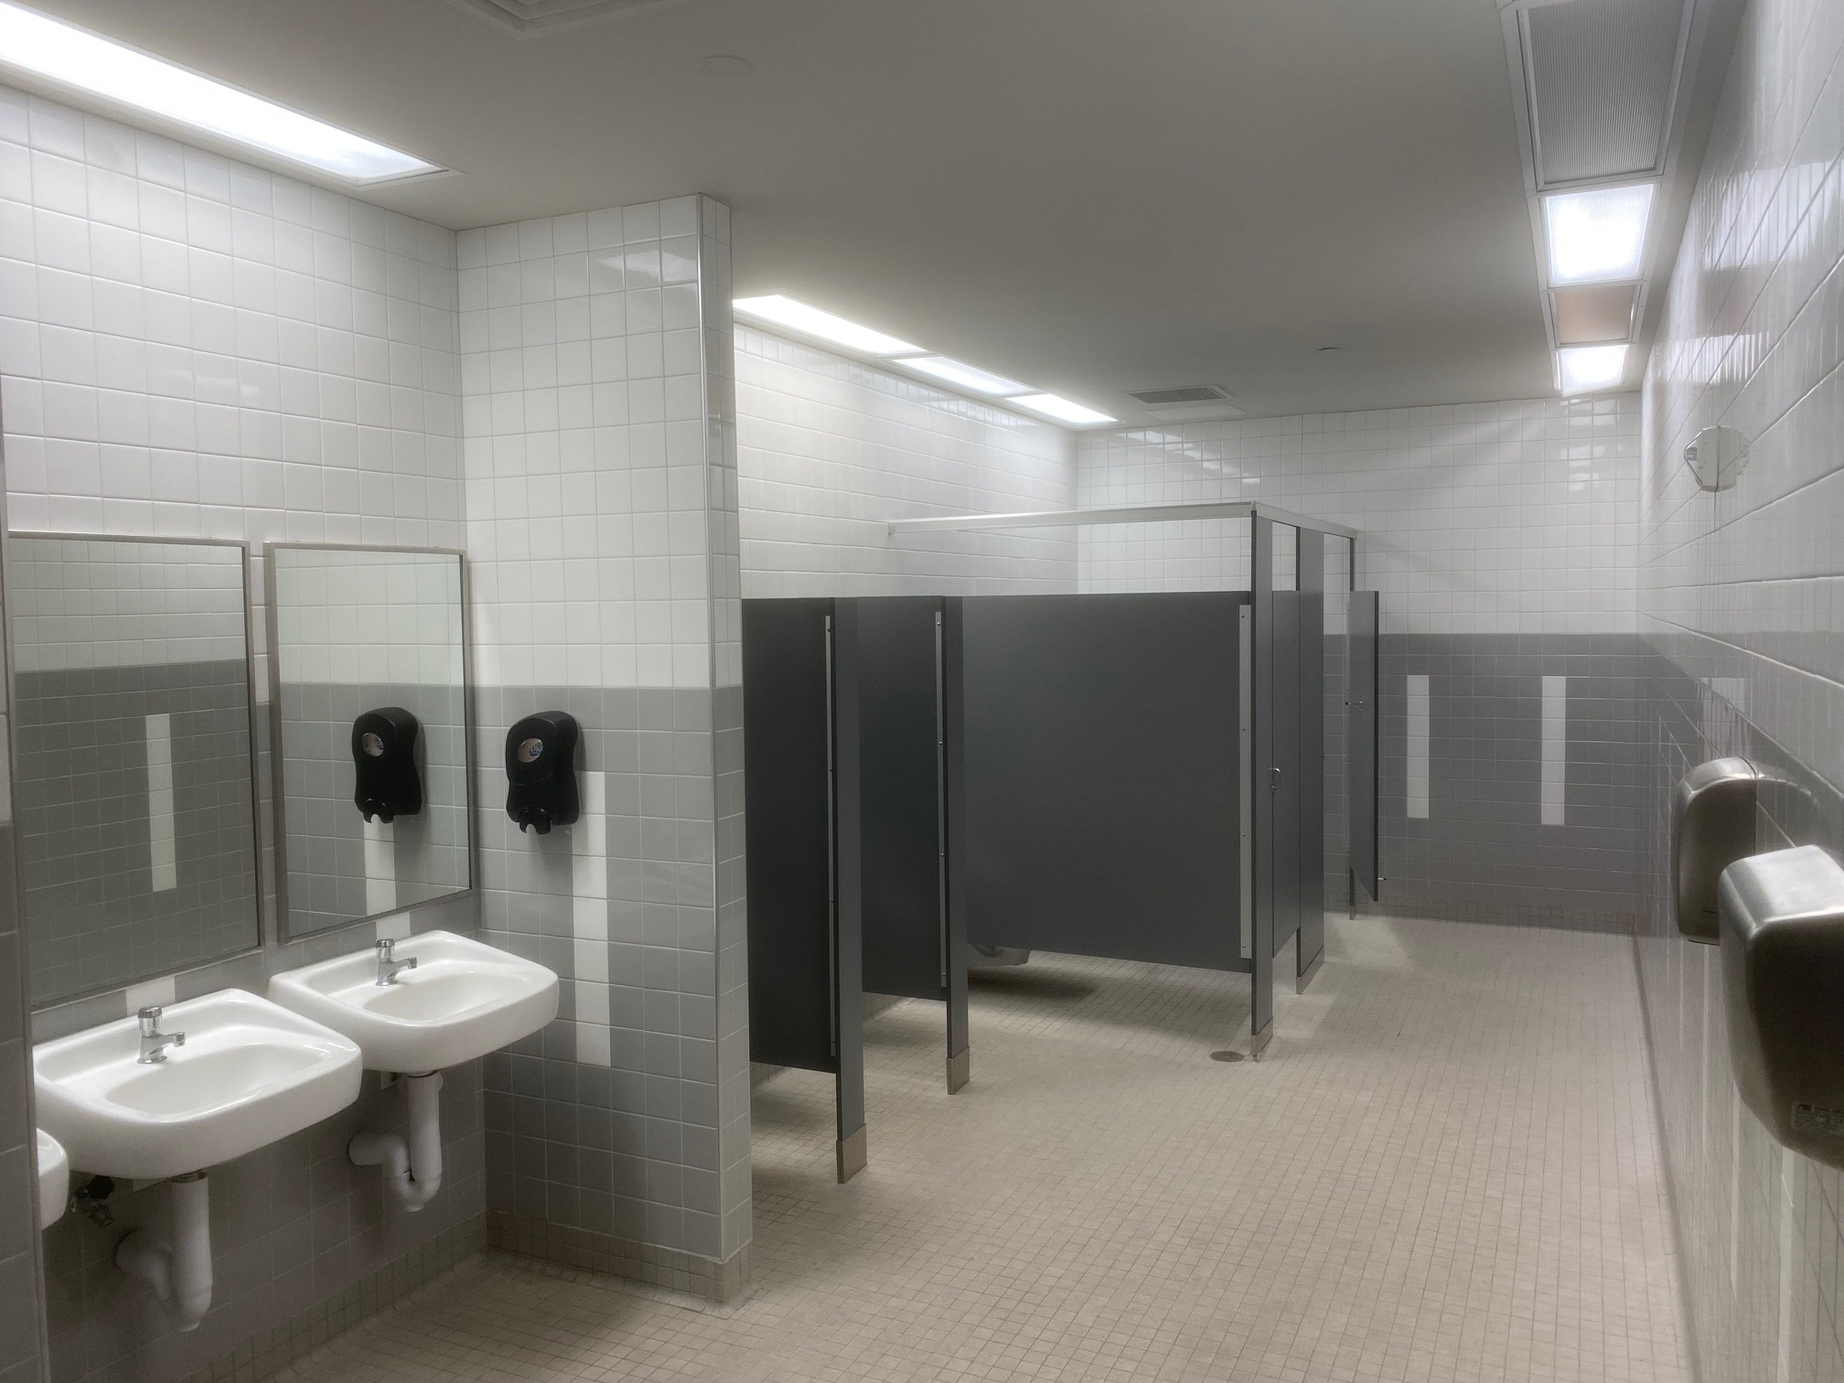
A&M Consolidated High School – Phase 1

Slide 19
A&M Consolidated High School – Phase 2
Phase 2 - Summer of 2023
  Planning meeting with Gwen Elder occurred on September 14, 2022
  Interior finishes updates for paint, carpet, hard flooring, and LED lighting
  Security Vestibule Upgrades and Principal’s Office suite
  Auditorium upgrades
  Science wing classrooms and labs
  Large public corridors that connect these areas
  Possible fine arts renovations components in Band, Choir, and Orchestra
    Depends on scope of work possible in the 9 weeks of summer

Slide 20
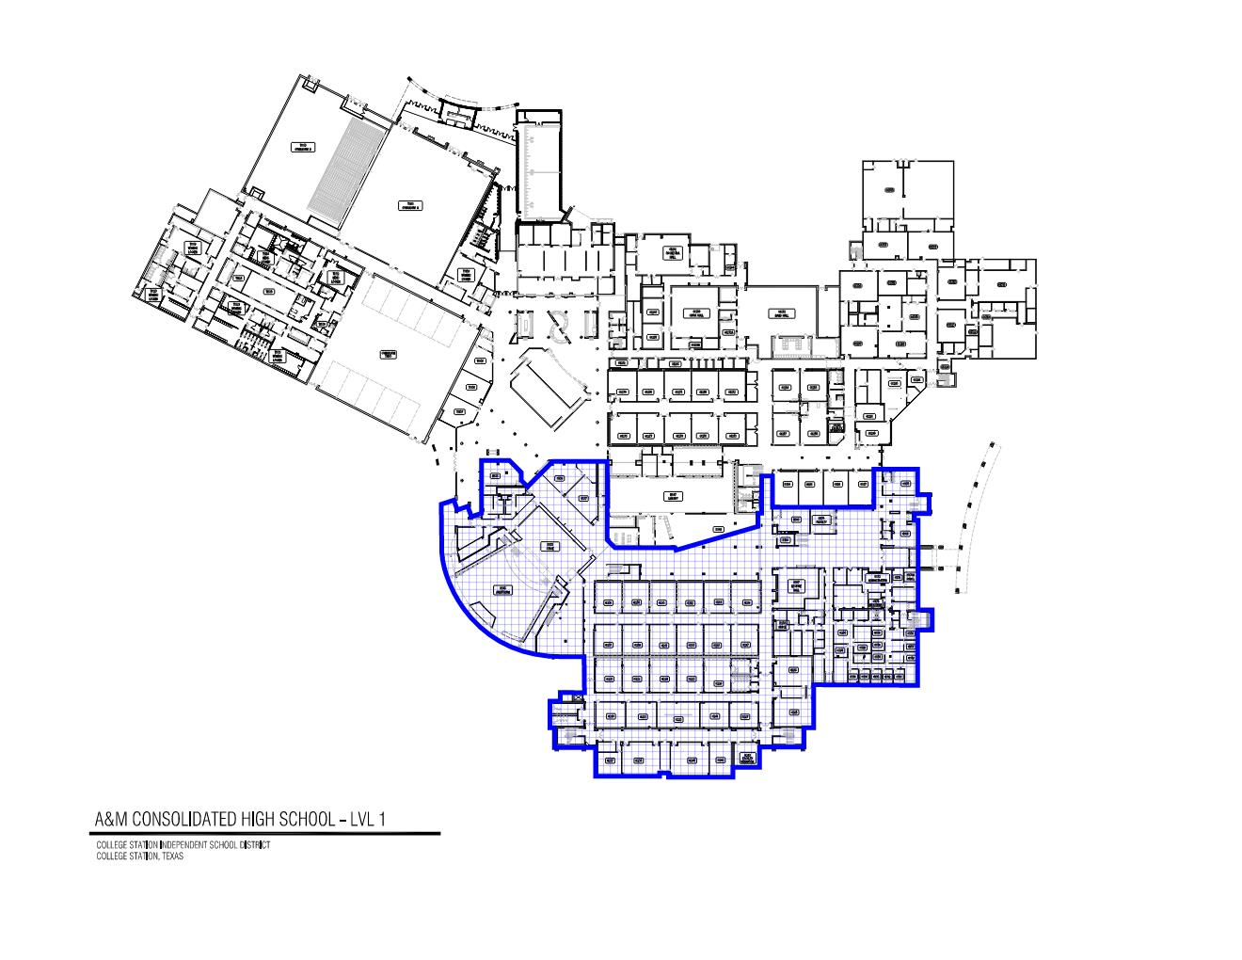
A&M Consolidated High School – Phase 2

Slide 21
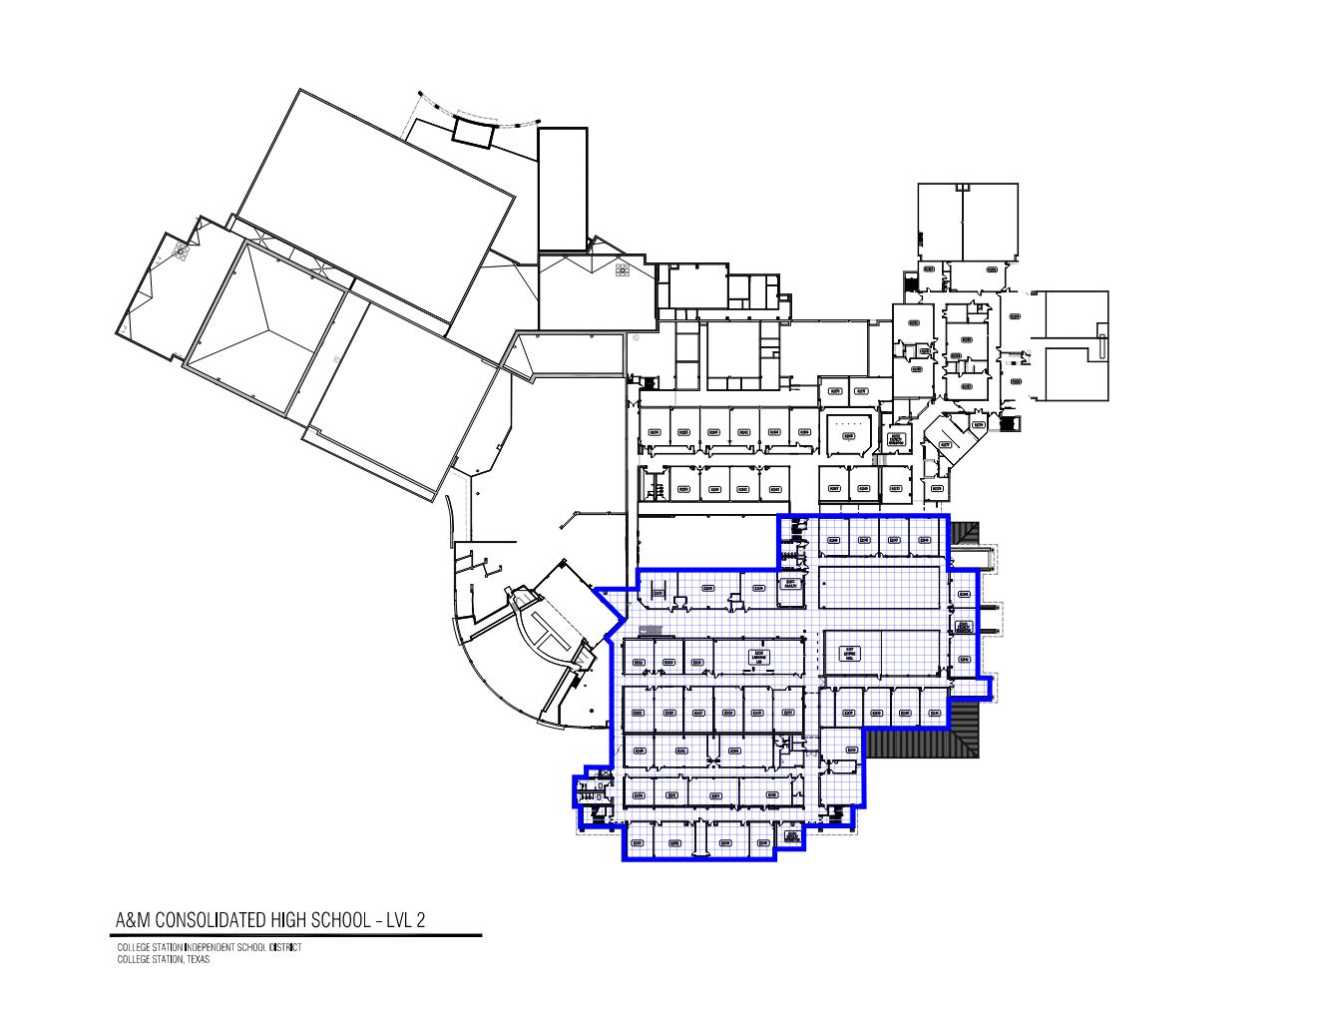
A&M Consolidated High School – Phase 2

Slide 22
A&M Consolidated High School
Phase 3 - Summer of 2024
  Continuation of interior finish replacements on the northern half of the building
  Cafetorium dining area
Phase 4 – Summer of 2025
  Continuation of interior finishes replacement throughout the building, especially public corridors
Miscellaneous other:
  Fire Sprinkler system components
  Exterior LED lighting for parking lots

Slide 23
Pebble Creek Elementary
Renovations will focus on refreshing some interior items such as carpet, hard flooring, restrooms, doors, cabinets, etc.
A repurposing of the old existing Principal’s Office suite will be included to convert that square footage to more useable space for conference room and breakout spaces for specialty needs
First meeting with Blaire Grande occurred on September 14, 2022
  Confirmed scope and conceptual concepts
Currently planned for construction during the summer of 2023

Slide 24
Cypress Grove Intermediate
Renovations will focus on refreshing finishes, to include new carpet, hard flooring, paint, restrooms, doors, cabinets, etc.
Design meetings are planned to commence in the early fall of 2023
Currently planned for construction during the summer of 2024

Slide 25
Career and Technical Education (CTE) Center
Design and development started on Phase 1of the CTE Center
  Location will be the 90-acre Fry Tract on South Dowling Road
  The first phase will primarily be designed for animal housing, small show arena, and an office/restrooms/concessions
  Site is being master planned for future growth
Construction Manager at Risk to be considered for approval tonight
Scheduled to commence construction in late fall of 2022 or early spring 2023
Phase 2 will likely be part of a future bond program
  Possible new building for classrooms/labs/indoor show arena/etc.

Slide 26
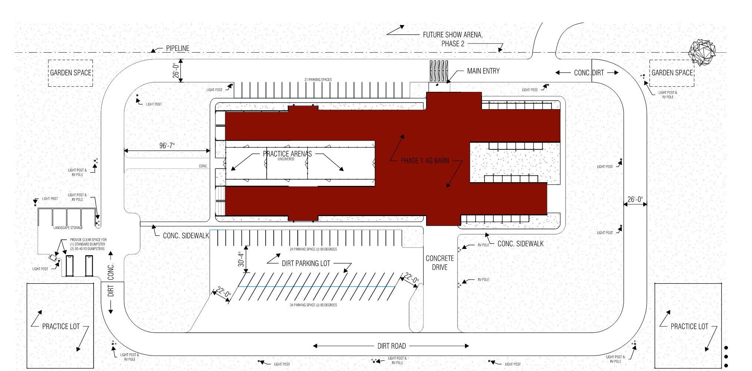
Career and Technical Education (CTE) Center

Slide 27
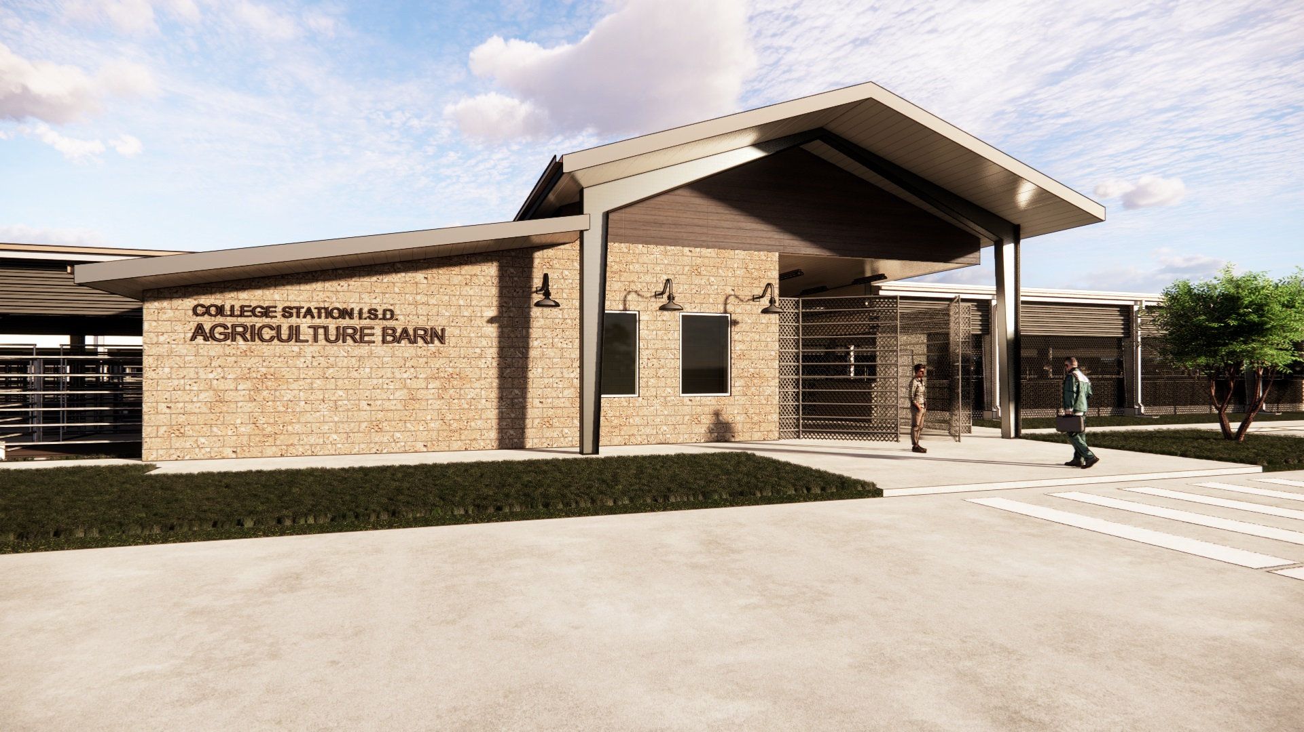
Career and Technical Education (CTE) Center

Slide 28
Career & Technical Education (CTE) – Projects
Metal canopies and fencing at both comprehensive high schools - summer of 2022
  Canopies are complete
  Fencing is still ongoing
Classroom upgrades for AMCHS Intro
  Culinary Arts planned for the Summer of 2023 in conjunction with AMCHS Phase 2
CTE areas behind AMCHS and CSHS
  Being master planned for layout and construction of various components
  Scheduling to be determined

Slide 29
Career & Technical Education (CTE) – Projects
Metal canopies and fencing at both comprehensive high schools - summer of 2022
  Canopies and fencing are now complete
Classroom upgrades for AMCHS Intro
  Culinary Arts planned for the Summer of 2023 in conjunction with AMCHS Phase 2
CTE areas behind AMCHS and CSHS
  Being master planned for layout and construction of various components
  Scheduling to be determined

Slide 30
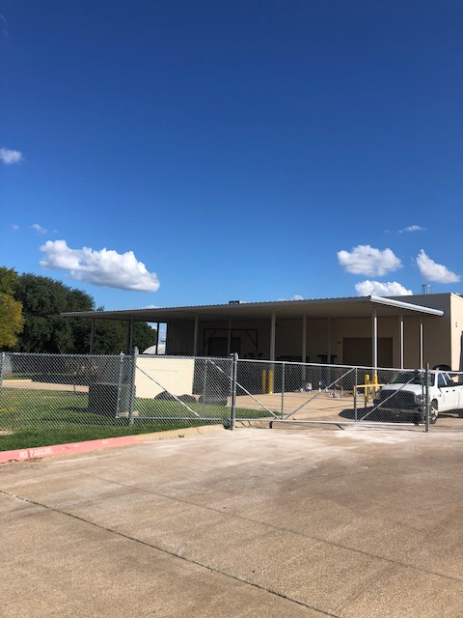
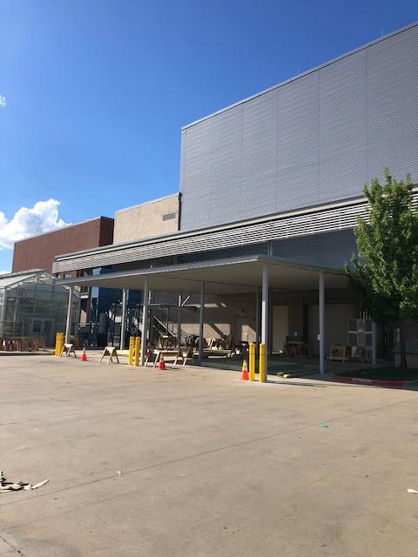
Metal Canopies and Fencing
AMCHS
CSHS

Slide 31
Miscellaneous Other Bond Projects
Natatorium Renovation
  Boiler replacement complete as of August 2022
  Remaining renovation work is ready to commence design work now
    Tile, paint, and plaster replacement of main pool area and offices/locker room spaces
    Structural steel rework to correct some corrosion issues
  Work is scheduled to commence in April of 2023 for completion in early Fall of 2023
Transportation Parking Extension
  Currently on hold due to inflation and the need for buses

Slide 32

Questions & Comments

