Slide 1

2021 Bond Update
August 15, 2023

Slide 2
General Bond Information
General Projects – Summer2023
  Southwood Valley Elementary- Phase II
  A&M Consolidated HS – Phase II
  Pebble Creek Elementary
  Natatorium
  Security Vestibules
  CTE Center
  Miscellaneous Projects
General Projects for 2023-2024
  A&M Consolidated HS – Phase III
  Cypress Grove IS
Agenda

Slide 3
Bond Balances as of July 31, 2023
Proposition | Total Authorized | Expended | Committed | Balance | % Available
General | $ 70,630,000 | $ 29,010,852 | $ 19,778,156 | $ 21,840,992 | 31%
Technology / Personal Device | $ 4,525,000 | $ 4,265,718 | $ 111,312 | $ 147,970 | 3%
Natatorium Renovations | $ 2,970,000 | $ 669,953 | $ 1,748,941 | $ 551,106 | 18%
Total | $ 78,125,000 | $ 33,946,523 | $ 21,638,409 | $ 22,540,068

Slide 4
Technology Infrastructure – Proposition A - $12.3M
Infrastructure
  District wide Network Upgrades
  WiFi Upgrades and Additions
  Network Security – Firewall / Internet Filtering
  Classroom Displays (SMARTPanels) at all campuses - except the 5 most recently constructed
Security
  Videosecurity camera and server upgrades / additions
  Security Vestibule technology upgrades
Fine Arts Audio/Video
  Upgrade all secondary campuses fine arts facilities, high school auditoriums
  Upgrade all elementary campuses cafetoriums and gymnasiums

Slide 5
Technology Devices – Proposition B – $4.26M
Mobile Devices
  Student Laptops: 3,000 new student laptops deployed to all
  Teacher Laptops: All teachers, PK-12, deployed
Computer Labs
  Upgraded all core computer labs across the district

Slide 6
Southwood Valley Elementary

Slide 7
Southwood Valley Elementary
Phase 1 - Summer of 2022 – Substantially complete in August of 2022
  Relocation of the Principal’s Office suite and connecting new security vestibule
  Relocation of kindergarten classrooms and breakout rooms
  New exterior elevation with new windows and masonry at the front of the building
Phase 2 - Summer of 2023 – Substantially complete on August 7, 2023
  Renovation of Library and Cafeteria
  Renovation of all remaining classrooms

Slide 8
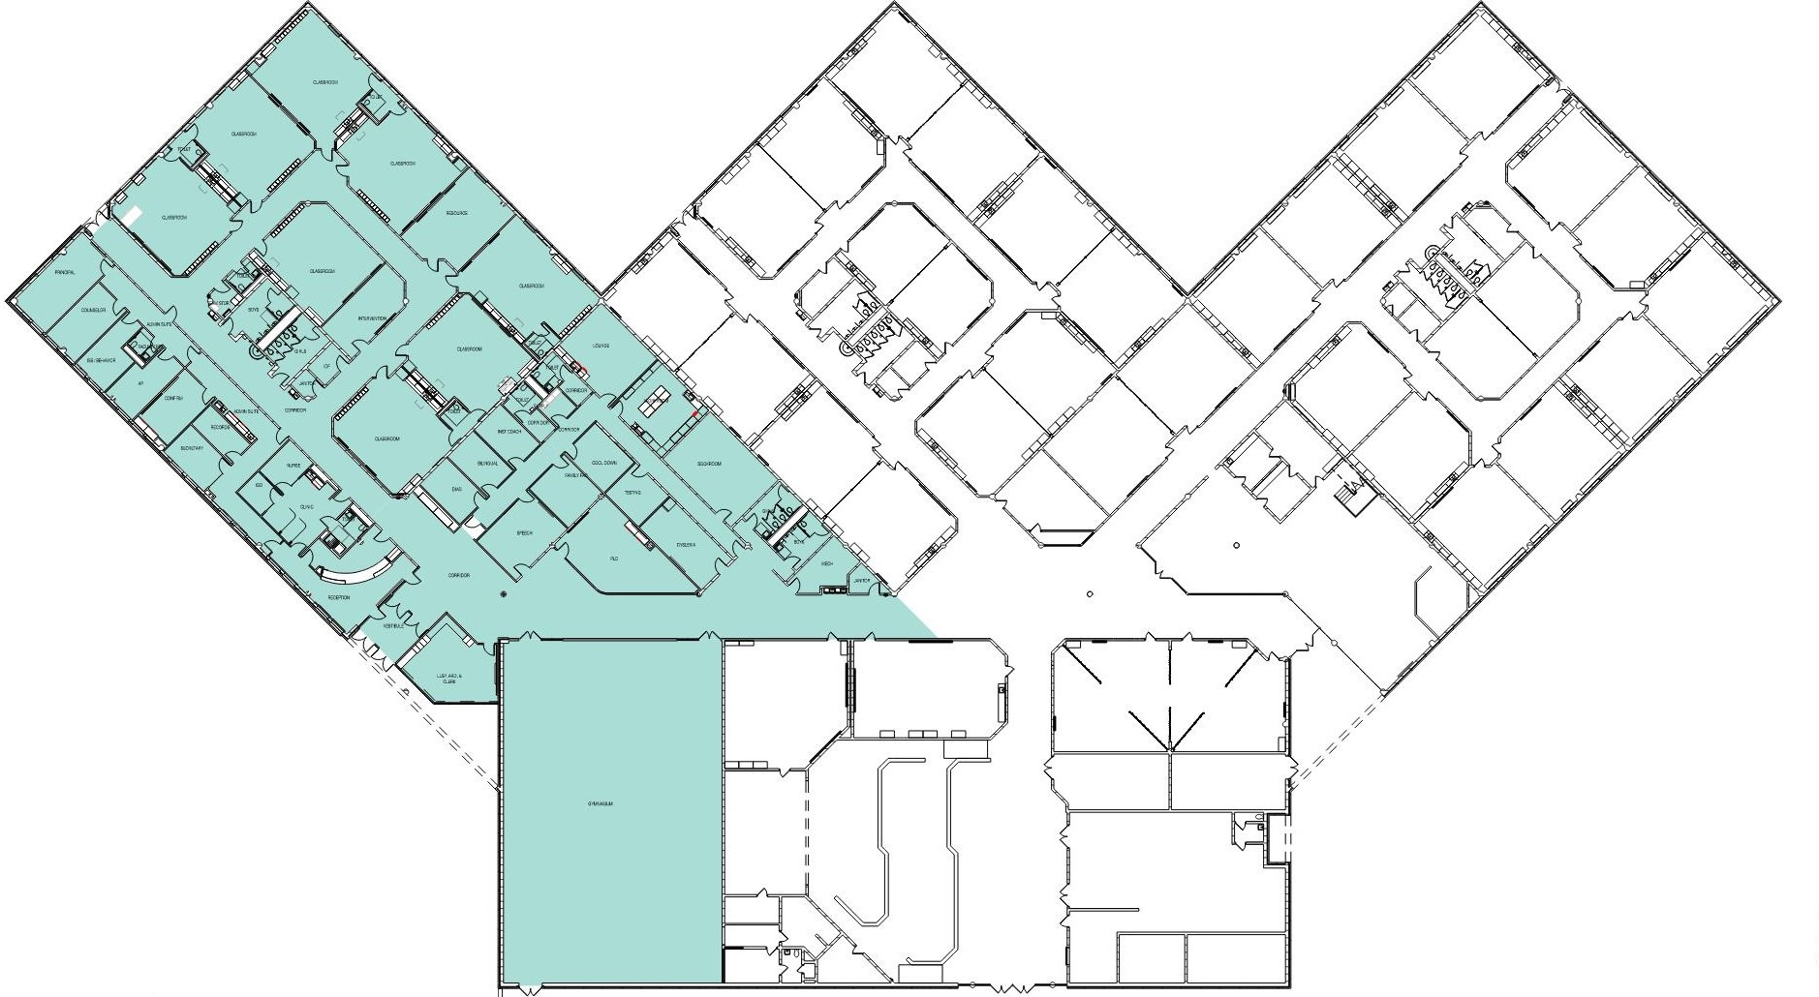
Southwood Valley Floor Plan– Phase 1

Slide 9
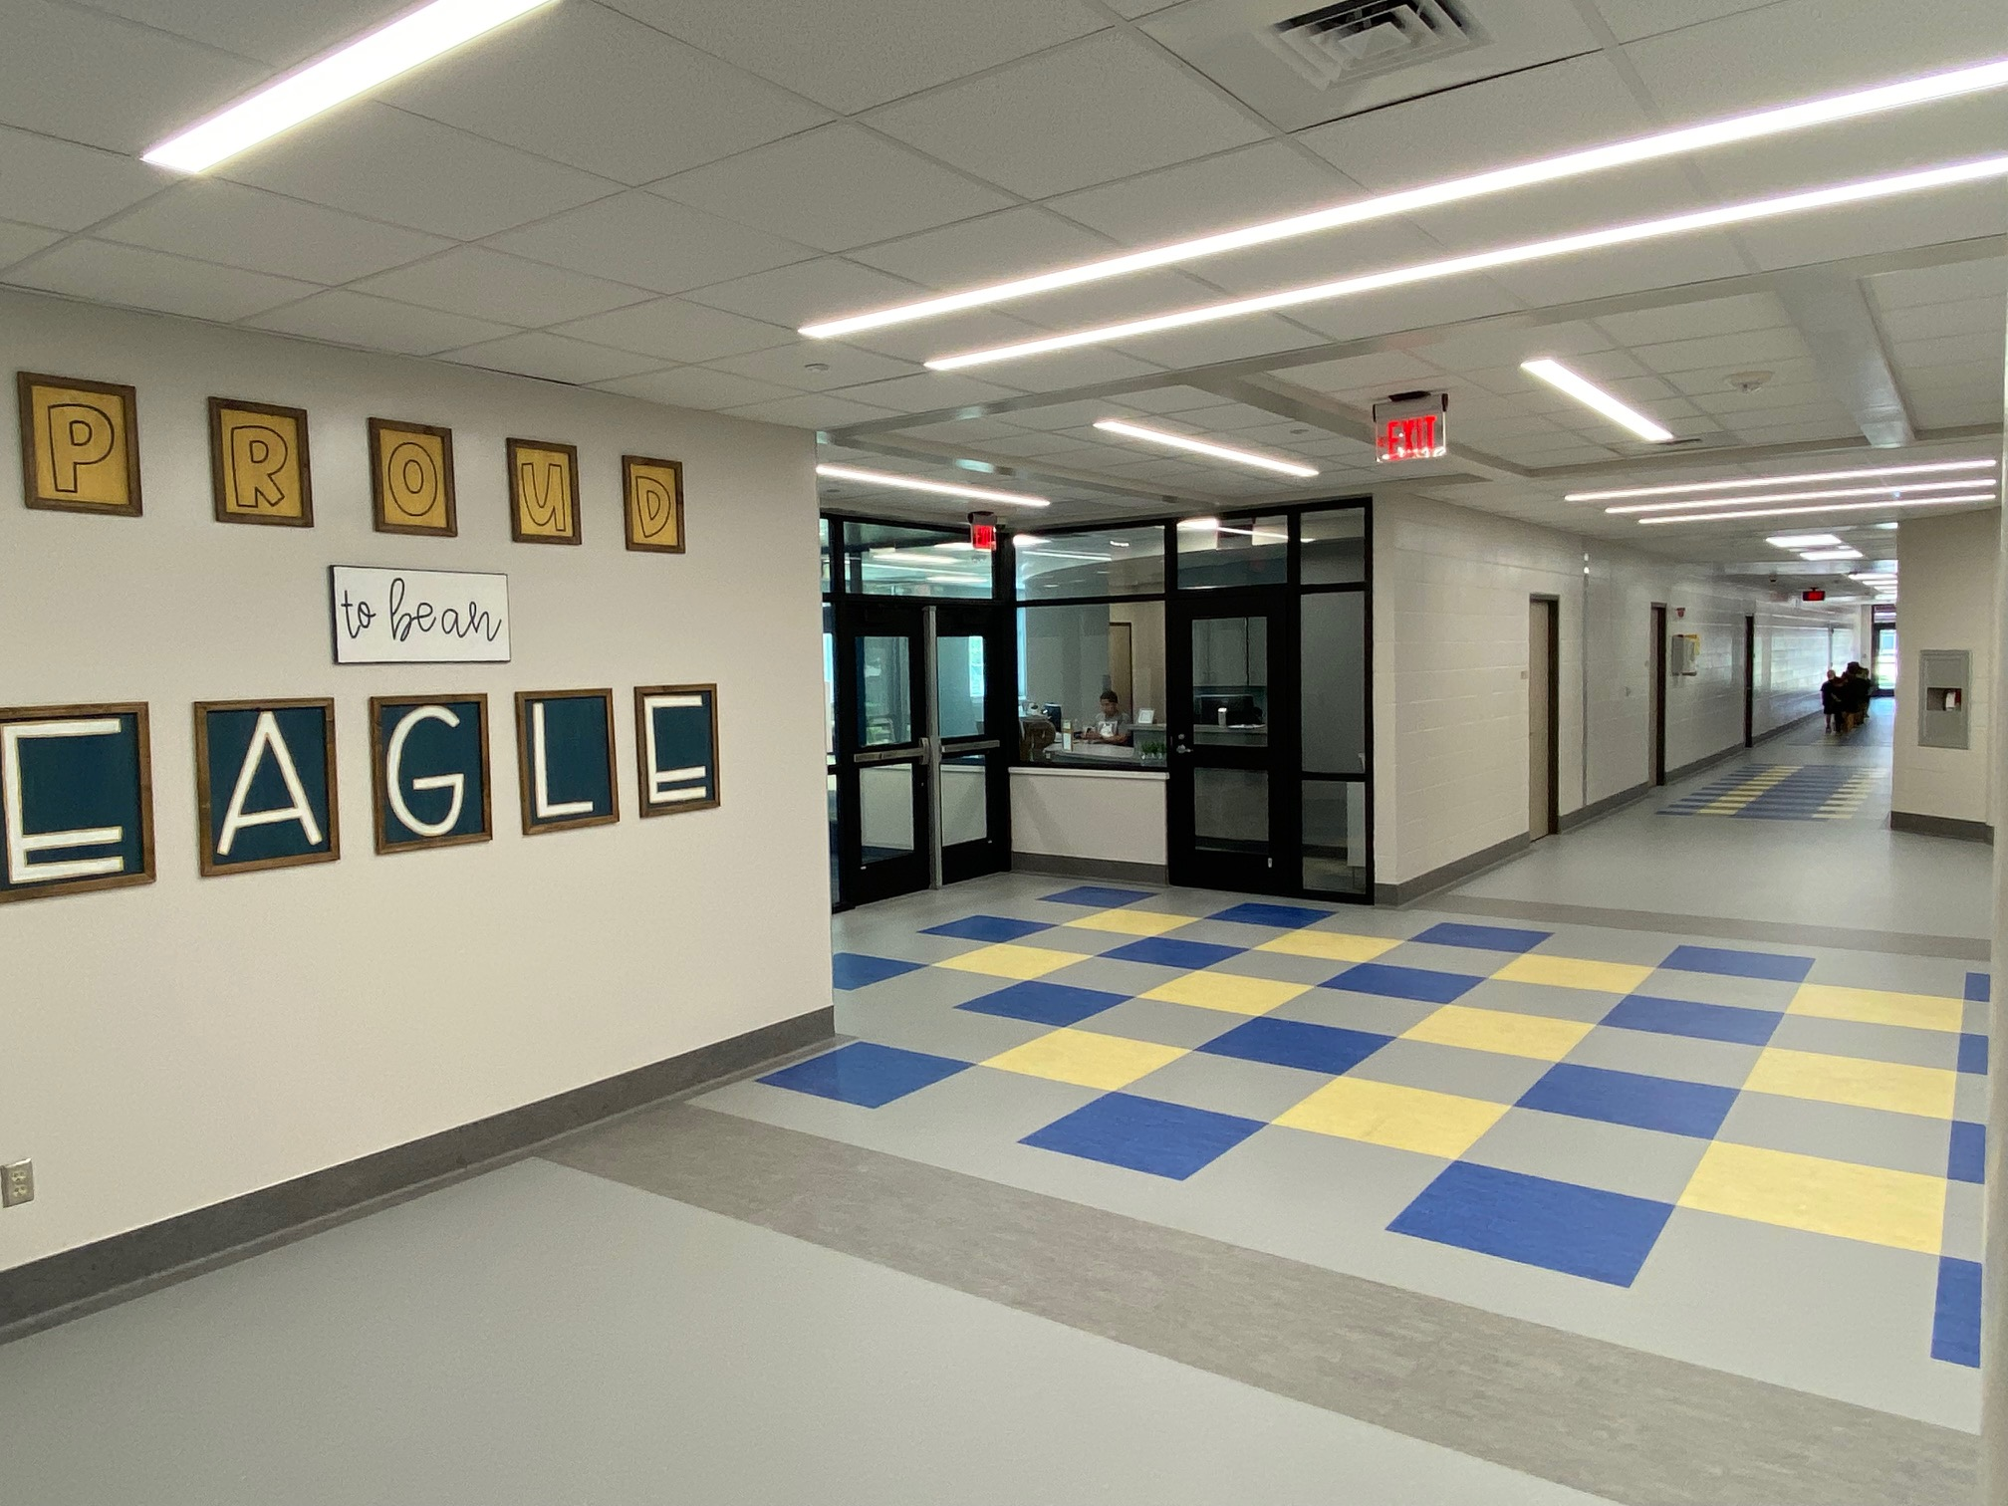
Southwood Valley – Phase 1

Slide 10
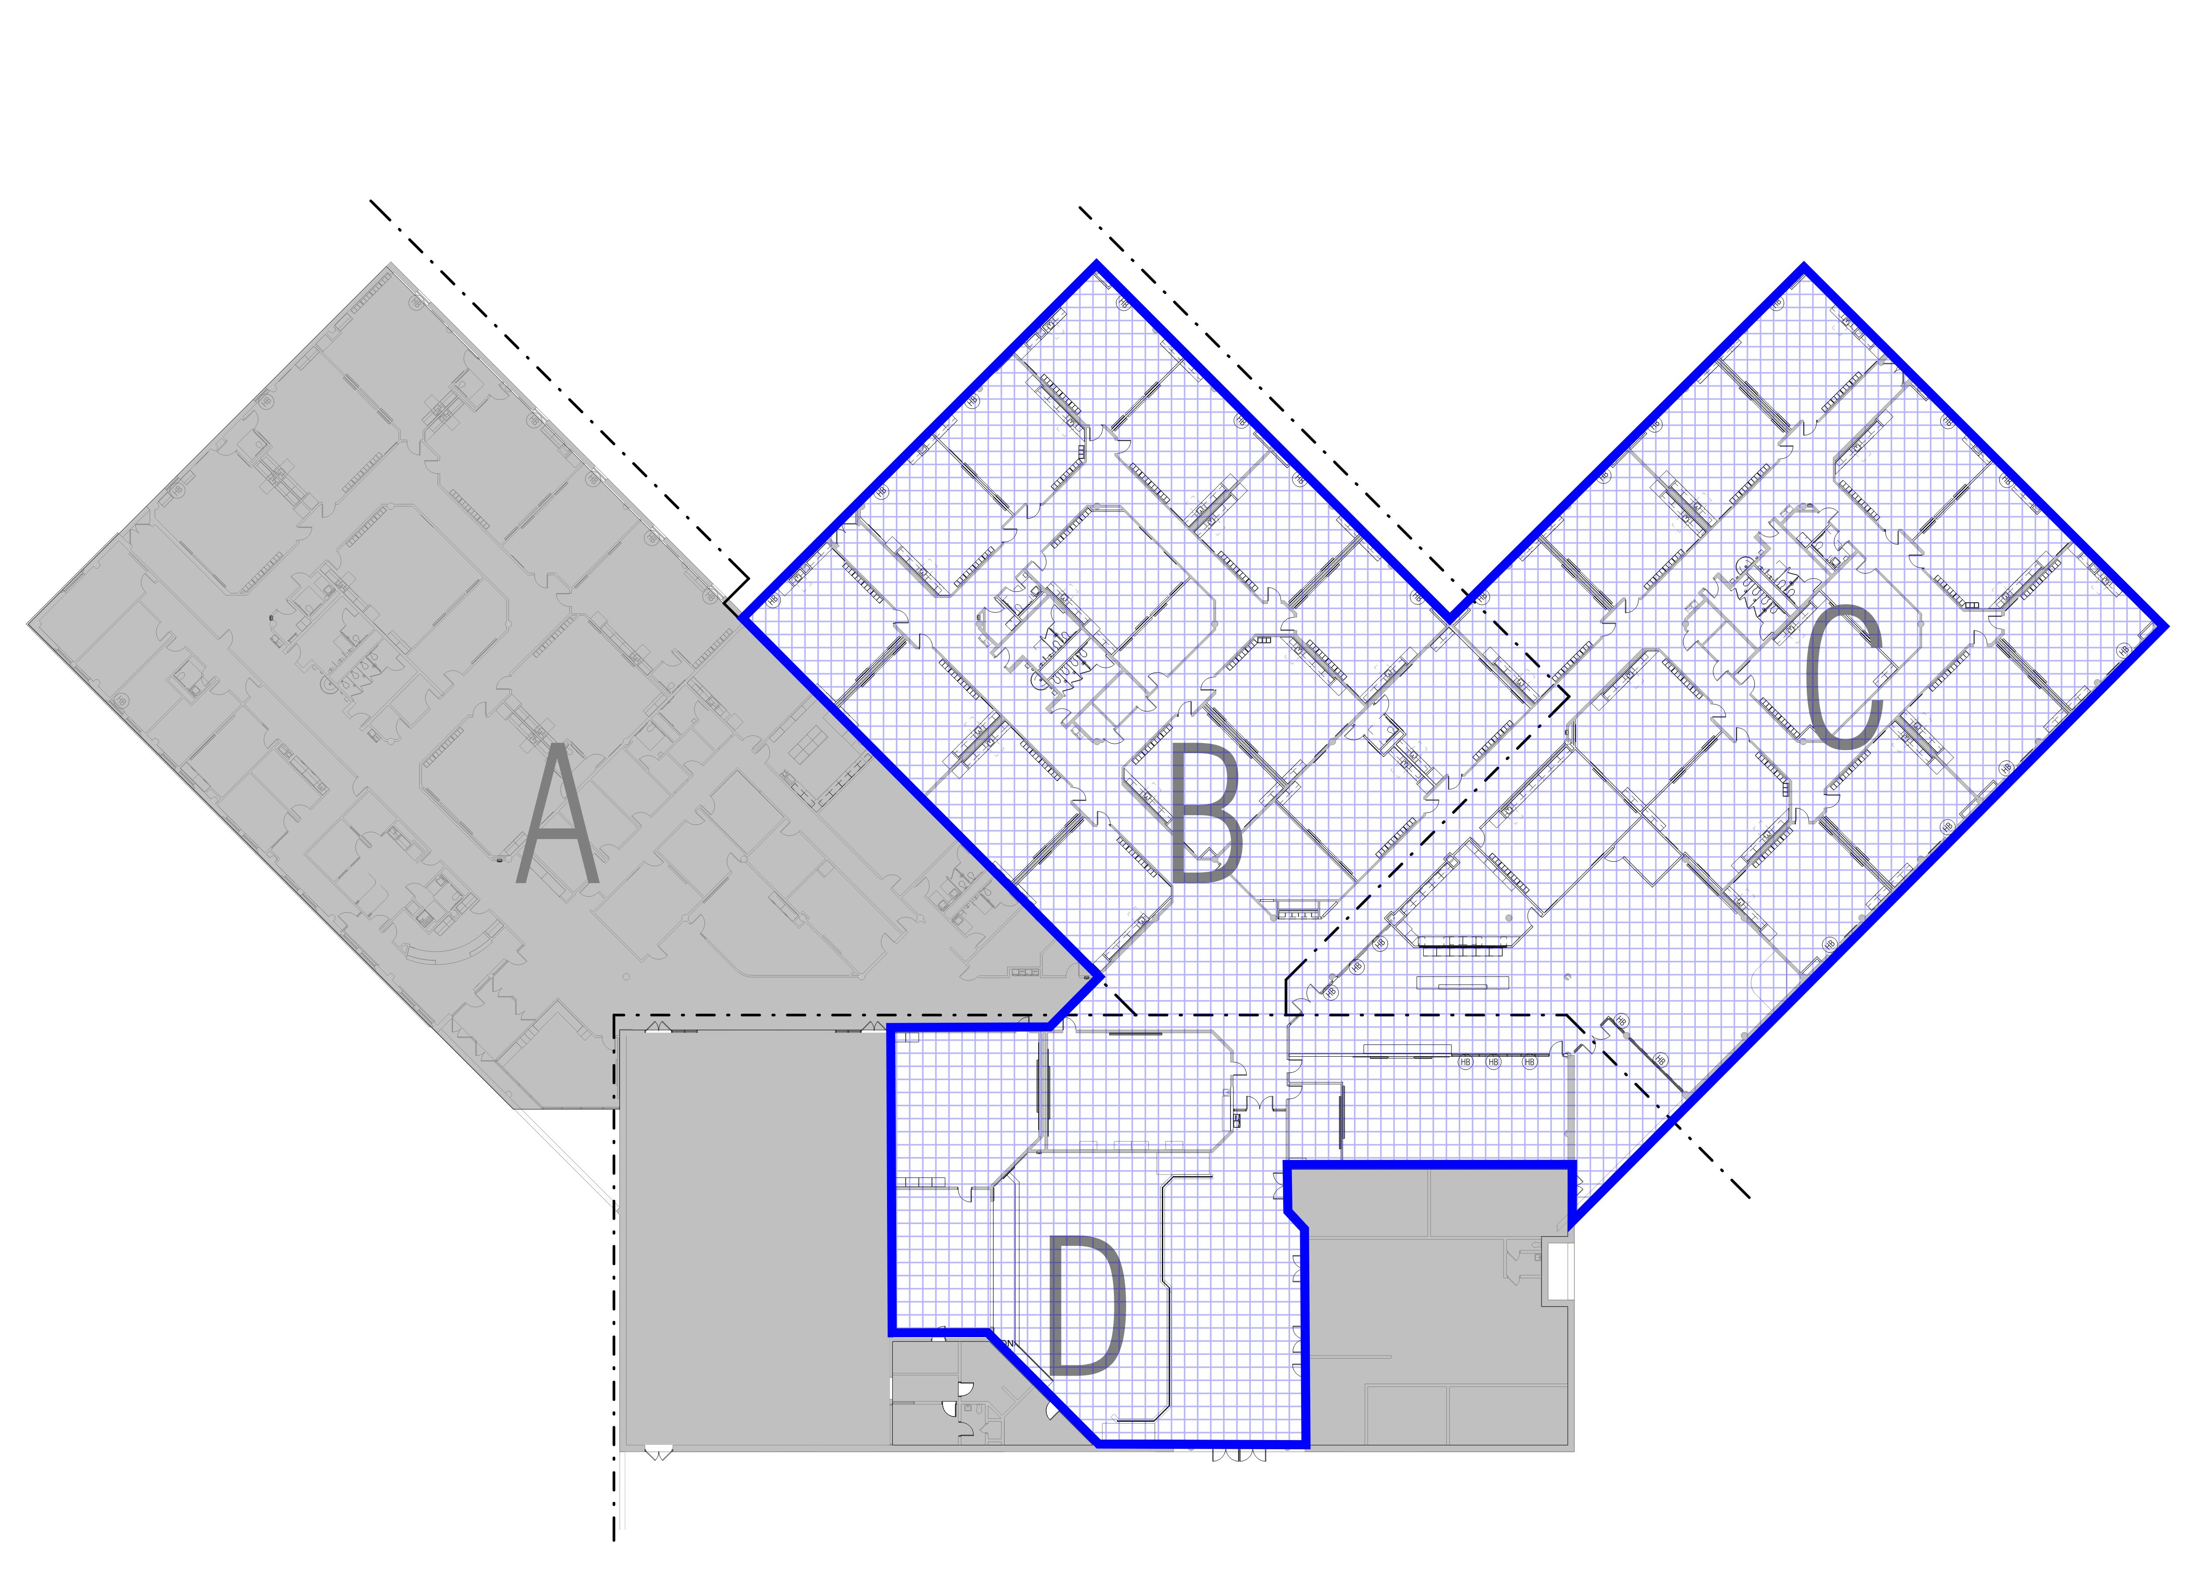
Southwood Valley Floor Plan– Phase 2

Slide 11
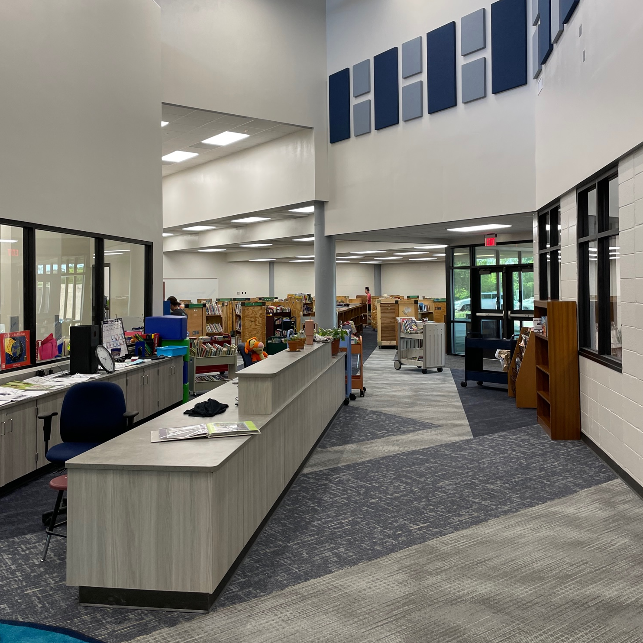
Southwood Valley – Phase 2

Slide 12
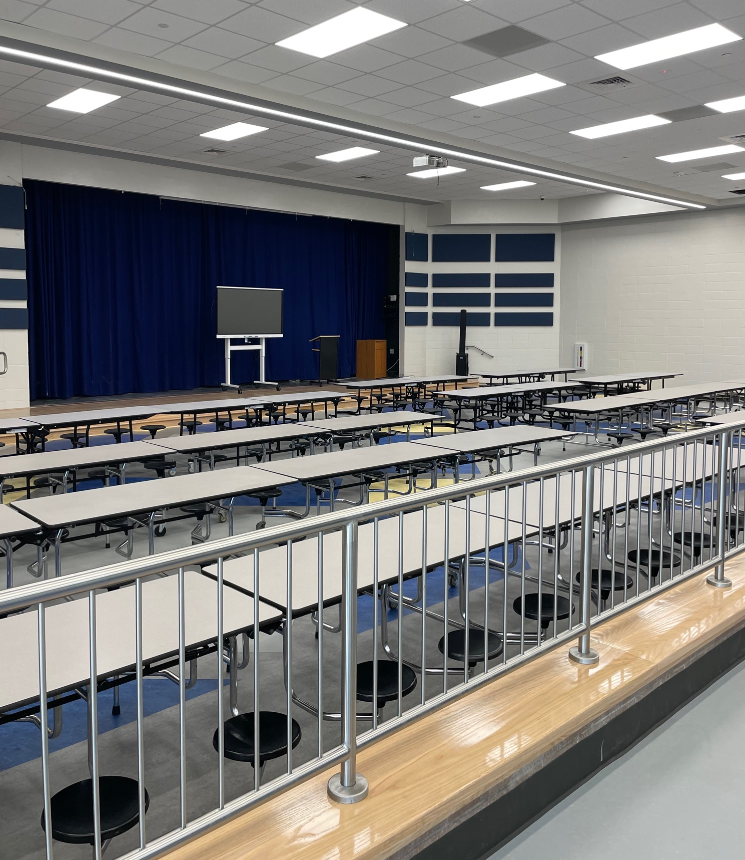
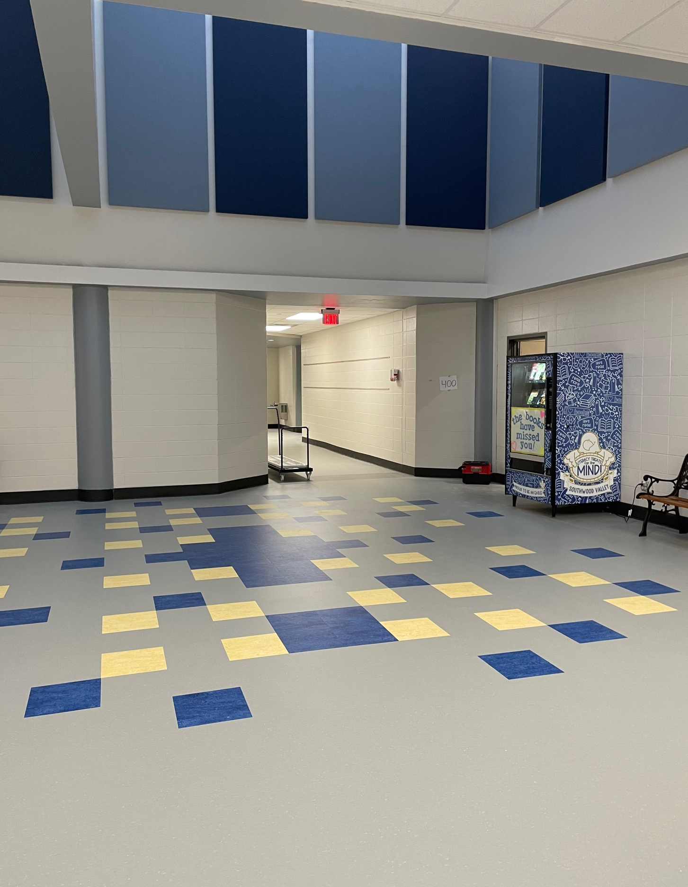
Southwood Valley – Phase 2

Slide 13
A&M Consolidated High School

Slide 14
A&M Consolidated High School
Biggest renovation project in the 2021 Bond Package
Entire renovation will be broken up into at least 4 phases
  Summers from 2022 through 2025
Focus will be on refreshing interior finishes such as carpet, hard flooring, paint, restrooms, doors, cabinets, etc. for classrooms and public areas
Fine Arts areas including the Auditorium renovation
Science Lab upgrades for safety and mechanical/electrical/plumbing improvements

Slide 15
A&M Consolidated High School
Phase 1 – Summer of 2022 – Completed in August of 2022.
  Restroom renovations for about half of the restrooms in the main campus building
  Cafetorium area storefront to secure and separate Athletics wing during events
Phase 2 – Summer of 2023 – Completed on August 4, 2023.
  Auditorium renovations
  Principal’s Office suite area renovations
  2 new Science Labs built in old classroom areas
  All classrooms with new finishes for carpet, paint, ceiling tile, cabinets

Slide 16
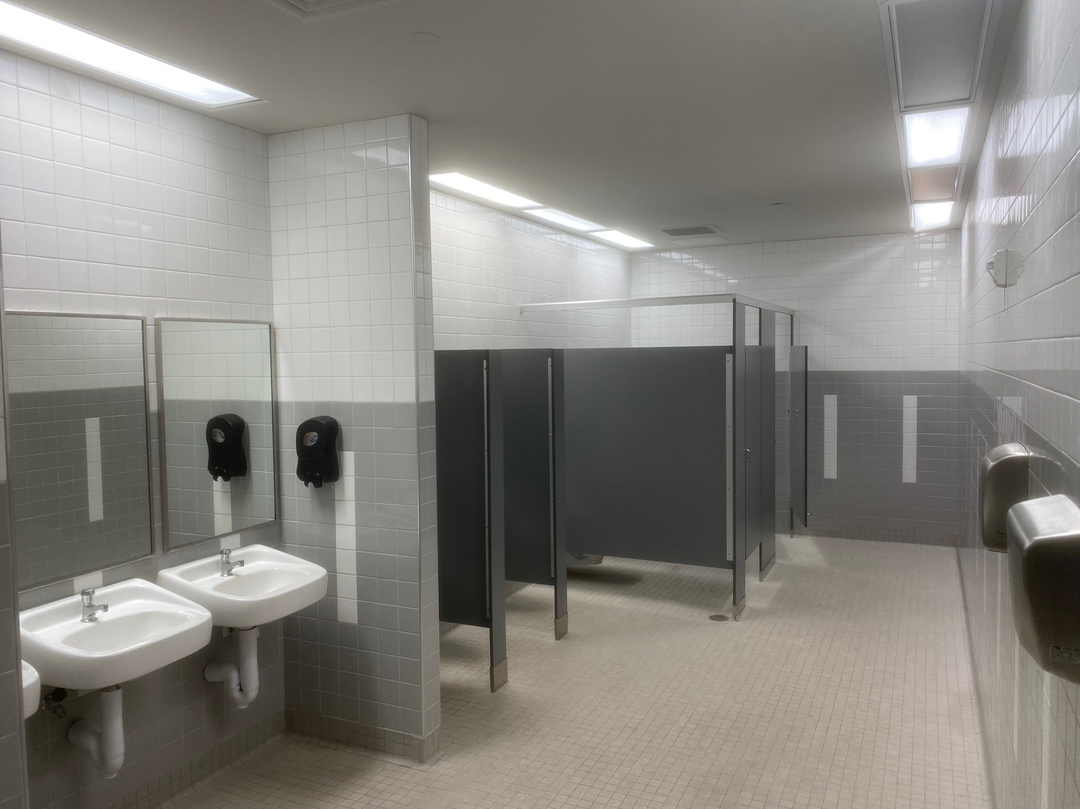
A&M Consolidated High School – Phase 1

Slide 17
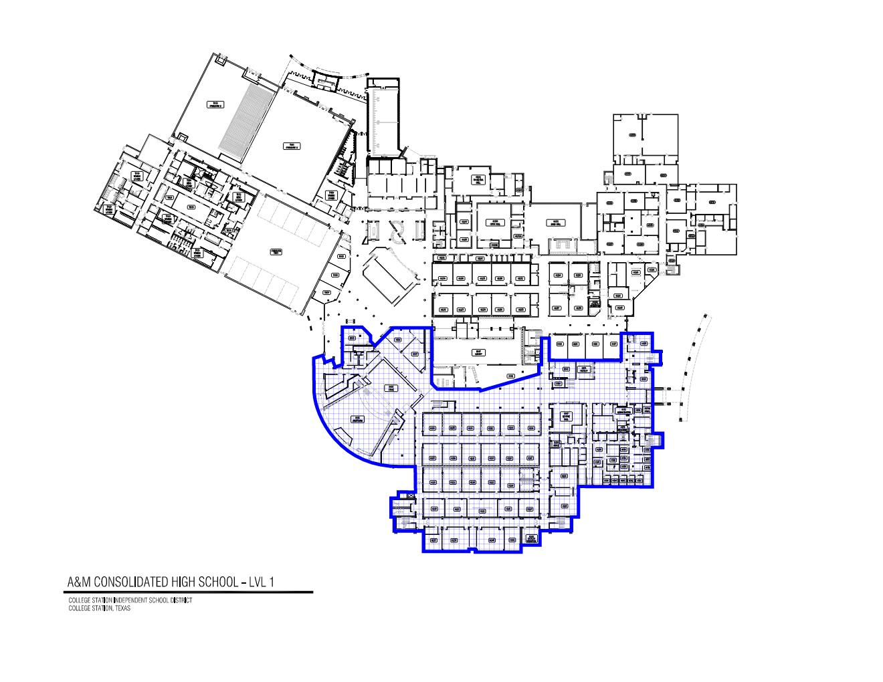
A&M Consolidated High School – Phase 2

Slide 18
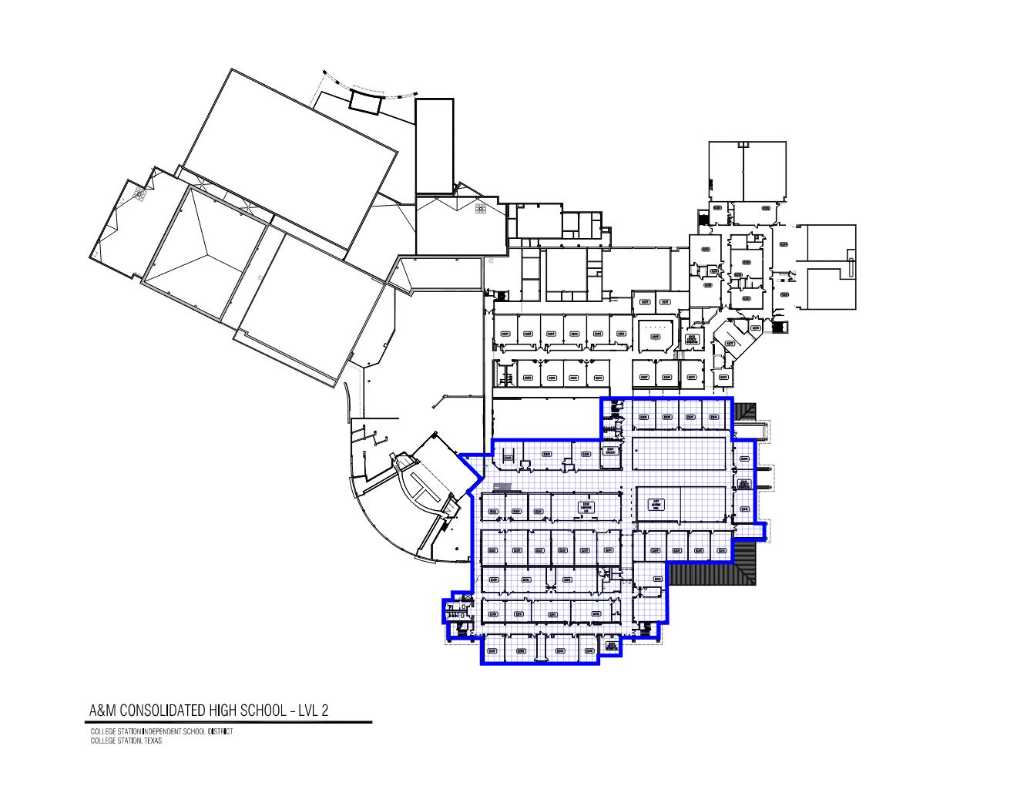
A&M Consolidated High School – Phase 2

Slide 19
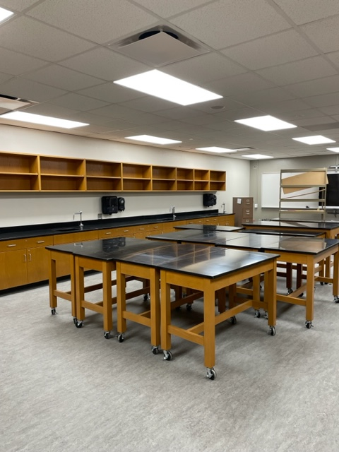
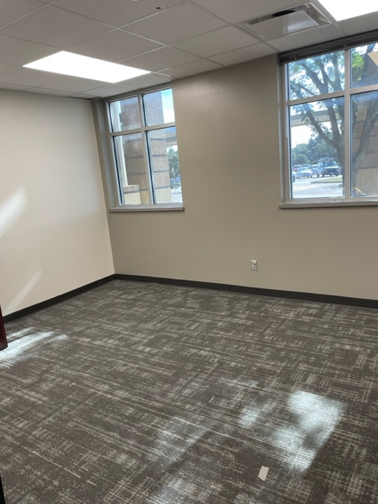
A&M Consolidated High School – Phase 2

Slide 20
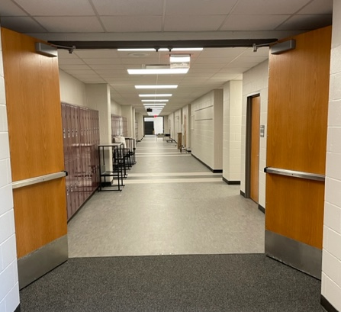
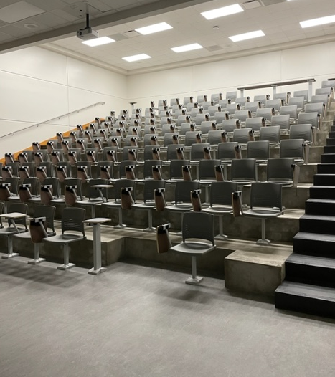
A&M Consolidated High School – Phase 2

Slide 21
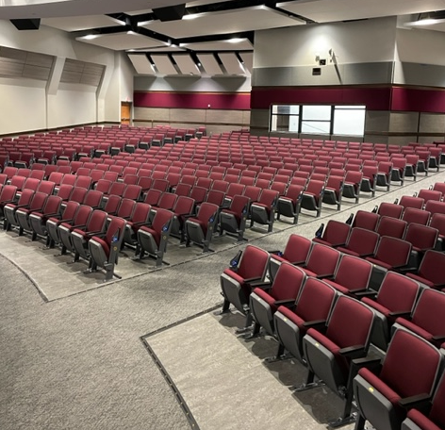
A&M Consolidated High School – Phase 2

Slide 22
A&M Consolidated High School
Phase 3 - Summer of 2024
  Continuation of an additional 30% of the interior finish replacements on the northern half of the building
  Would include Cafeteria and Choir/Band/Orchestra rooms
Phase 4 – Summer of 2025
  Continuation of any remaining areas throughout the building to complete project
Miscellaneous other:
  Fire Sprinkler system sprinkler head replacements as we do each section
  LED lighting replacement as we do each section

Slide 23
Pebble Creek Elementary

Slide 24
Pebble Creek Elementary
Project was designed and accomplished as a “one summer” project, which was approved in the Spring of 2023 and completed on August 4, 2023.
Renovations focused on refreshing interior finishes such as carpet, hard flooring, restrooms, doors, cabinets, etc.
A repurposing of the old existing Principal’s Office suite was included to convert that square footage to more useable space for conference room and breakout spaces for specialty needs

Slide 25
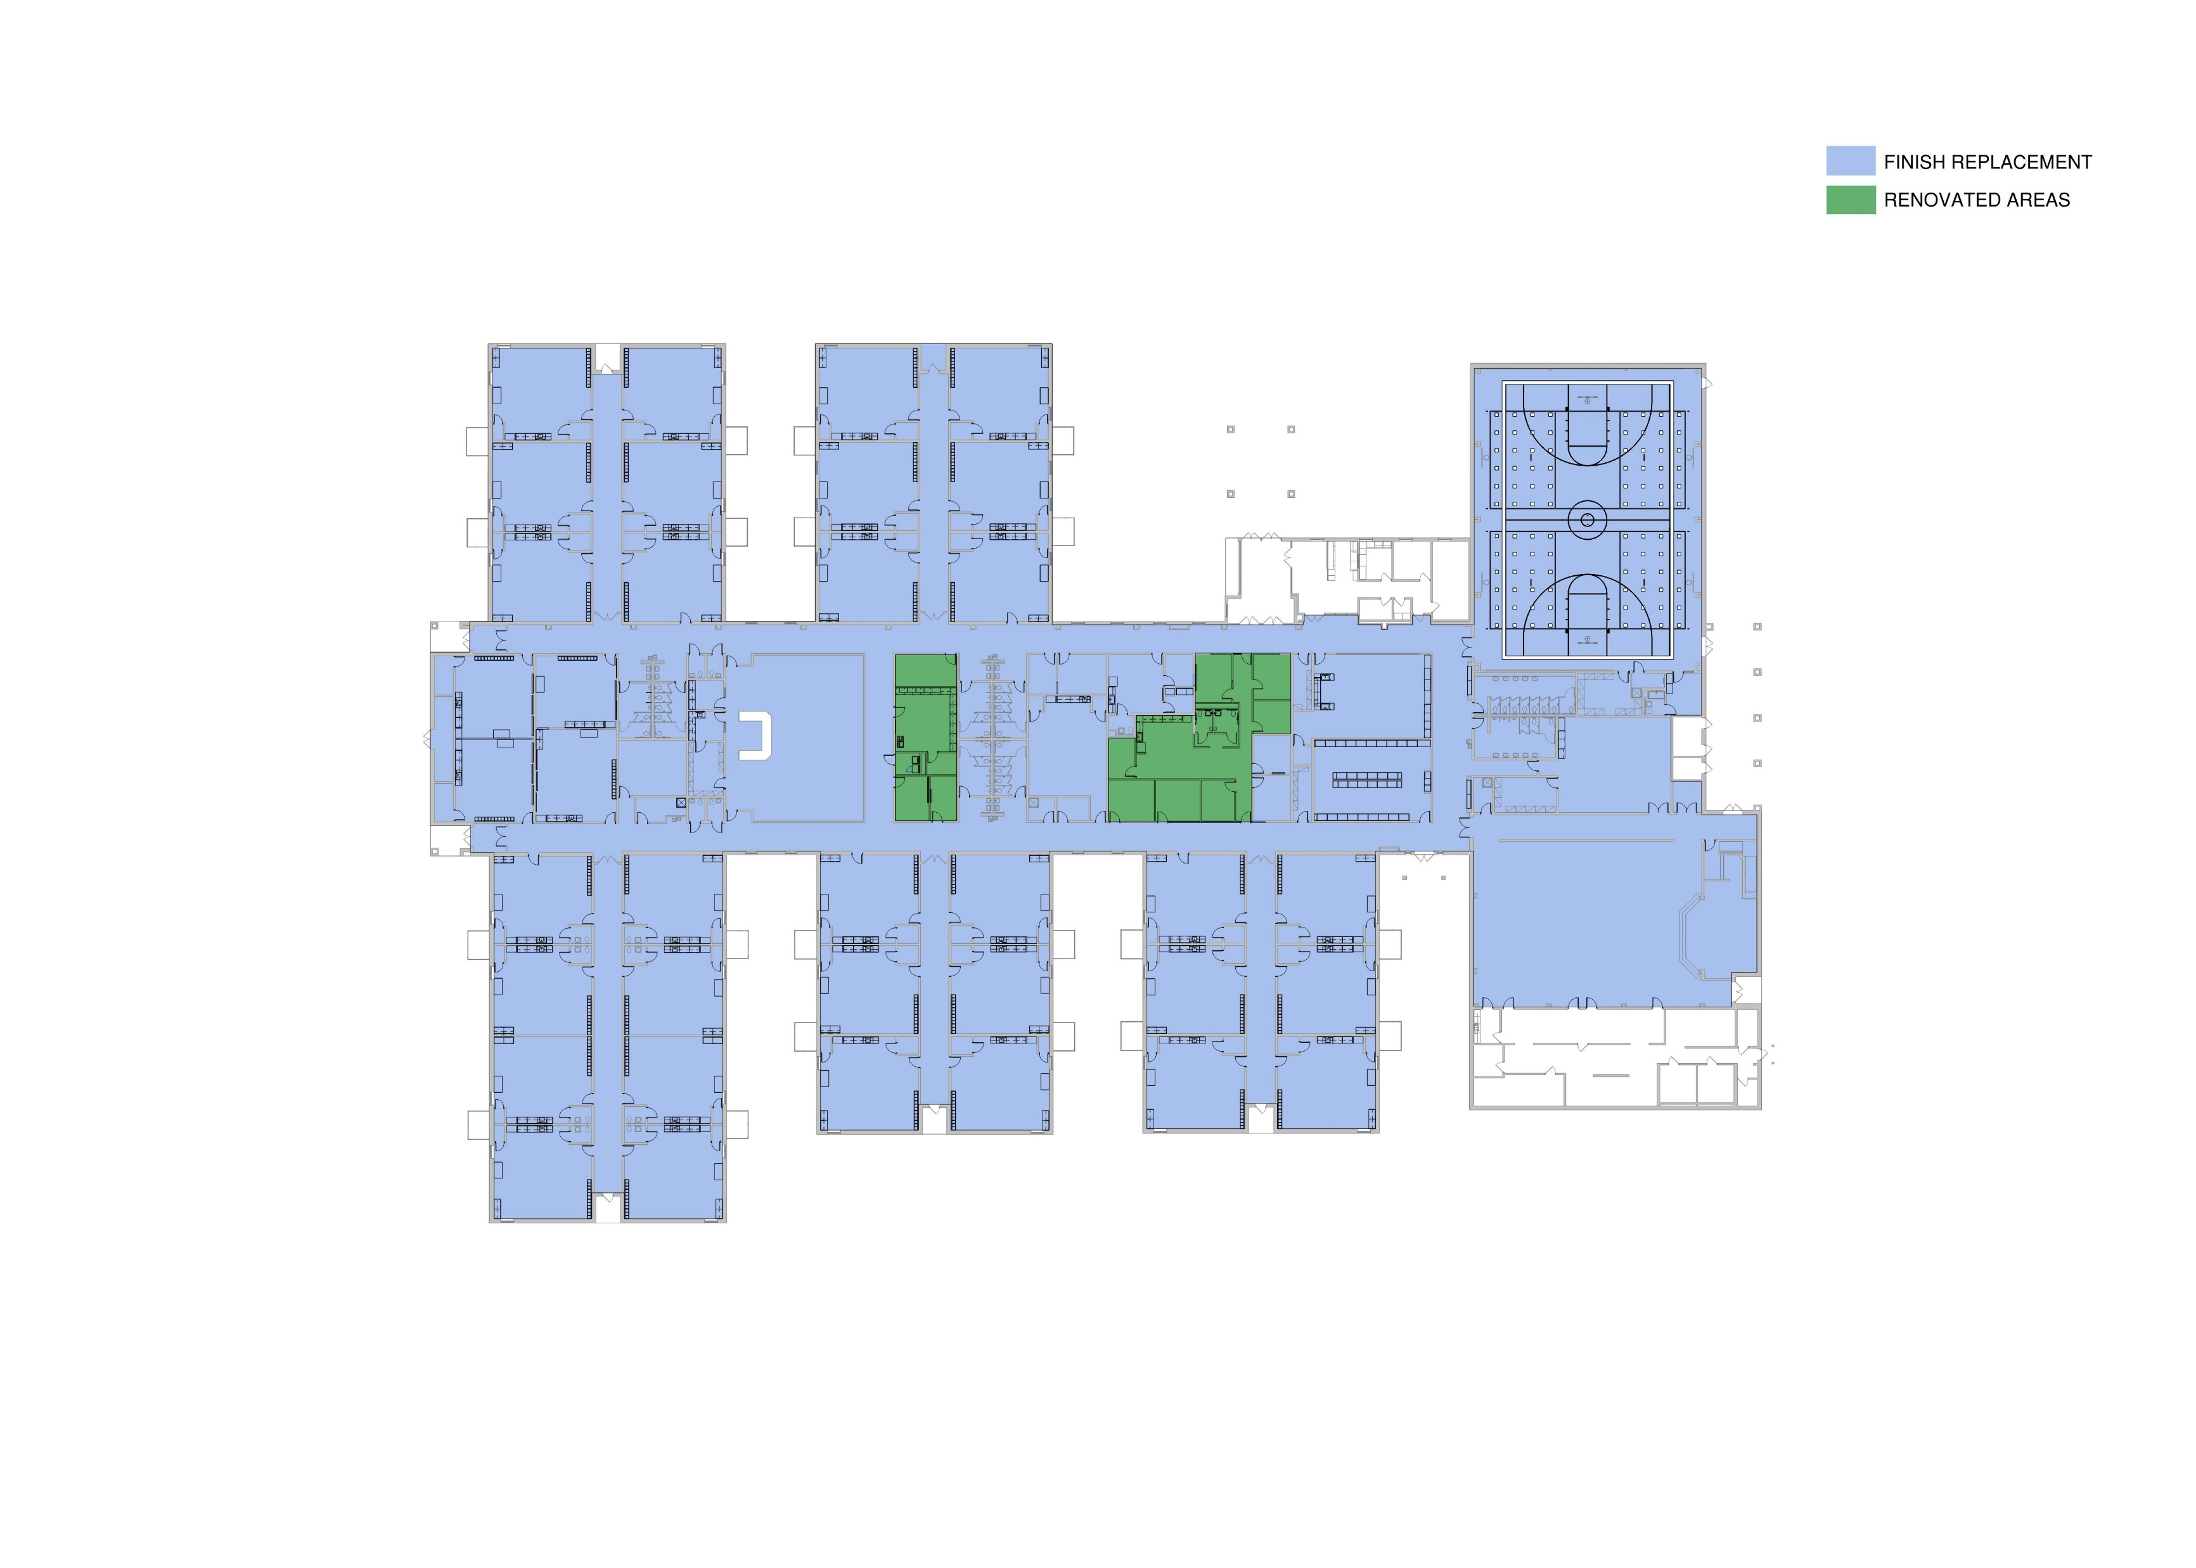
Pebble Creek Elementary

Slide 26
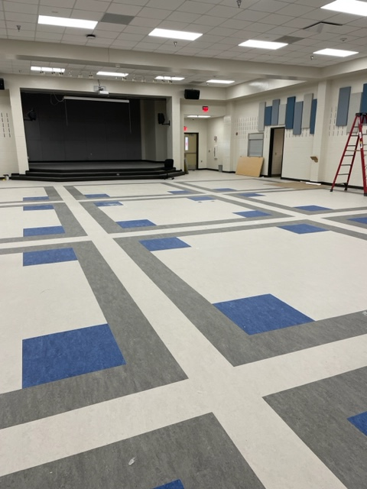
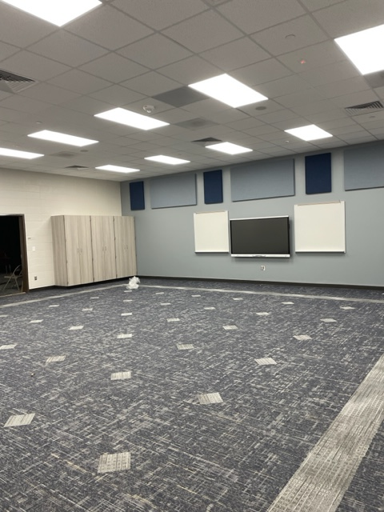
Pebble Creek Elementary

Slide 27
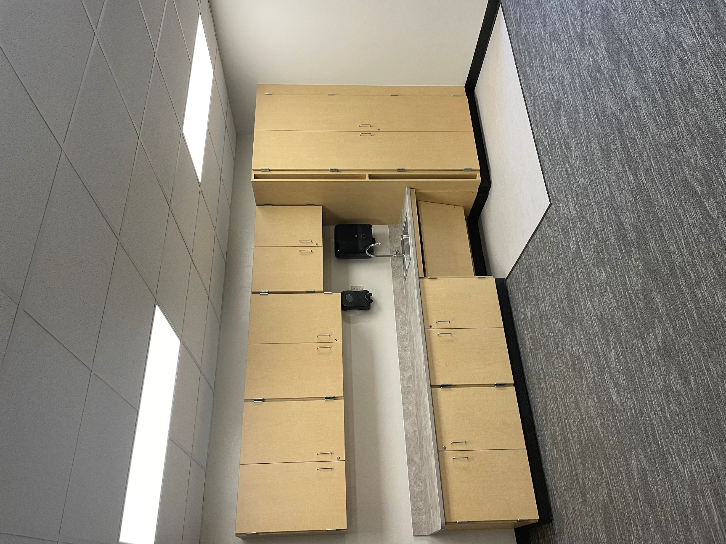
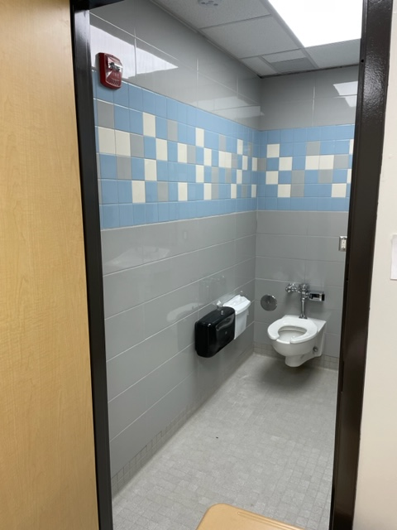
Pebble Creek Elementary

Slide 28
Cte center

Slide 29
Career and Technical Education (CTE) Center
Phase 1
  Basic project is an Agricultural Barn for animal holding and some parking and infrastructure.
  Work commenced in May of 2023.
  Scheduled completion is May of 2024.
  Work is 18% complete at this time.

Slide 30
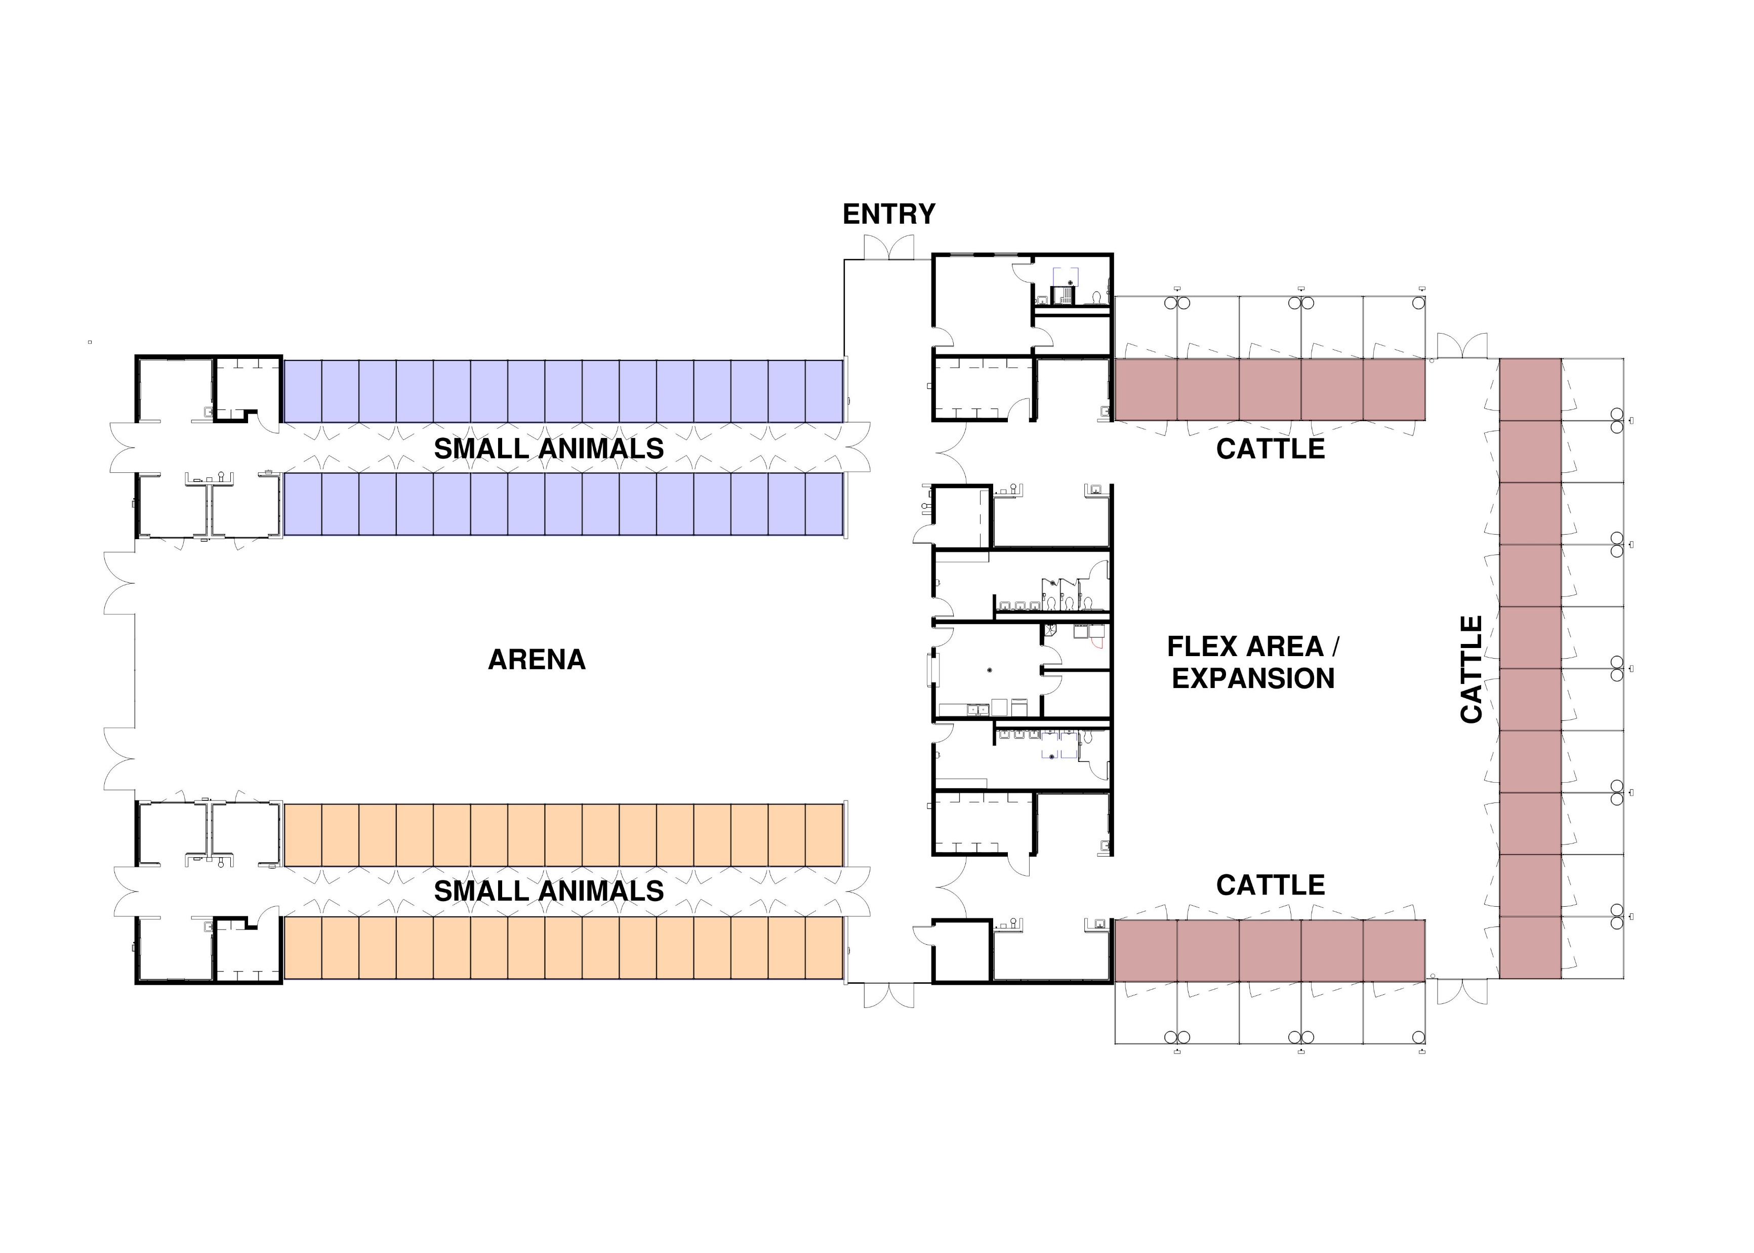
Career and Technical Education (CTE) Center

Slide 31
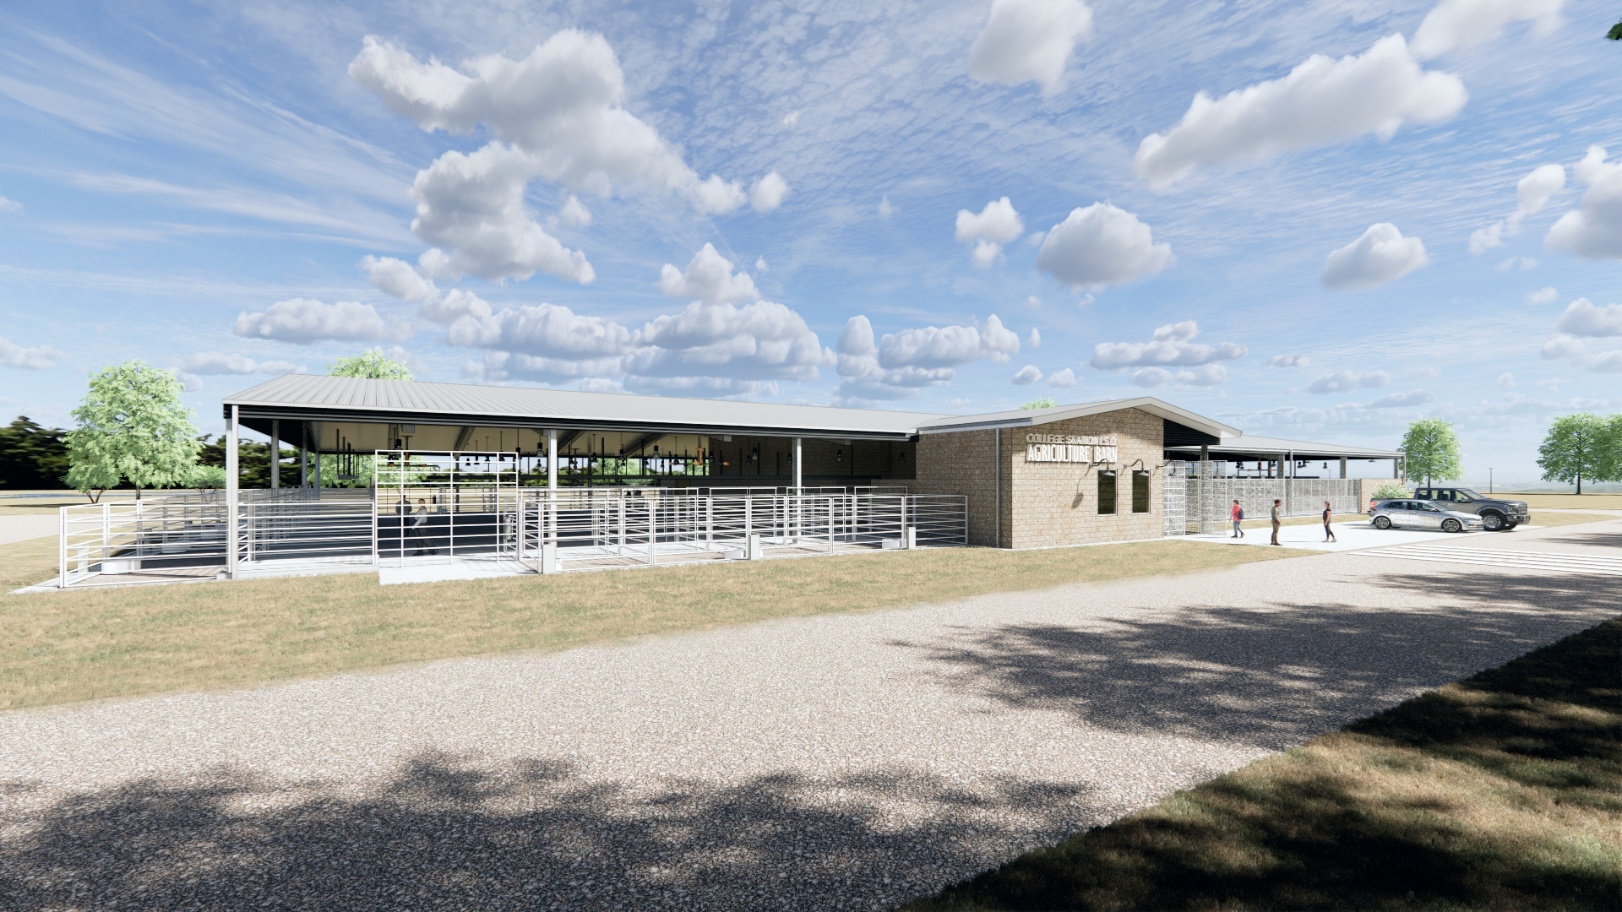
Career and Technical Education (CTE) Center

Slide 32
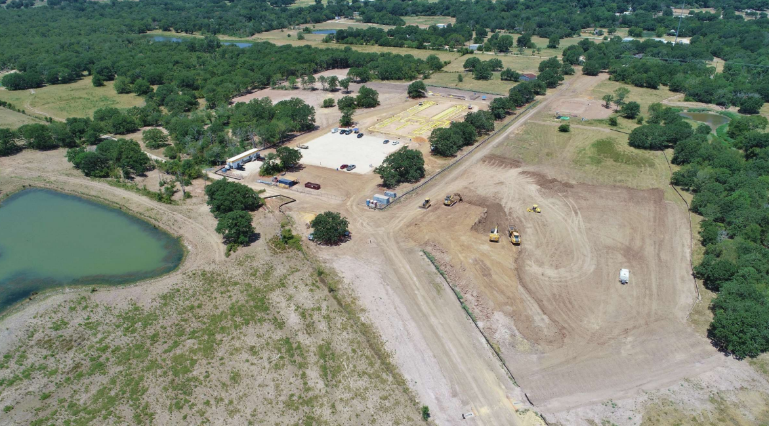
Career and Technical Education (CTE) Center

Slide 33
natatorium

Slide 34
Natatorium Renovations
Proposition C of the 2021 Bond Package.
  Scope is the full renovation of the natatorium pool, pool deck, and associated equipment as well as the office space and locker rooms.
This project was approved in the Spring of 2023 and work has been ongoing throughout the Summer of 2023.
Scheduled completion is October 20, 2023.

Slide 35
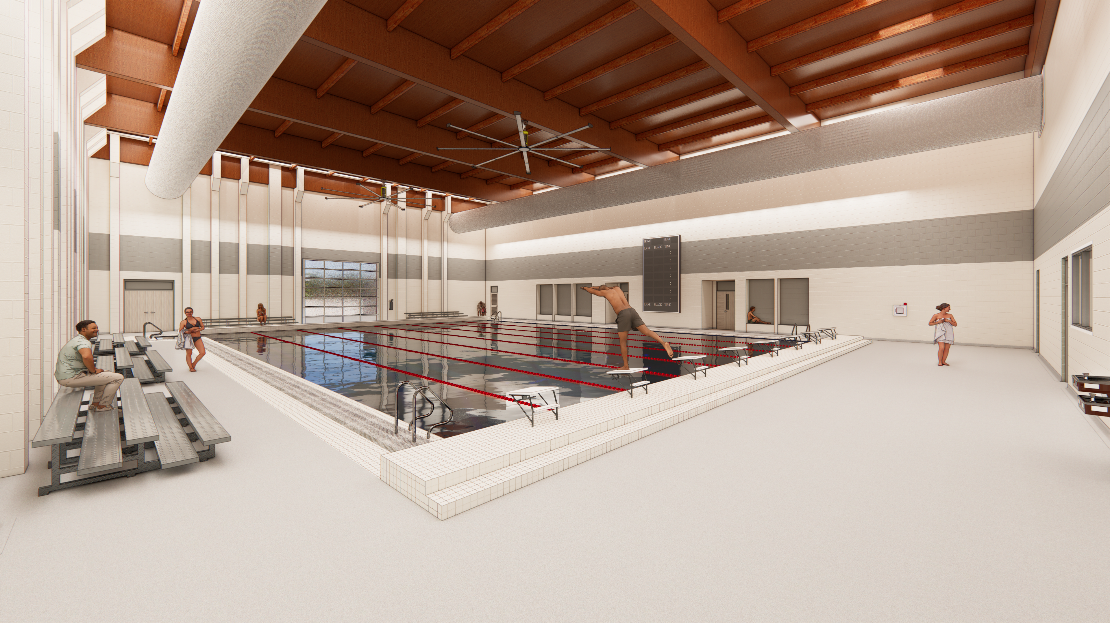
Natatorium Renovations

Slide 36
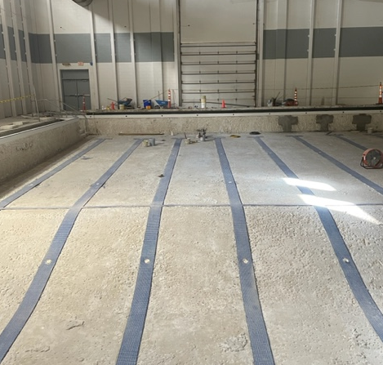
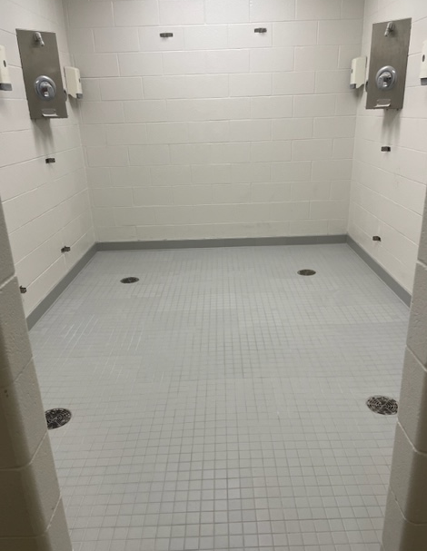
Natatorium Renovations

Slide 37
Other projects

Slide 38
Safety Improvements
Phase 1 - includes 9 Elementary and 3 Intermediate campuses (Summer 2023)
  South Knoll Elementary Oakwood Intermediate
  Forest Ridge Elementary Cypress Grove Intermediate
  River Bend Elementary Pecan Trail Intermediate
  Greens Prairie Elementary
  Rock Prairie Elementary
  College Hills Elementary
  Pebble Creek Elementary
  Spring Creek Elementary
  Creekview Elementary

Slide 39
Safety Improvements
Phase 2 – includes 2 High School and 3 Middle School campuses.
  College Station High School
  College View High School
  A&M Consolidated Middle School
  College Station Middle School
  Wellborn Middle School
Scheduled for Board approval in September of 2023.
AMCHS and SWVES security vestibules were included within their renovation projects, so they are not included in these counts.

Slide 40
Deferred Maintenance Projects thus far:
CSMS remove and replace one chiller
AMCMS remove and replace three rooftop air conditioning units
Forest Ridge Elementary remove and replace one chiller
Oakwood Intermediate School remove and replace cafeteria flooring
AMCMS water leak washout repair at cafeteria loading dock area
Forest Ridge Elementary roof replacement in conjunction with insurance
Southwood Valley Elementary School remove and replace two chillers and two boilers
AMCHS fire sprinkler head replacement and backflow preventer installation
AMCHS roof repair
Many more smaller scale repair projects across the district

Slide 41
Future Projects in 2021 Bond Package
Design work will be starting this fall of 2023 for these Summer of 2024 projects:
  Cypress Grove Intermediate School Renovations
  AMCHS Renovations Phase 3
Miscellaneous Deferred Maintenance
  HVAC unit repair/replacement on various campuses across the district
    Forest Ridge Elementary School chiller
    Rock Prairie Elementary School air conditioning
  Roofing repair on various campuses

Slide 42

Questions & Comments

