Slide 1
The college essay
Junior Workshop 4

Slide 2
Tips on Writing a College Essay

Slide 3

Why is the college essay important?
Let’s look at numbers: UCLA’S NUMBERS FOR FALL 2018
 | CA Residents | Out of State | International | Total
Applicants | 71,569 | 22,822 | 19,370 | 113,761
Admits | 8,725 | 5,035 | 2,210 | 15,970
Enrolled | 4,365 | 1,224 | 651 | 6,240
Admit rate | 12% | 22% | 11% | 14%

Slide 4

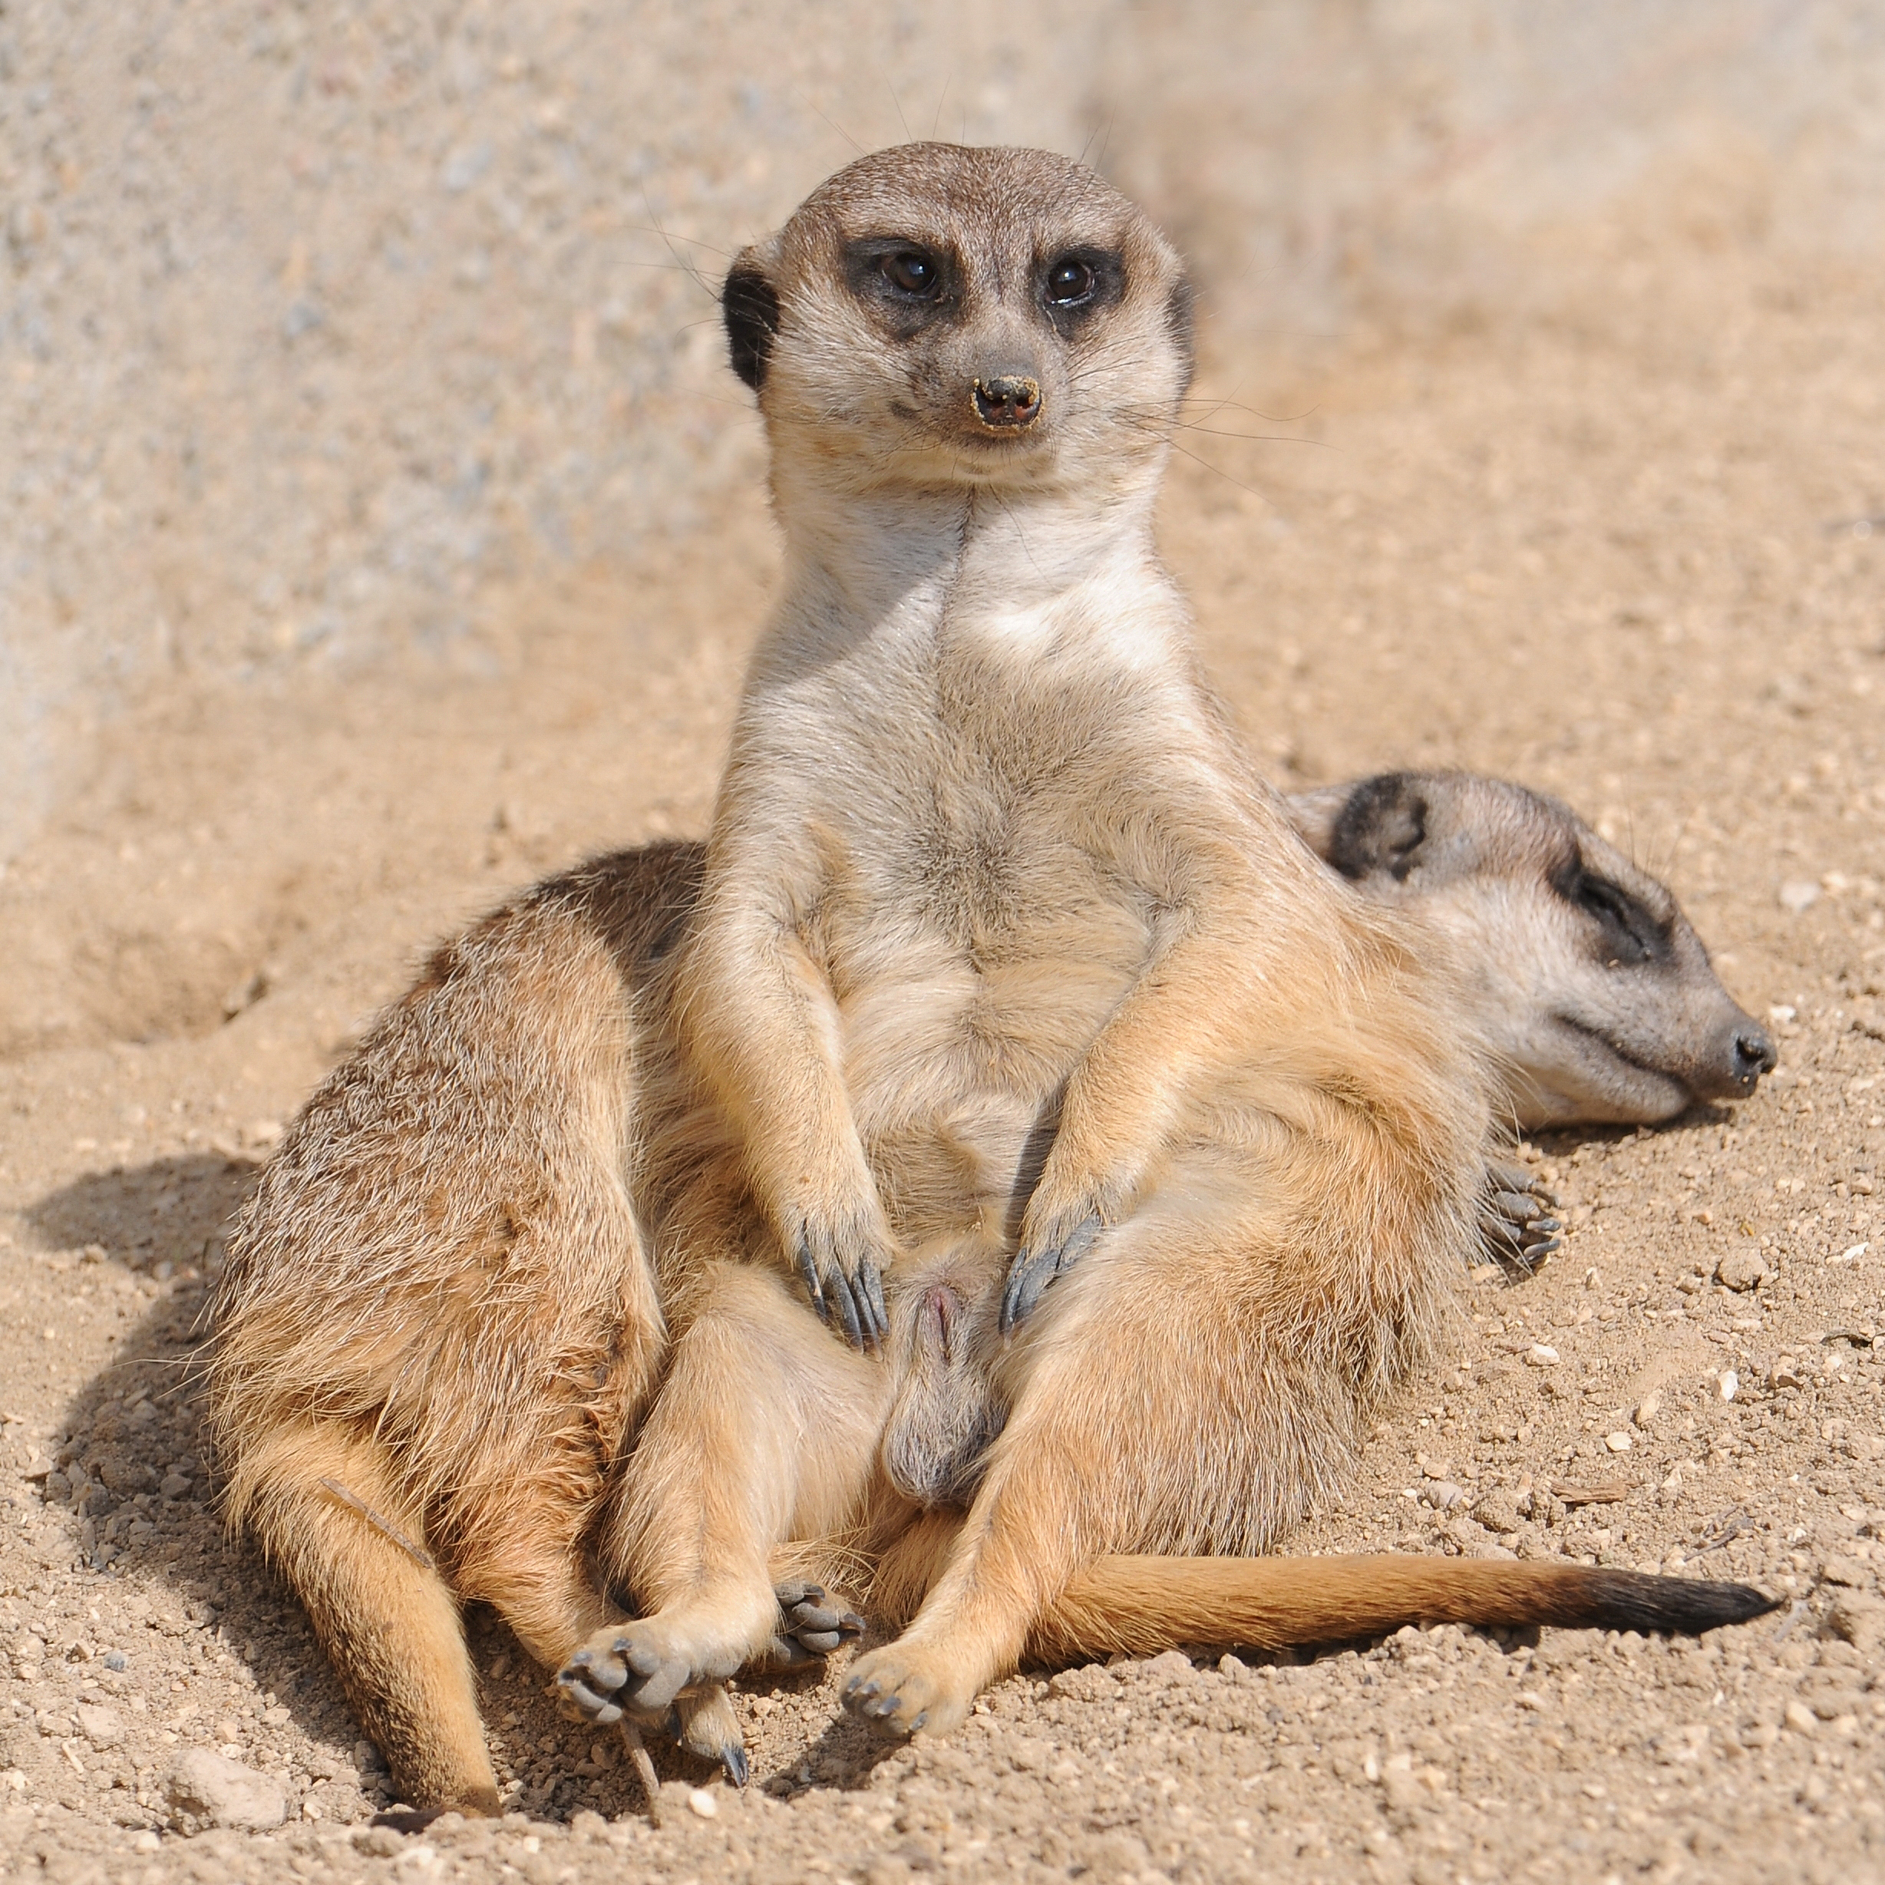
So…..how many applications do you think a college admission representative reads??
How will your application stand out??
Be different!

Slide 5
English Essay vs. College Essay
Your college essay:
is a story/narrative, don’t get caught up in facts/technicalities
is your voice! Don’t have mom write it!
think about the audience! Remember they are reading 100’s of essays.
have only one person read for grammar (ELA teacher) and one person who knows you well. This person should be honest and say it does sound like you or they know mom wrote it!
Always remember this is your essay!!!

Slide 6

Essay Prompts
2018-2019 Common Application Essay Prompts: Prompts
Barrett Honors College 2019 Essay Prompts: Barrett
University of Michigan 2019 Essay Prompts: University of Michigan

Slide 7
How to write a “Why Us” essay
Ex: How will you explore your intellectual and academic interests at the University of Pennsylvania? Please answer this question given the specific undergraduate school to which you are applying.
DON’T
DO
Write about the school’s size, location, reputation or weather
Simple use emotional language to make your case
Mess up the mascot, stadium, team colors or names of people and places.
Think of this as a “Why Them” essay
Offer to start something you can’t start
Think of this as a “Why we are perfect for each other” essay
Compare “what I want” and “what they have”
Mention specific classes, professors, clubs and activities you will actually participate in
Show a few more of your skills/talents/interests/passions
Offer to start something

Slide 8
Essay Resource
The College Essay Guy

Slide 9
Brainstorming
Grab A PARTNER AND ANSWER 5-10 QUESTIONS
Questions

Slide 10
FEELING AND NEEDS EXERCISE
*Feeling and Needs Worksheet
Fill out worksheet

Slide 11
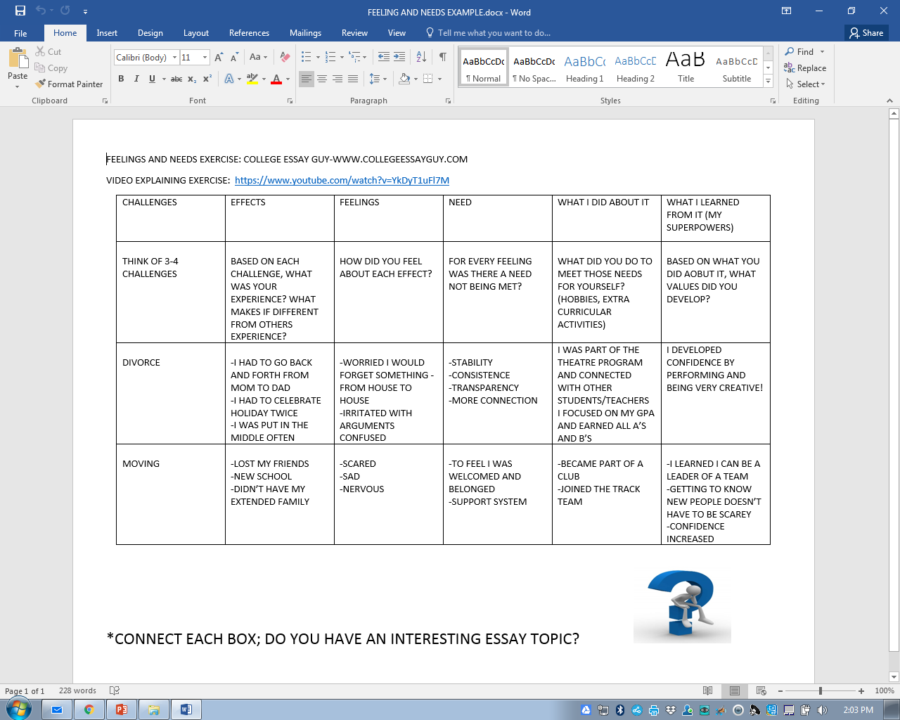

Slide 12
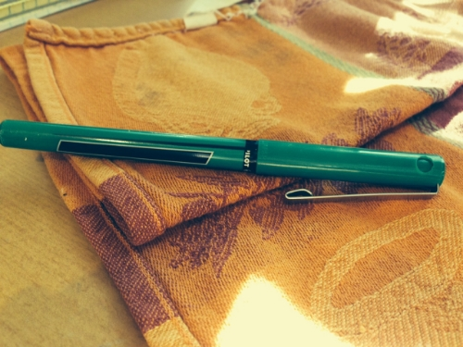
Objects exercise

